Slide 1
BUCK CONVERTER, CONSTANT CURRENT LED DRIVER CIRCUIT
POWER
INPUT
BUS CAPACITORS
NMOS
CURRENT
SENSE
INDUCTOR
DRIVER
DIODE
CAPACITOR
LEDs
CONTROLLER
TRIGGER INPUT
PULSE
GENERATOR
ISOLATOR
HIGH VOLTAGE
LOW VOLTAGE
09B-01
-

Slide 2
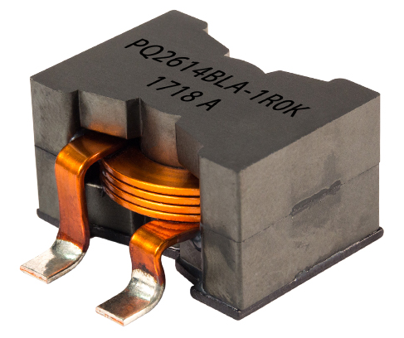
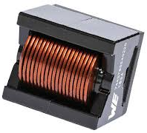
BUCK CONVERTER, CONSTANT CURRENT LED DRIVER CIRCUIT
PQ2614BHA-4R7K
7443763540470
HIGH VOLTAGE
LOW VOLTAGE
09B-01
-

