Slide 1
Statistical Tests: Chi-Square Test and ANOVA
Understanding Their Uses and Applications.

Slide 2
Chi-Square Distribution
An important idea in statistics is departure from expectation, especially with respect to category counts.
Expectation is defined loosely as “nothing unusual or of note in the data” (e.g., no correlation between variables or predictable patterns)The statistic that measures the extent to which results depart from the null expectation of independence is the chi-square statistic. It is the difference between the observed and expected values, divided by the square root of the expected value, squared, then summed across all categories.
This process standardizes the statistic so it can be compared to a reference distribution. A more general way of putting this is to note that the chi-square statistic is a measure of the extent to which a set of observed values “fits” a specified distribution (a “goodness-of-fit” test).
The chi-square distribution is the distribution of this statistic under repeated resampled draws from the null model
A low chi-square value for a set of counts indicates that they closely follow the expected distribution. A high chi-square indicates that they differ markedly from what is expected
Chi-square distributions are important in defining the F distribution, which is used in ANOVAs.
Imagine you take random samples from a chi-square distribution, and then divide the sample by the k of the distribution. Next, you repeat the process with a different chi-square distribution. If you take the ratios of the values from the two distributions, you will have an F distribution.

Slide 3
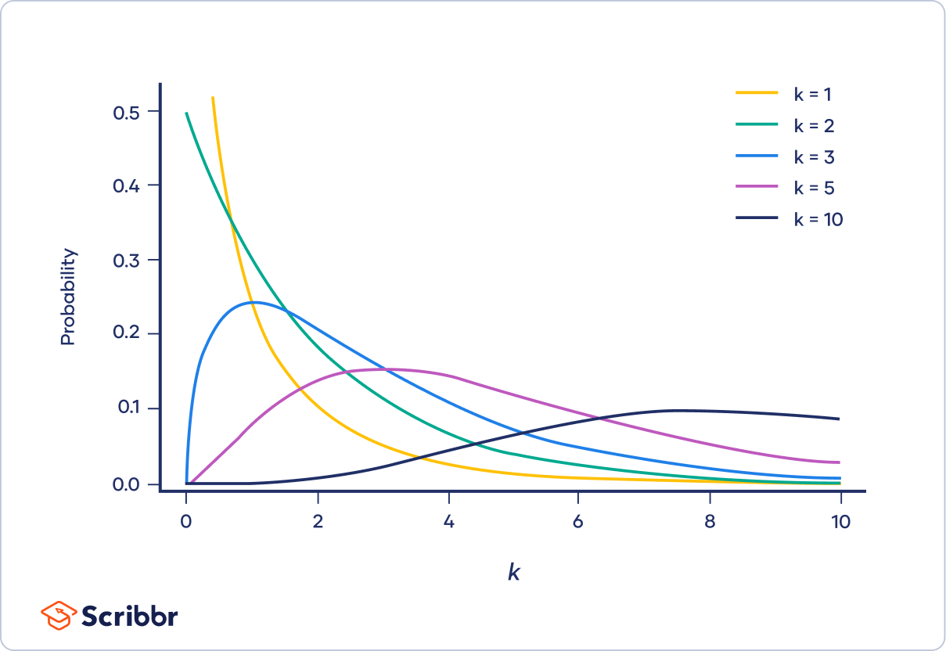
Chi-Square Distribution
The shape of a chi-square distribution is determined by the parameter k, which represents the degrees of freedom.
Very few real-world observations follow a chi-square distribution. The main purpose of chi-square distributions is hypothesis testing, not describing real-world distributions.

Slide 4
F-Distribution
F-Distribution A common procedure in scientific experimentation is to test multiple treatments across groups—say, different fertilizers on different blocks of a field. This is similar to the test referred to in the chi-square distribution, except we are dealing with measured continuous values rather than counts.
In this case we are interested in the extent to which differences among group means are greater than we might expect under normal random variation. The F-statistic measures this and is the ratio of the variability among the group means to the variability within each group (also called residual variability). This comparison is termed an analysis of variance
The distribution of the F-statistic is the frequency distribution of all the values that would be produced by randomly permuting data in which all the group means are equal (i.e., a null model). There are a variety of F-distributions associated with different degrees of freedom The calculation of F is illustrated in the section on ANOVA. The F-statistic is also used in linear regression to compare the variation accounted for by the regression model to the overall variation in the data.
F-statistics are produced automatically by R and Python as part of regression and ANOVA routines The F-statistic is based on the ratio of the variance across group means to the variance due to residual error. The higher this ratio, the more statistically significant the result. If the data follows a normal distribution, then statistical theory dictates that the statistic should have a certain distribution.

Slide 5
Introduction to Statistical Tests
Statistical tests help determine relationships between variables and differences between groups.
Two commonly used tests are:
- Chi-Square Test: For categorical data.
- ANOVA (Analysis of Variance): For continuous data.

Slide 6
Chi-Square Test
Definition:
The Chi-Square Test determines if there is a significant association between two categorical variables.
Types of Chi-Square Tests:
- Goodness of Fit: Checks if observed frequencies match expected frequencies.
- Test of Independence: Tests association between two categorical variables.
**Example:**
"Is there an association between gender and voting preference?"

Slide 7
Chi-square test statistic
 | Where X² is the chi-square test statistic is the summation operator (it means “take the sum of”) is the observed frequency is the expected frequency A larger χ² value indicates a greater difference between observed and expected frequencies.

Slide 8
Assumptions in Chi-Square test
Random selection: The data must be randomly selected to reduce potential bias.
Nominal or ordinal variables: The variables being tested must be nominal or ordinal.
Mutually exclusive categories: The categories must be mutually exclusive, meaning that each individual can only belong to one cell in the contingency table.
Expected frequencies: The expected frequency in each category must be at least 5 for the chi-square test of independence. For the goodness of fit test, the expected frequency should be at least 1, with no more than 20% of expected frequencies being less than 5.
Independence of observations: There should be no relationship between any of the cases, or participants.

Slide 9
Analysis Of Variance (ANOVA)
Definition:
ANOVA is used to compare the means of two or more groups to determine if they are significantly different.
Types of ANOVA:
One-Way ANOVA is used to compare two means from two independent (unrelated) groups using the F-distribution. The null hypothesis for the test is that the two means are equal. Therefore, a significant result means that the two means are unequal.
Two-Way ANOVA is an extension of the One Way ANOVA. With a One Way, you have one independent variable affecting a dependent variable. With a Two Way ANOVA, there are two independents. Use a two way ANOVA when you have one measurement variable (i.e. a quantitative variable) and two nominal variables. In other words, if your experiment has a quantitative outcome and you have two categorical explanatory variables, a two way ANOVA is appropriate.

Slide 10
ANOVA Formula
F-Statistic Formula:
F = Between-Group Variance / Within-Group Variance
Steps in ANOVA
1. Calculate the mean of each group.
2. Calculate the overall mean.
3. Compute between-group and within-group variances.
4. Compare the F-statistic to a critical value.

Slide 11
Assumptions in ANOVA
The population must be close to a normal distribution.
Samples must be independent.
Population variances must be equal
Groups must have equal sample sizes.

Slide 12
Key Differences Between Chi-Square and ANOVA
Aspect | Chi-Square Test | ANOVA
Data Type | Categorical | Continuous
Purpose | Tests for association between categories | Compares means across groups
Assumptions | No assumption about normality | Assumes data is normally distributed

Slide 13
Chi-Square Test for independence in Python
Import the necessary libraries:
from scipy.stats import chi2_contingency
import numpy as np.
perform the Chi-Square Test
Creating a contingency table
contingency_table = pd.crosstab(data[col1], data[col2])
Performing the Chi-Square Test
chi2, p, dof, expected = chi2_contingency(contingency_table)
Interpreting the result
if p < 0.05:
print(significant)
else:
print( not significant)
Print( “chi-square test statistic: ” chi2)
Print( “Probability value: ” p)

Slide 14
Chi-Square Test for goodness of fit in Python
import scipy.stats as stats
# Observed frequencies
observed = [8, 12, 10, 9, 11, 10]
# Expected frequencies (assuming a fair die)
expected = [10, 10, 10, 10, 10, 10]
# Perform Chi-square goodness of fit test
chi2_stat, p_value = stats.chisquare(observed, expected)
# Display the results
print("Chi2 Statistic:", chi2_stat) print("P-value:", p_value)
# Decision
alpha = 0.05
if p_value < alpha:
print("Reject the null hypothesis: The die is not fair.")
else:
print("Fail to reject the null hypothesis: The die is fair.")

Slide 15
One-Way ANOVA in Python
import numpy as np.
From scipy import stats.
mu = Hypothesized population mean
Perform one-sample t-test
t_stat, p_value = stats.ttest_1samp(Series, mu)
print("T statistic:", t_stat)
print("P-value:", p_value)
Setting significance level
alpha = 0.05
Interpret the results
if p_value < alpha:
print("Reject the null hypothesis; there is a significant difference between the sample mean and the hypothesized population mean.")
else:
print("Fail to reject the null hypothesis; there is no significant difference between the sample mean and the hypothesized population mean.")

Slide 16
Two-Way ANOVA in Python
Import the necessary libraries:
import numpy as np
from scipy import stats
Perform the t-test:
t_stat, p_value = stats.ttest_ind(Category1, Category2)
alpha = 0.05
if p_value < alpha:
print("Reject the null hypothesis; there is a significant difference between the mean of Category1 and Category2.")
else:
print("Fail to reject the null hypothesis; there is no significant difference between the mean of Category1 and Category2.

Slide 17
Conclusion
- Use Chi-Square for relationships between categorical variables.
- Use ANOVA to compare means between two or more groups.
Both tests are essential for decision-making and data analysis.

Slide 18
Thank You
Thank you!

