Slide 1

AUTOMATED TICKECT CLASSIFICATION
GROUP 2

Slide 2
BUSINESS UNDERSTANDING
Financial institutions receive thousands of customer complaints daily.
Manual complaint classification is slow and inefficient.
Objective: Automate complaint categorization using NLP & ML.
Customer complaints are submitted as unstructured text, requiring automation for faster processing.
Solution: Implement Natural Language Processing (NLP) to classify complaints automatically.

Slide 3
Business Objective
Develop an aoutomated ticket classification model for customer complaints.
Categorize complaints into 5 key service areas using Topic Modeling:
1. Credit Card / Prepaid Card
2. Bank Account Services
3.Theft / Dispute Reporting
4. Mortages / Loans
5. Others
Train a supervised learning learning model(e.g.LSTM,)
Key Benefits:
1. Faster complaint resolution.
2. Improved customer experience
3. Better resource allocation

Slide 4
DATA PREPARATION
Handling Missing Data:
Removed or imputed missing values to maintain data integrity.
Text Cleaning:
Removed stopwords, punctuation, and special characters.
Converted text to lowercase for consistency.
Tokenization & Vectorization:
Applied TF-IDF and Word2Vec to transform text into numerical representations.
Feature Engineering:
Extracted key terms and phrases for better model performance.

Slide 5
MODELING APPROACH
Data Preprocessing:
Cleaned text data.
Tokenized text and TF-IDF vectorization for feature selection.
Unsupervised Learning: Topic Modeling (LDA & NMF)
Supervised Learning: (LSTM)

Slide 6
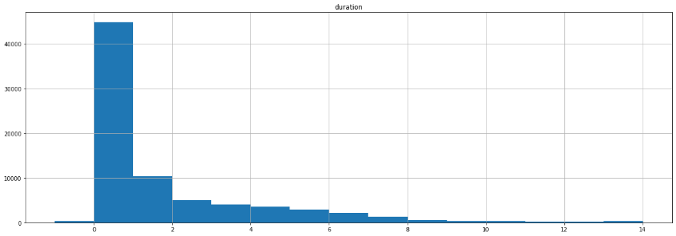
Observations
- The histogram shows a right-skewed distribution, with most complaints resolved within a few days (0-1) days. A small number of cases take significantly longer, faster complaints resolution.

Slide 7
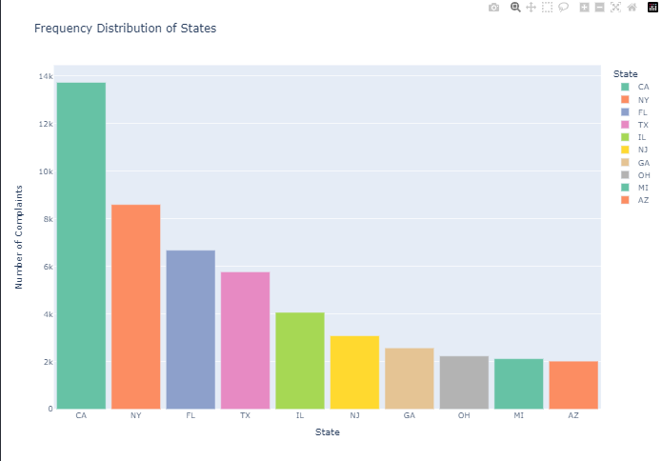
Observations : Most complaints originate from CA, NY, FL. These are the three states with most complains

Slide 8
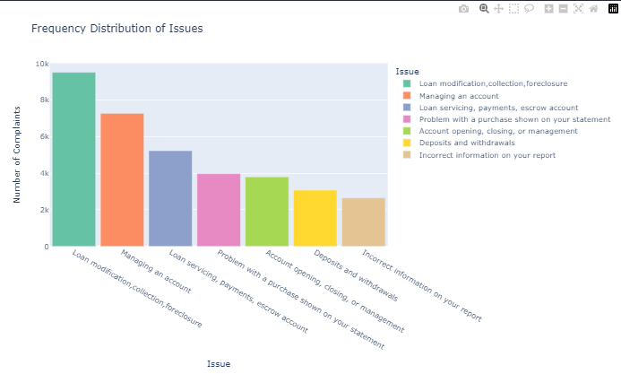
Observations : - Loan modification, collection, foreclosure tops the list of the most issues reported by the customers of JP Morgan - Managing an account and issues to do with loans are second and third respectively.

Slide 9
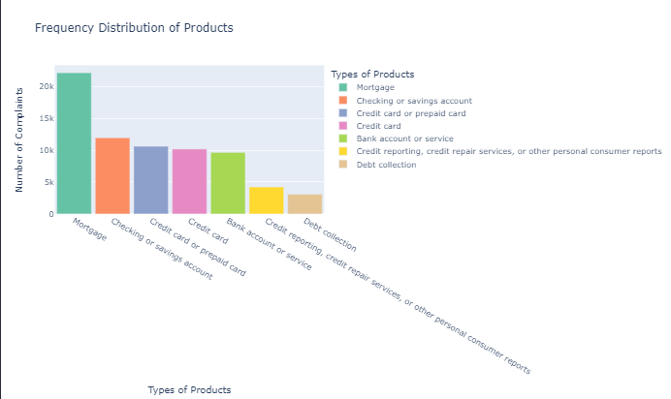

Slide 10
Observation on Distribution of product
Mortgage-related complaints are the highest, exceeding 20,000 cases.
Checking/savings accounts, credit cards, and prepaid cards also have a significant number of complaints, each around 10,000.
Bank account services, credit reporting, and debt collection have fewer complaints in comparison.
The distribution is uneven, with mortgage-related issues being the most frequent concern.

Slide 11
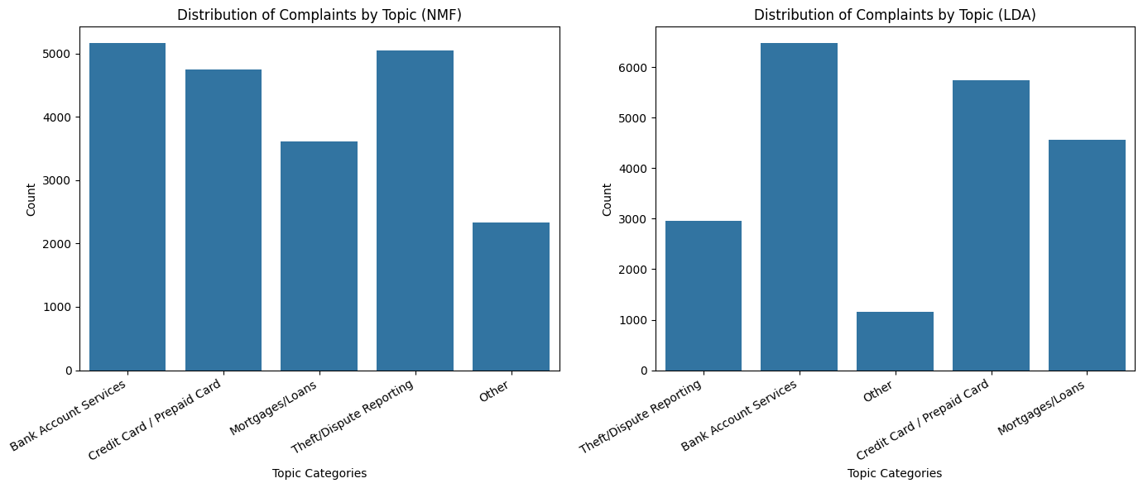
DISTRIBUTION OF COMPAINTS BY LDA & NMF

Slide 12
Observations on Topic Consistencies Between NMF and LDA
- Other Category – The "Other" category differs in size between the models, but it still represents a smaller portion of the dataset in both cases.
From the two distribution plots, we can observe some consistencies despite the differences in the topic modeling approaches:
- Bank Account Services – This topic is the most dominant in both NMF and LDA, suggesting strong clustering around banking-related complaints.
- Credit Card / Prepaid Card – This category also appears as a significant topic in both models, showing consistent identification of credit card-related issues.
- Mortgages/Loans – Both models assign a comparable number of complaints to this topic, reflecting a shared pattern in complaint distribution.
- Theft/Dispute Reporting – While there is some variation in frequency, this category is clearly identified in both models.

Slide 13
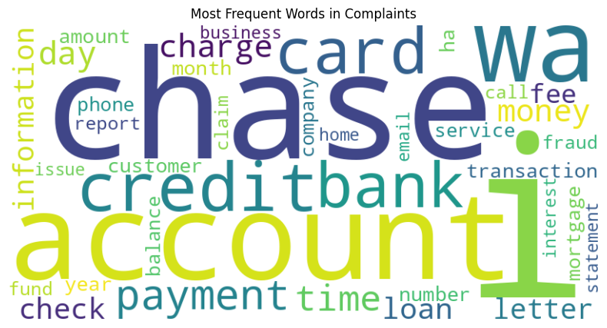

Slide 14
Observation
By removing "XXXX," the word cloud more clearly highlights key complaint themes, such as "account," "chase," "bank," "credit," "card," "payment," and "fraud."
This refinement improves readability and makes it easier to identify the most common financial concerns customers are raising.

