Slide 1
Forest Cover Type Prediction
1st Project Report for CSE 581
Dong Han
October 27, 2014
dhan@oakland.edu

Slide 2
Overview
Introduction of sample data
Process features to numerical variable or categorical variable
View of features correlations
Neural network classifier
Evaluation method
Neural network
The influence from number of hidden nodes
Preliminary experiment results
Experiment setup
Experiment result
Score on leader board
Next step

Slide 3
Introduction of data
Sample description
7 Different types of coverage, that we need predict.
We convert the result to categorical variable. Use a vector with 7 elements to describe the 7 types coverage.
E.g. [0, 1, 0, 0, 0, 0, 0] is the second cover type.
The sample size of Training set is 15120
The sample size of Testing set is 565892
We take features of Continuous data as Numerical variable
Elevation, Aspect, Slope
Horizontal_Distance_To_Hydrology
Vertical_Distance_To_Hydrology
Horizontal_Distance_To_Roadways
Horizontal_Distance_To_Fire_Points

Slide 4
Sample processing
Categorical data
ordinal variables (We assume these are numerical variables)
Hillshade_9am
Hillshade_Noon
Hillshade_3pm
nominal variable
Wilderness_Area (4 binary vector)
Soil_Type (40 binary vector)
Cover_Type (7 binary vector)

Slide 5
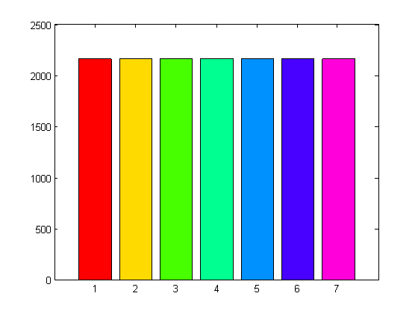
Training dataset
Number of samples for each cover type in training dataset.

Slide 6
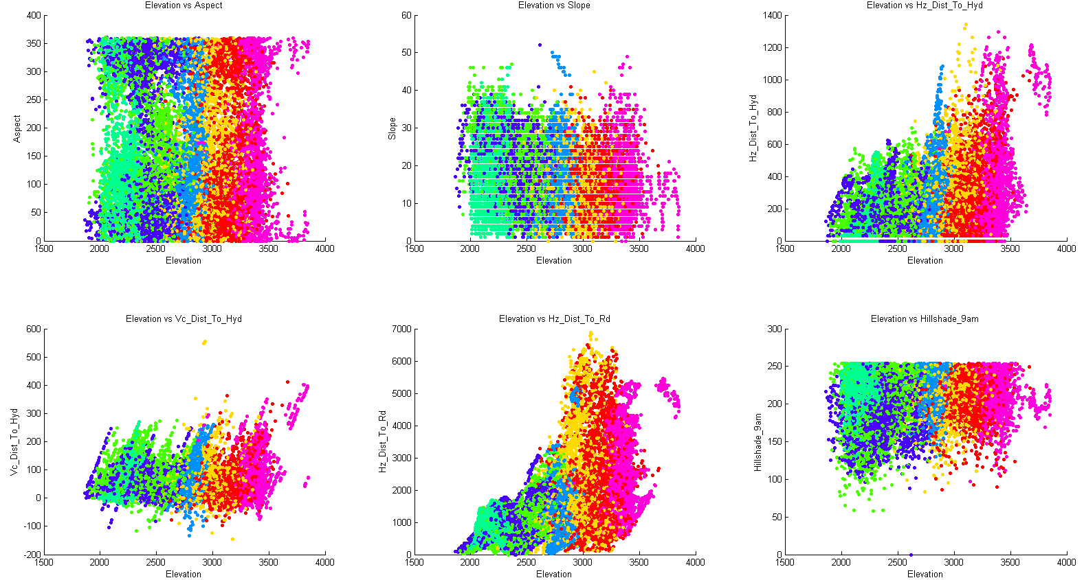
The plot for a pair of features(1/11)
Seven coverages distribute at different scale of Elevation.

Slide 7
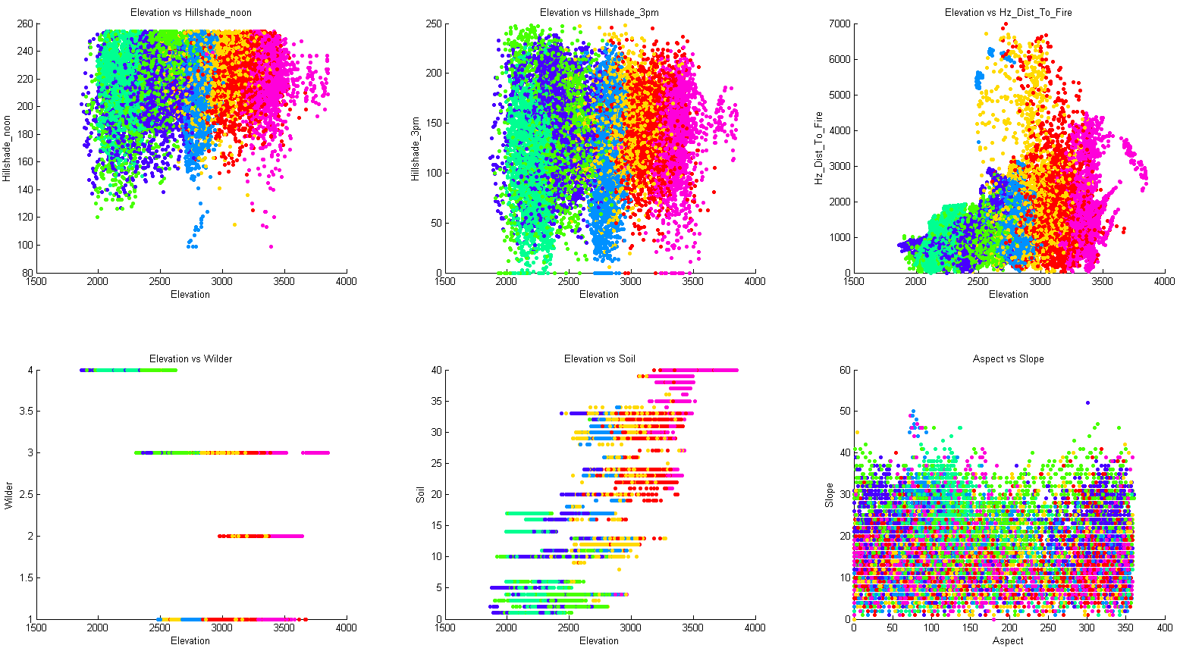
The plot for a pair of features(2/11)
Different Soil types grow different trees.

Slide 8
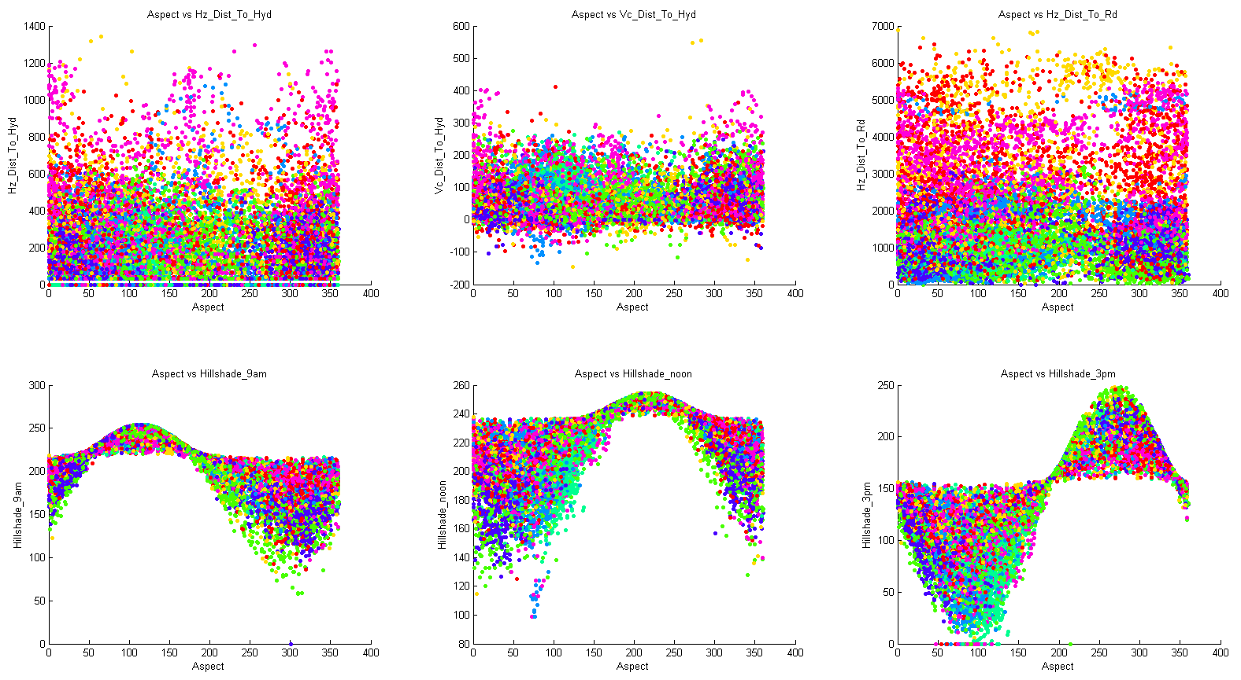
The plot for a pair of features(3/11)
Interesting correlations between Aspect and Hillshades

Slide 9
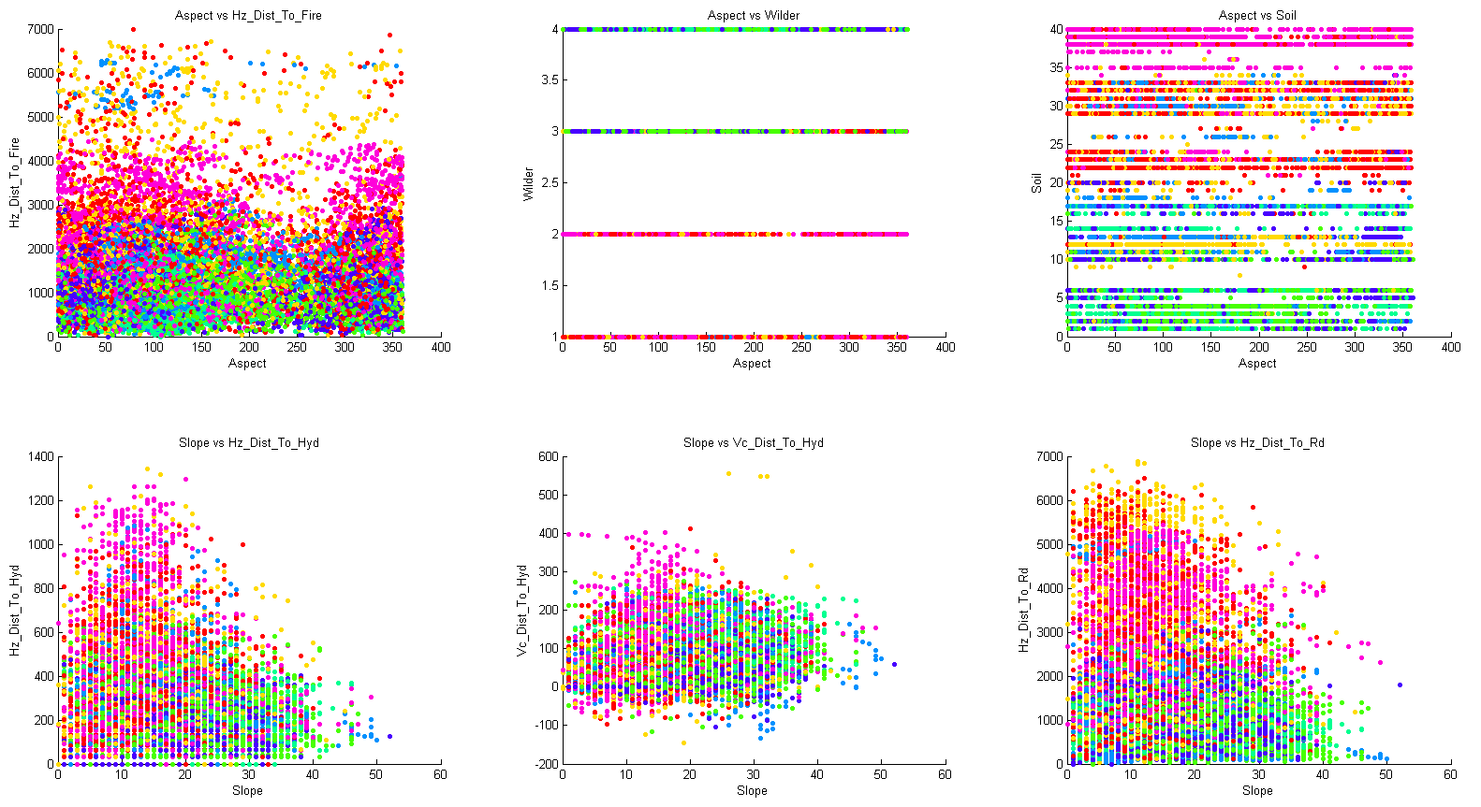
The plot for a pair of features(4/11)
Different types of wilderness and soils grow different trees

Slide 10
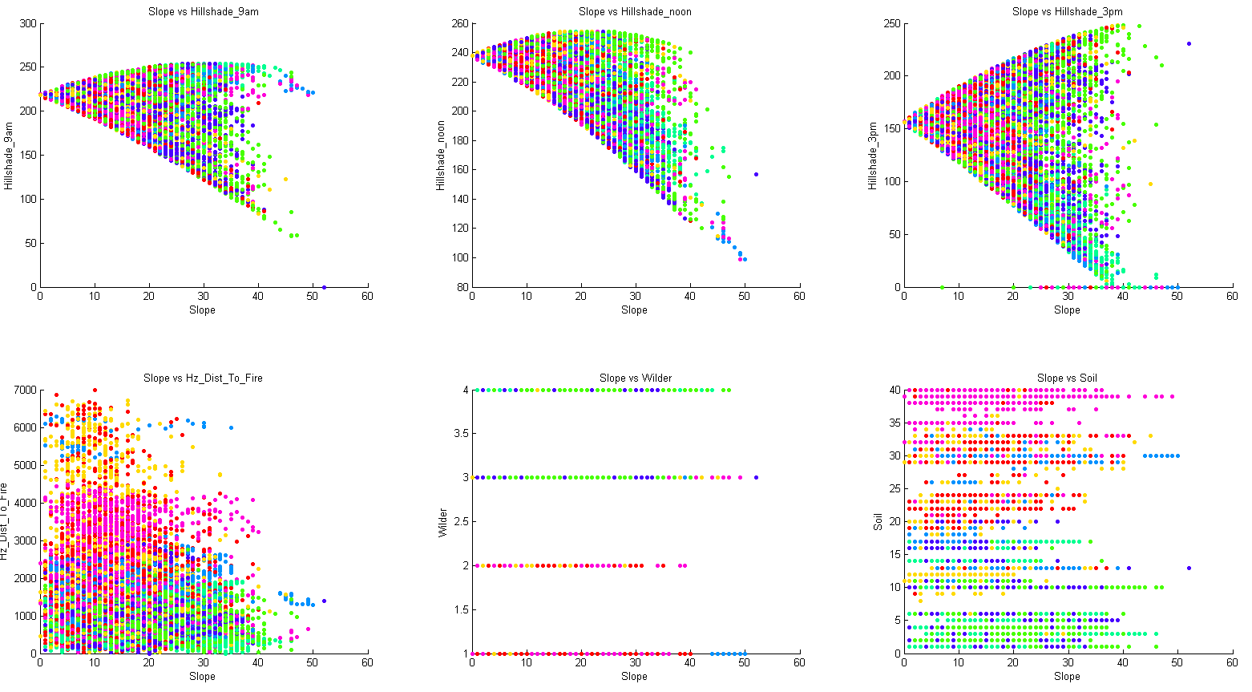
The plot for a pair of features(5/11)
Samples for Hillshade_3pm features have zero values.

Slide 11
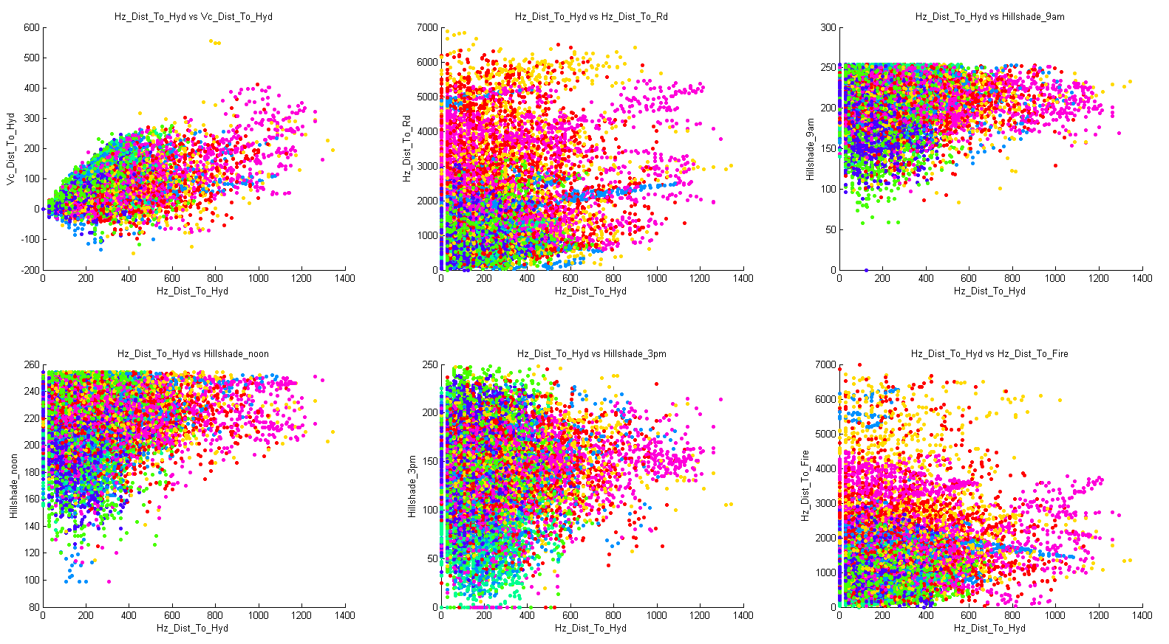
The plot for a pair of features(6/11)

Slide 12
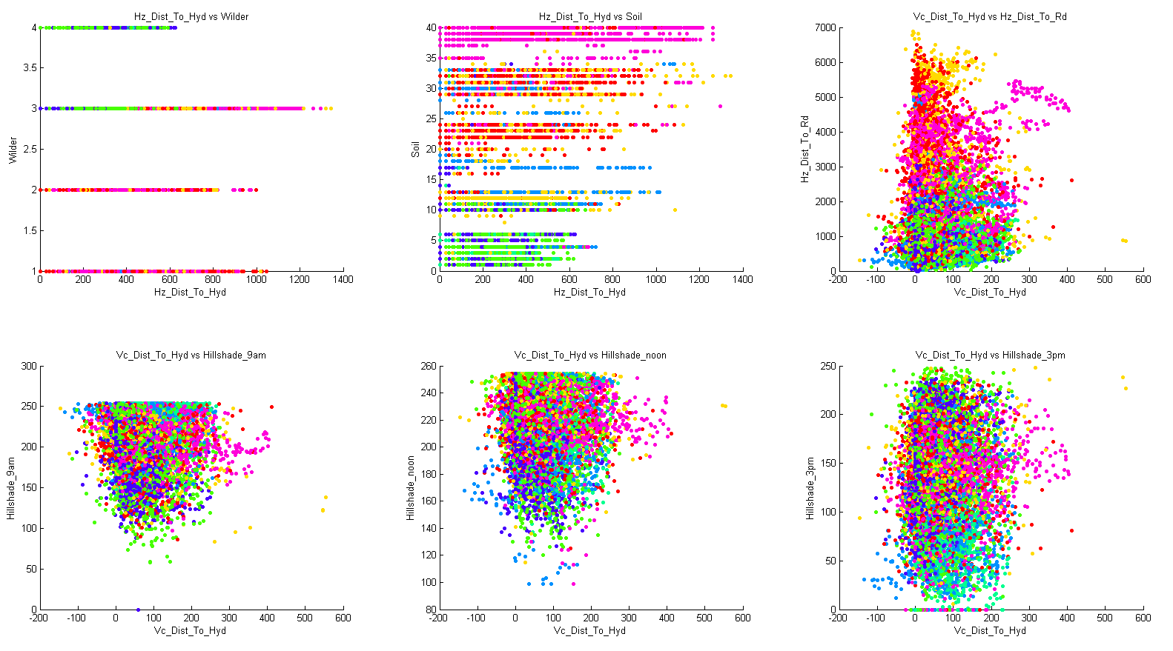
The plot for a pair of features(7/11)

Slide 13
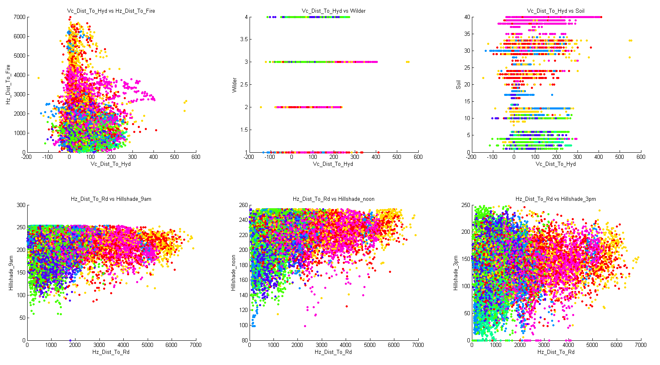
The plot for a pair of features(8/11)

Slide 14
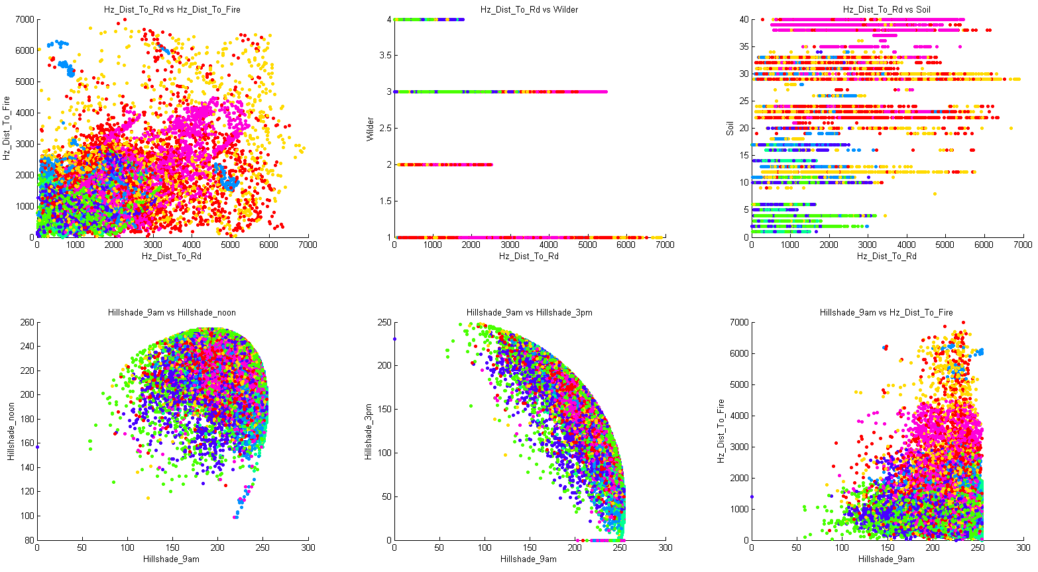
The plot for a pair of features(9/11)

Slide 15
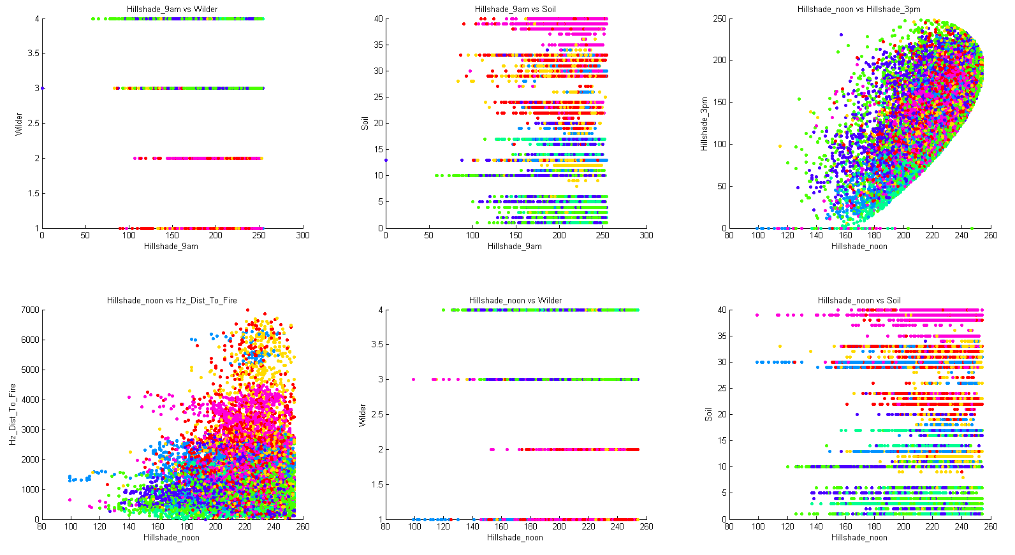
The plot for a pair of features(10/11)

Slide 16
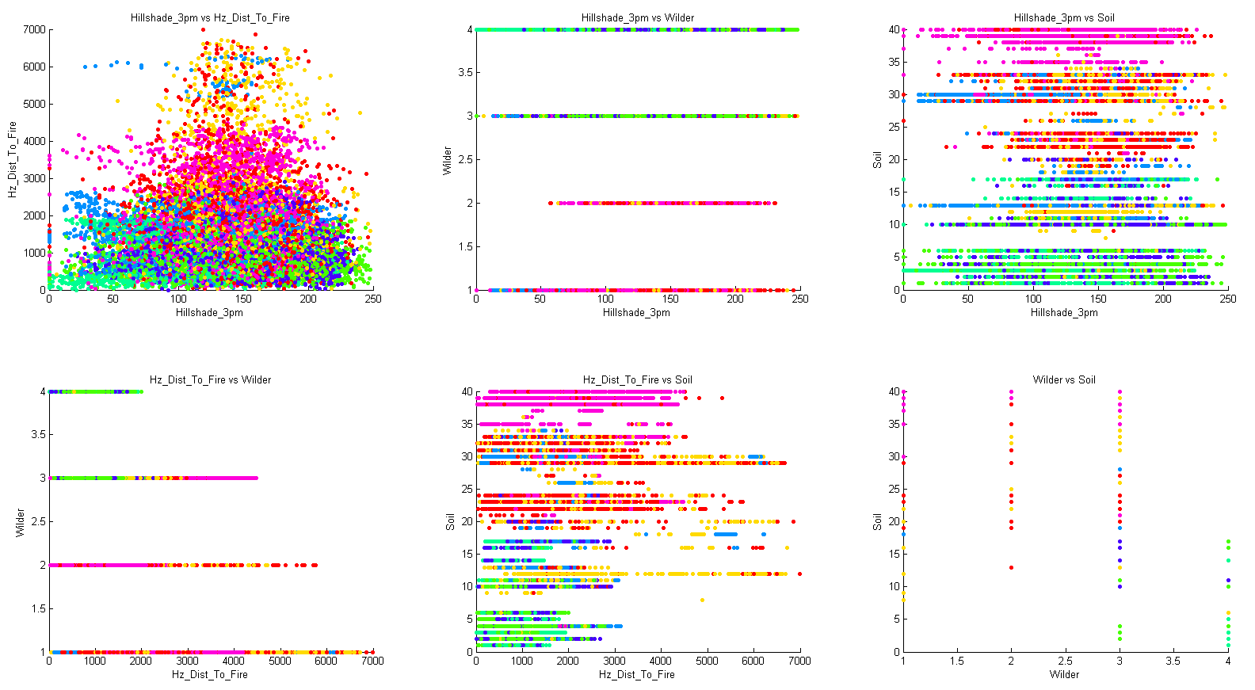
The plot for a pair of features(11/11)

Slide 17
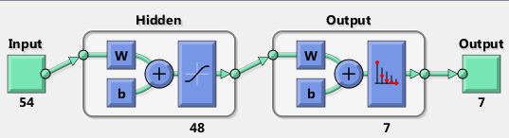
Preliminary experiment
Experiment Setup
We attempt to build a neural network that can classify forest cover type from seven types.
The reason we choose neural network is that it a good candidate model for solving problems that has many variables with complicated decision.
The input layer has 54 features.
The hidden layer has 48 nodes.
The number of nodes in hidden layer is determined by experiments.
The output uses 7 elements to define a cover type.

Slide 18
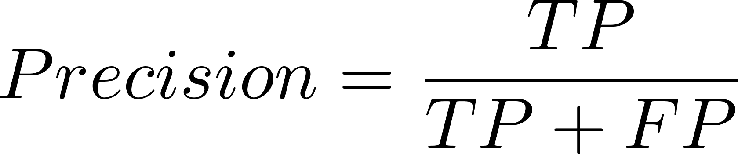
The result of different number of hidden nodes.
We do experiment for number of hidden nodes from 10 to 99.
For each specific number of hidden nodes, we do 10 times experiment.
We divide original training set to 3 different subsets
70% samples for training
15% samples for validation
15% samples for testing
Use precision to evaluate result.

Slide 19
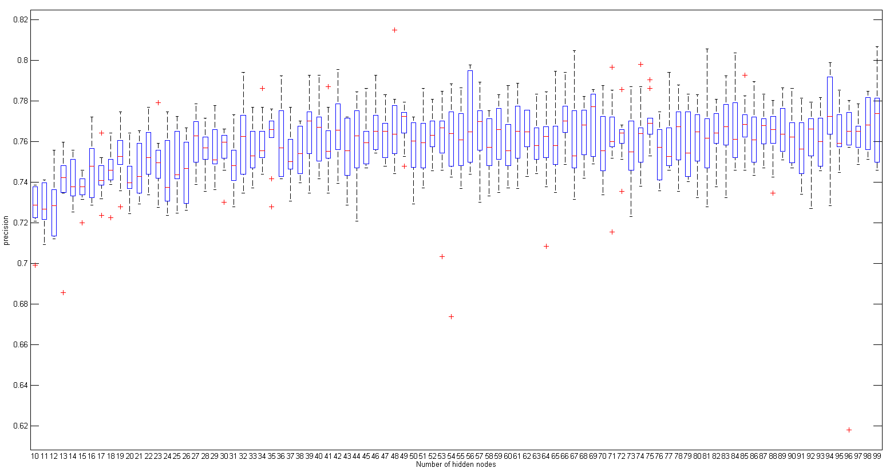
The result of different number of hidden nodes.
Boxplot of experiment for hidden nodes from 10 to99

Slide 20
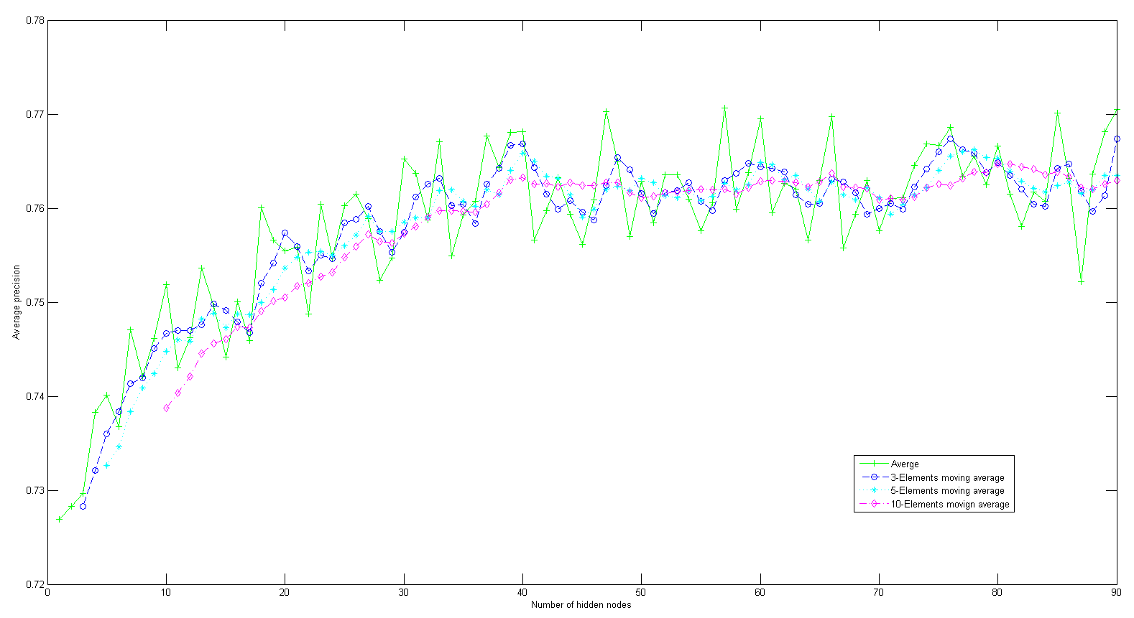
Trend of precision
From the plot, when size of hidden nodes is greater than 40,
we can get fare good precision.

Slide 21
Top N precisions in neural network. (N=10)
Size of hidden nodes | Precision on training dataset
48 | 0.8148
99 | 0.8068
81 | 0.8055
67 | 0.8046
84 | 0.8037
94 | 0.7989
74 | 0.7981
56 | 0.7976
56 | 0.7971
71 | 0.7967

Slide 22
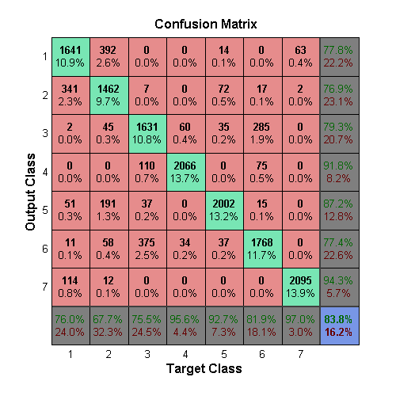
Confusion Matrix when hidden layer nodes is 48

Slide 23
Ensemble Methods
We use top N neural networks to establish an ensemble model. Then we use major vote to get output result.
Result:
Use top 100 neural networks.
The precision on the training set is 81.83%
Discussion:
The precision 81.83% is lower than the Top-1 method, which is 83.76%, however, the ensemble methods works better on test set.

Slide 24
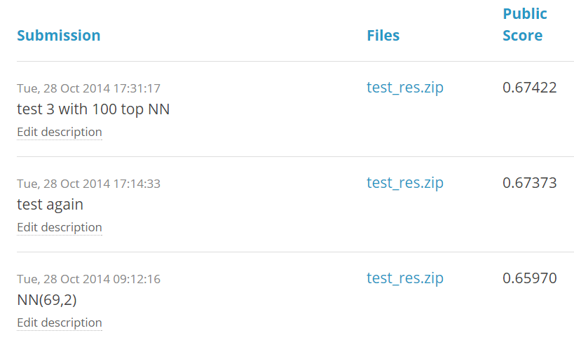
Result on Leader board
Third attempt: A major voting model uses top 100 best neural networks
Second attempt: A Neural Network that has 48 hidden nodes, which is the founded best model
First attempt: A Neural Network that has 69 hidden nodes
The best score on leader board is 0.985, my preliminary result gets score of 0.674,
still has a large potential to pursue.

Slide 25
Next step
Use the observed correlation to reconstruct some new features, which may improve prediction model.
Compare a few different classifiers and choose a better model.
K-NN
Neural Network
Ensemble Model

