Slide 1
Forest Cover Type Prediction
2nd Project Report for CSE 581
Dong Han
November 18, 2014
dhan@oakland.edu

Slide 2
Overview
Introduction of Artificial Neural Network (ANN) model for the project
Experiment setup 1
The influence of normalization
Experiment setup 2
Adjust early stopping parameter (max fail times)
Experiment setup 3
the influence of features
Input features set 1 (contains 54 different features)
Input features set 2 (contains 64 different features)
Compare the results
Conclusion and discussion

Slide 3
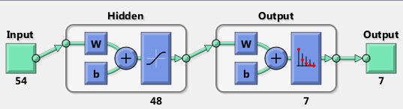
Introduction of Artificial Neural Network (ANN)
Method 1
Method 2
Use group of ANN
Get result from the group of ANN
.
.
.
In the following experiment the number of ANN in the group is set to 10 or 100

Slide 4
Experiment 1 The influence of normalization
The default normalization for input features
For all input numerical variables, the program normalizes them to [-1, 1]. For example:
Elevation [1859, 3858] → [-1 1]
Horizontal distance to hydrology [0, 1397] → [ -1 1]
Vertical distance to hydrology [-173, 601] → [-1 1]
For categorical variables, the default normalization also convert them to the range of [-1 1]. E.g. [1 0 0 0] → [1 -1 -1 -1], which does not make sense.
The default normalization is not appropriate for categorical variables.
The improved normalization, we just normalize numerical variables.
Remark
A trick here is that we do the normalization by using both training dataset and testing dataset, so that we can get benefits by using the features’ range in testing dataset.

Slide 5
The set up of Experiment 1
Experiment setup
We trained ANN classifier with number of hidden nodes from 40 to 200, with interval of 20. Therefore, we have ANN for hidden nodes as [40, 60, 80, … ,200], which are 9 different type of ANN.
For each hidden nodes setup, we training 50 ANN classifiers with random initial weights.
For each training, we divide training set to
80% samples for training samples
20% for validation (to avoid over fitting by using early stopping policy).
After the training, we get 9x50 = 450 ANN classifiers
Then we choose top 1, top 10 and top 100 classifiers for evaluation in training dataset and test dataset, respectively.
In top 10, and top 100 ANN classifiers, we use majority vote method to get classification result.
The training set has 15120 samples.
The testing set has 581012 samples.

Slide 6
The result of Experiment 1

Slide 7
Experiment 2
Adjust early stopping parameter
Improve Neural Network Generalization and Avoid Overfitting
When the network begins to overfit the data, the error on the validation set typically begins to rise.
When the validation error increases for a specified number of iterations, the training is stopped, and the weights and biases at the minimum of the validation error are returned.

Slide 8
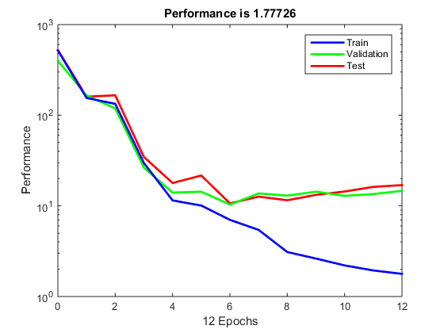
Experiment 2

Slide 9
The Result of Experiment 2

Slide 10
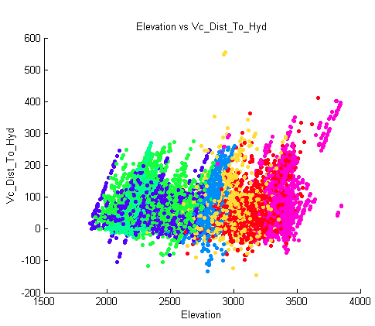
Experiment setup 3 the influence of features
We add some new features to the dataset.
For example
A feature to describe the sign of vertical distance to hydrology.
If the vertical distance is positive, the value of the feature is 1, if the vertical distance is negative, the value of the feature is -1.
The Euclidean distance to hydrology
We generate 10 new features for the dataset
Remark:
Some new features are referred from the source: http://nbviewer.ipython.org/github/aguschin/kaggle/blob/master/forestCoverType_featuresEngineering.ipynb

Slide 11
The result of Experiment 3

Slide 12
All results in one plot

Slide 13
Discussion
The best classifier from the experiment for the test dataset
Precision = 74.73%
The setup is 64 features (54 features + 10 new features)
Max failed times for validation is 128
The number of ANN in group is 10
Questions?

