Slide 1
Text Mining Project
Analyzing Tweets (First report)
Dong Han
dhan@Oakland.edu

Slide 2
Overview
Text mining task
Introduction to tasks
Cluster to subtopics
Text Mining steps
Raw data fetch
Raw data processing
Term-document matrix building
Latent semantic indexing
Similarity clustering
Discussion

Slide 3

Text mining
Analyzing Tweets

Slide 4

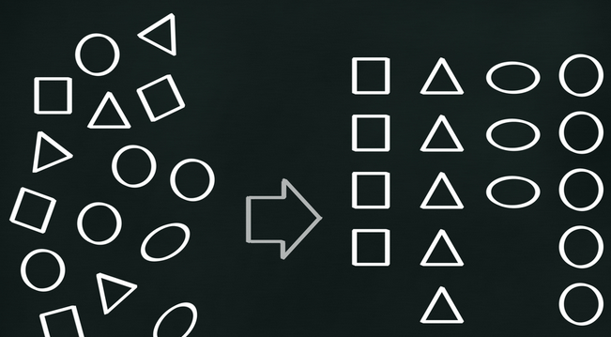
Analyzing Tweets
Since we type in a hash tag (#) to search tweets in twitter, there are a lot of related results are shown.
The problem is, some of these results are sharing the same hash mark, however, they are talking about different subtopics.
The twitter does not help us to categorize its result to different subtopics that makes messy results.
Our objective is to cluster the retrieved results to a few different topics depending on the predefined sensitivity threshold.

Slide 5

Text Mining steps 1: Get data
Get tweet data
Twitter provides development toolkit including APIs that can get search result from twitter web services
There are also some third part library that wrapped twitter’s core APIs to provide more flexible usage.
Tweepy, a Python library.
Java Twitter, a Java wrapper around the Twitter API
Twitter4j, yet another Java wrapper around the Twitter API
Get data from third part data integrated provider.
Zapier (recommended by Edisemi Destiny Anyaiwe)
keyhole.co
For the raw data, we save them as CVS format, which would be easier for process in next steps.

Slide 6
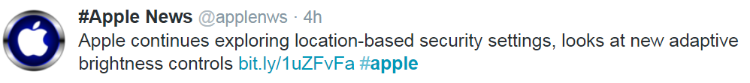
Text Mining steps 2: Raw data processing
A Tweet record will be processed as follows before analysis.
Text tokenization
apple; continues; exploring; location; based; security; settings; looks; at; new; adaptive; brightness; controls
Stopwords removal
apple; continues; exploring; location; based; security; settings; (looks); (at); (new); adaptive; brightness; controls
Word stemming
appl; continu; explor; locat; base; secur; set; adapt; bright; control
Synonyms (optional)

Slide 7
Text Mining step 3: Term-document matrix building
Based on the raw data, we build a term document matrix to show weight of word in each document.
 | d1 | d2 | d3
apple | w11 | w12 | w13
continue | w21 | w22 | w23
explor | w31 | w32 | w33
We rank words in a document by tf-idf weight.
The tf-idf weight is defined as following:
TF( token, document ) =
(Number of times the token in the document) /
Total number of words in the document
IDF(token) = lg( Total number of documents /
Number of documents with the token in it)
tf-idf(token, document) = TF(token, document)*IDF(token)

Slide 8
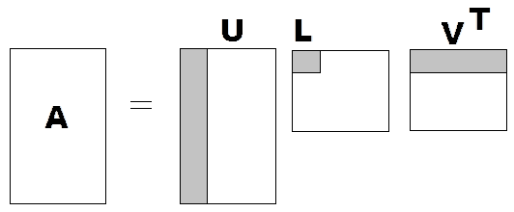
Text Mining step 4: Latent semantic indexing
Use SVD for term-document matrix
Discard smaller eigenvalues in L to get a reduced rank
Transformed term-document vector (matrix)
Original term-document vector (matrix)
=
*

Slide 9
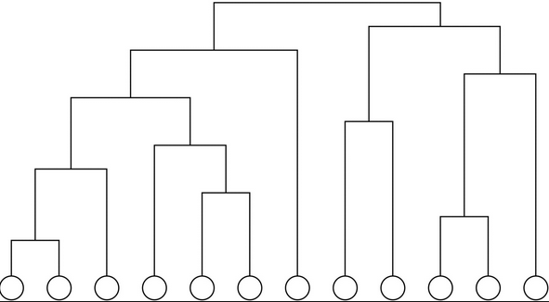
Text Mining step 5: Similarity clustering
Hierarchical clustering is applied for clustering.
We will consider both complete linkage clustering and single-linkage clustering.
Evaluate the result from the two different linkage criteria.
The hierarchical clustering is running on the low-rank approximation matrix, we consider cosine metrics to cluster the data set.
Cosine similarity

Slide 10
Some preliminary results
We search four hash tags
#apple
#google
#microsoft
#cometlanding
We collect search records from date 11/07/2014 to 11/13/2014. The total records for these tags are
#apple has 88,774 records
#google has 48,750 records
#microsoft has 25,819 records
#cometlanding has 65,613 records

Slide 11
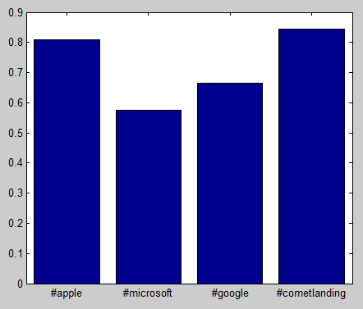
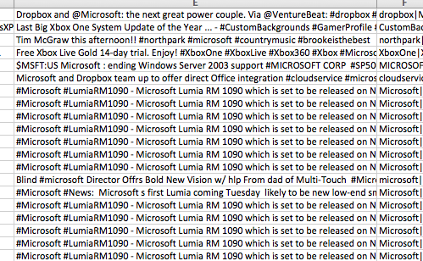
Some observations (1)
Duplication
The ratio of unique records to total records.

Slide 12
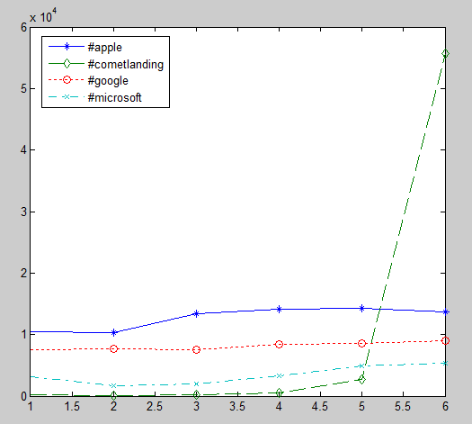
Some observations (2)
Number of records for each day

Slide 13
Discussion
The scale of the problem
A large scale SVD is impossible to be solved due to limitation of computation resource. If this is a problem in the tweet analysis, we will randomly select appropriate number of sample records from the total data set.
Some important parameters
The weight in term document is using tf-idf weight. We can also choose some other alternative weighting policies, such as boolean or counting.
In LSI, different low-rank k can affect the quality of clustering. The k value will be chosen from the result of experiment.
From experiment to determine the layer of hierarchical clustering that can get the best users’ experience.
Performance Evaluation

