Slide 1
Project #1
Skin detection
Task 3 & 4
02/10/2015
Dong Han
dhan@Oakland.edu

Slide 2
Overview
Experiment setup
Experiment demo
Experiment result

Slide 3
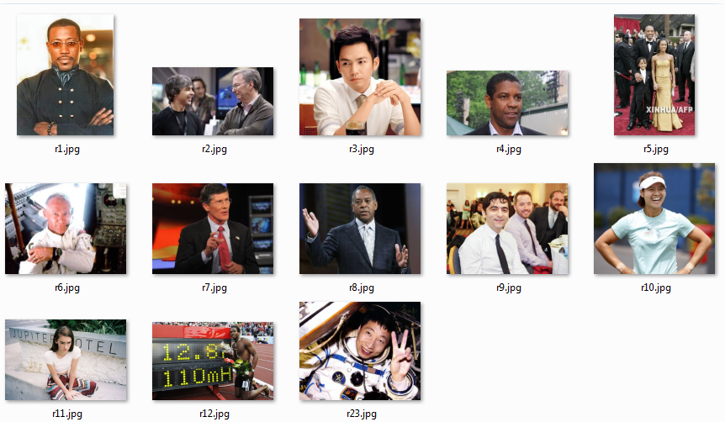
Experiment Setup 1 (Training set)
We choose 13 pictures for training.
In each picture we collect around 120 points
Skin pixels | Non-skin pixels | Total
1052 | 1218 | 2270
46.34% | 53.66% | 100%

Slide 4
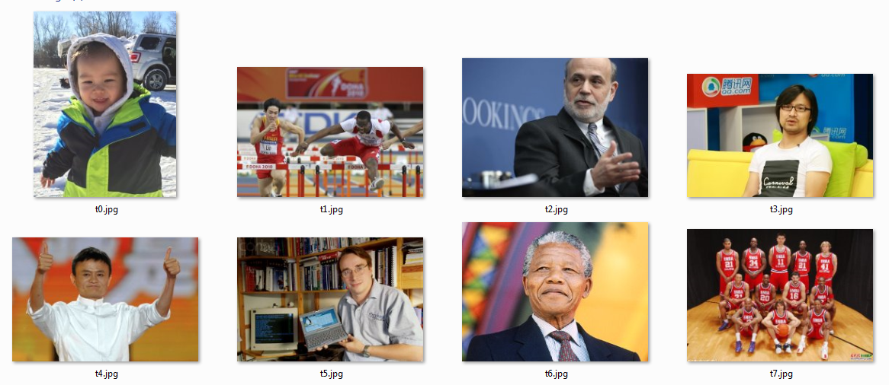
Experiment Setup 2 (Testing set)
We choose another 7 pictures for testing.
The pictures for testing are different from pictures for training.
In each picture, we randomly labeled around 120 points.
Skin pixels | Non-skin pixels | Total
404 | 568 | 972
41.56% | 58.44% | 100%

Slide 5
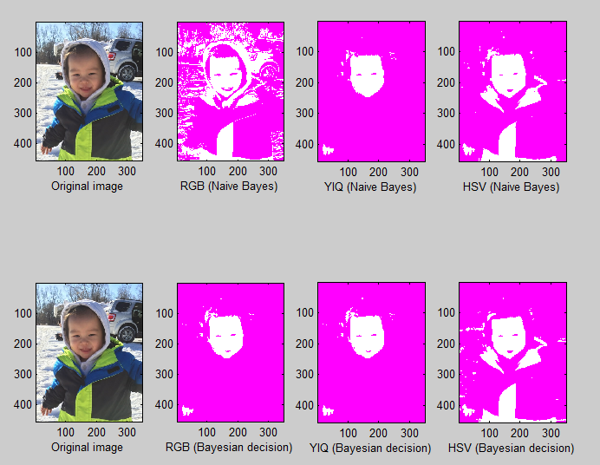
Demo (1/7)

Slide 6
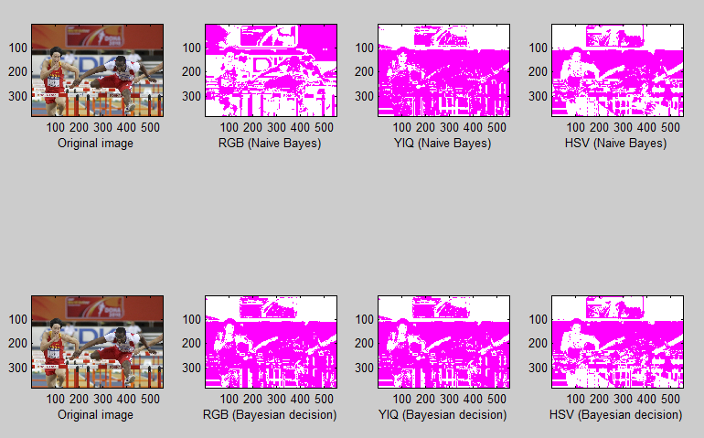
Demo (2/7)

Slide 7
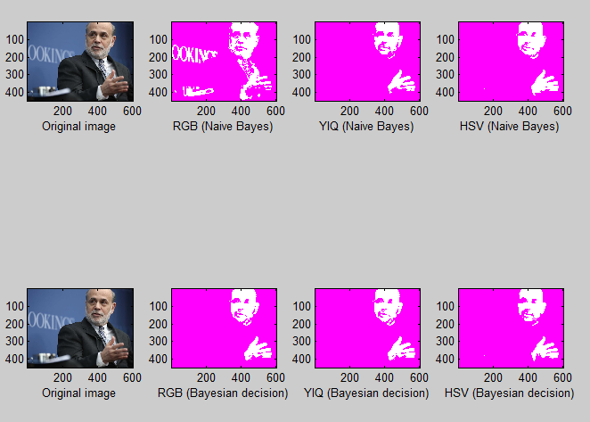
Demo (3/7)

Slide 8
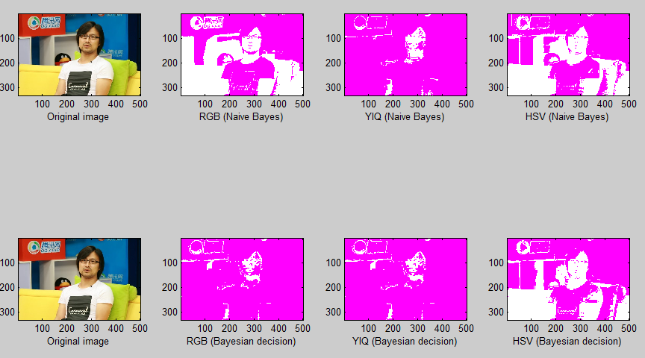
Demo (4/7)

Slide 9
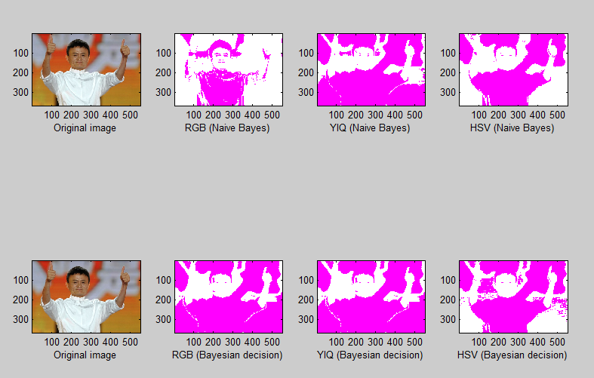
Demo (5/7)

Slide 10
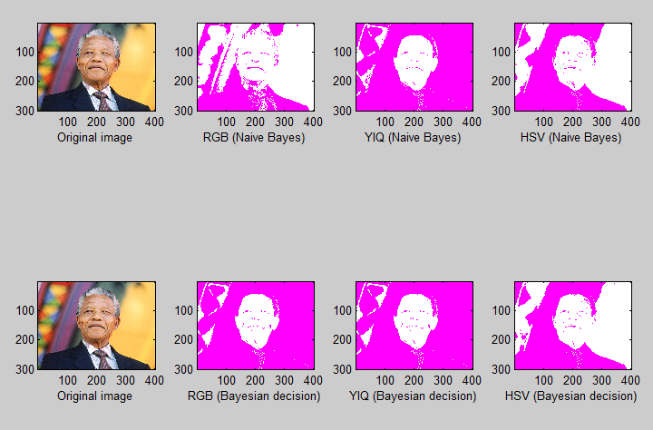
Demo (6/7)

Slide 11
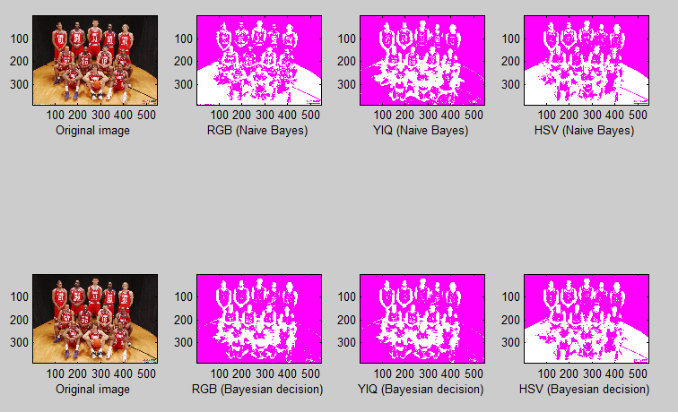
Demo (7/7)

Slide 12
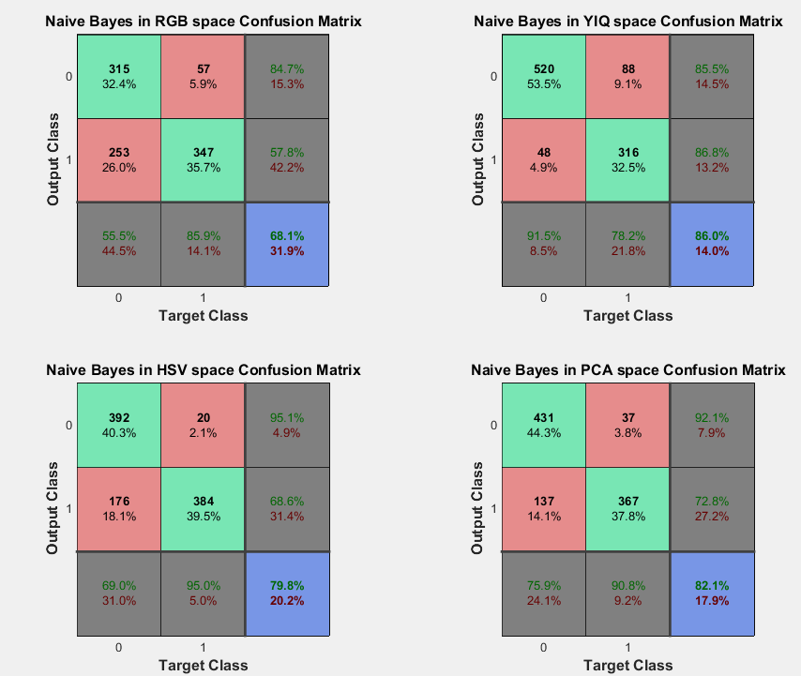


Experiment result (Naïve Bayes)

Slide 13
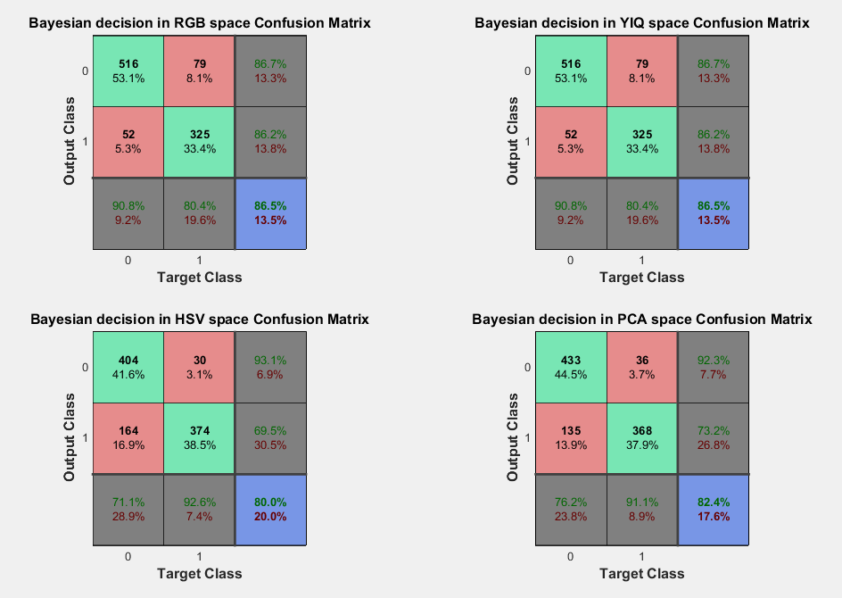


Experiment result (Bayesian decision)
Best Result of Naïve Bayes is 86.0%
Best Result of Bayesian decision is 86.5%

Slide 14
Thanks.

