Slide 1
Project #1
Skin detection
Task 3 & 4
02/10/2015
Dong Han
dhan@Oakland.edu

Slide 2
Overview
Experiment setup
Experiment demo
Experiment result

Slide 3
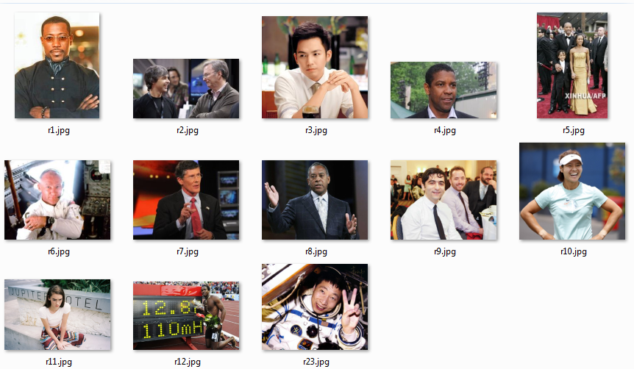
Experiment Setup 1 (Training set)
We choose 13 pictures for training.
In each picture we collect around 120 points
Skin pixels | Non-skin pixels | Total
1052 | 1218 | 2270
46.34% | 53.66% | 100%

Slide 4
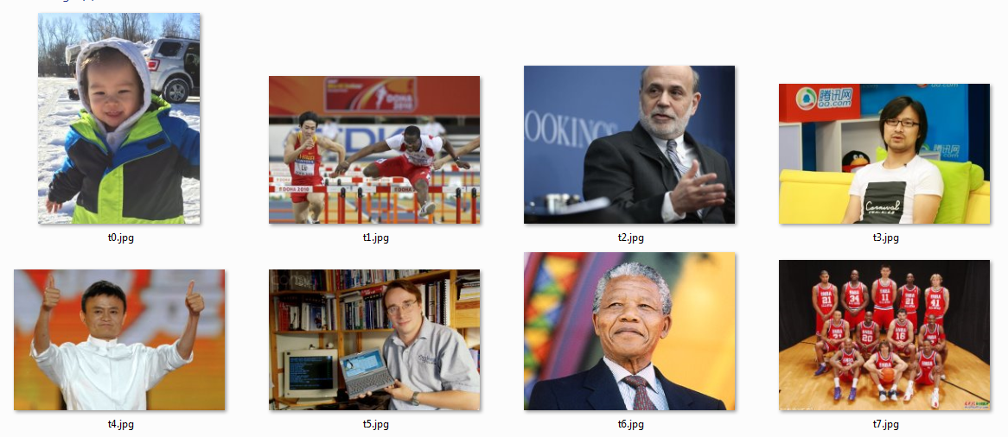
Experiment Setup 2 (Testing set)
We choose another 7 pictures for testing.
The pictures for testing are different from pictures for training.
In each picture, we randomly labeled around 120 points.
Skin pixels | Non-skin pixels | Total
404 | 568 | 972
41.56% | 58.44% | 100%

Slide 5
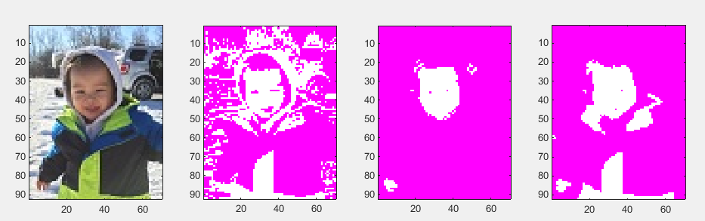
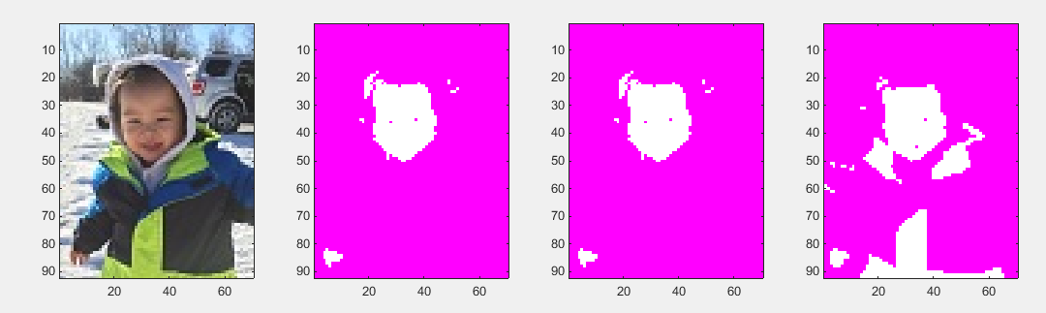
Demo

Slide 6
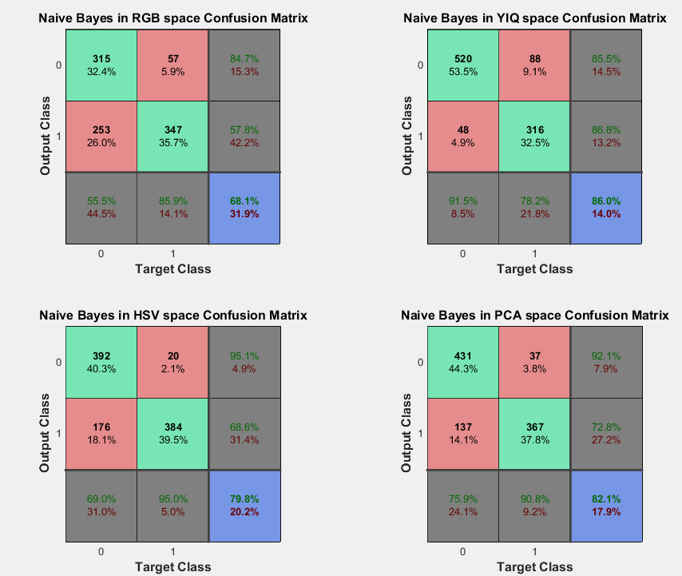


Experiment result (Naïve Bayes)

Slide 7
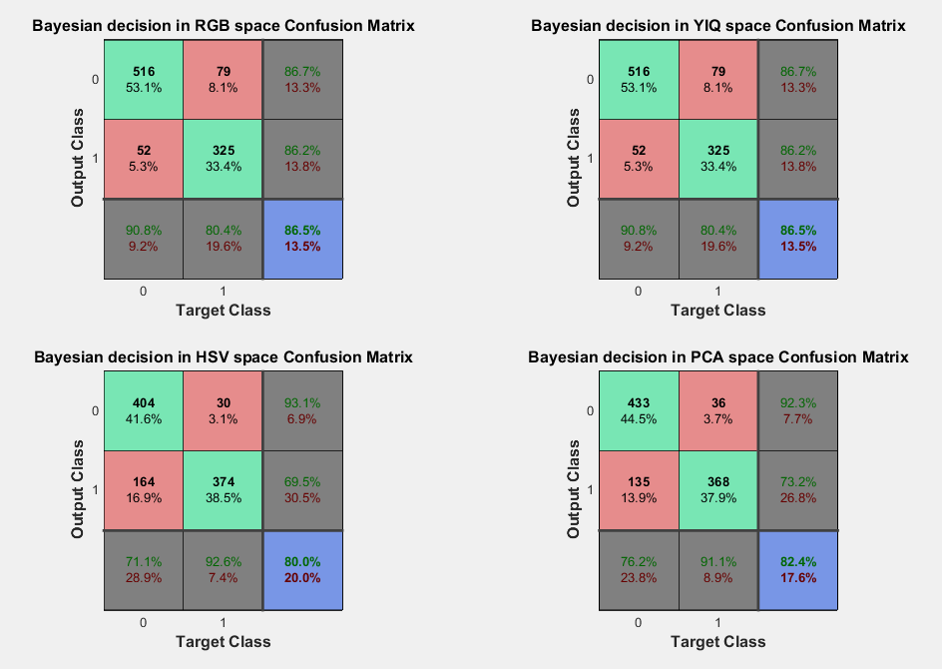


Experiment result (Bayesian decision)
Best Result of Naïve Bayes is 86.0%
Best Result of Bayesian decision is 86.5%

Slide 8
Thanks.

