Slide 1
Project #1
Skin detection
Task 1 & 2
01/29/2015
Dong Han
dhan@Oakland.edu

Slide 2
Overview
Pixel selection and annotation based on MATLAB
Another method: using skin data set with ground truth
We get labeled pixels from existing skin data set.
Data statistics

Slide 3
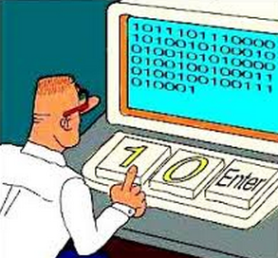
Pixel selection and annotation based on MATLAB
It is time consuming to develop a brand new pixel annotation tool.
In MATLAB, there is a tool “imtool”, integrated in MATLAB, with source code in MATLAB system library.
By patching the source code, we can add new features to work for the task.

Slide 4
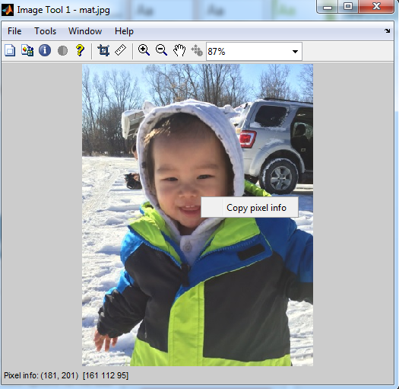
Imtool (genuine)
We want to add pixel selection function in the context menu
The imtool depends on a few important MATLAB library files.
We change these library files by adding new codes (to hijack some functions) in these files.
MATLAB\images\imuitools\imtool.m
MATLAB\images\imuitools\impixelinfoval.m
MATLAB\images\imuitools\impixelinfo.m

Slide 5
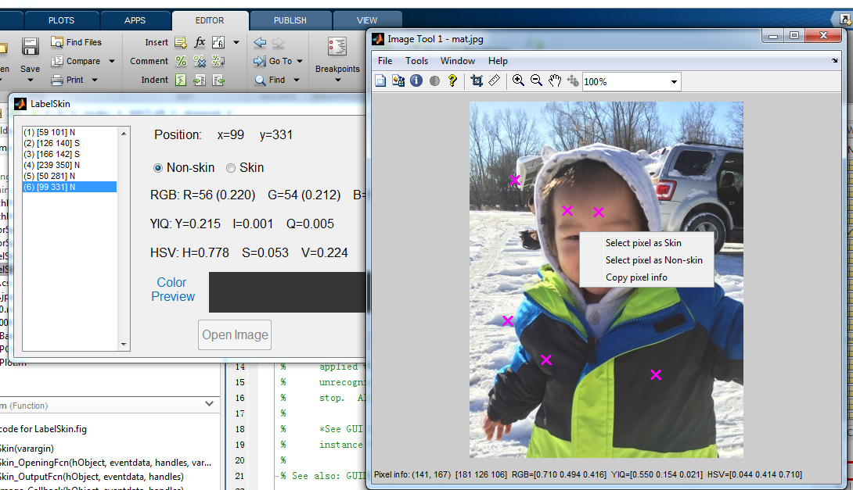
Imtool2 (patched)
Two new menu items are added here
Advantage:
No need to create a new wheel.
Get advanced functions (scaling, pixels selection, etc.) immediately
Drawback:
Cannot be published as an individual tool.
MATLAB library file is changed, which may cause problem in compatible.
Show three different color spaces (RGB, YIQ and HSV).
Demo show

Slide 6
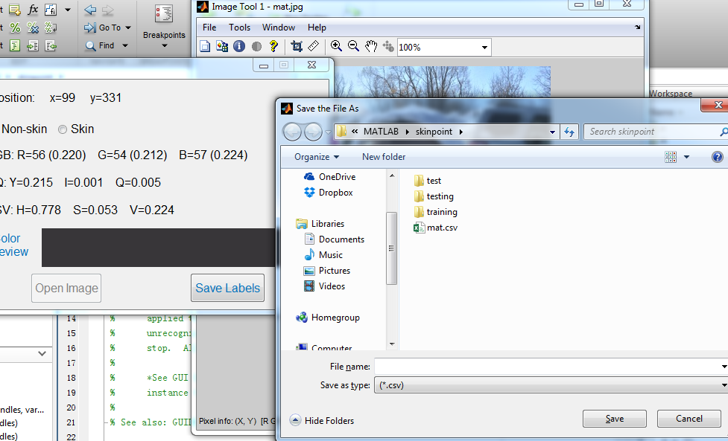
Imtool2 (patched)
After pixels selection and annotation, we can save pixels as csv file.

Slide 7
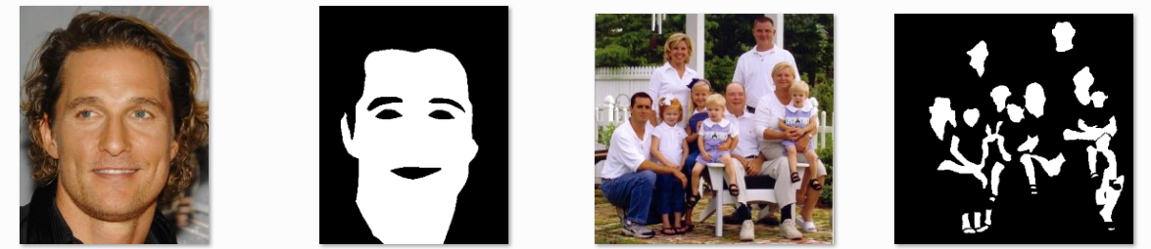
Using skin data set with ground truth
Existing dataset
Adaptive Skin Detection
http://lbmedia.ece.ucsb.edu/research/skin/skin.htm
human skin detection dataset
http://web.fsktm.um.edu.my/~cschan/downloads_skin_dataset.html
Use the dataset for training and testing

Slide 8
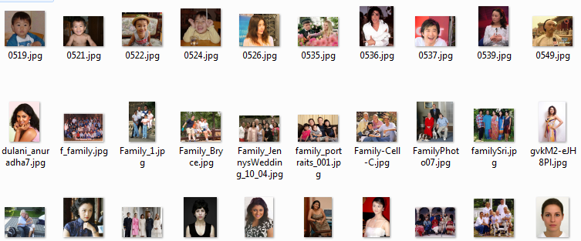
Part of pictures used in the project
150 pictures are chosen from 632 pictures as training set

Slide 9
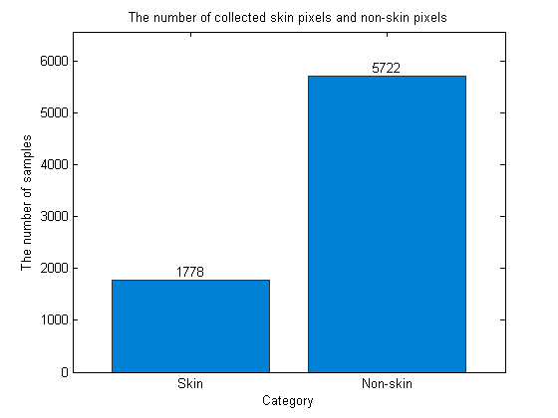
Experiment 1: data statistics
We randomly select 50 pixels from each picture.
In all, we get 50*150 = 7500 samples (1778 pixels for skin, 5722 pixels for non-skin)

Slide 10
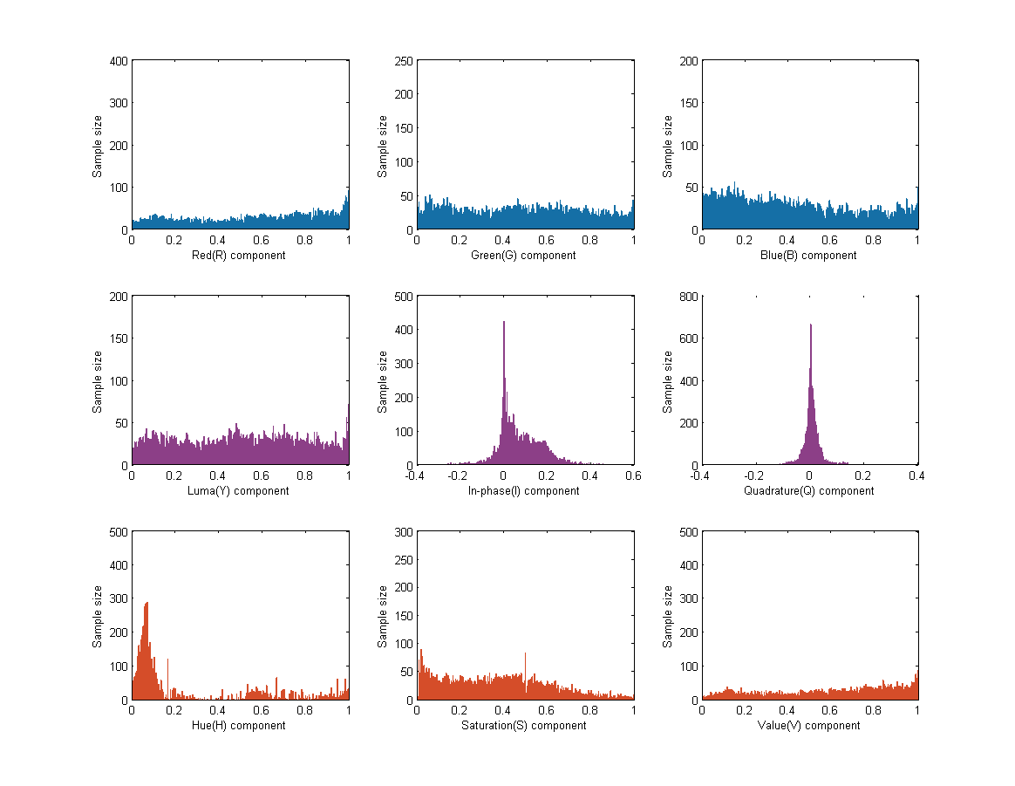
Histograms for each components in a color space.
RGB
YIQ
HSV

Slide 11
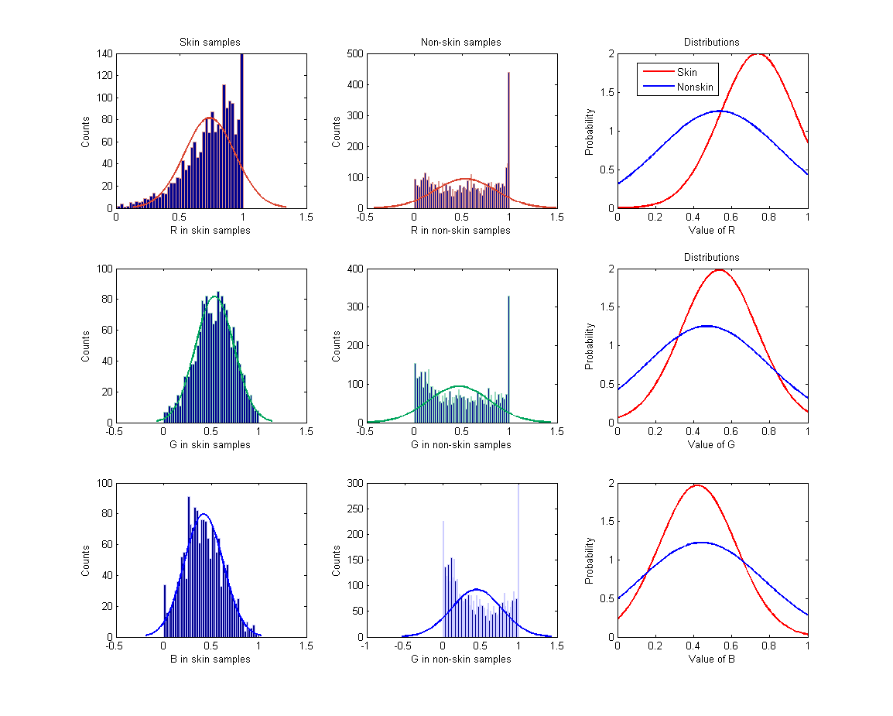
Skin pixels and non-skin pixels in RGB color space
R
G
B

Slide 12
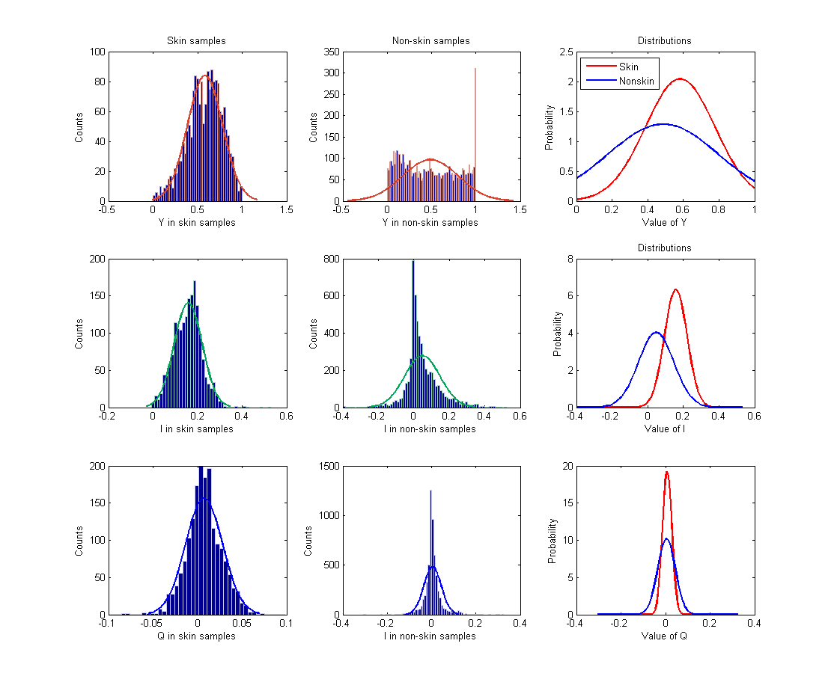
Skin pixels and non-skin pixels in YIQ color space
Y
I
Q

Slide 13
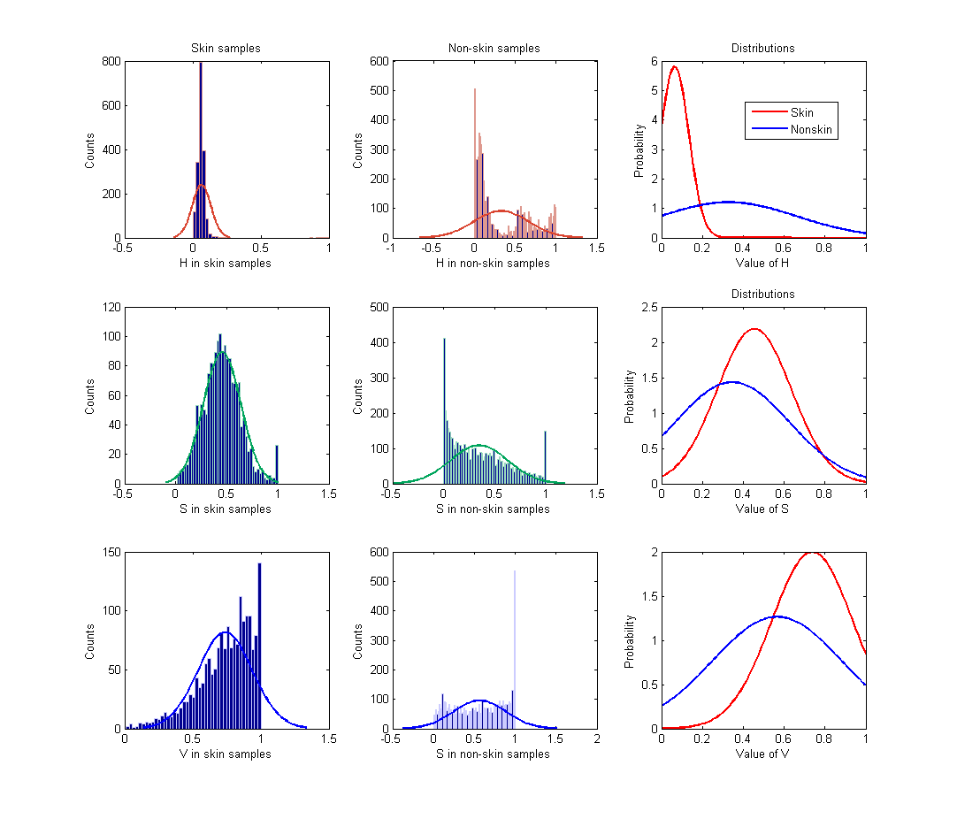
Skin pixels and non-skin pixels in HSV color space
H
S
V

Slide 14
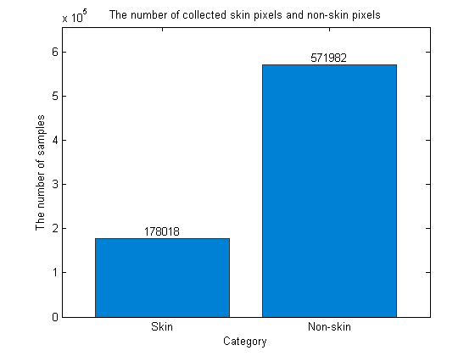
Experiment 2: data statistics
We randomly select 5000 pixels from each picture.
In all, we get 5000*150 = 750000 samples (178018 pixels for skin, 571982 pixels for non-skin)

Slide 15
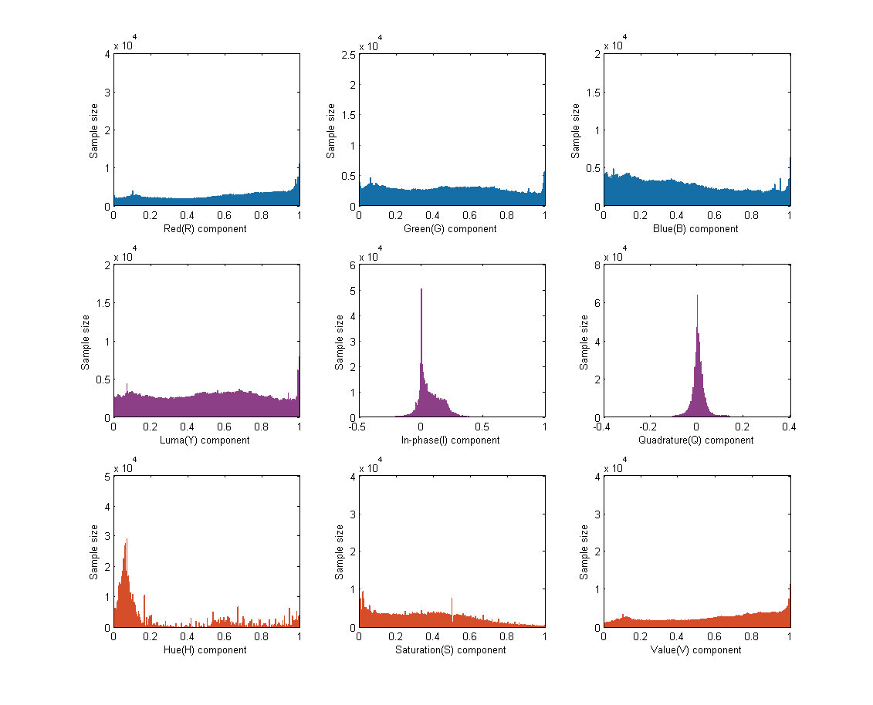
Histograms for each components in a color space.
RGB
YIQ
HSV

Slide 16
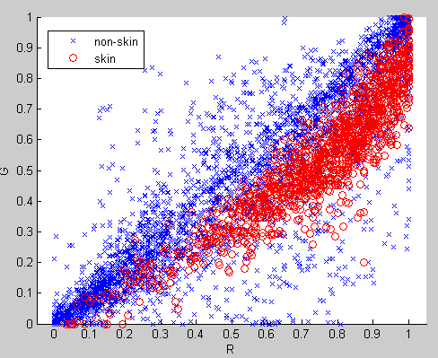
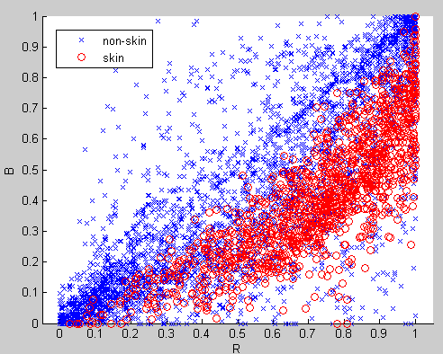
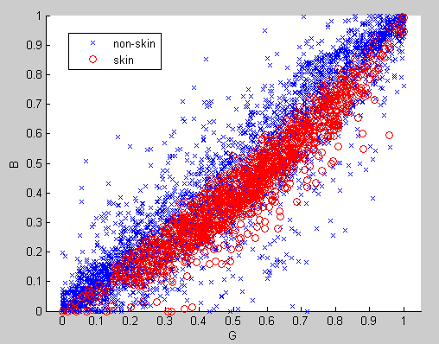
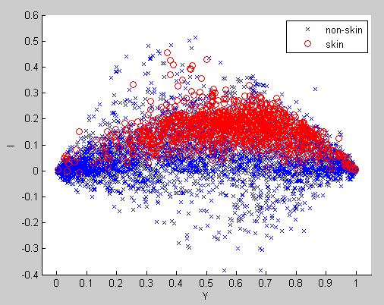
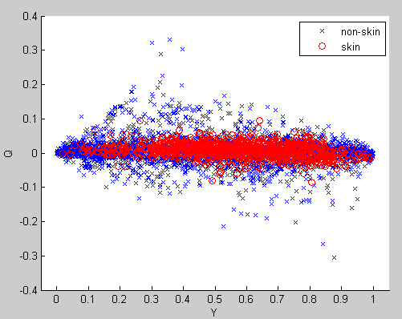
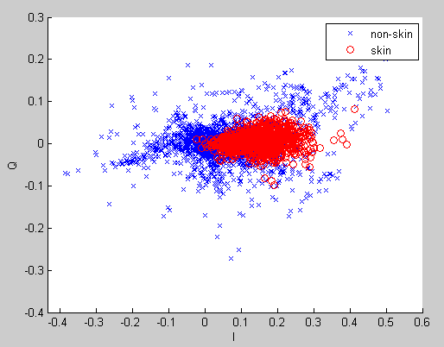
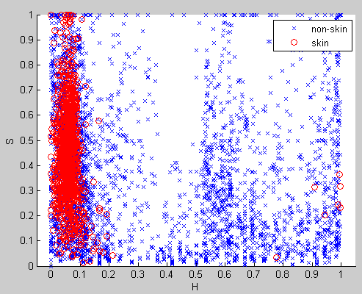
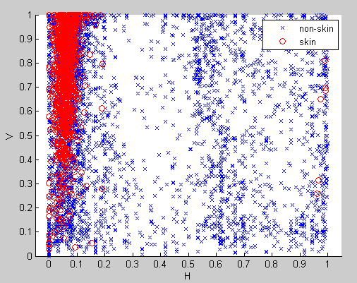
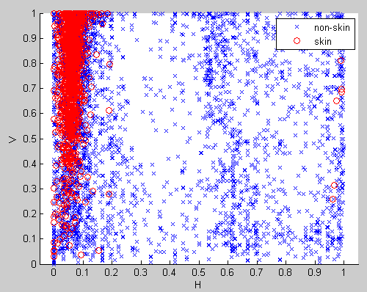
RGB
YIQ
HSV

Slide 17
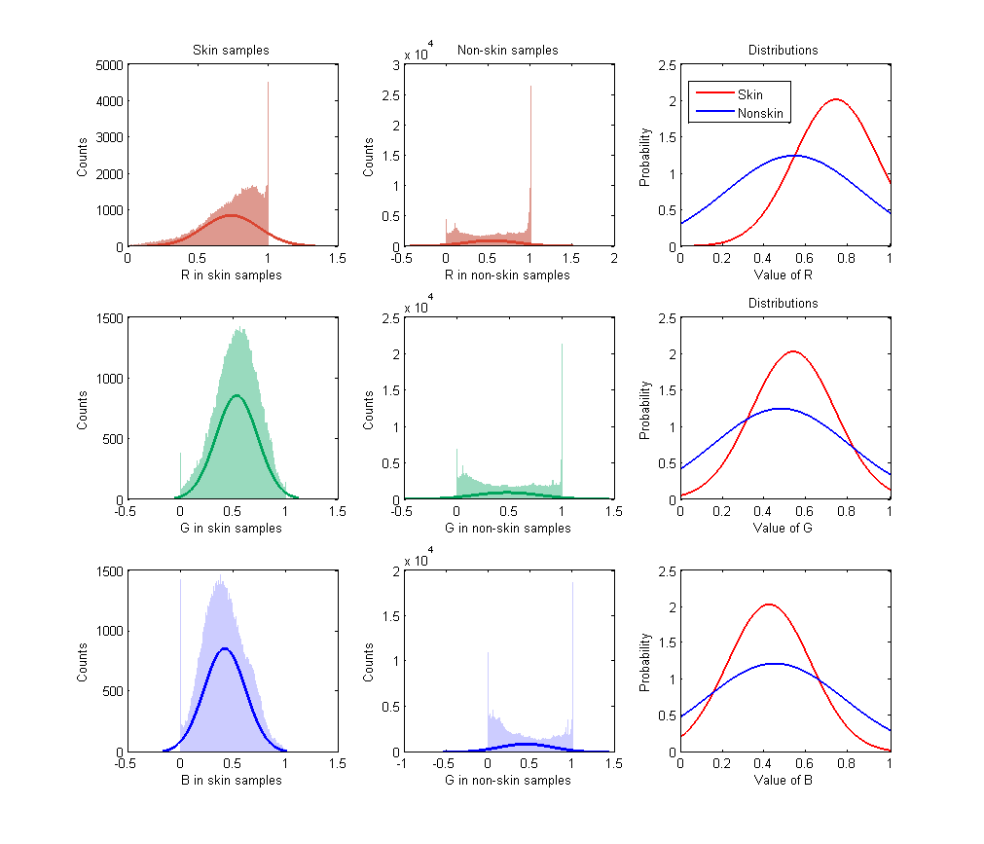
Skin pixels and non-skin pixels in RGB color space
R
G
B

Slide 18
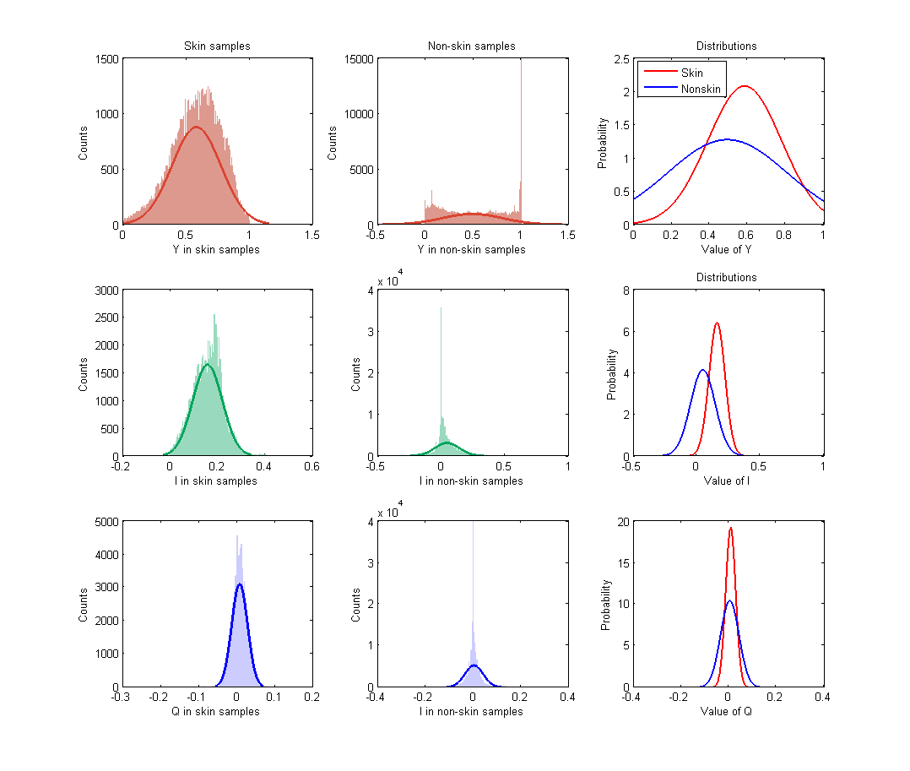
Skin pixels and non-skin pixels in YIQ color space
Y
I
Q

Slide 19
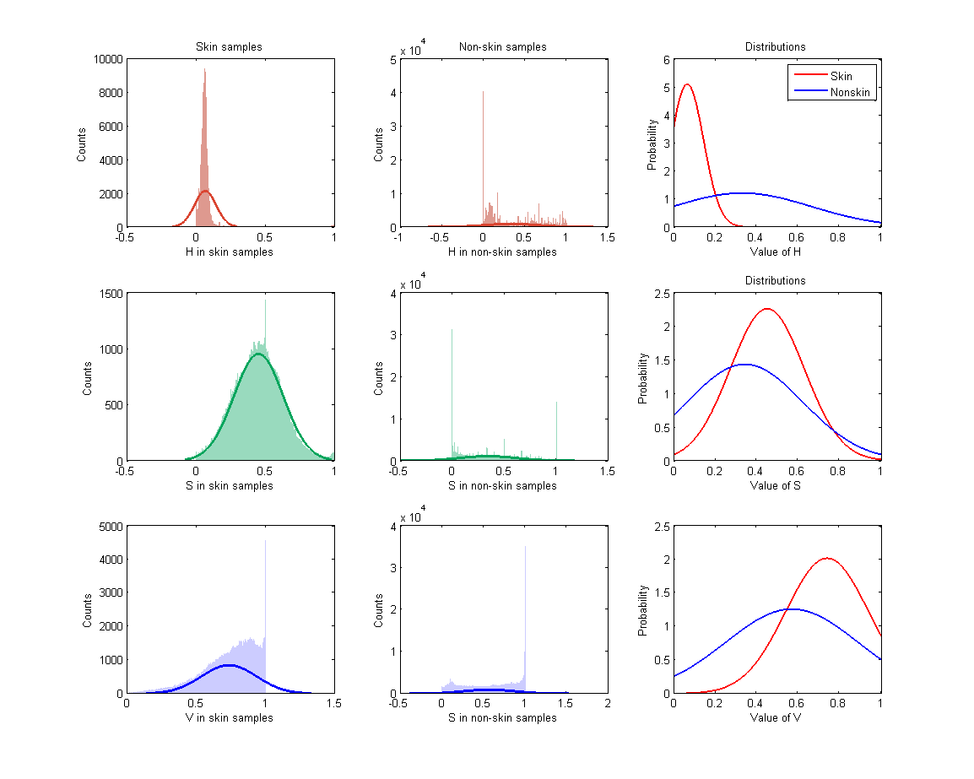
Skin pixels and non-skin pixels in HSV color space
H
S
V

Slide 20
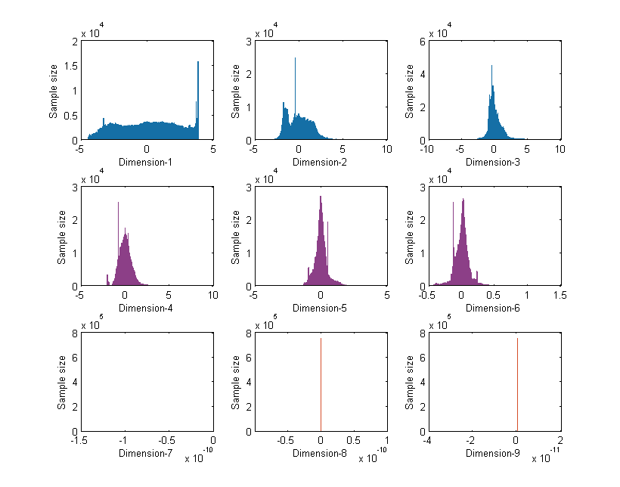
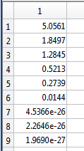
PCA
Since we have 9 features, we can try PCA to reduce the number of dimensions.
Eigen values

Slide 21
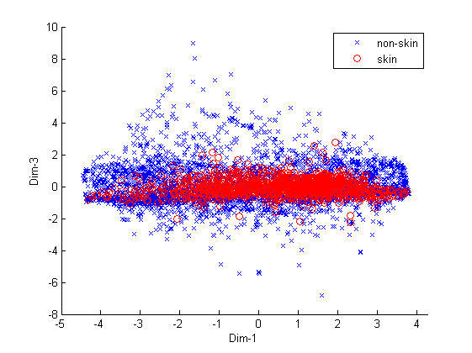
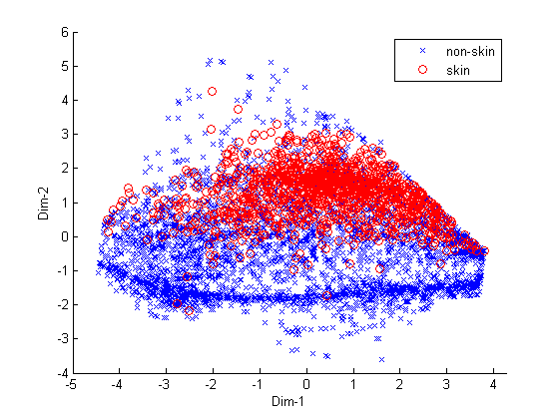
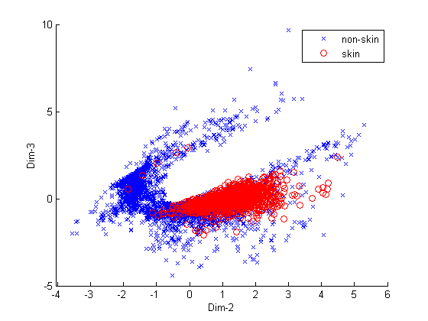
Scatter plots for features pairs

Slide 22
Thanks.

