Slide 1
Project #2
Digit Recognition
03/19/2015
Dong Han
dhan@Oakland.edu

Slide 2
Overview
Digit number generation
Experiment results for Classification models
  1-NN classifier
  Back-propagation Network with 6 hidden nodes
  Back-propagation Network with 12 hidden nodes
  Decision Tree Classifier
Performance Evaluation for different p.

Slide 3
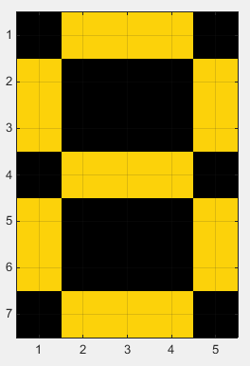
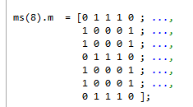
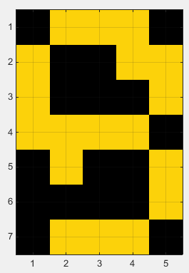
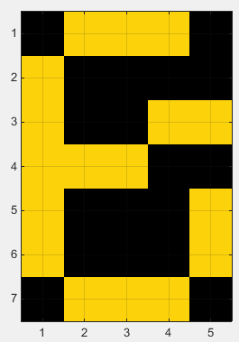
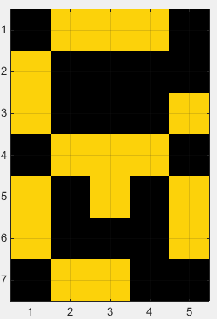
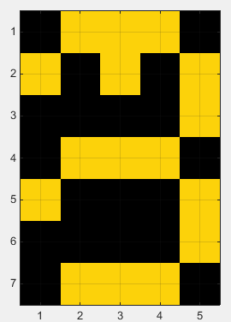
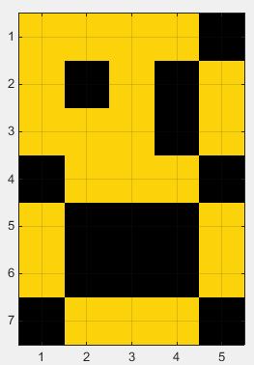
Digit number generation
Choose number 8 as an example:
Some mutated samples

Slide 4
1-NN classifier
[1 1 1 0 1 1 0 1 …… 1 1 1]
[1 0 1 0 1 0 0 1 …… 1 0 1]
calculate the Euclidean distance of two vectors.
Each vector has 35 (5x7) elements.

Slide 5
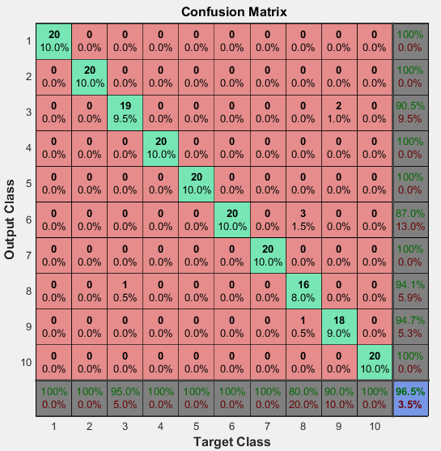
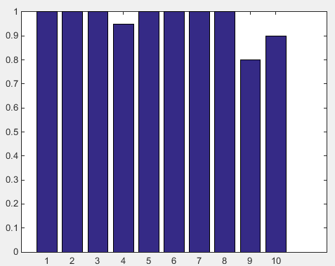
The result of 1-NN classifier
p=0.1

Slide 6
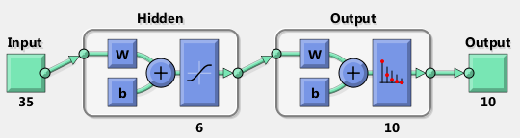
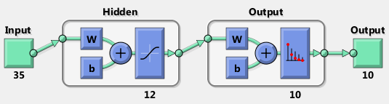
Back-propagation Network with 6 or 12 hidden nodes

Slide 7
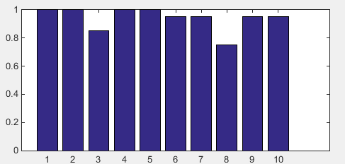
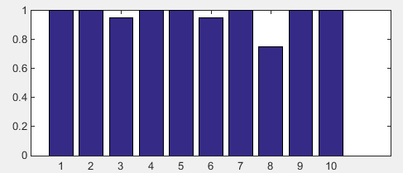
Back-propagation Network with 6 or 12 hidden nodes
  Back-propagation Network with 6 hidden nodes
  Back-propagation Network with 12 hidden nodes

Slide 8
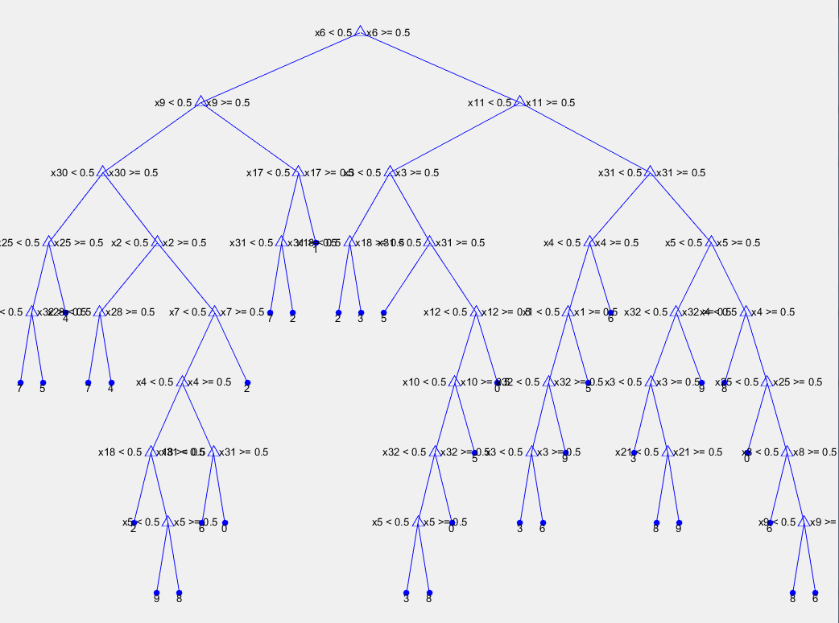
Decision Tree Classifier

Slide 9

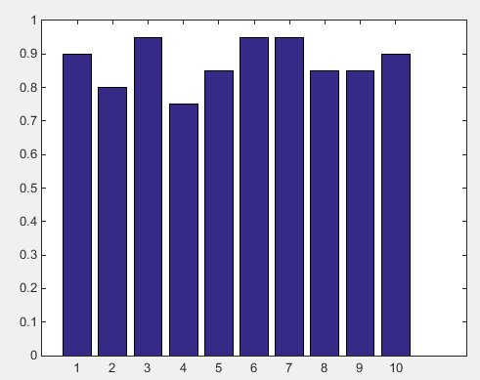
Decision Tree Classifier

Slide 10
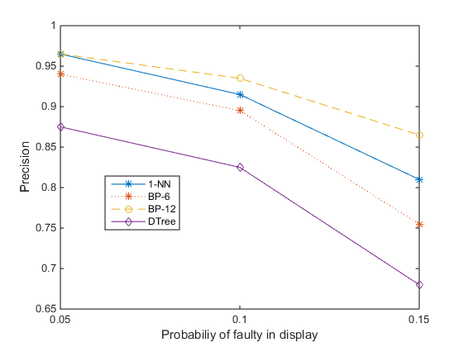
Performance Evaluation for different p
p=0.05, 0.1, 0.15

Slide 11
Thanks.

