Slide 1
Project #2
Digit Recognition
04/14/2015
Dong Han
dhan@Oakland.edu

Slide 2
Overview
Recall of results in previous presentation.
Experiment results for Classification models
  Features from counts of yellow cells on rows and columns
    1-NN classifier, BP Network with 6 hidden nodes, BP Network with 12 hidden nodes, Decision Tree Classifier
  Dimensions reduction based on PCA
    The evaluation of reduced dimensions
    Comparing the difference in performance based on original features, features by counts, and features after PCA.
Recognize rotated numbers
Conclusion

Slide 3
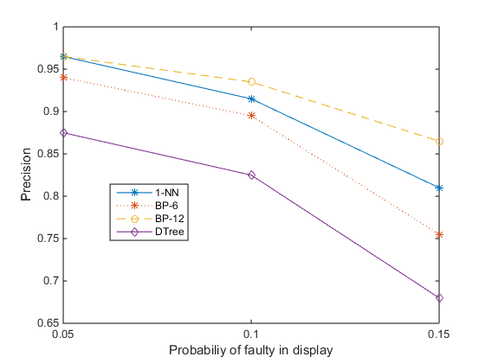
Recall of results in previous presentation
We give features as a 35 binary vectors. Then train 4 different classifiers.
The results show that
The BP Neural Network with 12 hidden nodes gives the best performance in these classifiers.
When error probability p is increasing, the precisions of classifiers are decreasing significantly.
p=0.05, 0.1, 0.15

Slide 4
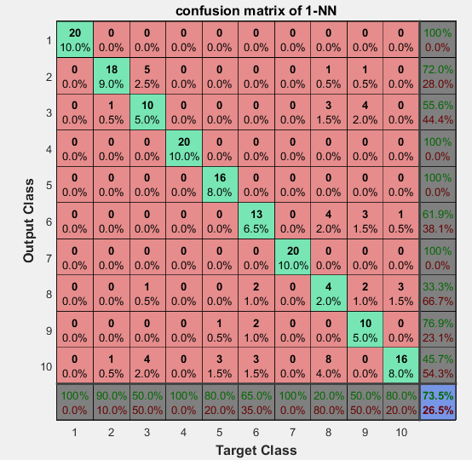
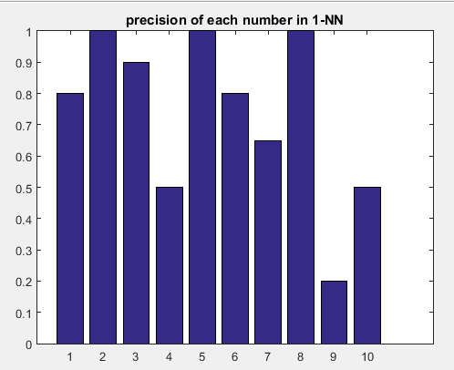
Experiment result for 1-Nearest Neighbor
P=0.1

Slide 5
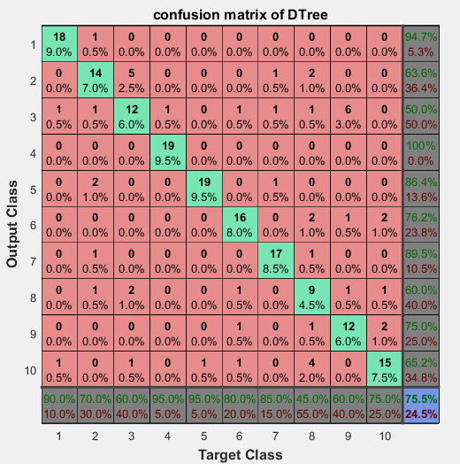
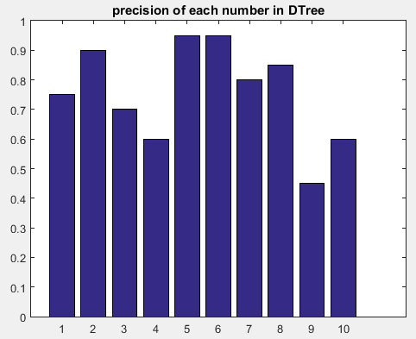
Experiment result for Decision Tree

Slide 6
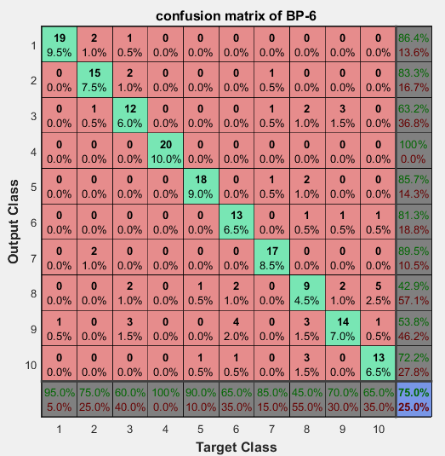
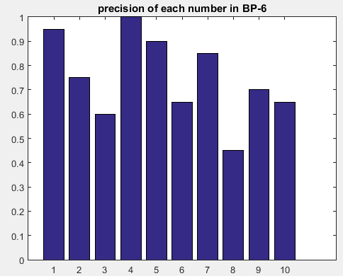
Experiment result of BP Neural Network with 6 hidden nodes

Slide 7
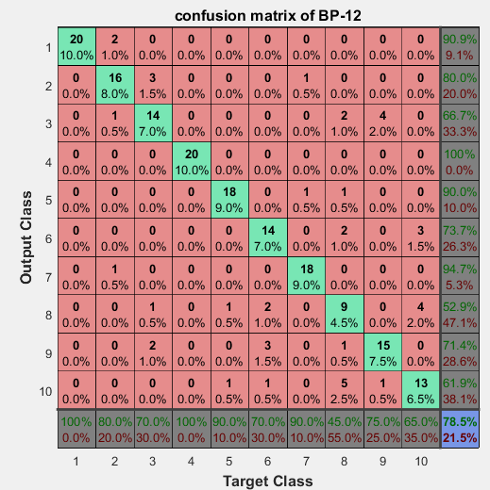
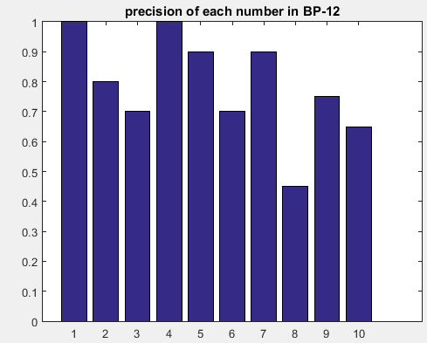
Experiment result of BP Neural Network with 12 hidden nodes

Slide 8
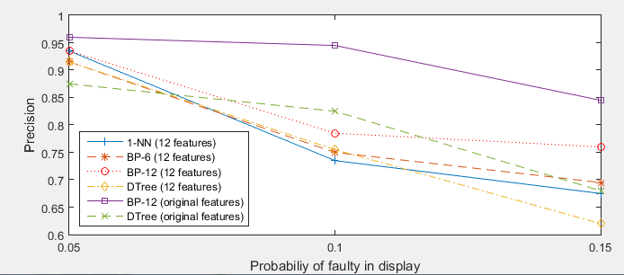
Comparison of different classifiers
When p is small (e.g. p=0.05), the performance result of new features and original features are similar.
When p is increasing, the performance result of original features are better than the new features.

Slide 9
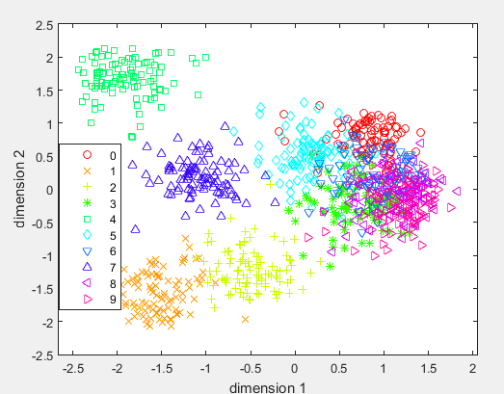
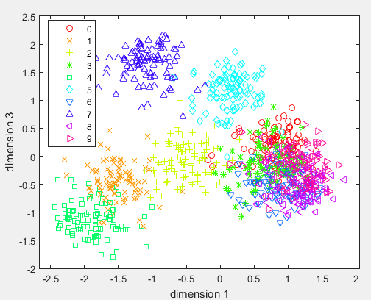
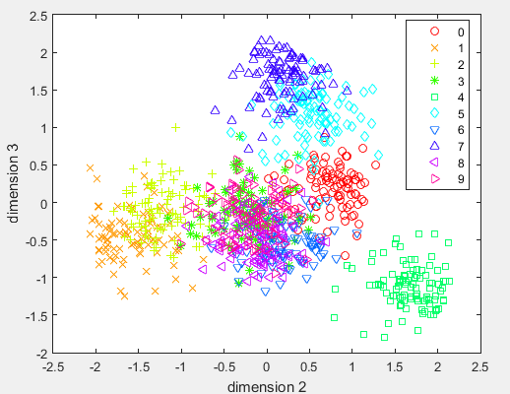
PCA
In PCA method, we reduce the original 35 dimensions to 10 dimensions.
The scatter plots show the comparison of first 3 dimensions.

Slide 10
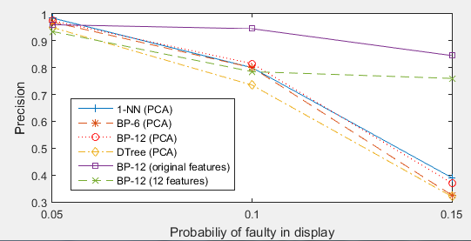
Discussion the result of PCA
Though the dimensions are reduced to 10, the PCA methods shows its high quality in classification when p is not larger.
When p =0.05, features based on PCA gets the best result.
When p=0.1, features based on PCA is still better than the features based on counts.

Slide 11


But, what if ……

Slide 12
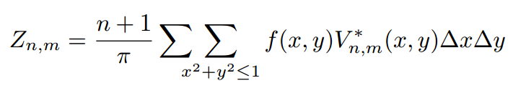
Zernike Moments as rotation invariant features
For the same n,m of Zernike moment, the magnitude, or absolute value of Zernike moment is same, though the image is rotated.
“n” is the order of Zernike moment.
“m” is the repetition number of Zernike moment
For each image, we can get any order of Zernike moment of the image.
For example, Z_{2,0} , Z_{2,2} , Z_{3,1}
Then we deal with each order as a feature of the image.
Each Zernike moment is a complex value like (a+bi).
We can consider it as a kind of overview of an image.
Reference: Khotanzad, A.; Yaw Hua Hong, "Invariant image recognition by Zernike moments," Pattern Analysis and Machine Intelligence, IEEE Transactions on , vol.12, no.5, pp.489,497, May 1990

Slide 13

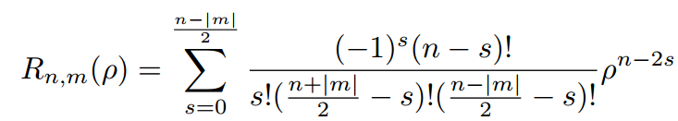
Zernike Moments as rotation invariant features
V* is complex conjugate of V
We convert Cartesian coordinate to polar coordinate

Slide 14
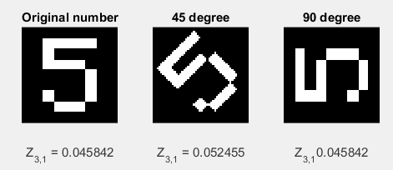
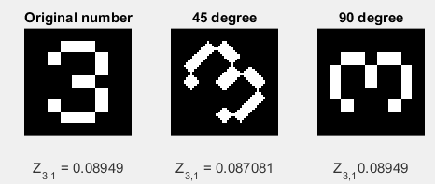
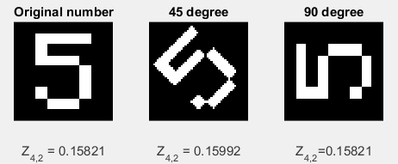
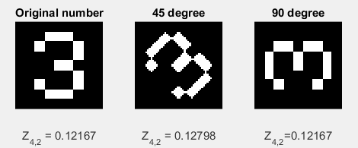
Experiment result of Zernike moments

Slide 15
Conclusion
In the project, we use basic features from pixels to recognize digit number. The BP neural network shows nice result.
Another features based on counts of rows and columns are also discussed.
We use PCA method to reduce dimensions to avoid curse of dimensions.
In addition, we introduce Zernike moments to detect rotated numbers.

Slide 16
Thanks.

