Slide 1
DHCP
Pankaj Seervi

Slide 2
Dynamic Host Configuration Protocol (DHCP)
DHCP is based on a client-server model and based on discovery, offer, request, and ACK.
DHCP port number for server is 67 and for the client is 68. It is a Client server protocol which uses UDP services. IP address is assigned from a pool of addresses. In DHCP, the client and the server exchange mainly 4 DHCP messages in order to make a connection, also called DORA process, but there are 8 DHCP messages in the process.

Slide 3
DHCP messages
DHCP discover message –
This is a first message generated in the communication process between server and client. This message is generated by Client host in order to discover if there is any DHCP server/servers are present in a network or not. This message is broad-casted to all devices present in a network to find the DHCP server. This message is 342 or 576 bytes long.

Slide 4
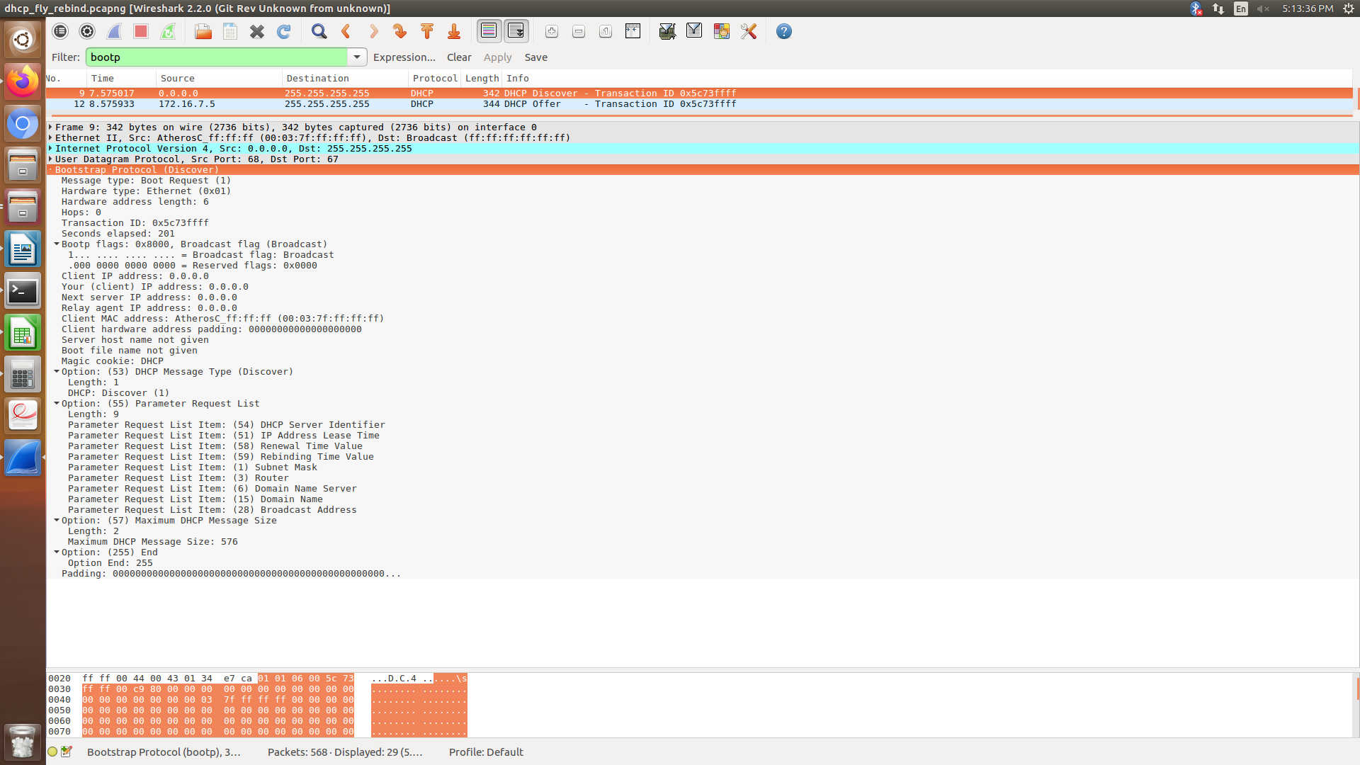
DISCOVER

Slide 5
DHCP offer message
The server will respond to host in this message offer the unleased IP address and other TCP configuration information. This message is broad-casted by server. Size of message is 342 bytes. If there are more than one DHCP servers present in the network then client host will accept the first DHCP OFFER message it receives. Also a server ID is specified in the packet in order to identify the server.

Slide 6
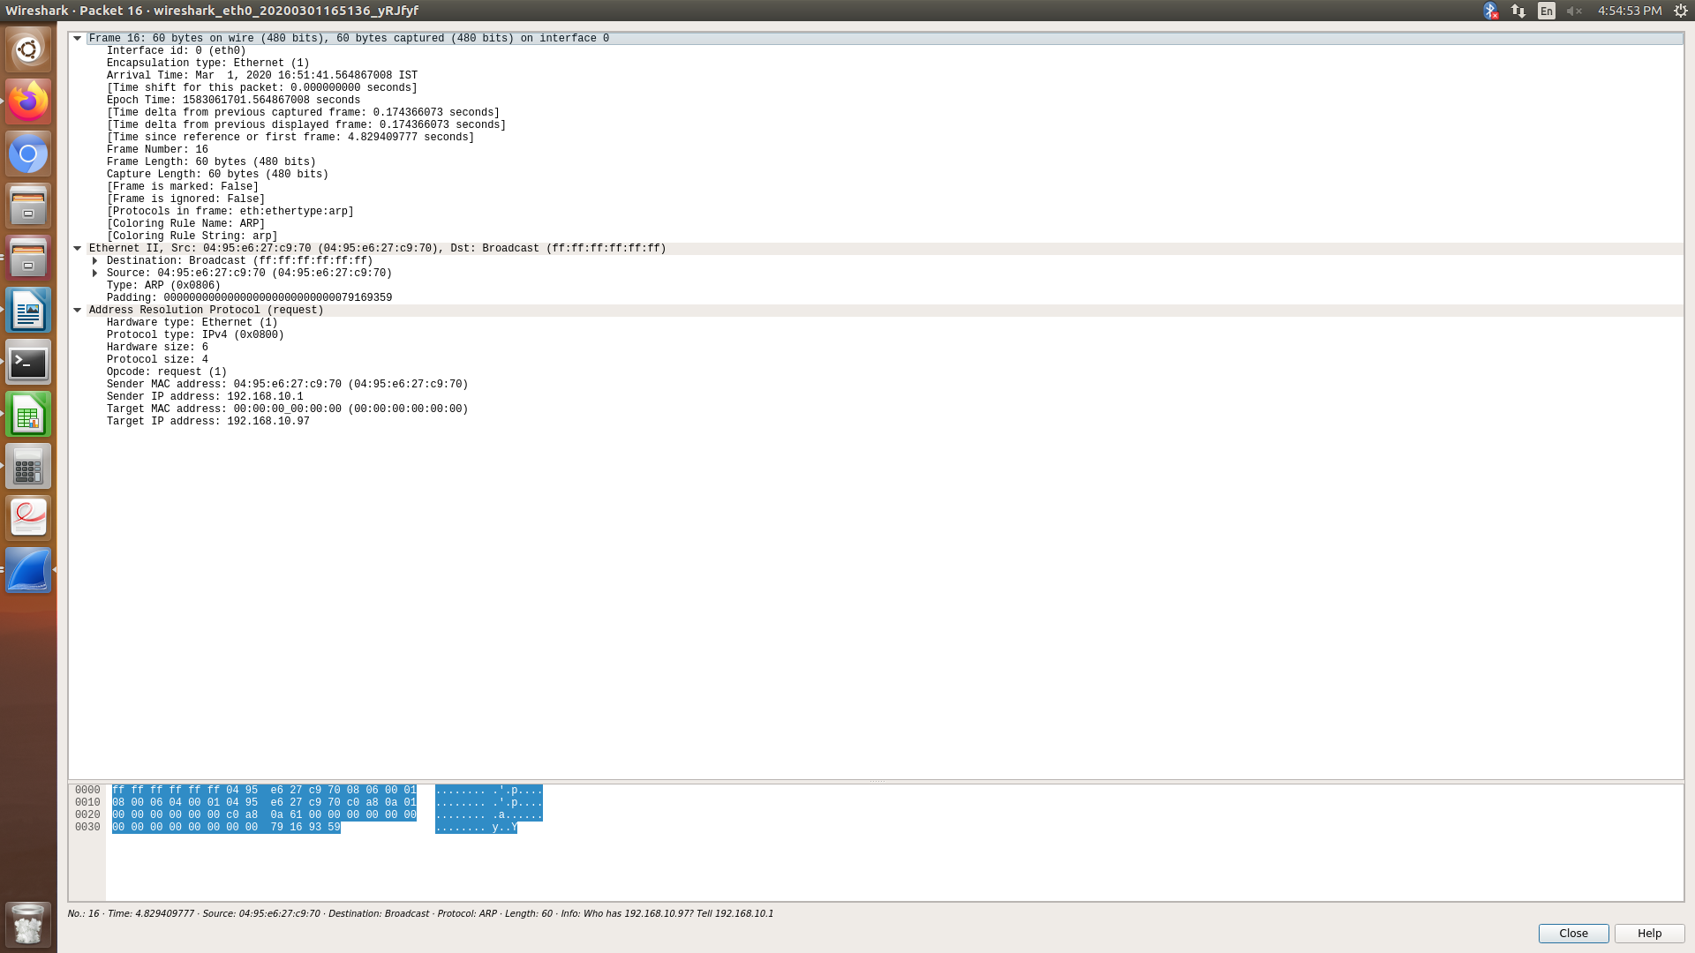
ARP FOR CHECKING UNUSED IP

Slide 7
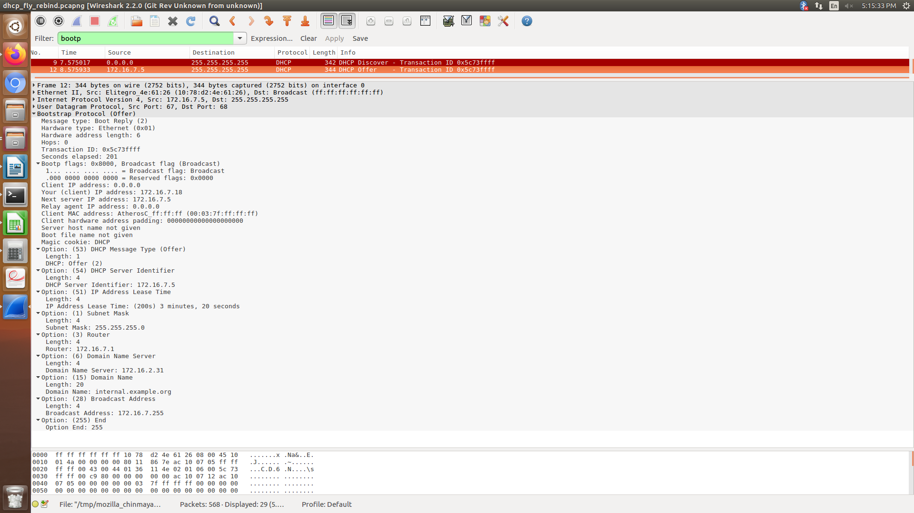
OFFER

Slide 8
DHCP request message
When a client receives a offer message, it responds by broadcasting a DHCP request message.
DHCP acknowledgement message
In response to the request message received, the server will make an entry with specified client ID and bind the IP address offered with lease time. Now, the client will have the IP address provided by server.

Slide 9
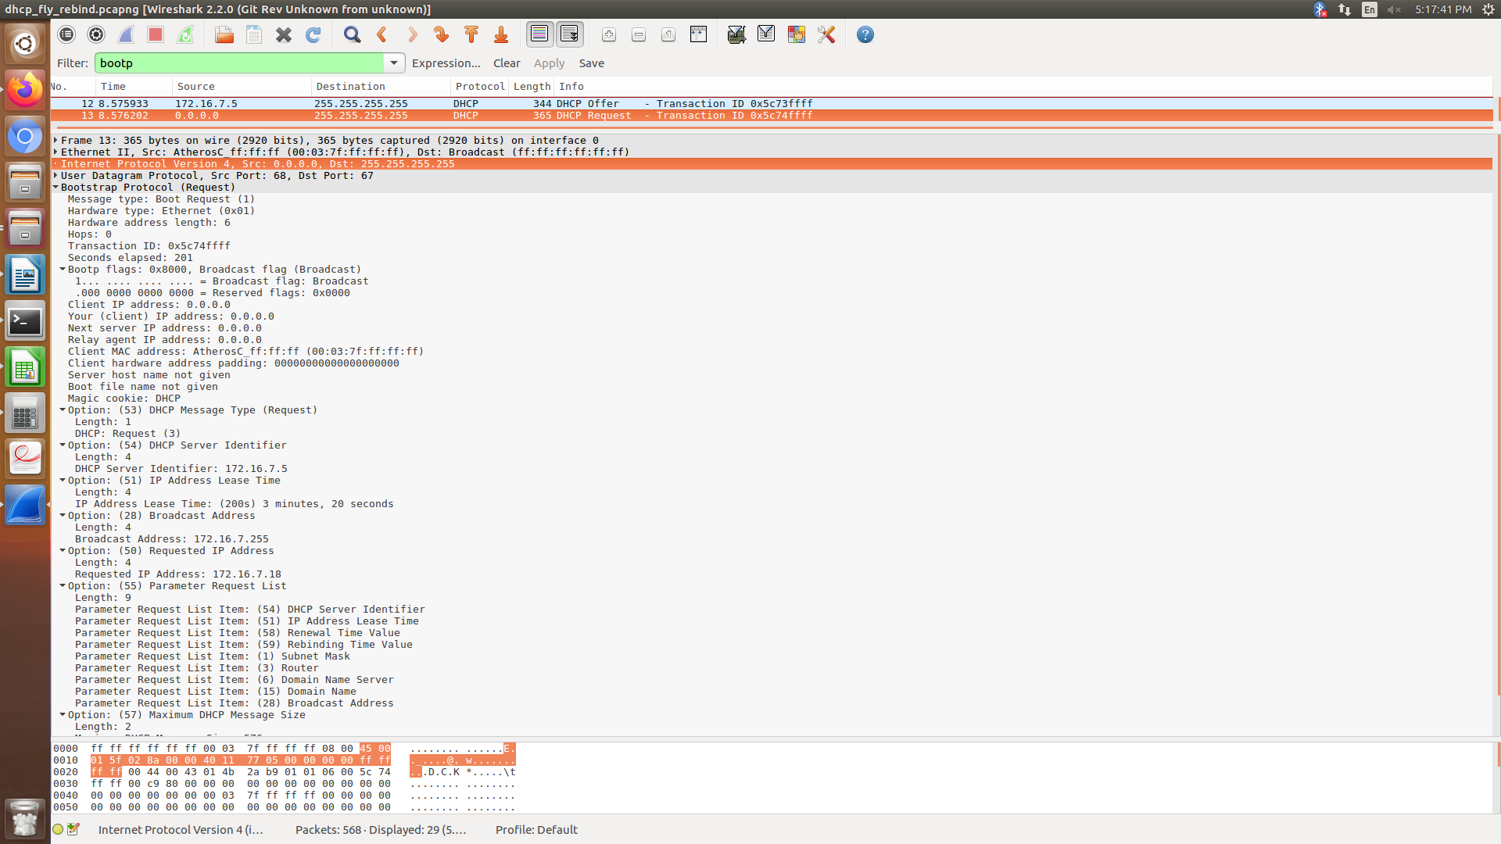
REQUEST

Slide 10
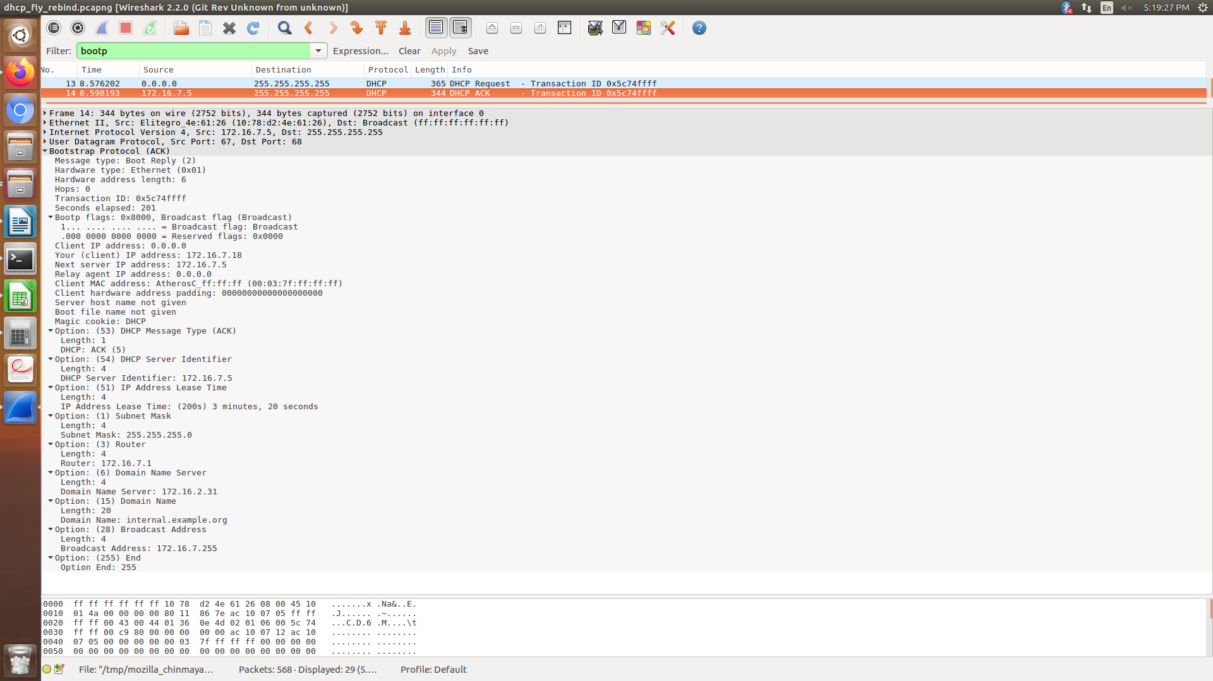
ACK

Slide 11
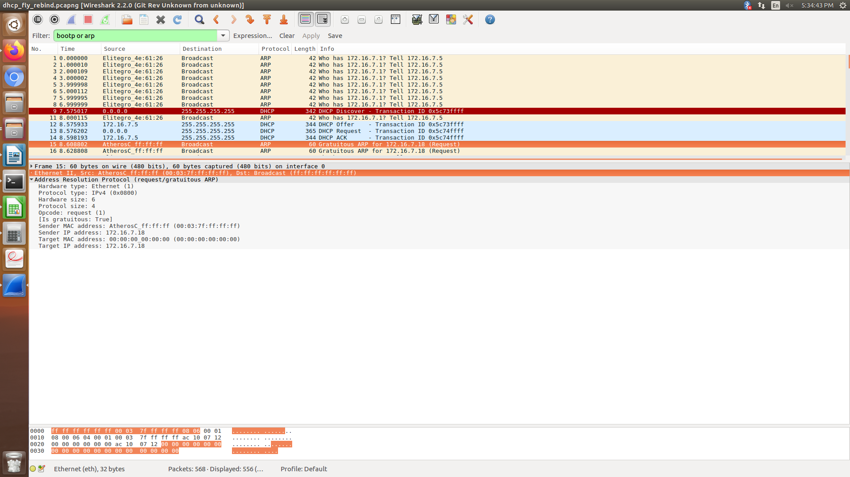
GRATUITOUS ARP

Slide 12
DHCP negative acknowledgement message
Whenever a DHCP server receives a request for IP address that is invalid according to the scopes that is configured with, it send DHCP Nak message to client. Eg-when the server has no IP address unused or the pool is empty, then this message is sent by the server to client.
DHCP decline
If DHCP client determines the offered configuration parameters are different or invalid, it sends DHCP decline message to the server .When there is a reply to the gratuitous ARP by any host to the client, the client sends DHCP decline message to the server showing the offered IP address is already in use.

Slide 13
DHCP release
A DHCP client sends DHCP release packet to server to release IP address and cancel any remaining lease time.
DHCP inform
If a client address has obtained IP address manually then the client uses a DHCP inform to obtain other local configuration parameters, such as domain name. In reply to the dhcp inform message, DHCP server generates DHCP ack message with local configuration suitable for the client without allocating a new IP address. This DHCP ack message is unicast to the client.

Slide 14
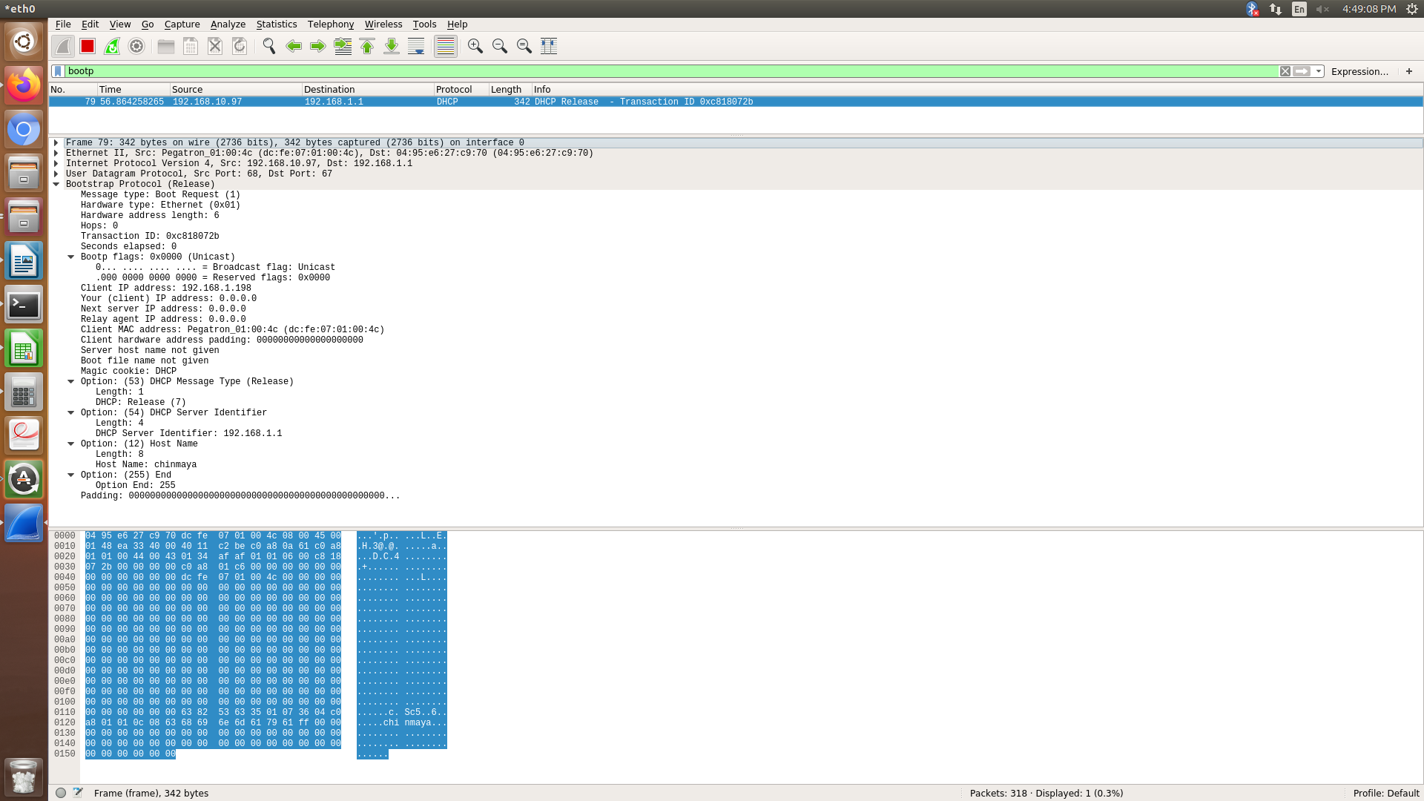
RELEASE

Slide 15
Stage of DHCP
INIT
Renewal
Rebinding
INIT Reboot

Slide 16
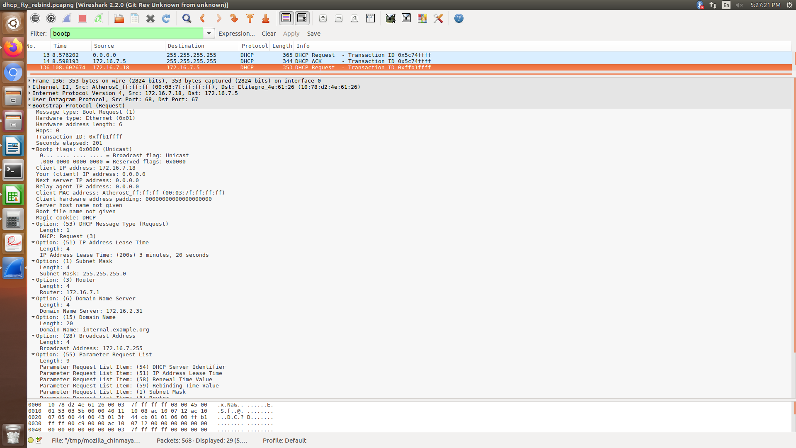
Renewal REQUEST

Slide 17
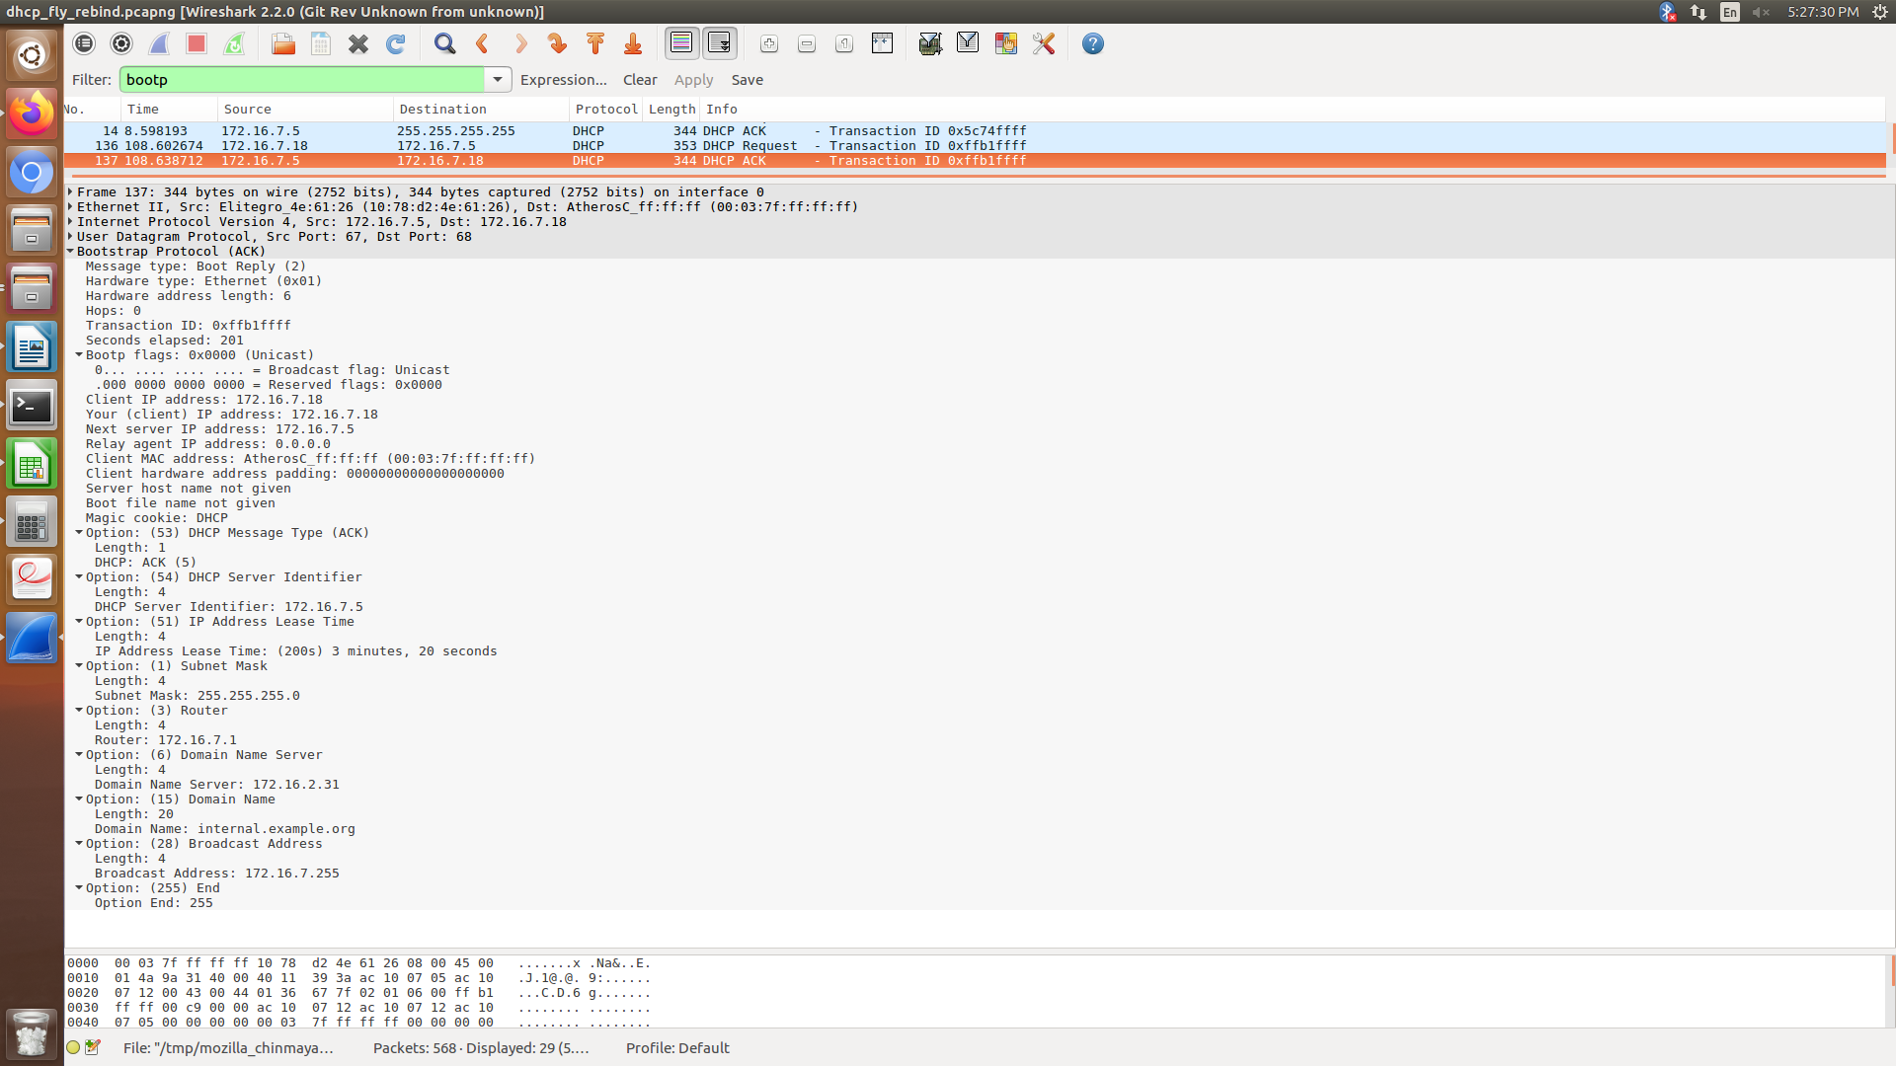
ACK

Slide 18
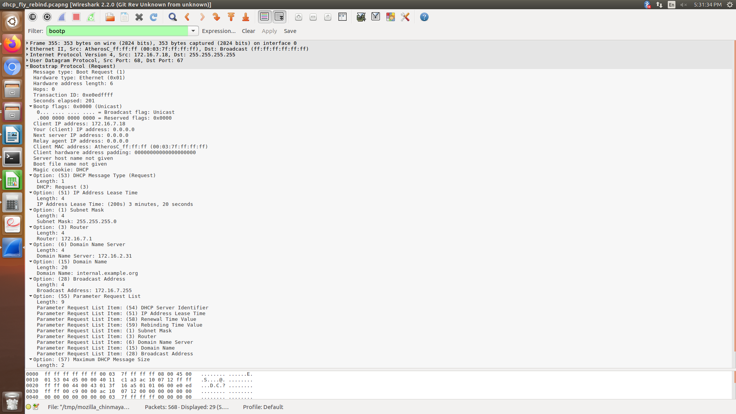
REBIND REQ

Slide 19
DHCP TIMERS
Lease Renewal Timer:
Lease Rebinding Timer:
Lease Expiry Timer:

