Slide 1
Networking
Vignesh Ravichandran

Slide 2
Content
OSI Model
TCP/IP protocol suite
IPv4
NAT
ARP/RARP

Slide 3
OSI MODEL
OSI (Open System Interconnection) : deals with open system i.e system open for communication with other system.
Used for understanding and designing a network architecture
Layered structure

Slide 4

Layers in OSI
        7-LAYER in OSI model

Slide 5
Application layer
Responsible for providing services to the user for accessing the network
Services - electronic mail, file transfer, web browsing, etc,.

Slide 6
Presentation layer
Responsible for translation, compression and encryption.
Translation - translates different data representations from the application layer to uniform standard format
Encryption – sender transform the original information to another form, while recevier decrypt the information to original form
Compression – reduces the number of bits contained in the information

Slide 7
Session layer
Responsible for session management, synchronization and authorization
Session management – establish, maintain and end the communication between two process
Synchronization – allows a process to add checkpoint for bigger files

Slide 8
Transport layer
Responsible for segmentation, error control and flow control
Segmentation – message divided into transmittable segment and each segment has sequence number
Error control – receiver provide acknowledgements of successful transmissions or request for resending of packets which arrive with errors

Slide 9
Network layer
Responsible for deliver the packets from source to destination host
Logical address used for finding the destination in larger network
Network layer device - routers

Slide 10
Data link layer
Responsible for access control, flow control and framing
Access control – responsible to find which packet belongs to which device using physical address
Framing – packet received from network layer, if greater than MTU (maximum transferable unit) then it is divided to manageable frames

Slide 11
Physical layer
Manages the interface between the computer and the network medium (coaxial, twisted pair wires, etc,.)
Converts bits into electrical signals and vise-versa
Defines the direction of transmission and network topology
Also defines the data rate

Slide 12
TCP/IP PROTOCOL SUITE
TCP/IP was developed earlier than the OSI 7-layer mode, it does not have 7 layers but have only 4 layer
Collection of protocols that collectively provides the data transport services used on the Internet
Well known protocol suite in WAN

Slide 13
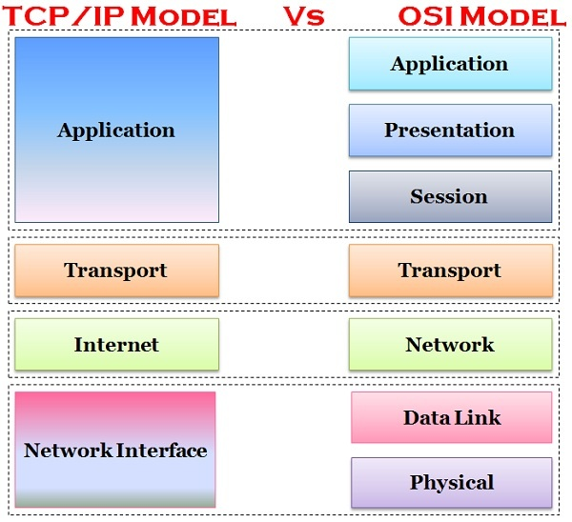
TCP/IP PROTOCOL SUITE

Slide 14
IPv4 addressing
32 bit address
Address space – 2^32
Represented in dotted-decimal notation
Categories :
  Classful addressing
  Classless addressing

Slide 15
Classful addressing
Fixed number of blocks and size
IPv4 address space is divided into 5 classes
  Class A : 0.0.0.0 to 127.255.255.255 (Large organization)
  Class B : 128.0.0.0 to 191.255.255.255 (Medium organization)
  Class C : 192.0.0.0 to 223.255.255.255 (Small organization)
  Class D : 224.0.0.0 to 239.255.255.255 (Multicast)
  Class E : 240.0.0.0 to 255.255.255.255 (Reserved)
Subnetting
Superneting

Slide 16
Classless addressing
To overcome address depletion in classful addressing
Size of block depends on organization need
/n defines the mask

Slide 17
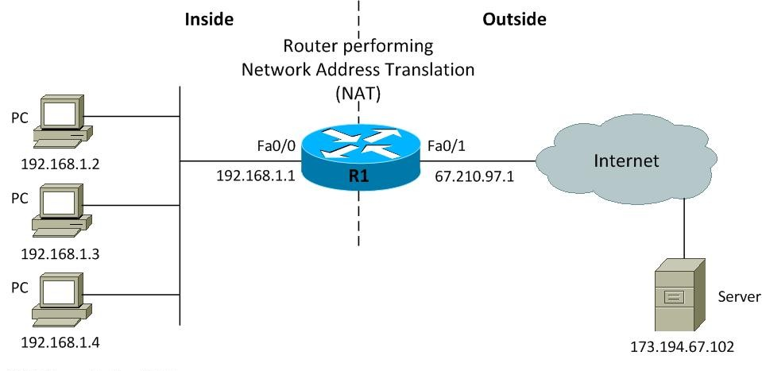
NAT (Network address translation)
Method of connecting multiple host in local area network to external network using one or small set of ip address
Private network is unique inside organization not globally
Address transulation and Transulation table

Slide 18
NAT Contd..
Using one public IP address
      Local area network connected with external network with only one public IP address
      Two or more host in the same local area network can't communicate with same extenal host at same time.
Using pool of IP address
      Pool of public IP address are give to the local area network to overcome drawback of using one public IP address

Slide 19
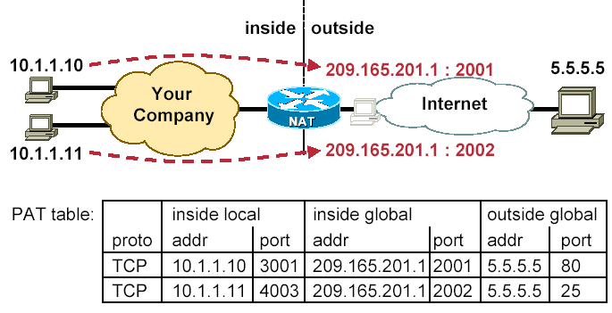
NAT Contd..
Using both IP address and port number
        In router transulation table includes source and destination port number to reduce the confusion

Slide 20
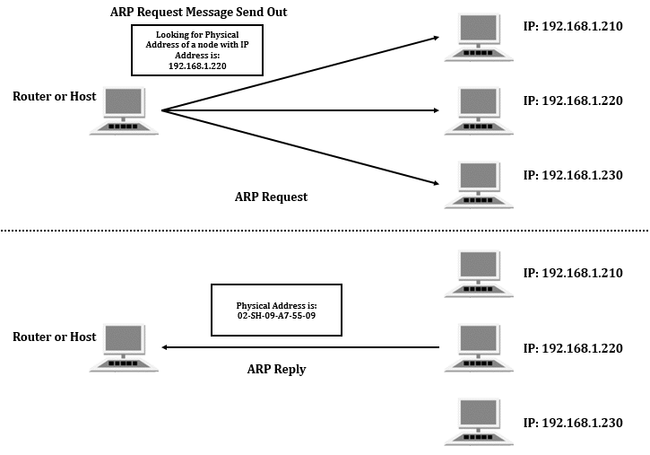
ARP (Address Resolution Protocol)
Mapping between the logical and physical address
ARP query packet will create when the destination physical address is unknown
ARP cache in system

Slide 21
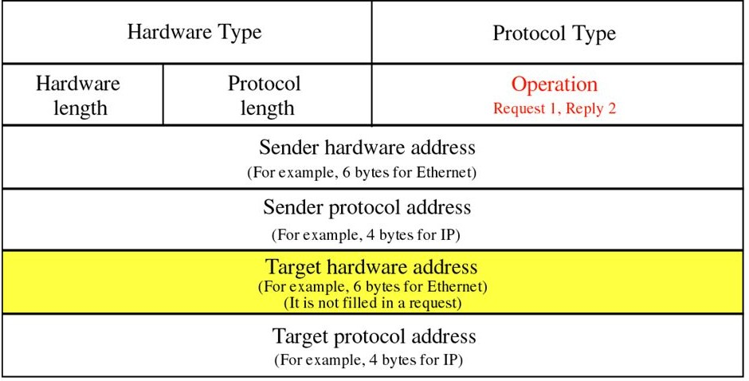
ARP packet format

Slide 22
RARP (Reverse Address Resolution Protocol)
Used when host knows its physical address but doesn't knows logical address
Request packet broadcast to all host in local network
RARP server will reply to requesting machine
If organization have more than one subnet then all subnet have RARP server

Slide 23
Difference between IPv4 and IPv6
IPV4 | IPv6
IPv4 has 32-bit address length | IPv6 has 128-bit address length
Address representation of IPv4 in decimal | Address Representation of IPv6 is in hexadecimal
It Supports Manual and DHCP address configuration | It supports Auto and renumbering address configuration
Fragmentation performed by Sender and forwarding routers | In IPv6 fragmentation performed only by sender
In IPv4 Encryption and Authentication facility not provided | In IPv6 Encryption and Authentication are provided

