Slide 1
POWER MANAGEMENT

Slide 2
Table Of Contents
Introduction
Wireless Radio Activities
Modes of STA
Basic Power Management Structure
When a STA wakes from Doze state
TIM Field
802.11 Power Management
802.11e U-APSD
IBSS Power Management

Slide 3
Introduction – Why Power Management
Battery life is a Major constraint
Factors affect the battery life of 802.11 devices -
    Screen size,
    Brightness,
    Multi-tasking capabilities, and
    Wireless transmitter power etc ..,

Slide 4
Introduction
Wireless Radio Activities
      Asleep
      Idle and awake
      Receiving
      Transmitting
GOAL

Slide 5
Introduction – What is Power Management ?
Power management – Management of Time.
STA modes
  Active :
      STA is always available to transmit and receive data.
  Power Save :
      STA radio is unable to receive frame transmissions.

Slide 6
Basic Power Management Structure
STA AP
1 Sleep
2 Buffer
3 Request
4 send data

Slide 7
Introduction
Association Identifier
When STA wakes from doze state
  STA has a frame to send [simply wakes up and send its frame.]
  Based on some kind of internal timing mechanism.

Slide 8
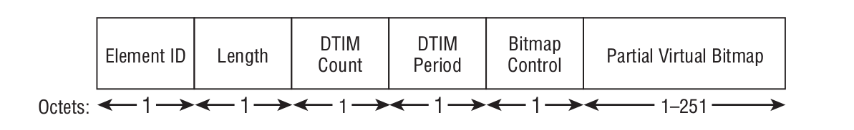
TIM FIELD
Beacon Frames
Purpose - information about buffered frames on the AP.

Slide 9
TIM FIELD
DTIM Count
- Indicates when the beacon will be DTIM beacon.
DTIM Period
- Indicates the number of beacon frames between DTIM beacons.
- Should not be too high or low
Bitmap Control
- Indicate whether broadcast/multicast frames are buffered at the AP.
- Space Saver
Partial Virtual Bitmap
- Each bit in the PVB value corresponds to one of those AID of STA.

Slide 10
DTIM
Purpose - Gives info about broadcast/multi-cast buffered traffic.
Two fields of TIM are affected:
DTIM Count - 0
Bitmap Control 1st bit -> 1 -> multicast/broadcast buffered data
-> 0 -> No multicast/broadcast buffered data

Slide 11
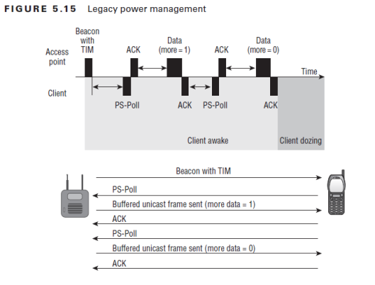
802.11 Power Management

Slide 12
802.11 Power Management
Limitations
    Throughput decreases
    Drain on STA battery life
PS – Poll Frame Recovery
    Neither ACK nor Data is received from the AP in response to a PS-Poll frame
    AP sends a data frame but fails to receive the ACK frame

Slide 13
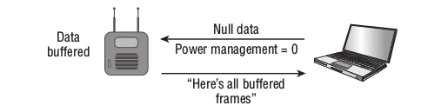
802.11e U-APSD
STA uses a null data frame
Retrieves all buffered data
Less overhead
Less power consumption

Slide 14
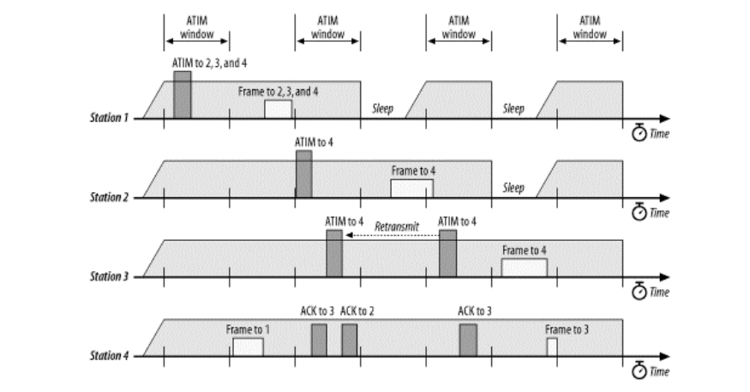
IBSS Power Management
No Central Co-ordinator.
Use ATIM

