Slide 1
STP (Spanning Tree Protocol)

Slide 2
Table Of Contents
Basics of Switching
Why STP
What is STP
Basic terms in STP
How STP works

Slide 3
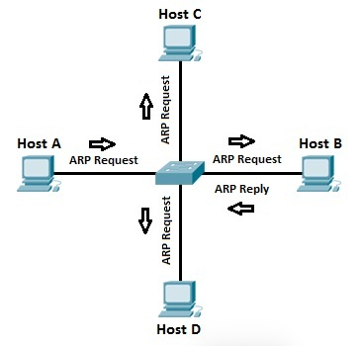
Switching
Switch
  Device which forwards a frame based on the destination MAC address.
Advantages over Hubs
  Reduces traffic on a LAN
  Enhances security.
How a Switch works
  Initially MAC addresses are not known
  Uses ARP process to find the MAC address
  Switch stores MAC and interface port

Slide 4
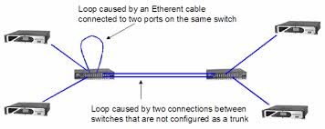
Why STP
Switching Loop
  More than one path between two endpoints.
What a Switching loop causes
    Broadcast storms
    Unstable MAC table
Why STP
    Fault Tolerance
    Redundancy

Slide 5
What is STP
STP
Network protocol that builds a loop-free logical topology for Ethernet networks.
Functionality
Provide fault tolerance
To prevent bridge loops

Slide 6
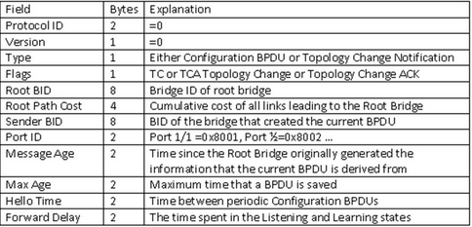
Basic Terms
BPDU (Bridge Protocol Data Unit)
Frame used to share information about switch and its interface connections.
Switches use BPDU to learn :
-> the network topology
-> other switches connections and
-> any existing loops.
Root Bridge
Switch with the lowest switch ID is selected as Root Bridge.
Switch ID = Priority + MAC Addr

Slide 7
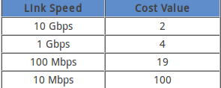
Basic Terms
Port Costs
→ Each port is assigned with a cost.
→ Port cost is used to choose the best path when multiple links are available between two switches (Selecting Root Port).
Path Cost
Accumulated value of port costs from Root Bridge to other switches .
→ For Root Switch path cost = 0
→ Root Bridge advertises BPDU out from its interface setting path cost -> 0.
→ Connected switch on receiving BPDU,
path cost = path cost of Root bridge + incoming port cost

Slide 8
Basic Terms
Root Port
Port that has the shortest path(low cost) to the Root Bridge.
Purpose : To reach the Root Switch.
Designated port (Forwarding Port)
Used to forward the frames.
Non-designated port (Blocking Port)
Remains disable to remove loops.

Slide 9
How STP works
Election of Root Bridge.
Selecting a root port.
Select designated port if multiple connections b/w switches.
Block port that is not either a root or designated port.

Slide 10
How STP Works
Electing a Root Bridge
→ Elected based on its Switch ID
Switch ID = Priority (16 bit) + MAC Addr (48 bit)
→ Switch with lowest priority wins.
→ If (priority is same) :
Switch with lowest MAC address will be the root.

Slide 11
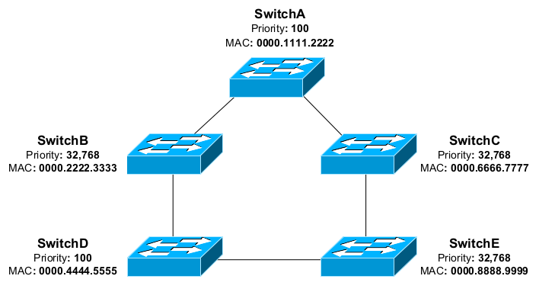
How STP Works

Slide 12
How STP Works

Slide 13
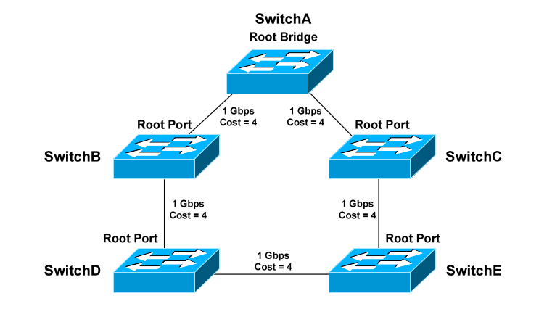
How STP Works
Identifying Root Ports :
Purpose - to point to the Root Bridge.
→ The root port of each switch
has the lowest root path cost
to get to the Root Bridge.
Scenarios :
Multiple Paths, different cost
Multiple Paths, same cost
Different neighbour
Same neighbour
Different port Priority
Same port priority

Slide 14
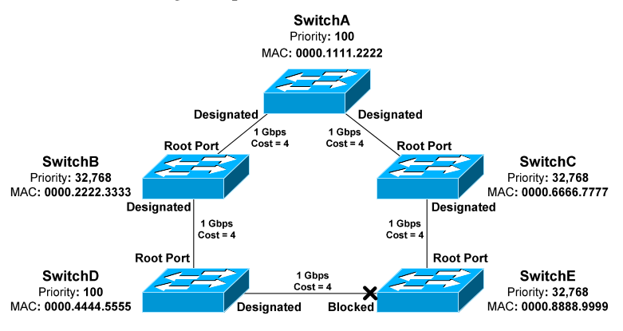
How STP Works
Identifying Designated Ports :
Purpose - responsible for forwarding BPDUs and frames.

Slide 15
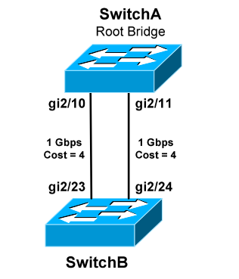
How STP Works
Port Id :
Purpose - used as the final tiebreaker in electing root & designated port.
Port Id = Port Priority (4 bit) + Port Number (12 bit)

Slide 16
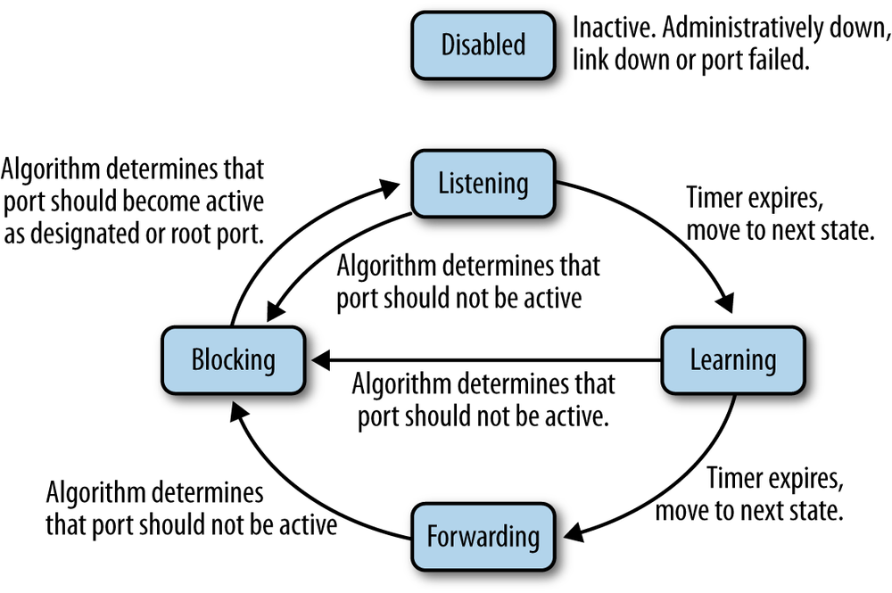
How STP Works
STP Port States :

Slide 17
How STP Works
STP Timers :
Hello timer (2 sec):
Determines how often switches send BPDUs.
Forward Delay Timer (15 sec):
Determines how long a port must spend in both a listening & learning state before entering to learning and forwarding state.
Max Age Timer (20 sec):
Indicates how long a switch to hold on to BPDU info of neighbor switch before discarding.

Slide 18
How STP Works
STP Topology Changes
When a Topology Changes
If (topology change occurs) :
Switch will send a TCN BPDU out its root port, destined for the Root Bridge. Indicating that a change occur.
Recovery From Topology Changes
The bridge notifies the root bridge of the spanning tree TC.
The root bridge "broadcasts" the information into the whole network.

Slide 19
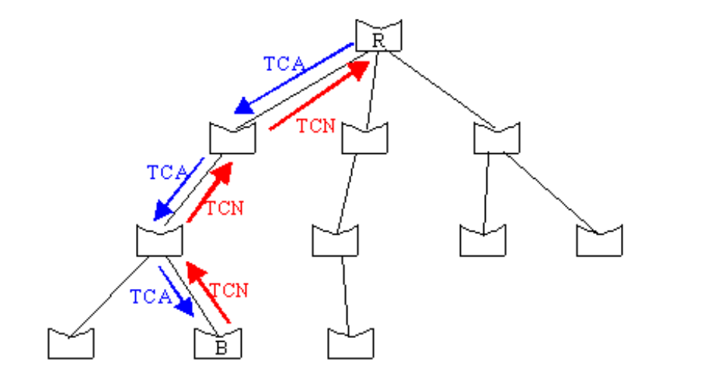
How STP Works
Notify the Root Bridge :
If (topology change occurs) :
→ Bridge starts to send TCNs on
its root port.
If (designated bridge receives the TCN) :
→ Acknowledges TCN with TCA
→ Generates TCN for its root port.

Slide 20
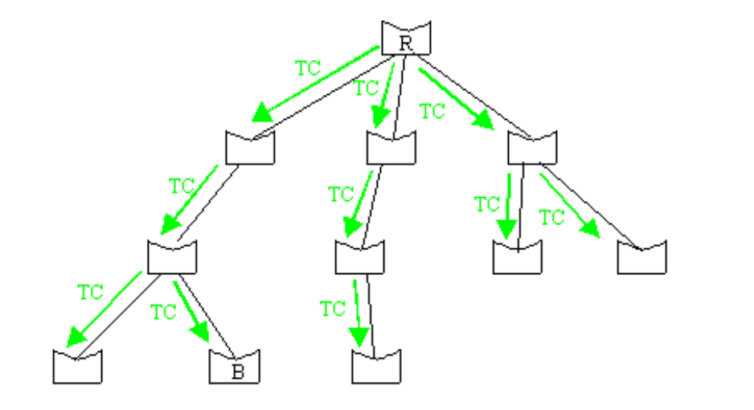
How STP Works
Broadcast the Event to the Network :
If (Root Bridge receives TCN) :
→ Acknowledges TCN with TCA.
→ Send configuration BPDUs with the
topology change (TC) bit set.
If (Bridge receives BPDU with TC bit set) :
→ Relay [forward] BPDU with TC bit set.
→ Reduce aging time ->frwd_delay time.

Slide 21
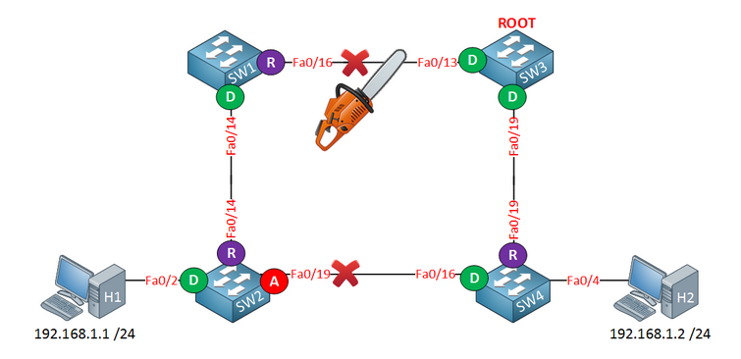
Why STP
Why reducing aging time to forward_delay time
Assume SW1 <--x--> SW3 fails.
H1 & H2 won't communicate till fa0/19 interface of SW2 goes into forwarding.
SW2 to move the fa0/19 from blocking -> forwarding [takes 50 sec].
SW2 still has the MAC addr of H2 and forwards to SW1
Impossible to communicate for a min of 300 sec.

Slide 22
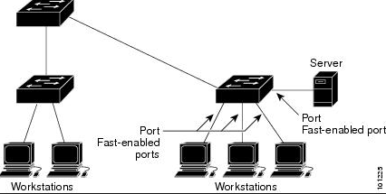
How STP Works
Improving STP Convergence
Why to improve convergence ?
→ A host will be without network connectivity for a min of 30 sec when first powered on.
30 sec -> two forward delay times after listening & learning.
Port Fast :
Bypassing the port from blocking -> forwarding state.
Benifits - Eliminating 30 second delay.
Eliminates unnecessary BPDU traffic and frame flooding.
Constraints- PortFast should only be enabled on ports connected to a host.
Otherwise results in a broadcast storm.

Slide 23
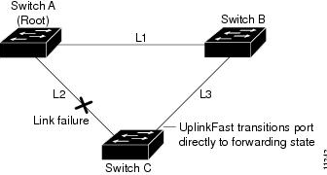
How STP Works
Uplink Fast
  Useful when there is an direct link failure.
  Enabled only for switches with redundant blocked ports.
  Backup link is brought from blocking state to forwarding state,

Slide 24
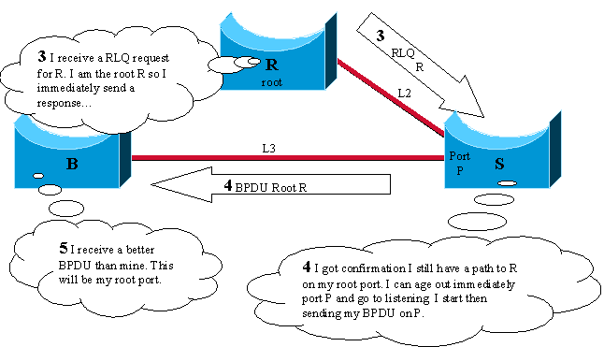
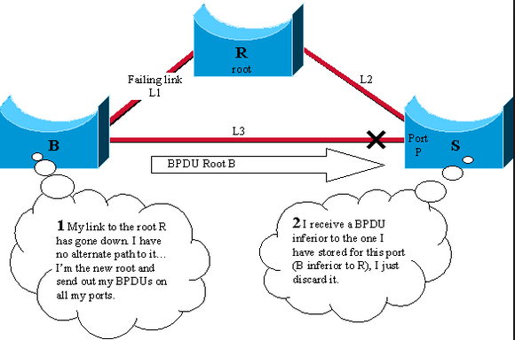
How STP Works
Backbone Fast
  Useful when there is an Indirect link failure.
  Allows a switch to bypass the max age timer.

