Slide 1
WLAN BASICS – Part-II
Lalith Raj P

Slide 2
Cover
Basic Terminology
2.4GHz, 5GHz bands
History IEEE 802.11a/b/g/n/ac

Slide 3
Basic Terminology
Frequency(or radio frequency)
The rate of radio signal to send and receive communication signal
Measured in hertz (hz), cycles per second.
Common frequencies that are used for wifi communication are 2.4 Ghz (giga hertz per second) and 5 Ghz.

Slide 4
Basic Terminology
Bandwidth
The upper and lower limit of the frequency used for transmitting or receiving information.
It's also measured in hertz.
Example: wireless network operate on 2.4 Ghz with 20Mhz bandwidth.
Bigger bandwidth --> higher transfer rate, because more data can be transmitted on one unit of time.

Slide 5
Basic Terminology
Range
The measurement of how far can the data/signal transmitted and received.
In radio communication this can be from couple of meters to tens/hundreds of kilometers.
How far the radio communication can reach is subjective to environment condition and also frequency.

Slide 6
Basic Terminology
High frequency -> low range -> high bandwidth.
Low frequency -> high range -> low bandwidth.

Slide 7
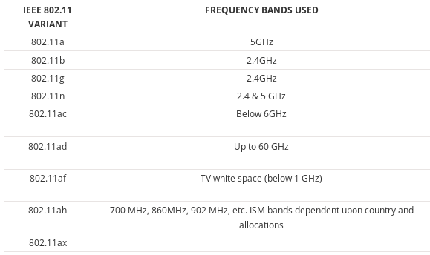
802.11 systems & frequency bands
A summary of the bands used by the 802.11 systems

Slide 8
2.4 GHz
2.4 GHz channels
Total of fourteen channels defined for use by Wi-Fi 802.11 for the 2.4 GHz ISM band.
WLAN / Wi-Fi channels are spaced 5 MHz apart
802.11 Wi-Fi standards specify a bandwidth of 22 MHz and channels are on a 5 MHz incremental step.

Slide 9
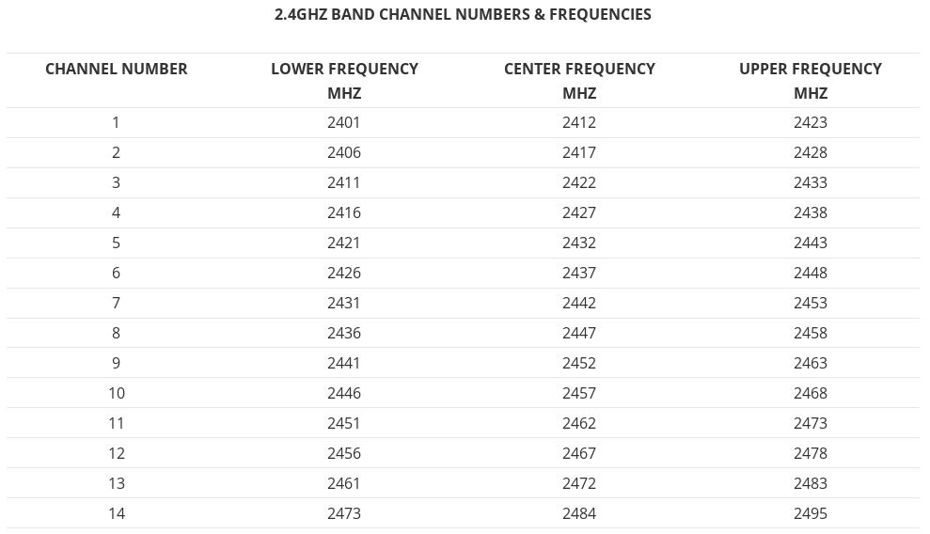
2.4 GHz
2.4 GHz Wi-Fi channel frequencies

Slide 10
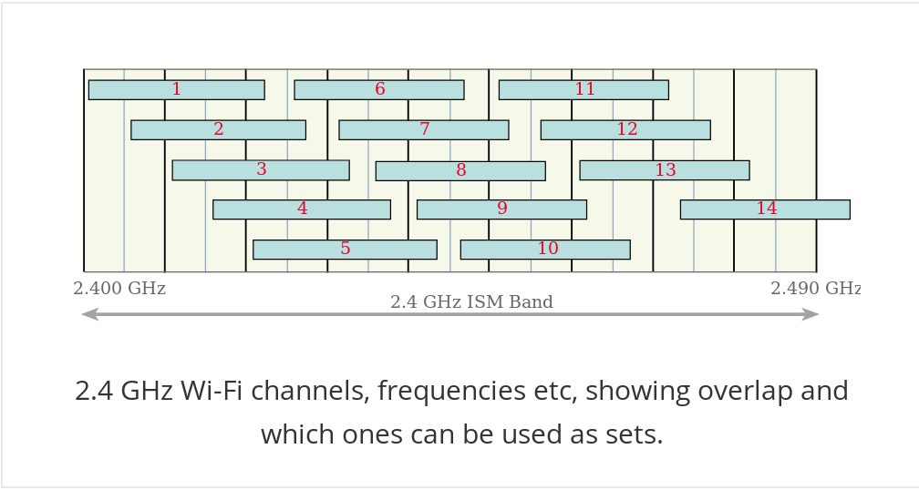
2.4 GHz
2.4 GHz WiFi channel overlap and selection
Channels overlap and it is possible to find a maximum of three non-overlapping channels.
There are five combinations of available non overlapping channels

Slide 11
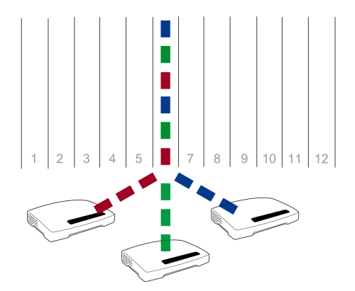
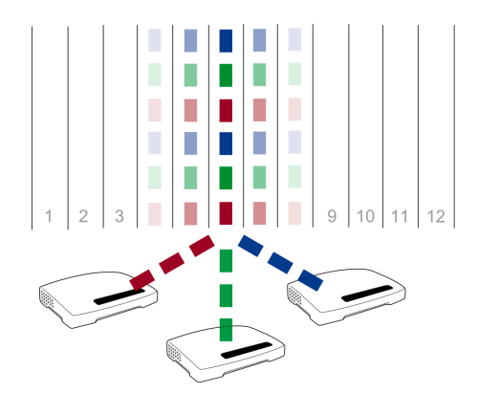
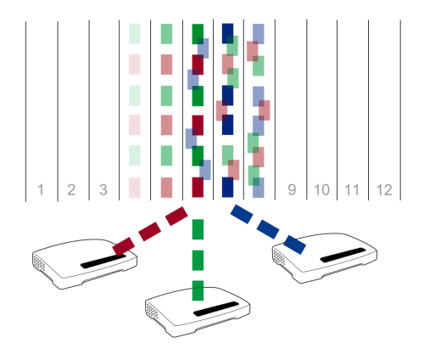
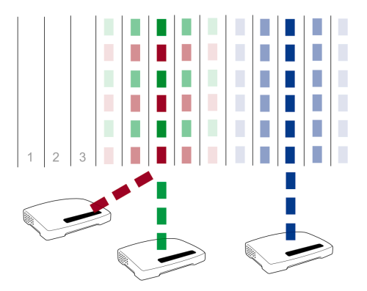
2.4 GHz
Three routers are all using channel 6.
The data isn't interfering
However the channel is a little contended

Slide 12
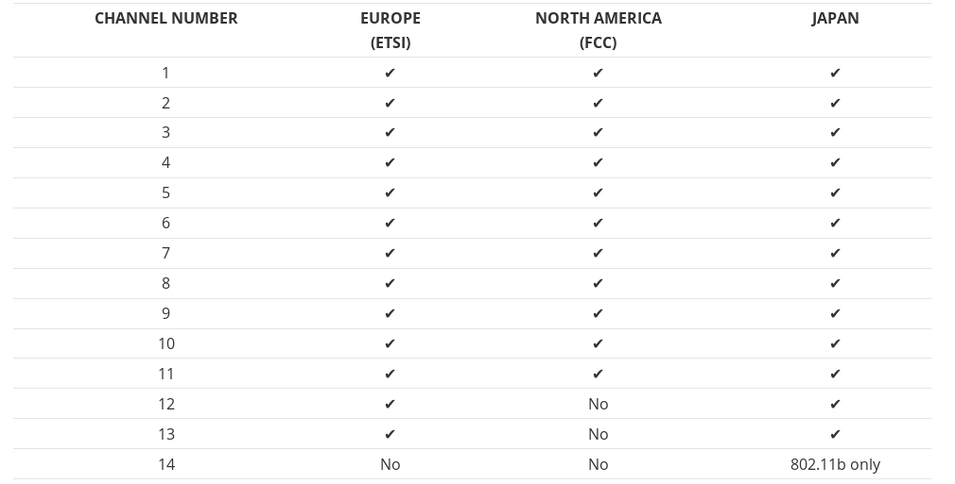
2.4 GHz
2.4 GHz Wi-Fi channel availability

Slide 13
5 GHz
5 GHz Wi-Fi channels fall outside the accepted ISM unlicensed band
As a result various restrictions are placed on operation at these frequencies.

Slide 14
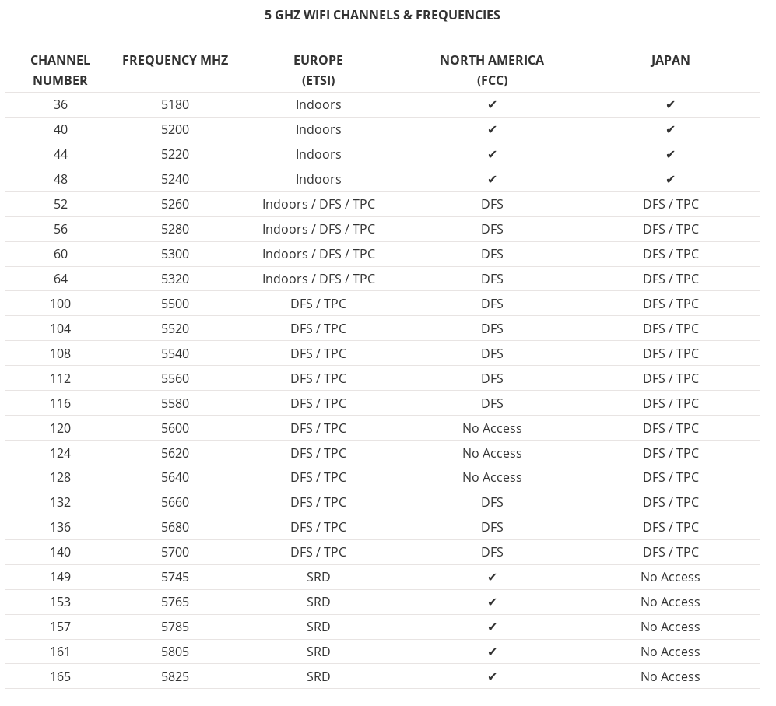
5 GHz
DFS = Dynamic Frequency Selection
TPC = Transmit Power Control
SRD = Short Range Devices 25 mW max power

