Slide 1
WLAN BASICS

Slide 2
Contents:
OSI Model
802.11 Overview

Slide 3
Why OSI Model ?
OSI Model was to show how to facilitate communication between the different systems without require changes the logic of underlying hardware and software.

Slide 4
What is OSI Model ?
OSI means open system interconnection model.
It is layered model introduced in 1970 by ISO(international standards organization)
An open system is a set of protocols that allows any two different systems to communicate regard less of their underlying architecture.
It is a model for understanding and designing a network architecture that is flexible,robust,interoperable.

Slide 5
Different Layers in OSI Model
Application Layer.
Presentation Layer.
Session Layer.
Transport Layer.
Network Layer.
Datalink Layer.
Physical Layer.

Slide 6
Sub Groups Of Layers
Network support layers:
    Physical layer, data link layer and network layer are deal with the physical aspects of moving data from one device to other.
User support layers :
    Session, presentation and application layers are used for intercommunication among unrelated software systems.
Transport layer connect these subgroups and ensure the data transmission.

Slide 7
Application Layer
Functions Of Application Layer :
    User interface and services
    Mail services -SMTP
    File transfer and access management-FTP
    Network virtual terminal -Telenet.

Slide 8
Presentation Layer
Functions Of Presentation Layer :
    Character code Translation
    Compression
    Encryption and Decryption

Slide 9
Session Layer
Functions Of Session Layer :
    Dialog control
    Synchronization

Slide 10
Transport Layer
Functions Of Transport Layer :
    Service Point Addressing
    Segmentation and Reassembly
    Decision of connection
          Reliable connection(TCP)
          Unreliable connection(UDP)
    Error control
    Flow control

Slide 11
Network Layer
Functions Of Network Layer :
    Source to destination delivery of packet for that it requires
        Logical addressing
        Routing

Slide 12
Datalink Layer
Functions Of Datalink Layer :
    Framing
    Physical addressing
    Flow control
    Error control
    Access control

Slide 13
Physical Layer
Functions Of Physical Layer :
    Physical characteristics of interfaces and media
    Representation of bits
    Data rate
    Synchronization of bits
    Line configuration
    Physical topology

Slide 14
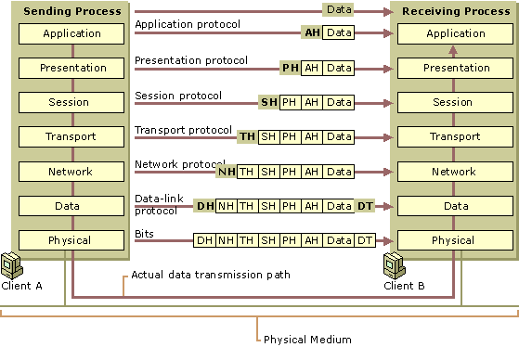
OSI Model

Slide 15
Components Of IEEE 802.11 architecture
Components :
The IEEE 802.11 architecture consist of several components that interact to provide a WLAN that support station mobility transparently to upper layers.
Station(STA)
Access Point (AP)
Basic Service Set (BSS)
Distribution System(DS)
Extended Service Set(ESS)
Independent Basic Service Set(IBSS)

Slide 16
Cont ...
Station(STA) :
Any device that contains 802.11-compliant MAC and PHY interface to the wireless medium (WM).

Slide 17
Cont ...
Access Point (AP):
Any entity that has STA functionality and provides access to the distribution services, via the wireless medium for associated STAs.

Slide 18
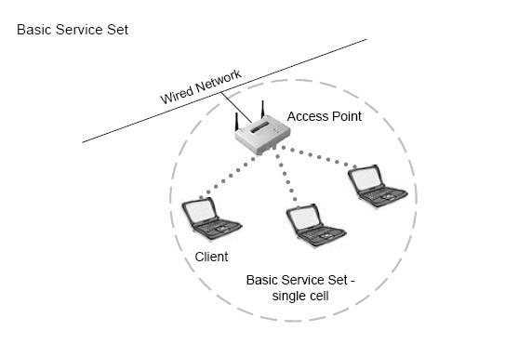
Cont ...
Basic Service Set(BSS) :
Basic service set (BSS) is the basic building block of an IEEE 802.11 WLAN.

Slide 19
Cont ...
Distribution System :
A system used to interconnect a set of basic service sets an integrated local area networks (LANs) to create an extended service set (ESS).
The architectural component used to interconnect infrastructure BSSs is the DS.

Slide 20
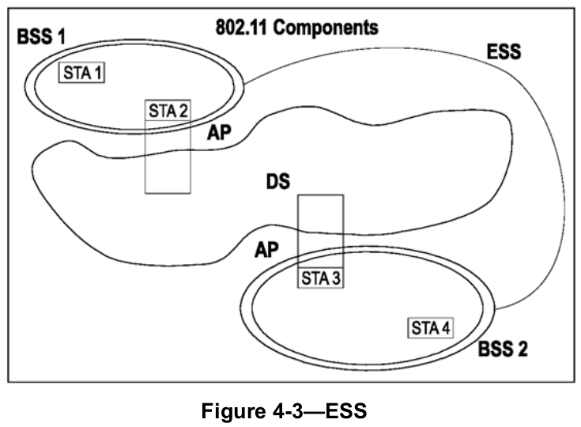
Cont ...
Extended service set (ESS):

Slide 21
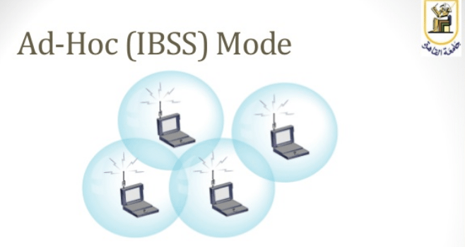
Cont ...
Independent Basic Service Set(IBSS) :
An IBSS consists solely of client stations that use peer-to-peer communications. An IBSS is a self-contained network that does not use an access point and has no access to a distribution system.

Slide 22
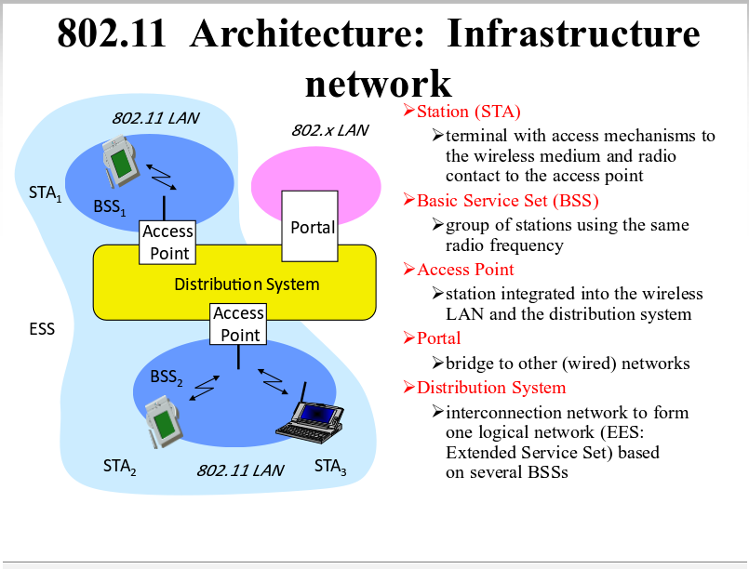
Cont...

Slide 23
Basic Terminology
Wave length :
Wave length is the distance travelled in one oscillation,or cycle of the signal.
Amplitude :
Amplitude is the height,force or power of the signal.

Slide 24
Cont ...
Frequency :
Frequency is the number of times per second that the signal oscillates.
Measured in Hertz(Hz),cycles per second.
Common frequencies that are used for wireless communications are 2.4 GHz and 5 GHz.

Slide 25
Cont ...
Bandwidth
Bandwidth is the difference between the upper and lower frequencies in a continuous set of frequencies.
It's also measured in hertz.
Example: wireless network operate on 2.4 GHz with 20MHz bandwidth.
Bigger bandwidth --> higher transfer rate, because more data can be transmitted on one unit of time.

Slide 26
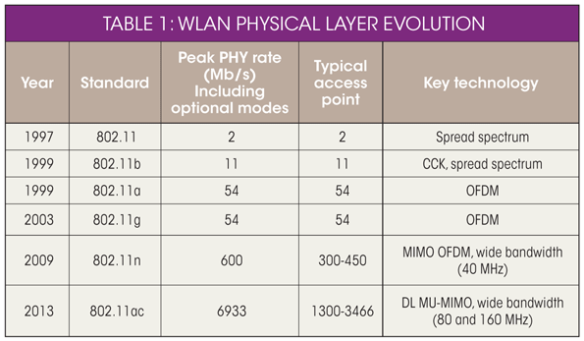
802.11 Amendments

Slide 27
Wifi Alliance
The Wi-Fi Alliance is a global, nonprofit industry association of more than 300 member companies devoted to promoting the growth of WLANs.
Provide a highly effective collaboration forum.
The Wi-Fi Alliance’s main task is to ensure the interoperability of WLAN products by providing certification testing.
To see certifications of the wireless devices go to www.wifi-org

Slide 28

QUERIES PLEASE

Slide 29


