Slide 1
Dynamic Host Configuration Protocol v4
G. Naresh

Slide 2
CONTENTS
Limitations of BOOTP
What is DHCP
Format of DHCP message
Timeline Diagram
State – Transition Diagram
DHCP Configuration
References

Slide 3
Limitations of BOOTP
BOOTP works well only in relatively static environment
  Computers remain at fixed locations.
  BOOTP configuration file is manually created to specify BOOTP parameters for each hosts, It cannot be changed quickly (static assignment) .
There must be enough IP addresses to be assigned to each computer.

Slide 4
DHCP
The Dynamic Host Configuration Protocol is an Application layer protocol used by hosts for obtaining network setup information as:
  Leased IP Address
  Subnet Mask
  Default Gateway Address
  Host name
DHCP extends BOOTP in two ways:
  Delivering host-specific configuration parameters from a DHCP server to a host.
  Allocation of network addresses to hosts.

Slide 5
Cont...
DHCP participants can interoperate with BOOTP participants.
DHCP is built on a client-server model.
DHCP uses UDP as its transport protocol.
DHCP supports three mechanisms for IP address allocation:
  Automatic allocation - DHCP assigns permanent IP address to a client
  Dynamic allocation - DHCP assigns an IP address to a client for a limited period of time
  Manual allocation - a client's IP address is assigned by the network administrator

Slide 6
DHCP Leases
The Period over which a network address (IP address) is allocated to client is referred to as a Lease.
DHCP issue a lease for a dynamic IP address that expires at the end of lease time.
After 0.5 the lease time, client can renew the lease time.
After 0.875 the lease time, client can rebind the lease time.
Once lease has expired the client must either stop using the IP address or acquire a new IP address.

Slide 7
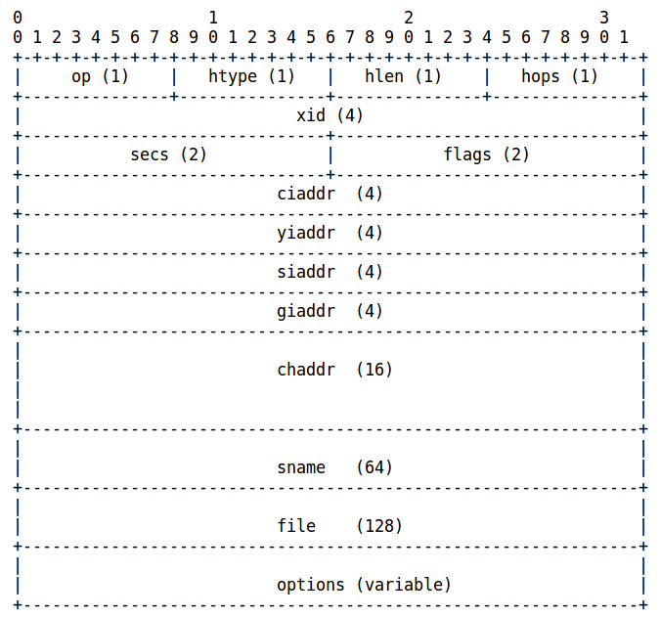
Format of DHCP message

Slide 8
DHCP Options field
DHCP Message Type - To convey the which type of the DHCP message.
  The code for this option is 53, and its length is 1. Legal values 1-9
Requested IP Address - To allow the client to request that a particular IP address be assigned.
  The code for this option is 50, and its length is 4.
Host Name - the name of the client.
  The code for this option is 12, and its minimum length is 1.
Parameter Request List - used by a DHCP client to request values for specified configuration parameters.
  The code for this option is 55. Its minimum length is 1.
Broadcast address - broadcast address in use on the client's subnet.
  The code for this option is 28, and its length is 4.

Slide 9
Cont...
Interface MTU - The MTU to use on this interface. The MTU is specified as a 16-bit unsigned integer.
  The code for this option is 26, and its length is 2.
Server Identifier - Used in DHCPOFFER and DHCPREQUEST messages.
  The code for this option is 54, and its length is 4.
IP Address Lease Time - Used in a client request to allow the client to request a lease time for the IP address.
  The code for this option is 51, and its length is 4.
Renewal (T1) Time Value -
  Time interval from address assignment until the client transitions to the RENEWING state.
  The code for this option is 58, and its length is 4.

Slide 10
Cont...
Rebinding (T2) Time Value -
  Time interval from address assignment until the client transitions to the REBINDING state.
  The code for this option is 59, and its length is 4.
Domain name - the domain name that client should use when resolving hostnames via the Domain Name System.
  The code for this option is 15. Its minimum length is 1.
End Option -
  marks the end of valid information in the vendor field. Subsequent octets should be filled with pad options.
  The code for the end option is 255, and its length is 1 octet.

Slide 11
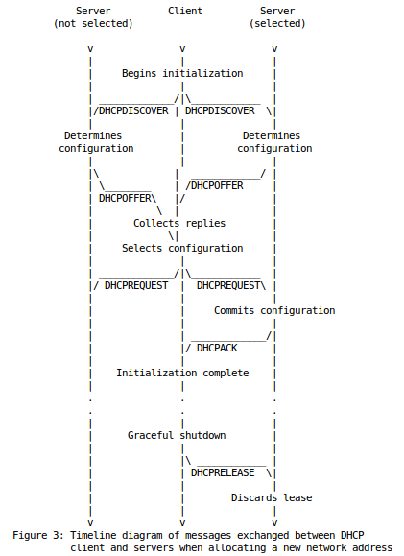
Timeline Diagram
Client-server interaction - allocating a network address

Slide 12
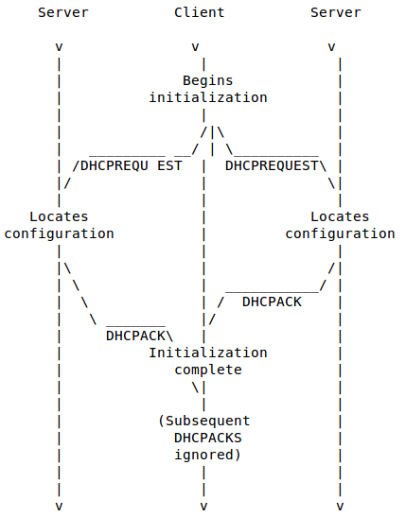
Cont...
Client-server interaction - reusing a previously allocated network address

Slide 13
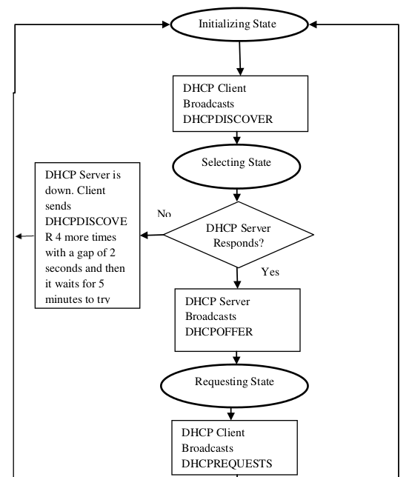
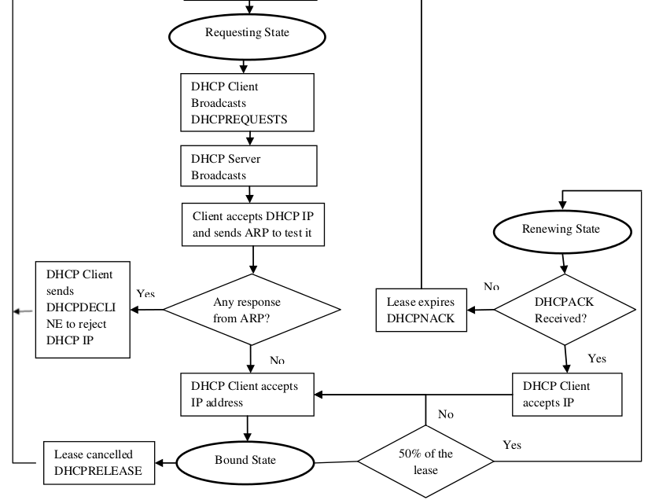
State – Transition Diagram

Slide 14
Install and Configure DHCP server
sudo apt-get install isc-dhcp-server
The default configuration file of DHCP server is /etc/default/isc-dhcp-server
  DHCP_CONF = /etc/dhcp/dhcpd.conf
  DHCP_PID = /var/run/dhcpd.pid
  INTREFACES = “eth0 ”
Path to dhcpd's config – file: /etc/dhcp/dhcpd.conf
  To make this server as official DHCP for your clients authoritative
Sudo service isc-dhcp-server restart
Sudo netstat -uap (for checking)
sudo dhclient -r eth0 (Interface)
  the -r option to release the current interface configuration
sudo dhclient eth0 (Interface)

Slide 15
References
Croft, B., and J. Gilmore, "Bootstrap Protocol (BOOTP)", RFC 951, Stanford and SUN Microsystems, September 1985.
Droms, R., "Dynamic Host Configuration Protocol", RFC 2131, Bucknell University, March 1997.
Alexander, S., and R. Droms, "DHCP Options and BOOTP Vendor Extensions", RFC 1533, Lachman Technology, Inc., Bucknell University, October 1993.

