Slide 1
Exploring football data using Clojure and friends
@markhneedham

Slide 2
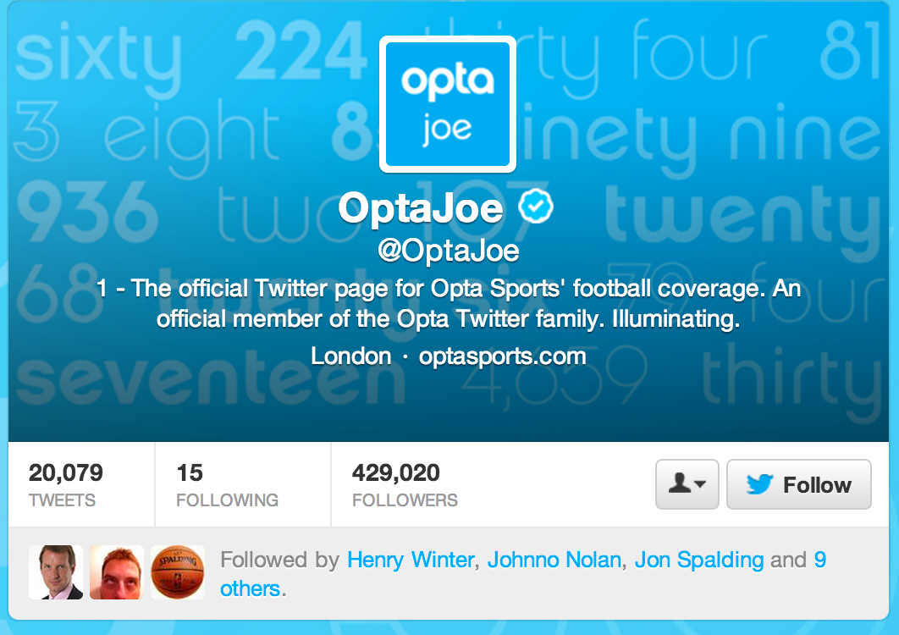
It all started with Joe

Slide 3

I can haz data?
I asked nicely!

Slide 4

No
☹

Slide 5

The Data Science Motto
Notes:
The Data Science Motto

Slide 6

Before we start scraping
Notes:
It’s easy to get carried away when you get into scraping mode so from my foolishness I’ve come up with a few observations to save you time

Slide 7


Don’t build a crawler
Notes:
Investigate URI structure for a bit – avoid writing a crawler if you can – it is paiiiiin

Slide 8

Download files to disk
Notes:
Don’t scrape live – download it to disk -> you will forget to get something and it’s painful having to go over the network next time

Slide 9
$ cat uris.txt
http://www.google.co.uk?q=mark
http://www.google.co.uk?q=mark2
http://www.google.co.uk?q=mark3
http://www.google.co.uk?q=mark4
http://www.google.co.uk?q=mark5
$ cat uris.txt |
xargs -P5 -Iuri wget uri
wget is your friend
Notes:
Use wget – it’s awesome – get a list of files and give it to wget & xargs

Slide 10
Find
Download
Extract
My Data work flow
Notes:
I try to use this work flow for data work – separate the steps, don’t mash them together. Then you can do them in different languages

Slide 11
By hand
wget
Clojure
My Data work flow
Notes:
I try to use this work flow for data work – separate the steps, don’t mash them together. Then you can do them in different languagse

Slide 12

Clojure + Enlive + emacs + nrepl = #win

Slide 13
Clojure => A JVM based LISP dialect
Enlive => A selector based templating library
nrepl => A Clojure REPL
Emacs => A text editor with nrepl integration
What are they?

Slide 14
Show the enlive syntax here
What are they?

Slide 15
Example of me hacking around with the UEFA page
An example

Slide 16
What is clojure good for here?
Nrepl + enlive really useful for exploring sources of data

Slide 17
Premier League Matches
Stadiums
Players
Champions League Matches
TV Games
All the data
Notes:
I’ve collected a bunch of different data using different tools, iterating the approach along the way.
Imported data using Ruby/Java – web driver & nokogiri & mechanize

Slide 18
Premier League Matches
Stadiums
Players
Champions League Matches
TV Games
neo4j
Modeling with graphs
Notes:
At the time I hadn’t done much stuff with graphs but I’d read that they were very good for modeling data with lots of dimensions so I thought I’d try it out
I’m using neo4j but there are other graph databases around

Slide 19
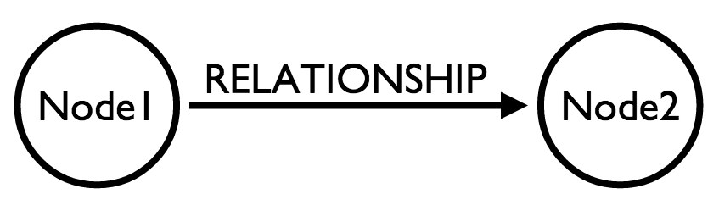
Modeling with graphs

Slide 20
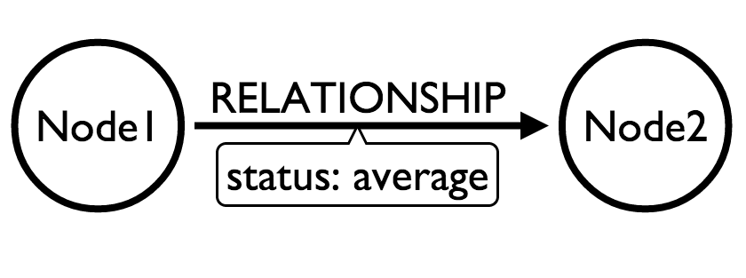
Modeling with graphs

Slide 21
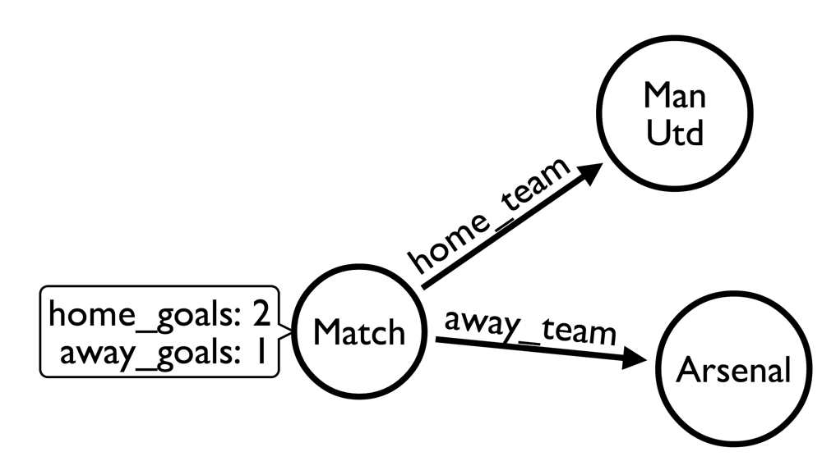
Modeling football

Slide 22
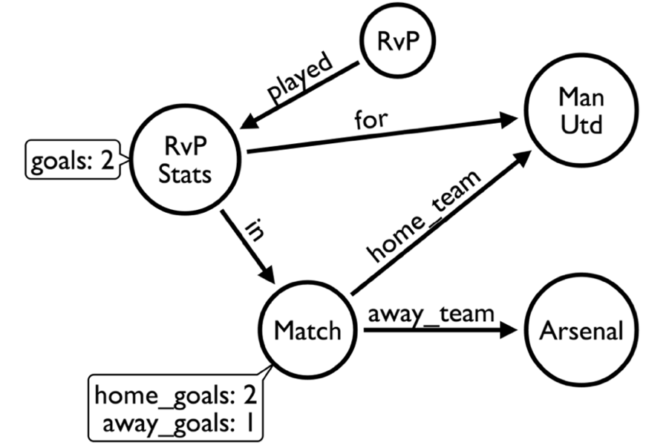
Modeling football

Slide 23
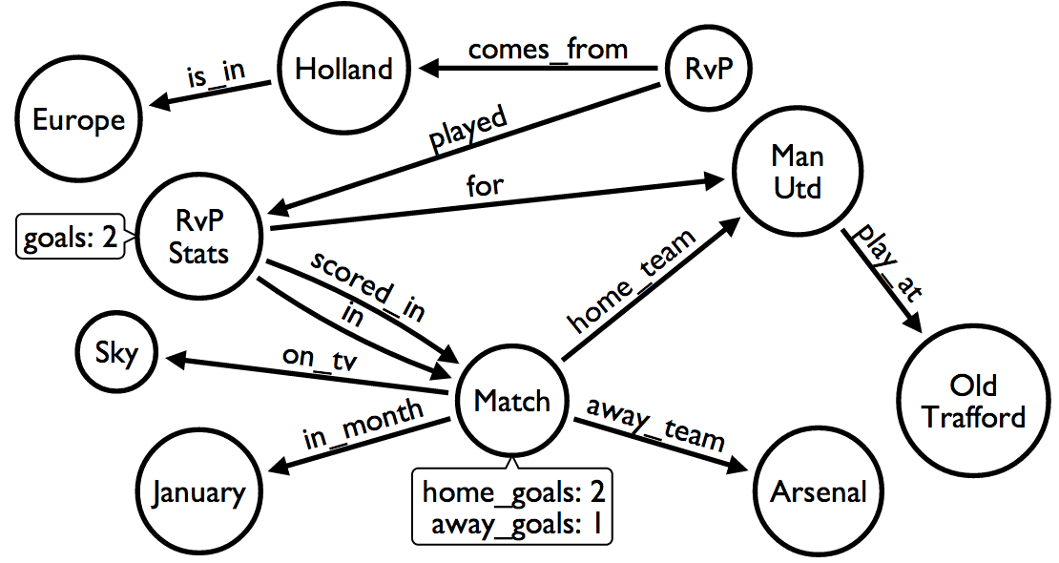
Modeling football

Slide 24
Brief introduction to querying with cypher
cypher – query language to extract info

Slide 25
START player = node:players('name:*')
MATCH player-[:played]->stats
RETURN player.name,
SUM(stats.goals) AS goals
ORDER BY goals DESC
LIMIT 10
Finding the top scorer
Notes:
We do an index lookup to find all the players
Then we follow the ‘played’ relationship from a player to find their performance in matches
Then we return the player and add up any goals they scored

Slide 26
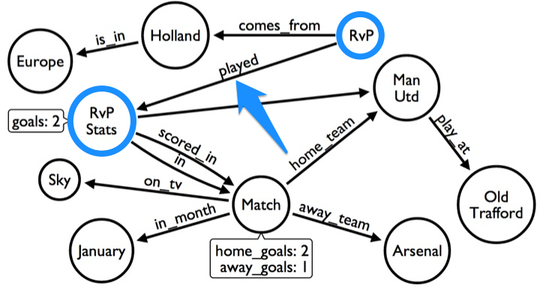
Finding the top scorer

Slide 27
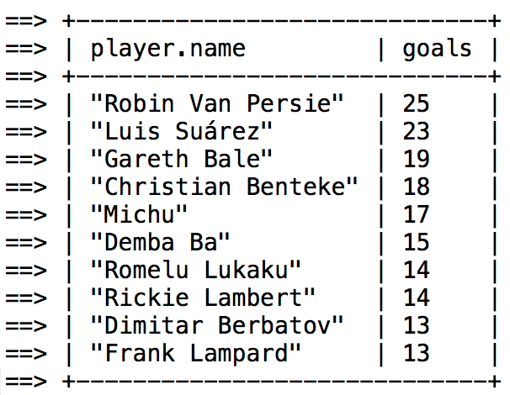
Finding the top scorer

Slide 28
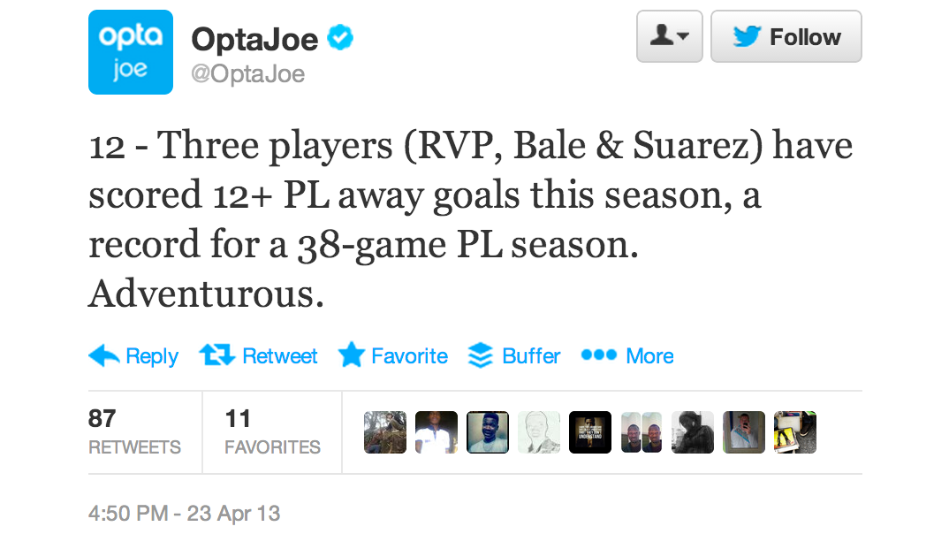
Find the top scorer away from home
Notes:
Attempting to match Opta

Slide 29
START player = node:players('name:*')
MATCH player-[:played]-stats-[:in]-game,
stats-[:for]-team
WHERE game-[:away_team]-team
RETURN player.name,
SUM(stats.goals) AS goals
ORDER BY goals DESC
LIMIT 10
Find the top scorer away from home
Notes:
Attempting to match Opta

Slide 30
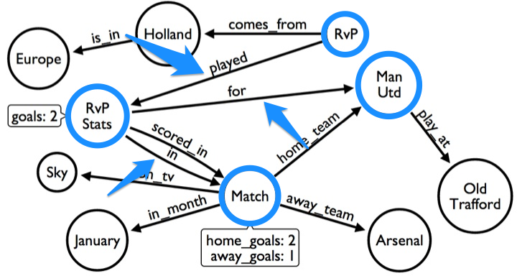
Find the top scorer away from home
Notes:
Attempting to match Opta

Slide 31
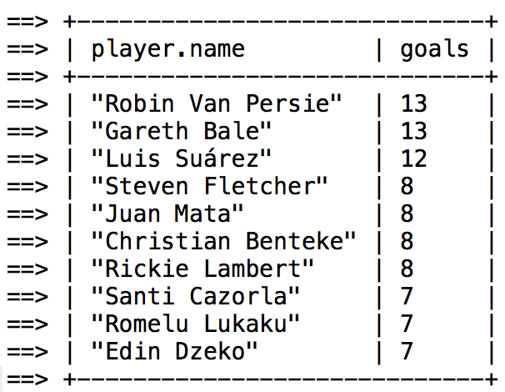
Find the top scorer away from home
Notes:
Attempting to match Opta

Slide 32
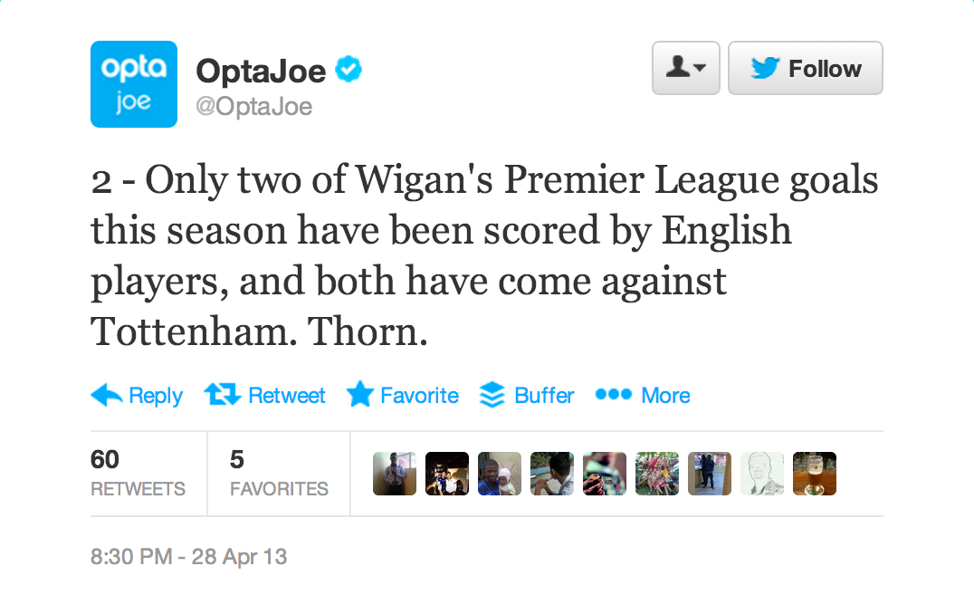
Find Wigan’s English scorers
Notes:
Now we have one which requires us to take the player’s nationality into account

Slide 33
START team = node:teams('name:"Wigan"'),
country=node:countries('name:"England"')
MATCH player-[:comes_from]->country,
team-[:home_team|away_team]->game,
game<-[:in]-stats-[:for]->team,
stats<-[:played]-player-[:scored_in]->game,
game<-[:home_team|away_team]-opposition
RETURN player.name AS name,
opposition.name AS opposition,
game.friendly_date AS date
Find Wigan’s English scorers
Notes:
Attempting to match Opta

Slide 34
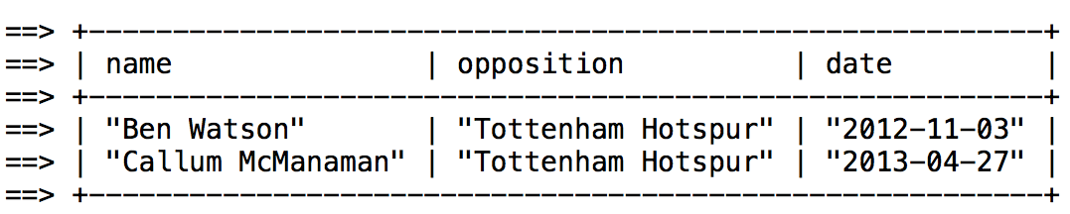
Find Wigan’s English scorers
Notes:
Attempting to match Opta

Slide 35
Rankings
If all the teams play each other then it’s fair to say that the team that finishes in first is the best one e.g. league competitions
Ranking Systems
Notes:
I started to have some questions which I thought should be based on team rankings: do players only score against rubbish teams? Who’s actually the best team in the Champions League for a given season

Slide 36
Objective vs Subjective Rankings
In competitions where everybody doesn’t play everybody else it’s a different story and there are different approaches we can take
Subjective – a human decides part of the ranking
e.g. UEFA coefficient – give points for each round
Objective – use statistical basis to come up with a model for rankings

Slide 37
“
The Elo rating system is a method for calculating the relative skill levels of players in competitor-versus-competitor games.
”
Elo Rating System
Notes:
The Elo Rating System
Most famously used in chess
Takes into account the importance of the match and the probability that each team will win

Slide 38
R' = R + K * (S - E)
R' is the new rating
R is the old rating
K is a maximum value for increase or decrease of rating (16 or 32 for ELO)
S is the score for a game
E is the expected score for a game
E(A) = 1 / [ 1 + 10 ^ ( [R(B) - R(A)] / 400 ) ]
E(B) = 1 / [ 1 + 10 ^ ( [R(A) - R(B)] / 400 ) ]
Elo Rating System
Notes:
Based on probabilities of wins – if you’re expected to win and you lose then you get penalised quite heavily
Elo's central assumption was that the chess performance of each player in each game is a normally distributed random variable.
A 200 point rating difference means a player has a 75% chance of winning

Slide 39
R(A) = 1900
R(B) = 1500
E(A) = 1 / [ 1 + 10 ^ ( [1500 - 1900] / 400 ) ]
= 1 / [ 1 + 10 ^ ( -400 / 400) ]
= 1 / [ 1 + 10 ^ -1 ]
= 1 / 1 + .1
= .91 / 91%
E(B) = 1 / [ 1 + 10 ^ ( [1900 - 1500] / 400) ]
= 1 / [ 1 + 10 ^ ( 400 / 400 ) ]
= 1 / [ 1 + 10 ^ 1 ]
= 1 / 11
= .09 / 9%
An example
Notes:
Based on probabilities of wins – if you’re expected to win and you lose then you get penalised quite heavily

Slide 40
If we win:
R' = 1900 + 32 * (1 - .91)
R' = 1900 + 32 * .09
R' = 1900 + 2.88
R' = 1903
If we lose:
R' = 1900 + 32 * (0 - .91)
R' = 1900 - 29.12
R' = 1871
An example
Notes:
You don’t gain much if you win, but you lose a lot if you lose

Slide 41
(defn expected [my-ranking opponent-ranking]
(/ 1.0
(+ 1
(math/expt 10 (/ (- opponent-ranking my-ranking) 400)))))
(defn ranking-after-game
[{ ranking :ranking
opponent-ranking :opponent-ranking
importance :importance
score :score}]
(+ ranking
(* importance
(- score (expected ranking opponent-ranking)))))
(defn ranking-after-win [args]
(ranking-after-game (merge args {:score 1})))
(defn ranking-after-win [args]
(ranking-after-game (merge args {:score 0})))
(defn ranking-after-draw [args]
(ranking-after-game (merge args {:score 0.5})))
The Code
Notes:
This is what the code looks like

Slide 42
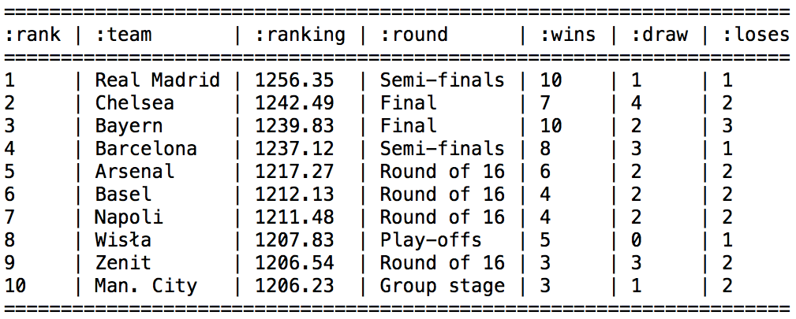
Did Chelsea deserve to win?

Slide 43
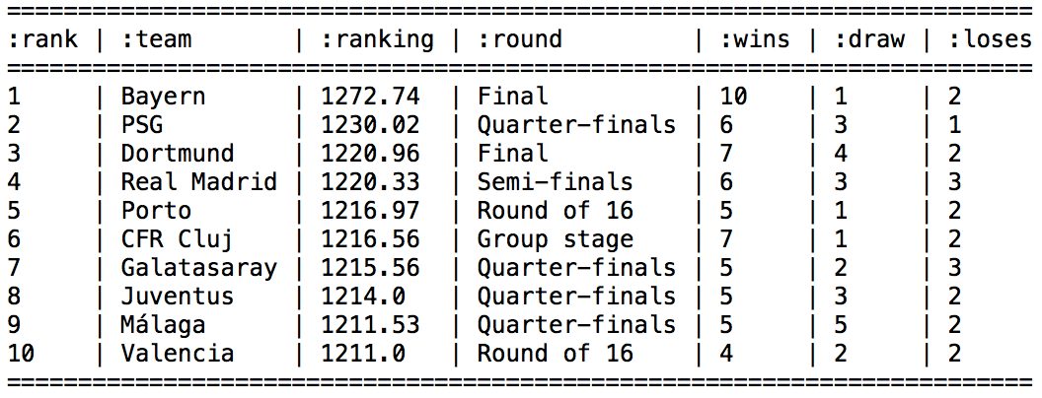
Where are Barcelona?
Notes:
Barcelona are missing, they won early games when everyone was closely ranked but then lost points late on

Slide 44
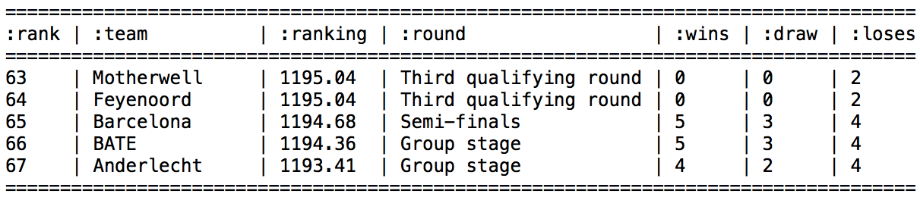
Where are Barcelona?
Notes:
Barcelona are missing, they won early games when everyone was closely ranked but then lost points late on

Slide 45
Everyone starts with the same base rating
Winning matters rather than making progress in the tournament
Ratings don’t change significantly game to game
Our “problems” so far
Notes:
Base rating – we put everyone at the same rating initially
Which means if you beat Barcelona right at the beginning
Then it’s the same as beating another weaker team

Slide 46
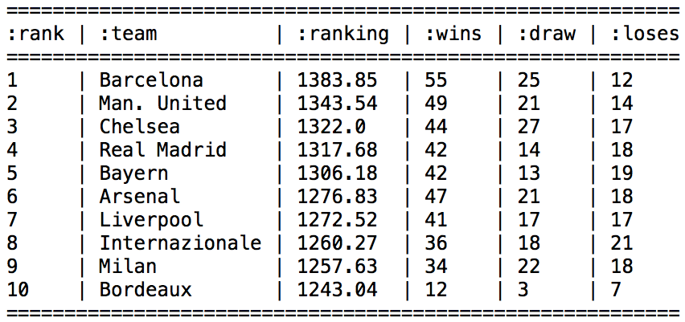
2004 - 2012
Notes:
We’ll build a base rating for teams from the previous 9 seasons
We include all the matches from 2004 until 2012 to get base ratings that we can use for 2012/2013
The ranking of some teams that didn’t even participate is higher than those that did!

Slide 47
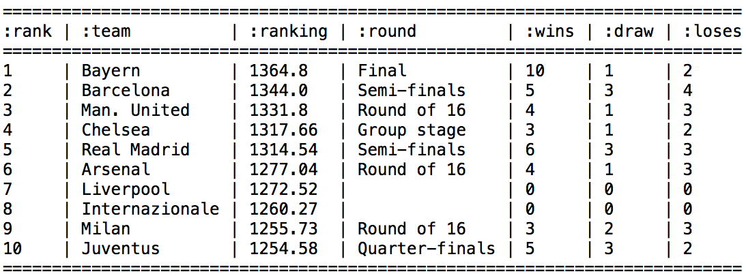
2004 - 2013
Notes:
Which means that for the teams participating in last year’s Champions League we end up with the following

Slide 48
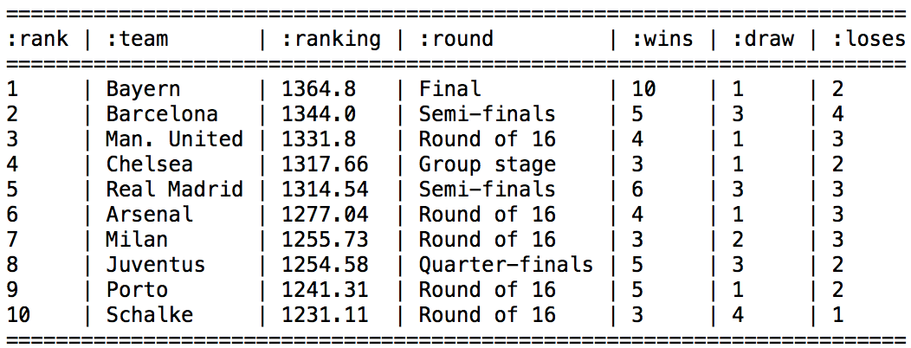
2012/2013 using 2004-2012 base ratings
Notes:
The ranking of some teams that didn’t even participate is higher than those that did!
Which means that for the teams participating in last year’s Champions League we end up with the following

Slide 49
New players can take a long time to ascend or descend to their correct levels.
Highly ranked players can be hesitant to play with provisional
There are no allowances for games with more than two players.
General problems with Elo
Notes:
We encounter number one but the other two don’t matter so much to us

Slide 50
Glicko
Addresses a deficiency in Elo: the reliability of player’s ratings
It does this by introducing a rating deviation and rating volatility
High RD -> Player not playing often so we have less confidence in this ranking
Low RD -> Playing often so we have more confidence in this ranking
Change in ranking depends on their RD
Glicko Rating System
Notes:
The first one applies to us – we need to run it over a few seasons worth of matches to get accurate rankings

Slide 51
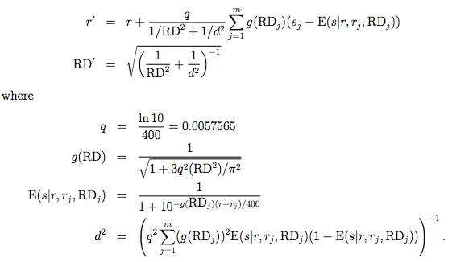
The Glicko Algorithm
Notes:
The first one applies to us – we need to run it over a few seasons worth of matches to get accurate rankings

Slide 52
Harkness
True Skill
eGenesis
USATT
Matrix Based Algorithms
Other Ranking Systems
Notes:
Harkness – originally used for chess. Used a simpler algorithm by averaging the opponents ranking and then adjusts your ranking based on that, not taking current one into account
True Skill – used by Microsoft for Xbox Live rankings (http://research.microsoft.com/en-us/projects/trueskill/)
eGenesis – designed to reduce the impact of cheating by creating fake players - http://chronx.com/live/index.php?topic=739.0
USATT – used for table tennis rankings. Similar to Elo but also takes uncertainty into account
Perron Frobenius Theorem & The Ranking of football teams - https://umdrive.memphis.edu/ccrousse/public/MATH%207375/PERRON.pdf

