Slide 1
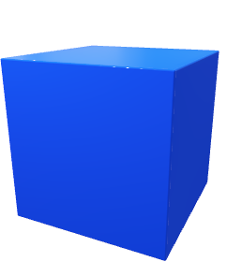
RGBA
Image/Video
3D ConvNet
Depth
Image/Video
Multilayer Perceptron
Output
3D ConvNet
Skeleton Text

Slide 2
3D Convolution
3D Convolution
Pooling
3D Convolution
Pooling
Dense (ReLU)
Dense (Softmax)
RGBA
Image/Video
……
Depth
Image/Video
3D Convolution
3D Convolution
Pooling
3D Convolution
Pooling
Output
……
Skeleton Text
3D ConvNet
Multilayer Perceptron

Slide 3
SOURCEs

