Slide 1
HEX
GAME
Jam
DigiPen Academy
Beak musong
Choi changgyu

Slide 2

INDEX
-
01. About Game
02. Hexagon formula
03. Hexagon rotate
04. Collision
05. Score Record
06. Trailer

Slide 3
About Game
Game Rules
Super Hexagon
+
Tetris
Team logo is ai generated,
In game, all lines and shapes are not

Slide 4
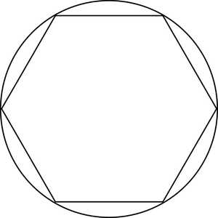
Hexagon formula
Calculate formula is very hard
x + r * cos(radian(60 * i)) , y + r * sin(radian(60 * i))
“i” is for caculation
(x, y)
r

Slide 5
Hexagon rotate
Everything is rotate together

Slide 6

Collision
Character and Wall colision Check!!!
Game Play
Collision Area

Slide 7
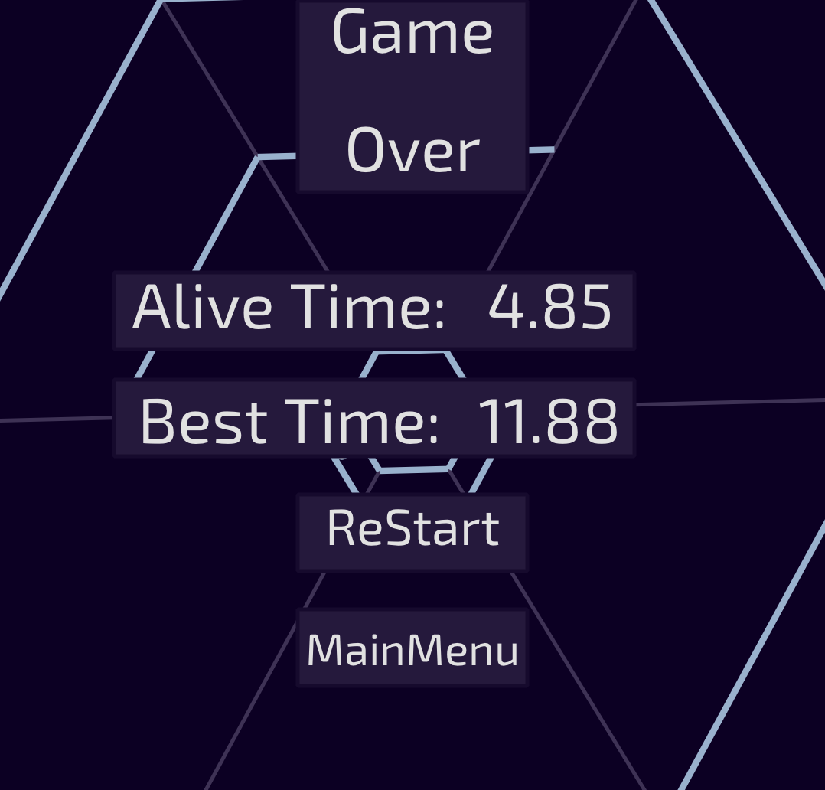
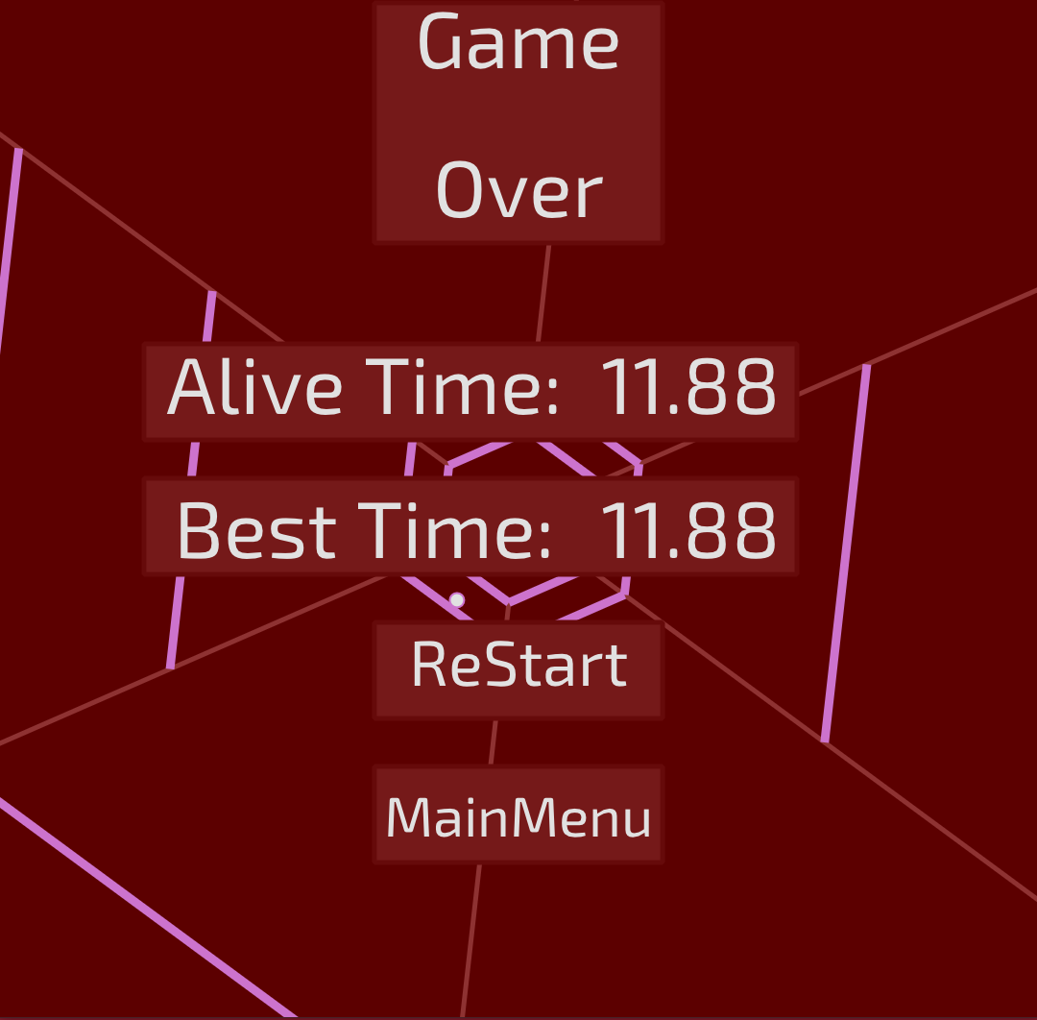
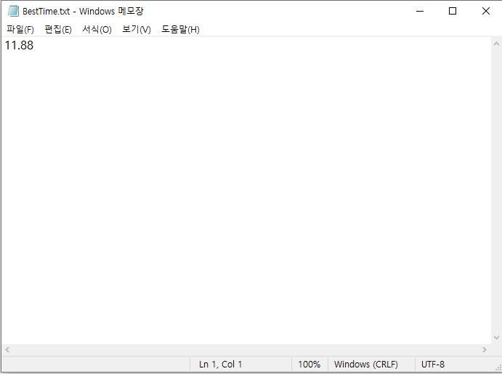
Score Record
Record the score in the txt file !!!
VIDEO GAME

Slide 8

Trailer
Hex_Ris Trailer

Slide 9
Special Thanks
Jose
Minjeong
Jihoon

Slide 10
Thank You

