Slide 1
BMI Analysis with PowerBI
Jason Zheng

Slide 2
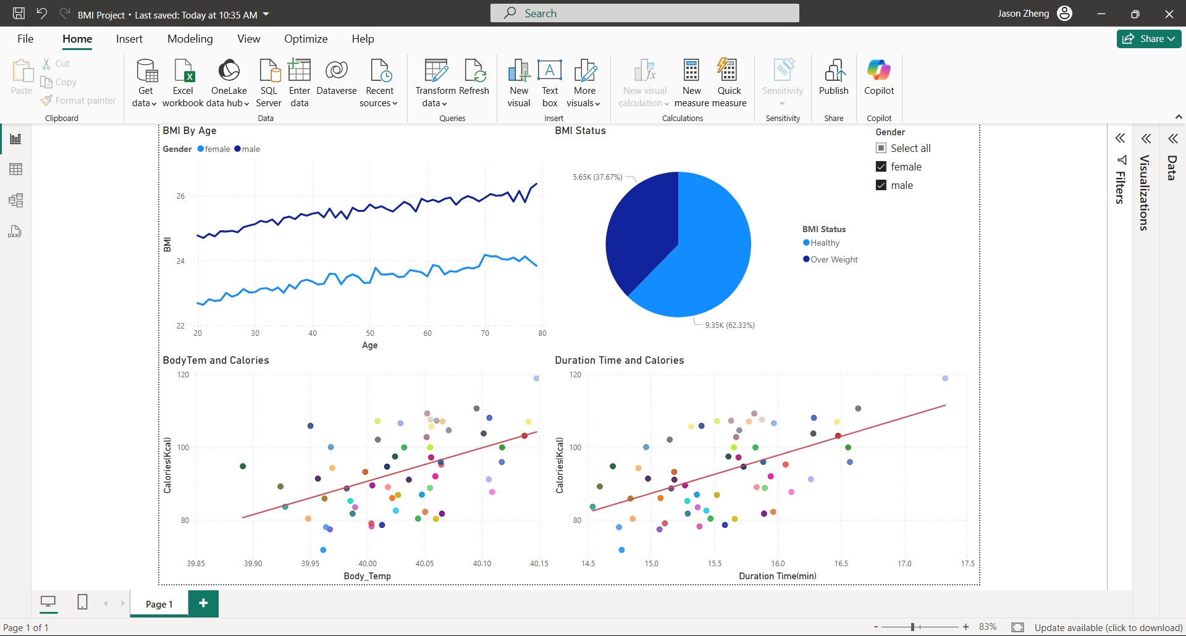
BMI Status for All
Body Temperature stands for the intensity of exercising, duration stands for the length, and calorie stands for the calories burnt every exercise.

Slide 3
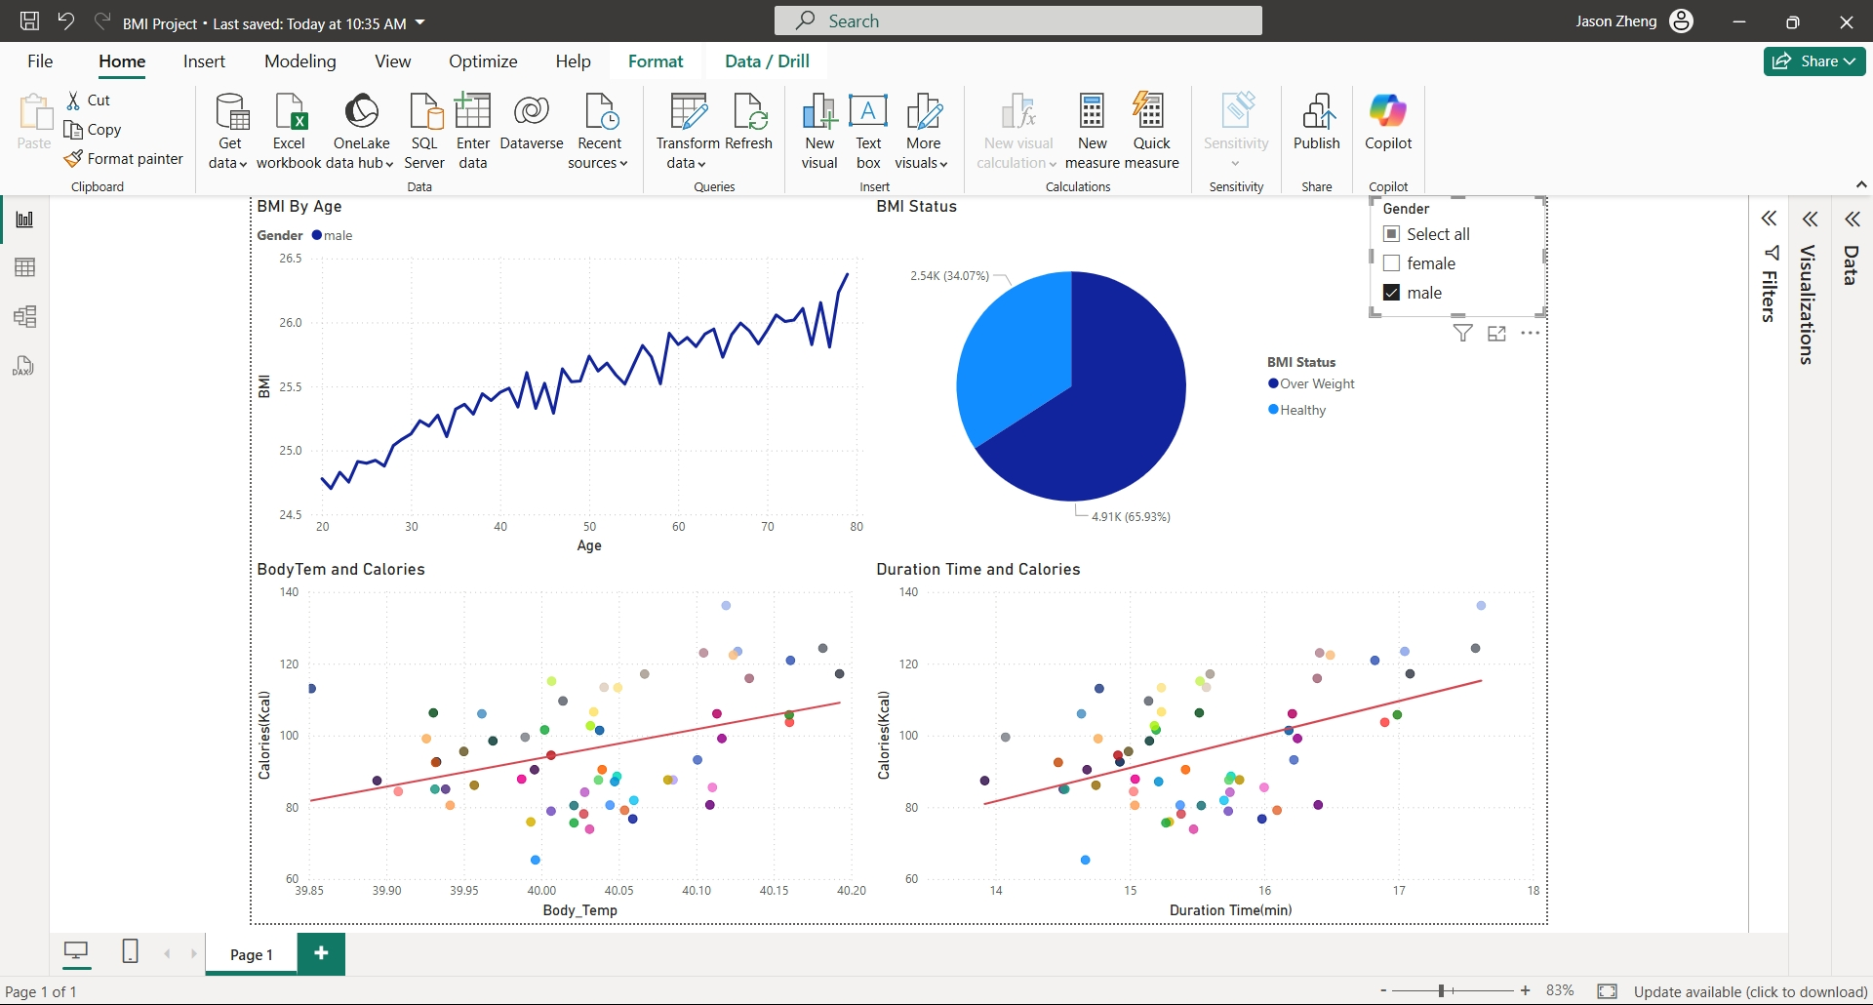
BMI Status of Male
More than half of males are over weight.
Body Temperature and Calories, Duration Time and Calories all display positive relationships.
As age increases, BMI increases.

Slide 4
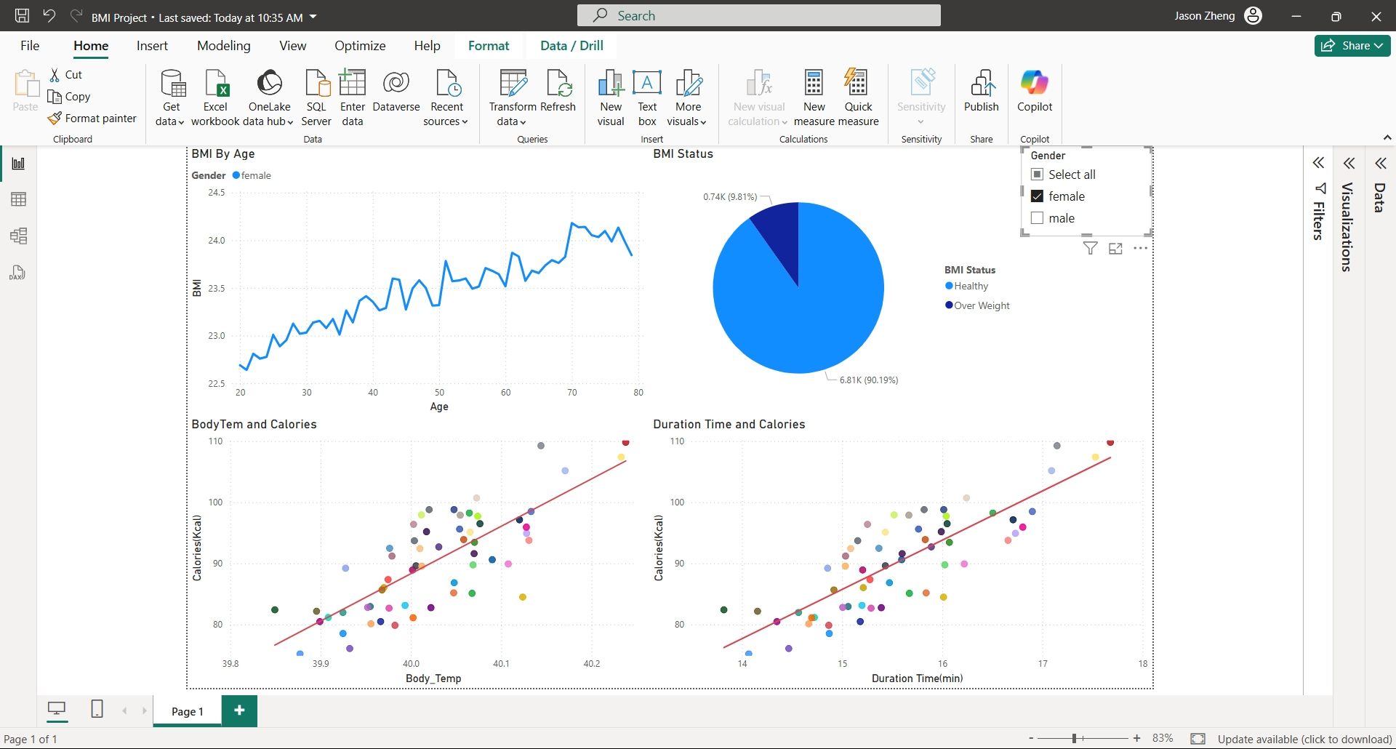
BMI Status of Female
Over 90% of females have healthy weight.
Body Temperature and Calories, Duration Time and Calories all display positive relationships.
As age increases, BMI increases.

Slide 5
Conclusion and Insights
BMI for male are generally higher than female.
BMI tends to increase with age.
Higher intensity of exercises and longer duration of each exercise will be more effective to burn calories.

