Slide 1
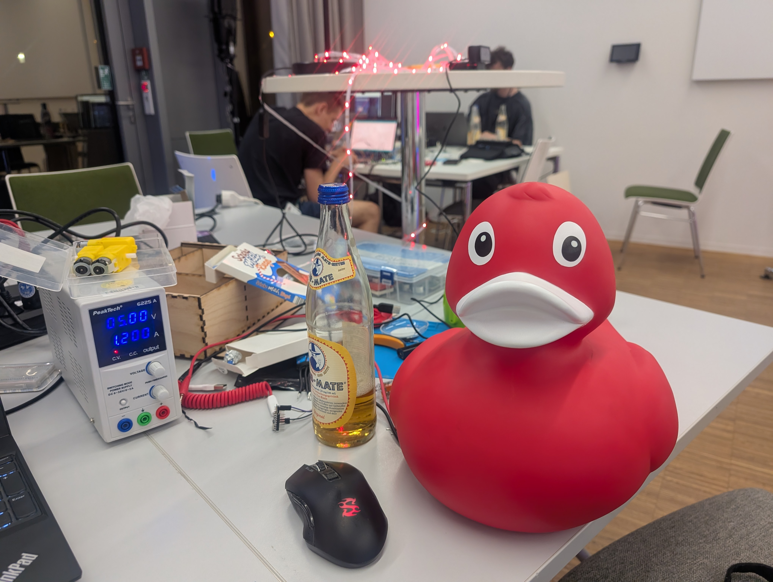
Quackonomous

Slide 2
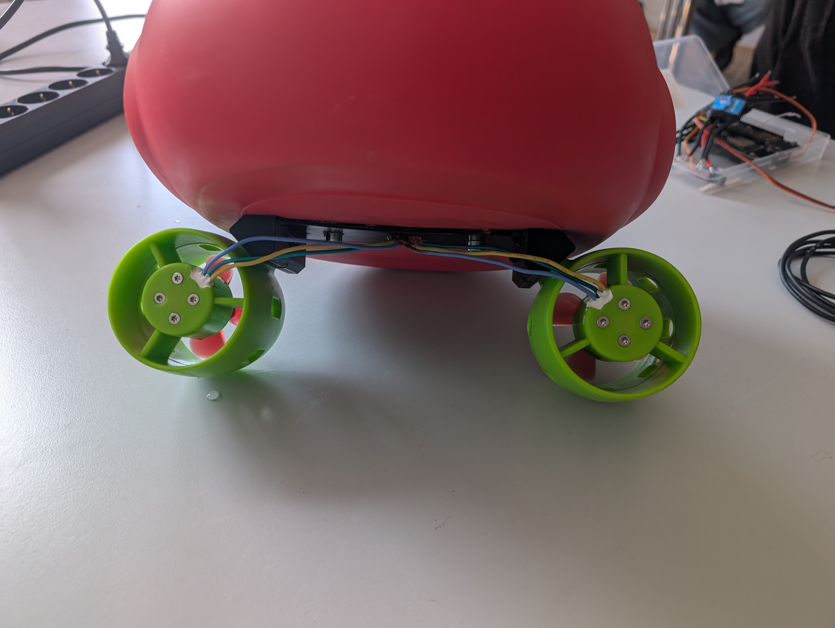
Dual Motor Design
Double 30A ESC
888W Total Motor Power

Slide 3
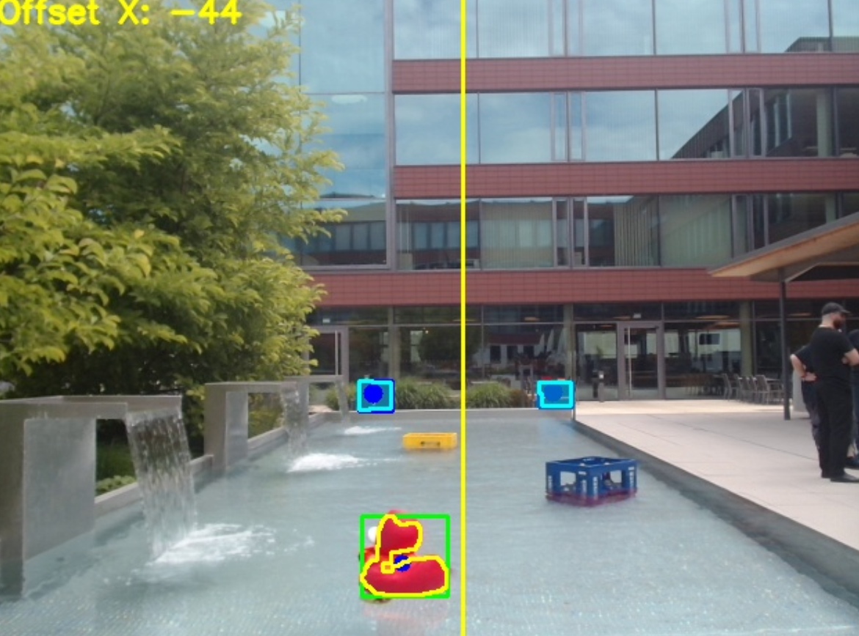
Duck Vision
Two Target Markers
Duck Tracking
Target Determination

Slide 4
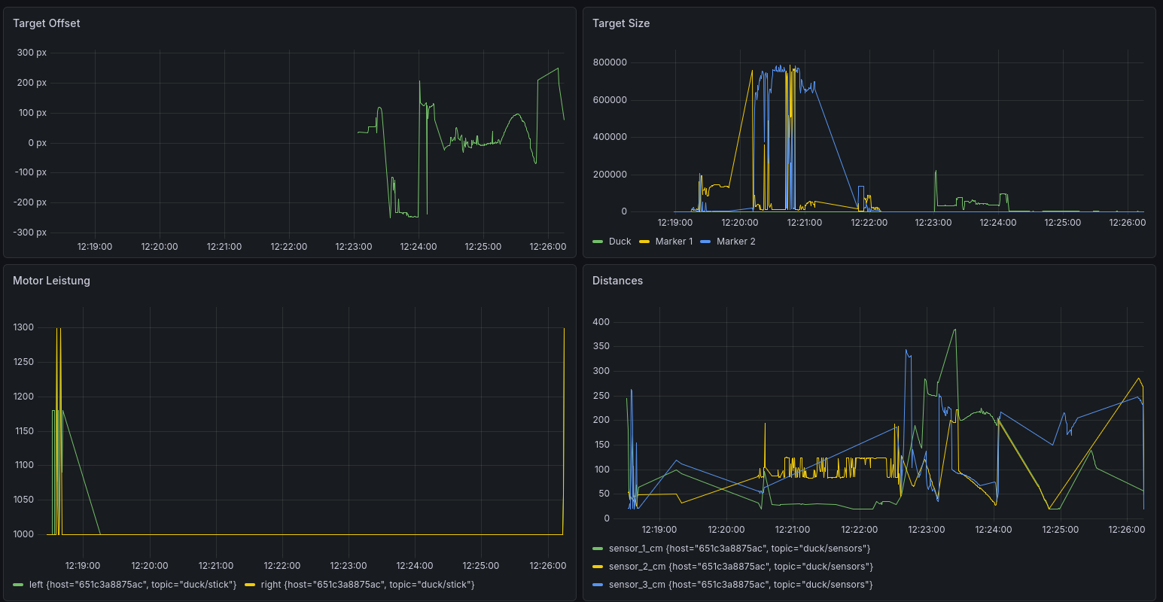
Metric Analytics
Mosqitto MQTT
Telegraf
Influxdb
Grafana

Slide 5
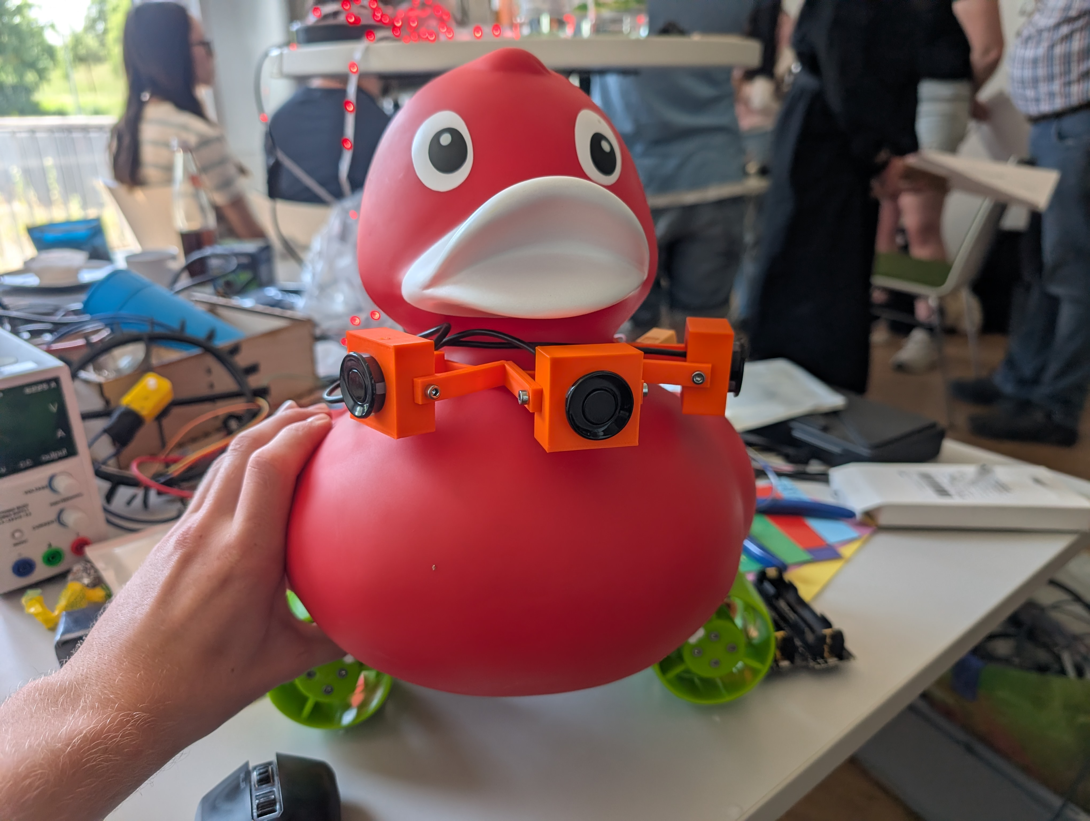
Ultrasonic Distance Sensors

Slide 6
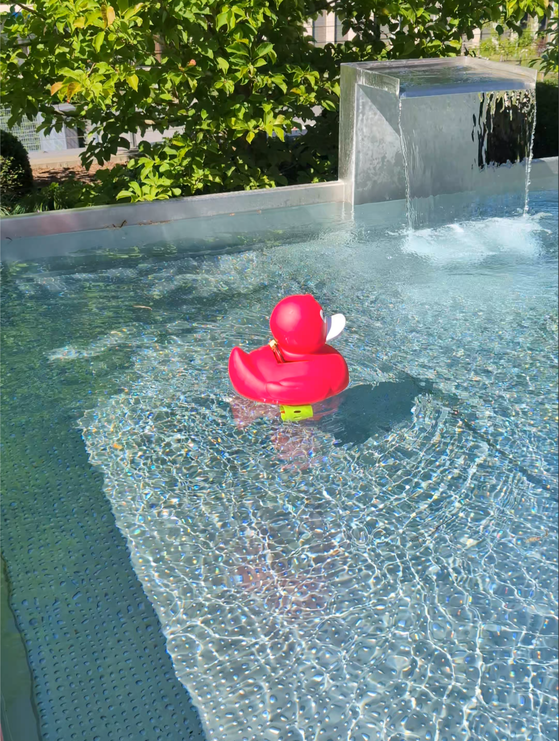
Backflip capability

