Slide 1

Modeling Maternal Mortality Rates: Abortion Access or Books?
Rebecca Minich
10.27.16
Notes:
https://assets.weforum.org/article/image/large_b05pCeiWDULOlBGVxJ52gFYvy6EPYx8R5WyOhPz1lNQ.jpg

Slide 2
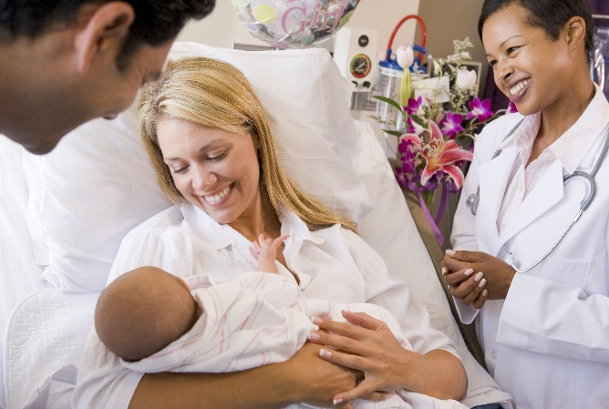
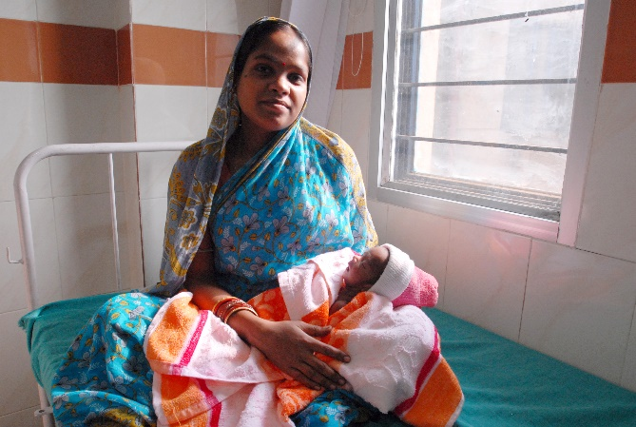
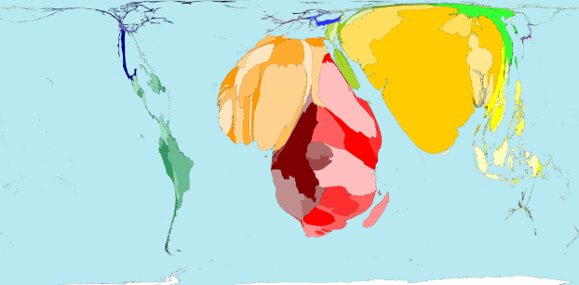
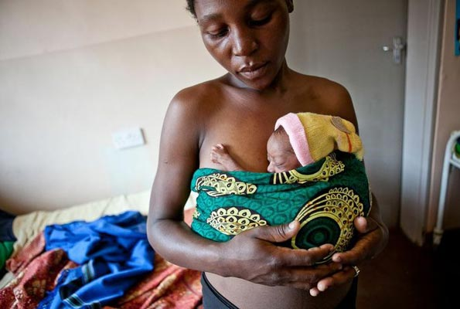
The Problem
Being a mom in a developed country is ghood
Notes:
Western mom - https://www.oakbendmedcenter.org/wp-content/uploads/2015/04/bigstock-New-Parents-With-Baby-Talking-4637025.jpg
Western mom - http://www.affordabledaycare.net/stk25210nwl.jpg
Orissa mom - https://upload.wikimedia.org/wikipedia/commons/c/c7/Mother_and_newborn_child_in_Orissa.jpg
East Africa mom - http://healthreportereastafrica.com/wp-content/uploads/2016/01/premature-babies-ug.jpg
Worldmapper - http://www.worldmapper.org/display.php?selected=258

Slide 3

What contributes to global maternal mortality rates?
Notes:
360 million people worldwide have disabling hearing loss, 90% of people are adults and the numbers increase with age.
Hearing loss may result from genetic causes, complications at birth, certain infectious diseases, chronic ear infections, the use of particular drugs, exposure to excessive noise and ageing.
Half of all cases of hearing loss are avoidable through primary prevention.
People with hearing loss can benefit from hearing aids, cochlear implants and other assistive devices; captioning and sign language; and other forms of educational and social support.
Current production of hearing aids meets less than 10% of global need.

Slide 4
What data have you gathered and how did you gather it?
“Nearly half of those older than 75 have difficulty hearing…[making it] hard to understand and …respond to warnings…hard to enjoy talking with family and friends, leading to feelings of isolation.”*
http://www.cdc.gov/nchs/data/databriefs/db214_fig1.png
*http://www.nidcd.nih.gov/health/hearing/Pages/Age-Related-Hearing-Loss.aspx
Notes:
Although the social burdens alone make this an important public health issue, there is also a steep economic cost HL in the form of disability, loss of days worked and the cost of devices to improve hearing. To better understand the progression of AHL I am going to describe mammalian auditory transduction

Slide 5
Which areas of the data have you cleaned, and which areas still need cleaning?
“Nearly half of those older than 75 have difficulty hearing…[making it] hard to understand and …respond to warnings…hard to enjoy talking with family and friends, leading to feelings of isolation.”*
Notes:
Although the social burdens alone make this an important public health issue, there is also a steep economic cost HL in the form of disability, loss of days worked and the cost of devices to improve hearing. To better understand the progression of AHL I am going to describe mammalian auditory transduction

Slide 6
What steps have you taken to explore the data?
“Nearly half of those older than 75 have difficulty hearing…[making it] hard to understand and …respond to warnings…hard to enjoy talking with family and friends, leading to feelings of isolation.”*
Notes:
Although the social burdens alone make this an important public health issue, there is also a steep economic cost HL in the form of disability, loss of days worked and the cost of devices to improve hearing. To better understand the progression of AHL I am going to describe mammalian auditory transduction

Slide 7
What insights have you gained from your exploration?
“Nearly half of those older than 75 have difficulty hearing…[making it] hard to understand and …respond to warnings…hard to enjoy talking with family and friends, leading to feelings of isolation.”*
Notes:
Although the social burdens alone make this an important public health issue, there is also a steep economic cost HL in the form of disability, loss of days worked and the cost of devices to improve hearing. To better understand the progression of AHL I am going to describe mammalian auditory transduction

Slide 8
Will you be able to answer your question with this data, or do you need to gather more data (or adjust your question)?
“Nearly half of those older than 75 have difficulty hearing…[making it] hard to understand and …respond to warnings…hard to enjoy talking with family and friends, leading to feelings of isolation.”*
Notes:
Although the social burdens alone make this an important public health issue, there is also a steep economic cost HL in the form of disability, loss of days worked and the cost of devices to improve hearing. To better understand the progression of AHL I am going to describe mammalian auditory transduction

Slide 9
How might you use modeling to answer your question?
“Nearly half of those older than 75 have difficulty hearing…[making it] hard to understand and …respond to warnings…hard to enjoy talking with family and friends, leading to feelings of isolation.”*
Notes:
Although the social burdens alone make this an important public health issue, there is also a steep economic cost HL in the form of disability, loss of days worked and the cost of devices to improve hearing. To better understand the progression of AHL I am going to describe mammalian auditory transduction

