Slide 1

Data Mining Report
戴鈞彥、余慶龍、游洲鈐

Slide 2

Introduction
Why we choice this dataset?
What attribute we have?
What attribute will affect our result?
The problem we met.

Slide 3
The Preprocess we do
Remove outliers
Discretization
(separate with same number of data)
Delete attribute (CfbsubsetEval with Bestfirst)

Slide 4
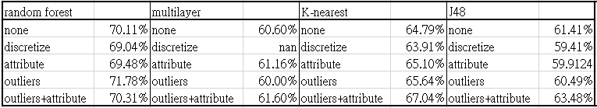
Our hypothesis：
Discretize will separate data into different interval,
and it can handle outliers very well.
But there are few outliers in our dataset,
and the same quality of wine is in a range, we do not need to separate it.
The accuracy always decrease after discretize

Slide 5
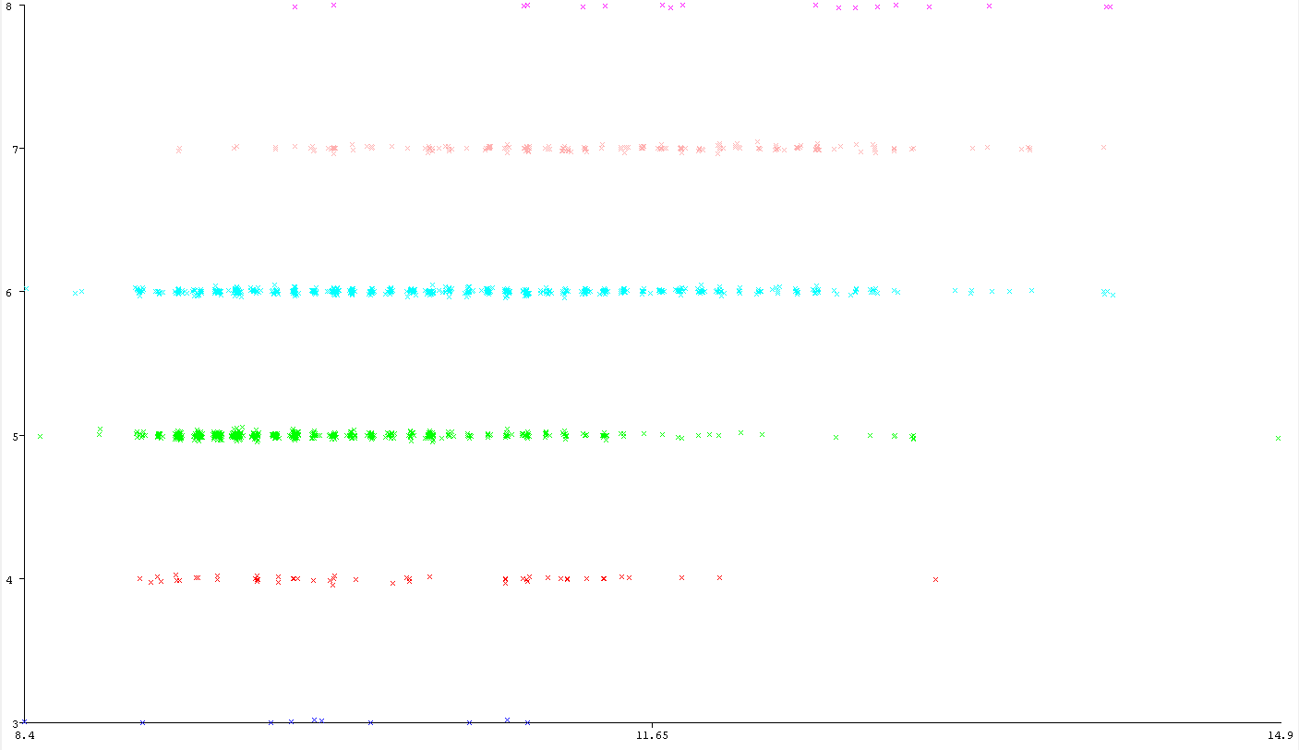
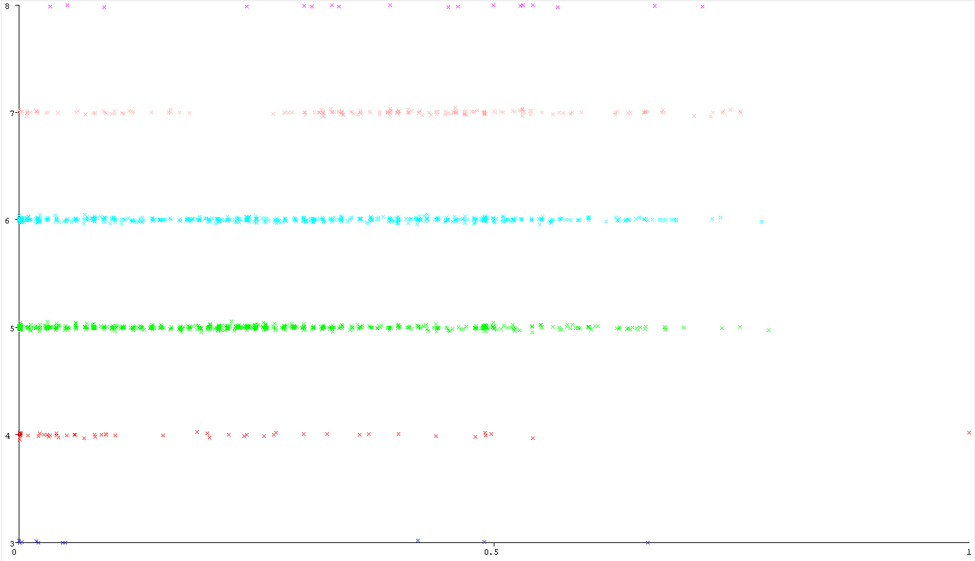
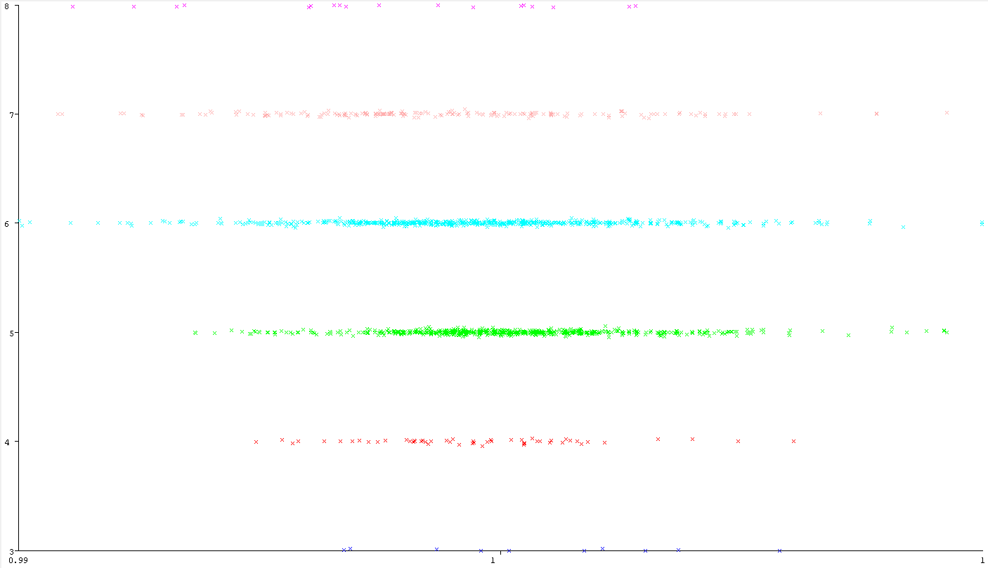
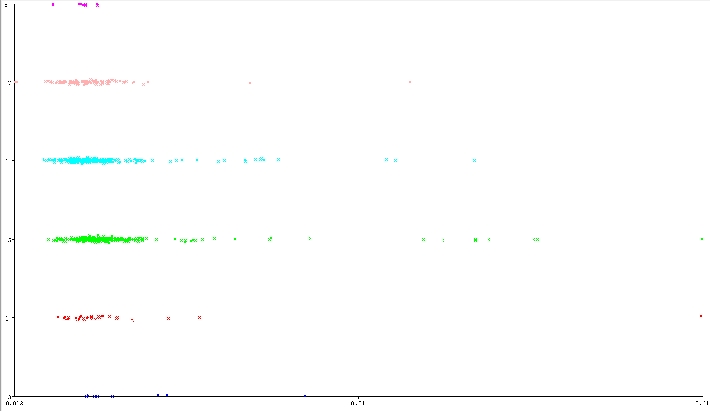
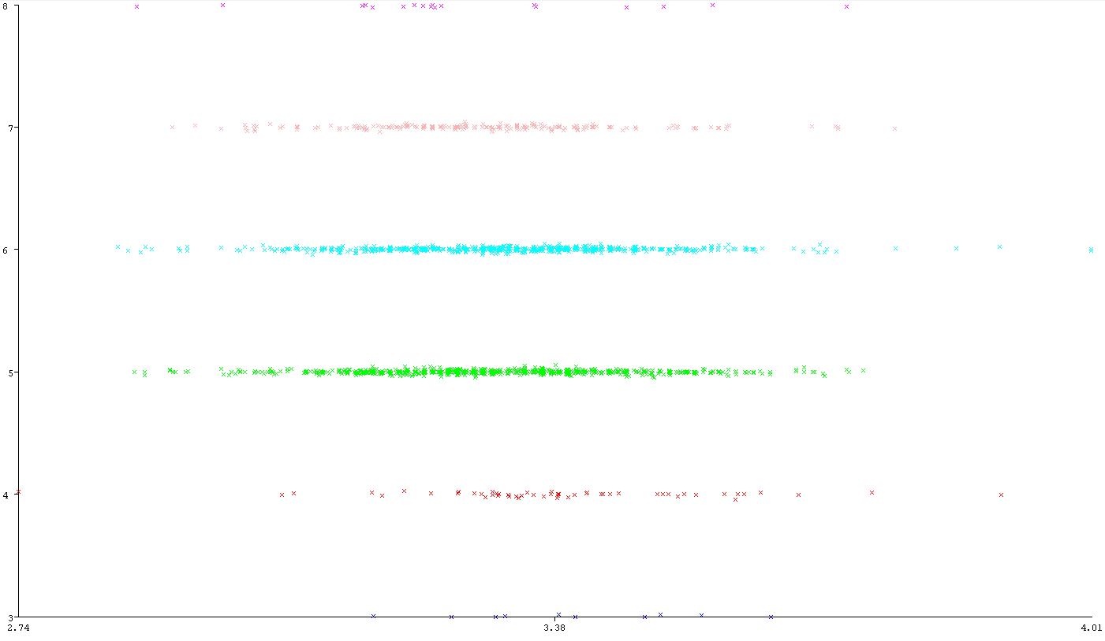
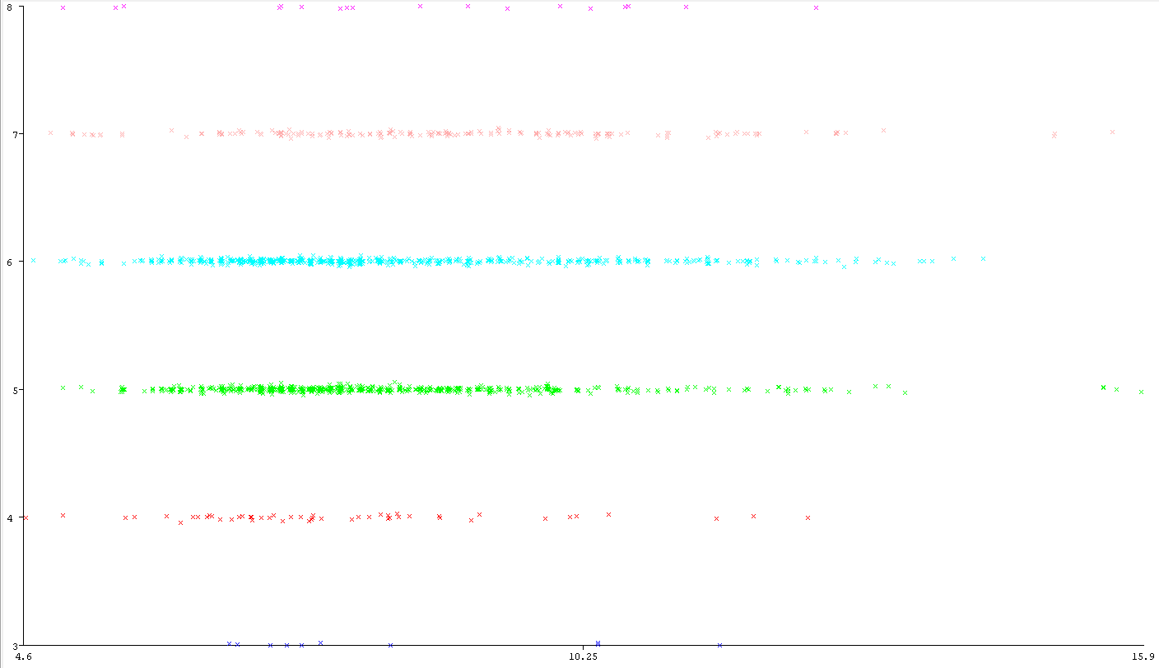
Alcohol - Quality
Chlorides - Quality
Citric acid - Quality
PH - Quality
Density - Quality
Fixed acidity - Quality

Slide 6
The datamining strategy
K-means with Classes to clusters evaluation
MultiLayerPerceptron (Neural Network)
IBK (K-nearest)
RandomForest (Decision Forest)
J48 (Decision Trees)

Slide 7
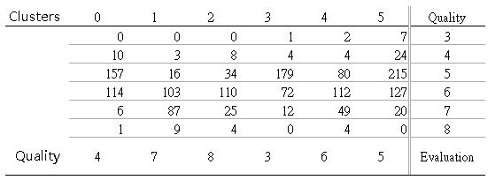
Simple K Means

Slide 8
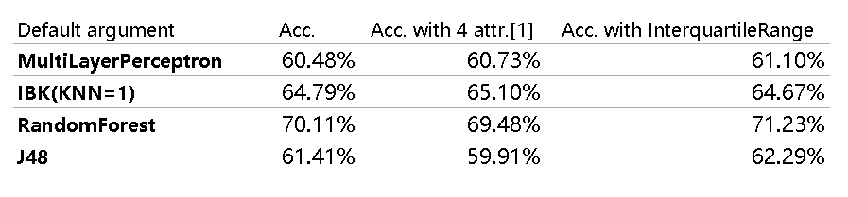
Select highest accuracy

Slide 9
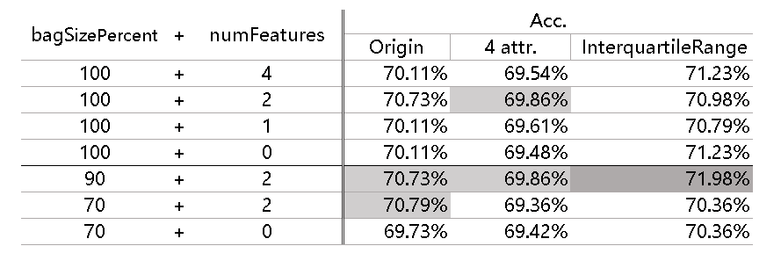
Random Forest

Slide 10
Conclusion

Slide 11
Reference
Dataset contributed by Paulo Cortez (Univ. Minho), Antonio Cerdeira, Fernando Almeida, Telmo Matos and Jose Reis (CVRVV) @ 2009

Slide 12
Thank you for your attention.

