Slide 1

Data Mining Report
member：
戴鈞彥、余慶龍、游洲鈐

Slide 2
Introduction
Why we choice this dataset?
What attribute we have?
What attribute will affect our result?
The problem we met.

Slide 3
The Preprocess method we do
Remove outliers
Discretization(separate with same number of data)
Delete attribute(CfbsubsetEval with Bestfirst)

Slide 4
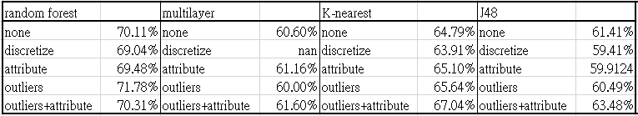
Our hypothesis：
Discretize will separate data into different interval,
and it can handle outliers very well.
But there are few outliers in our dataset,
and the same quality of wine is in a range, we don’t need to separate it.
The accuracy always decrease after discretize

Slide 5
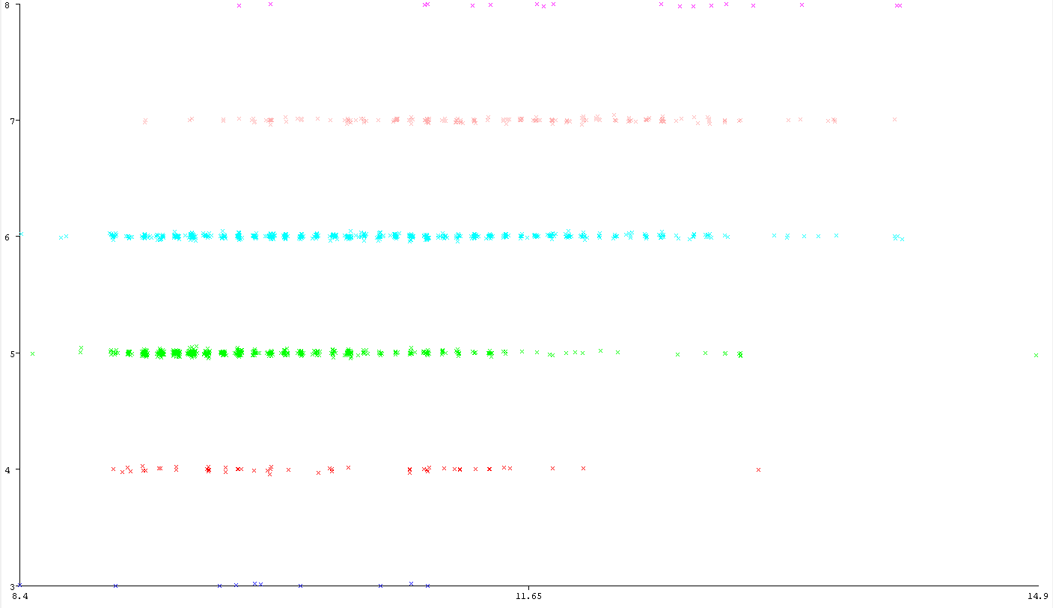
Alcohol - Quality

Slide 6
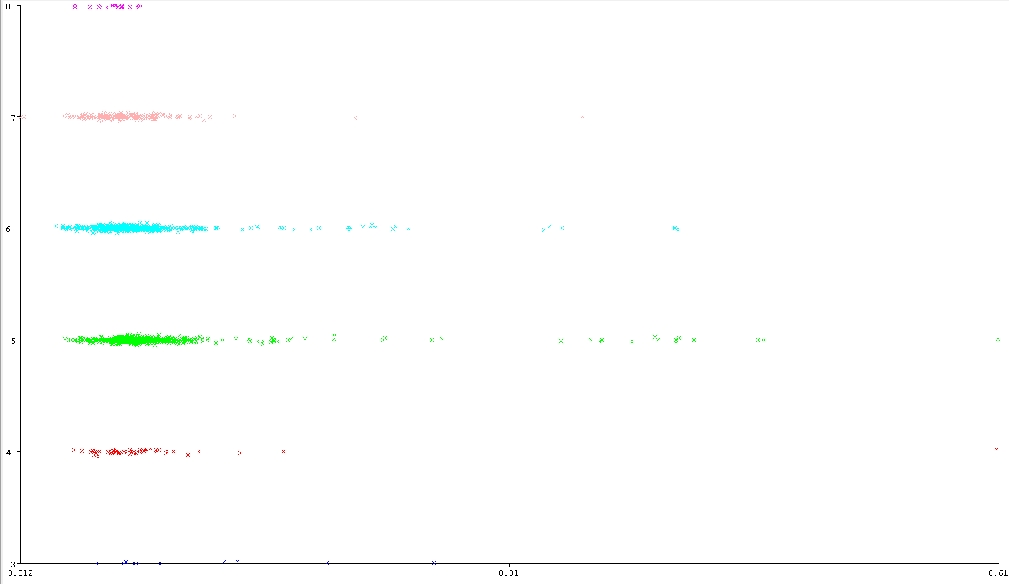
Chlorides - Quality

Slide 7
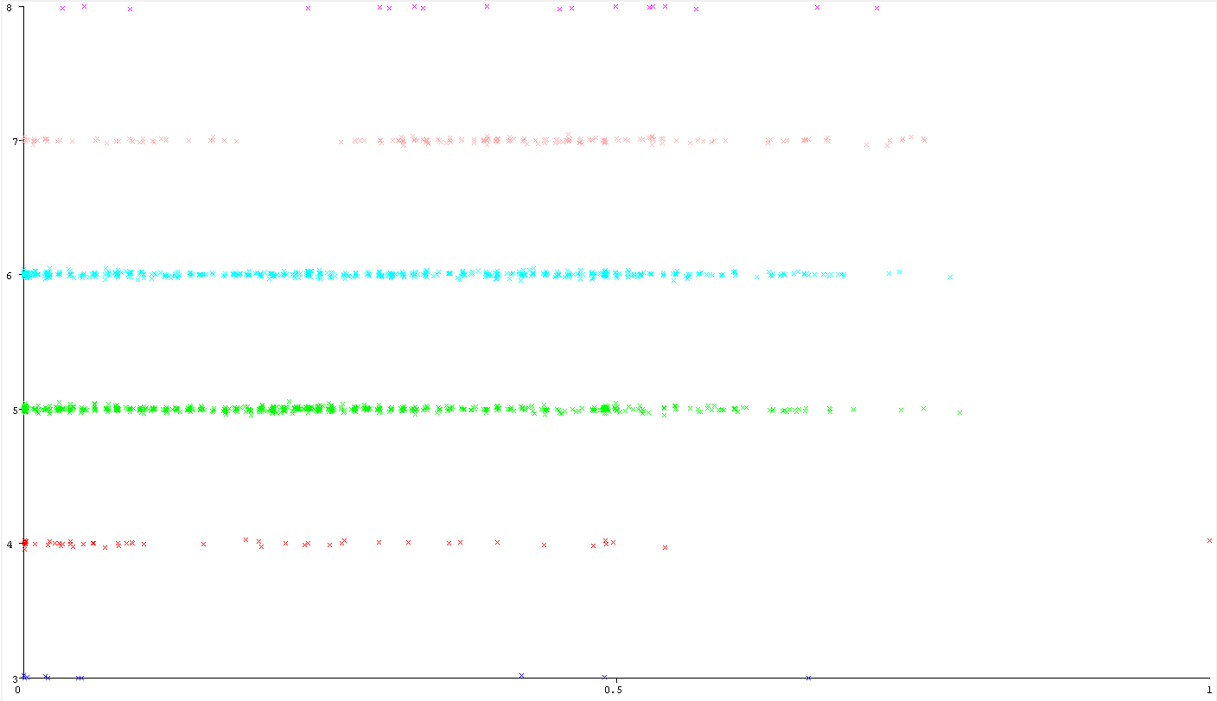
Citric acid - Quality

Slide 8
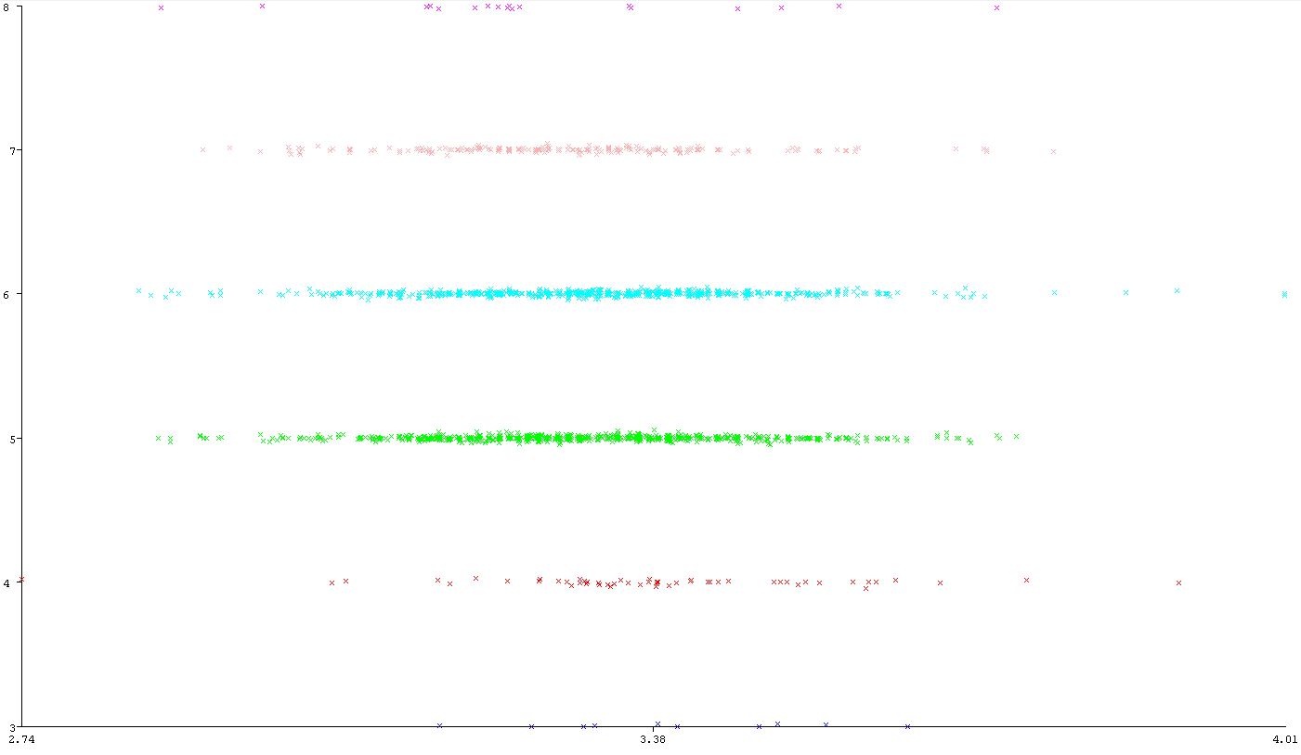
PH - Quality

Slide 9
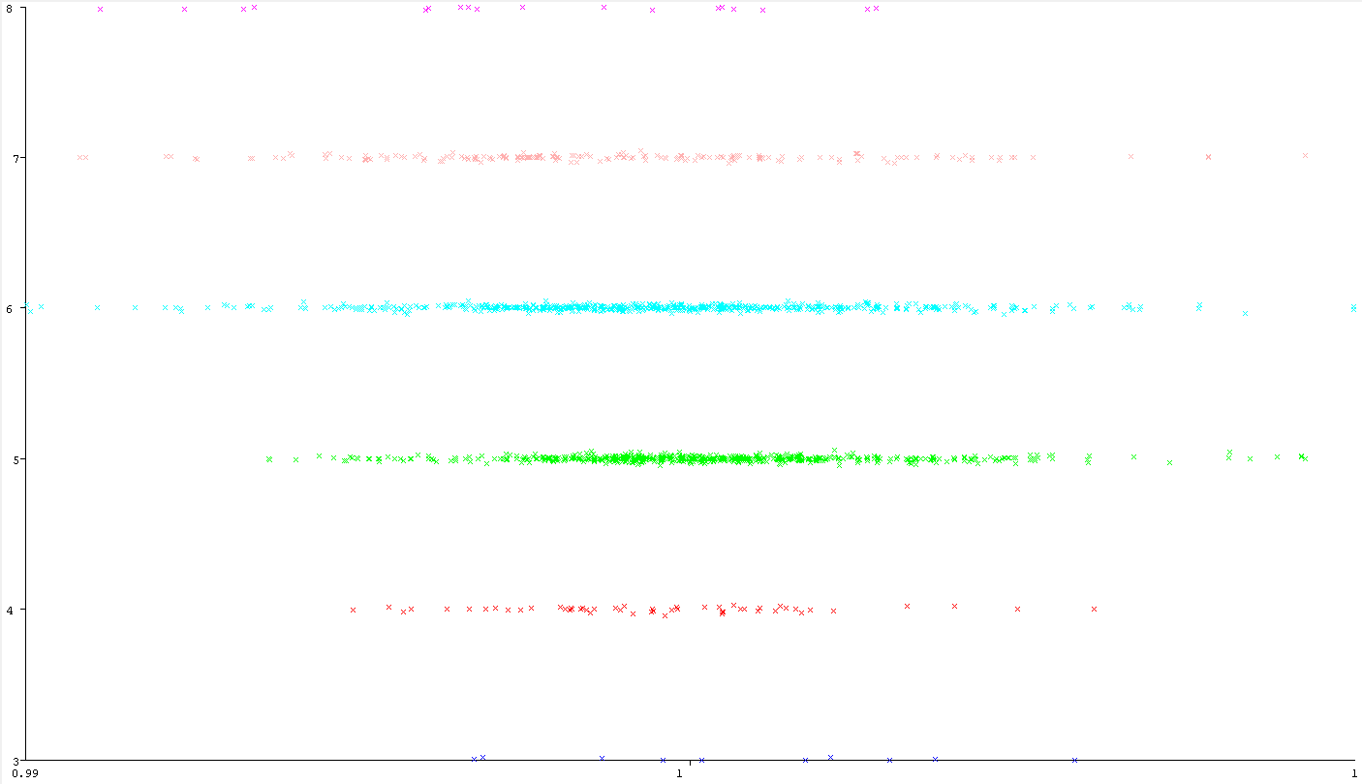
Density - Quality

Slide 10
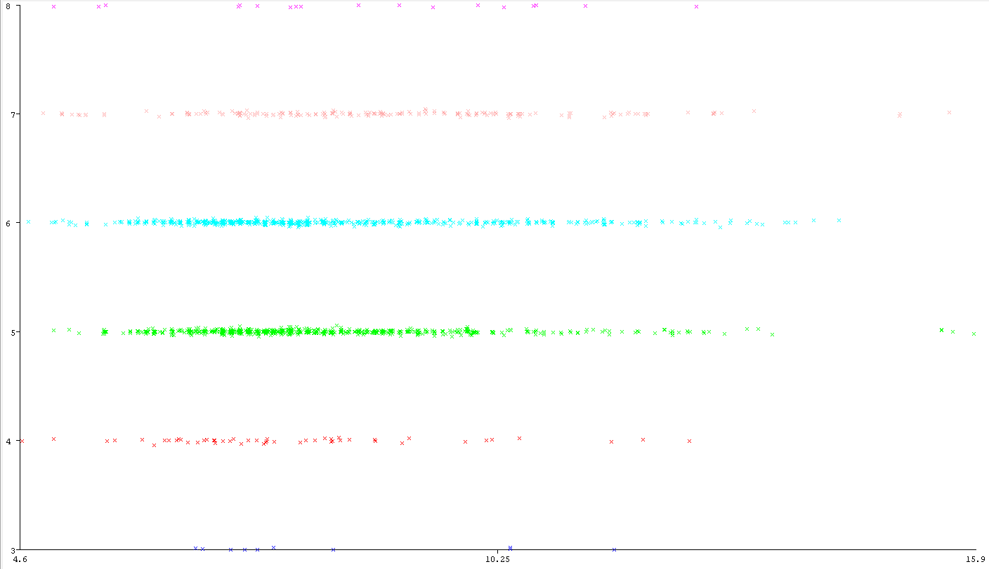
Fixed acidity - Quality

Slide 11
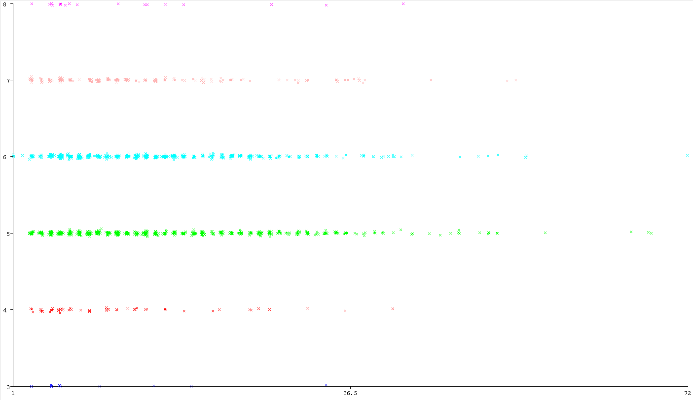
Free sulfur dioxide - Quality

Slide 12
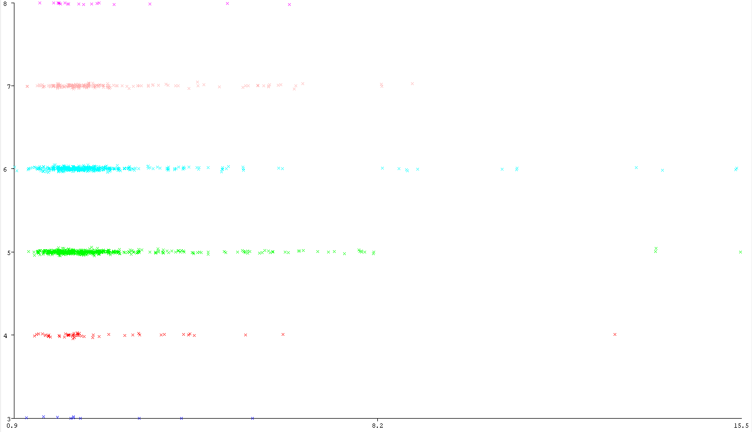
Residual sugar - Quality

Slide 13
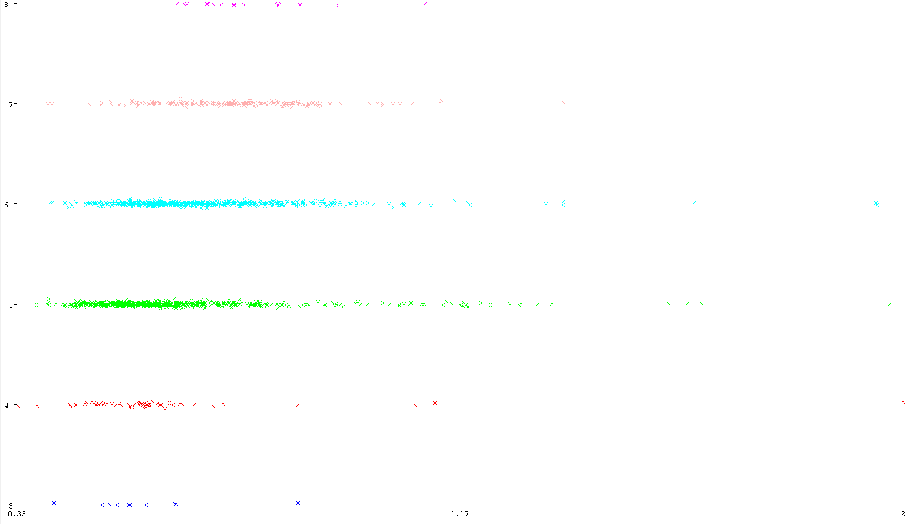
Sulphates - Quality

Slide 14
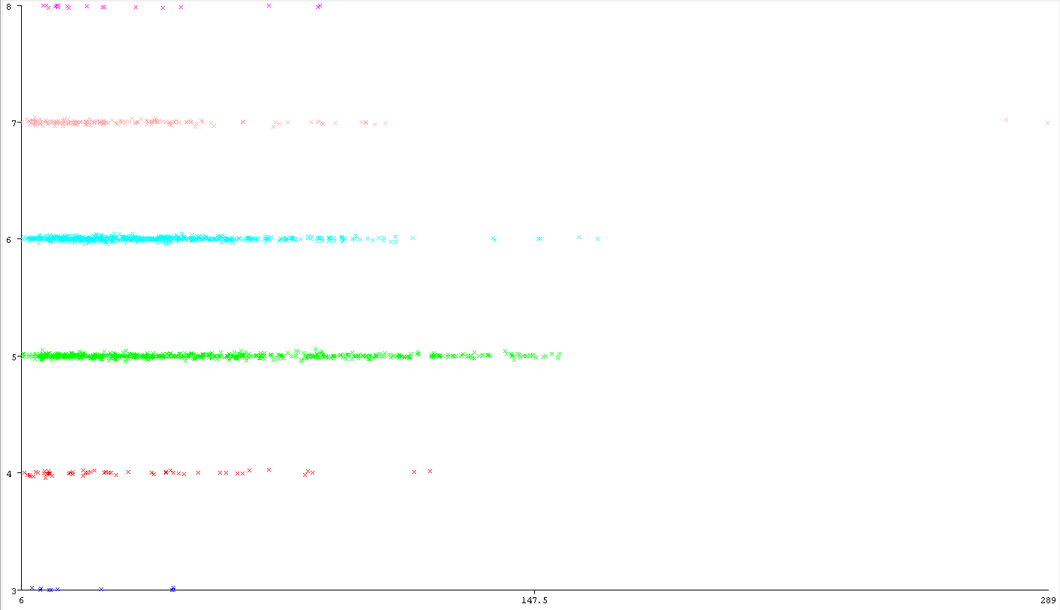
Total sulfur dioxide - Quality

Slide 15
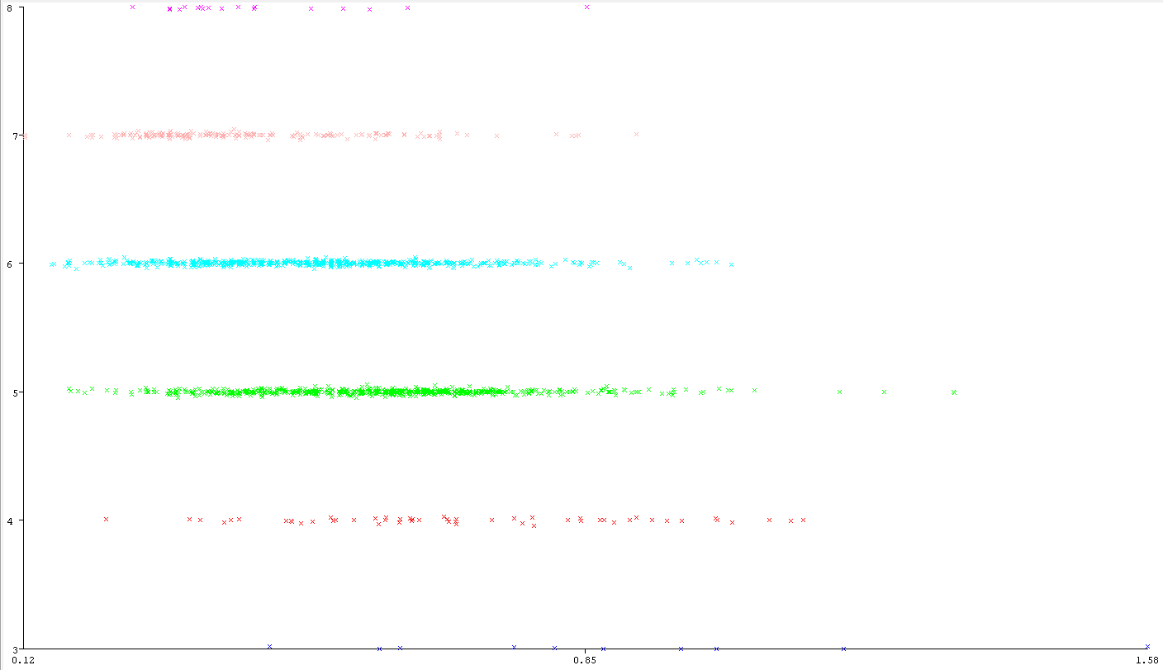
Volatile acidity - Quality

Slide 16
The datamining strategy we try
K-means with Classes to clusters evaluation
MultiLayerPerceptron (Neural Network)
IBK (K-nearest)
RandomForest
J48 (Decision Trees)

Slide 17
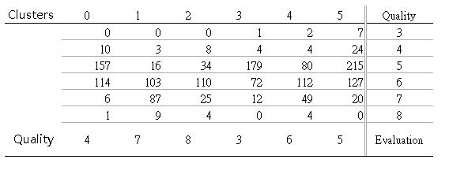
Simple K Means

Slide 18
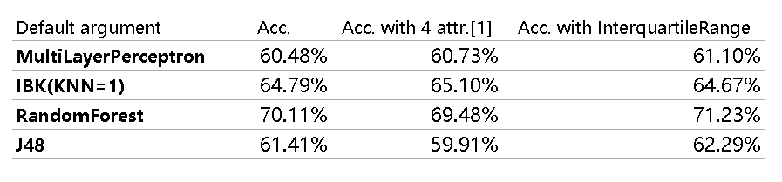
Select highest accuracy method

Slide 19
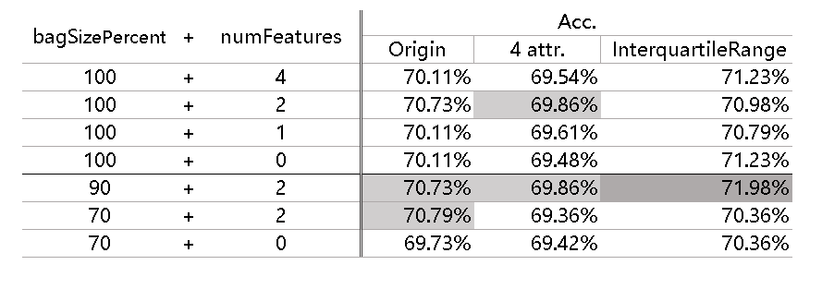
Random Forest

