Slide 1
August 24, 2021
Shanshan Bradford

Slide 2
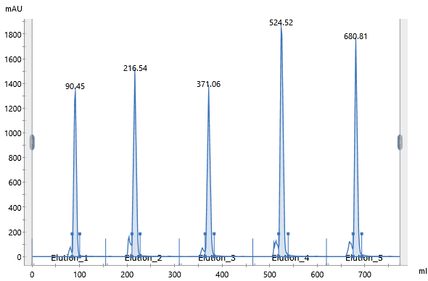
Sample MFP088-084 FPLC
MFP091
MFP084
MFP089
MFP088
MFP090

Slide 3
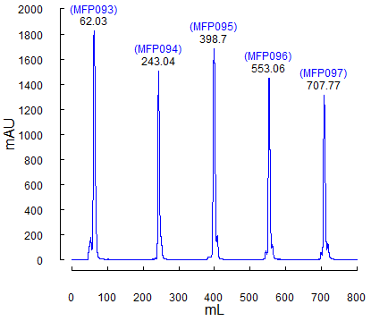
Sample MFP093-097 FPLC

Slide 4
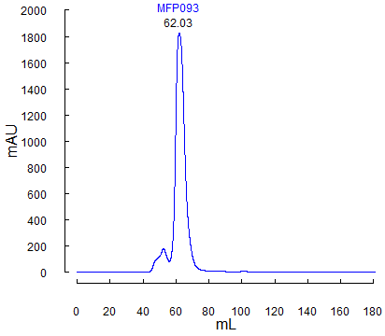
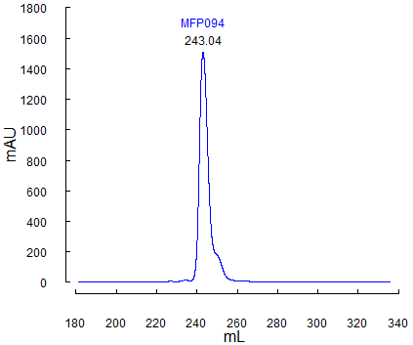
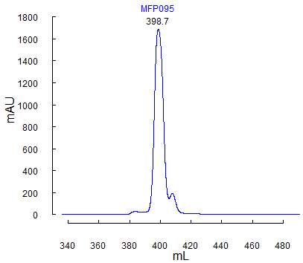
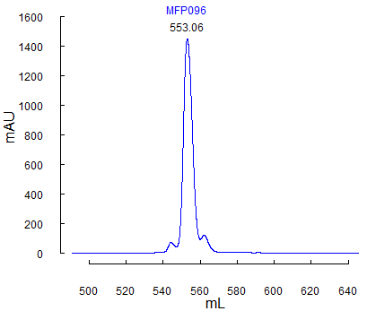
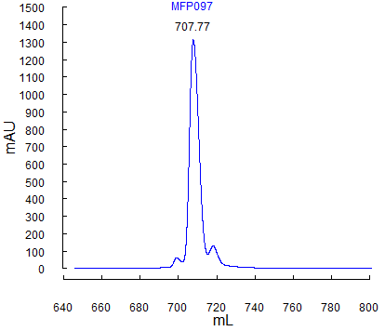

Slide 5
Protein Des | Sample | Tag Peak Position (mL) | Sample Peak Position (mL)
HSP90_CTD | MFP088 | 91.24 | 88.73
 | MFP089 | 61.91 | 62.91
 | MFP090 | 61.94 | 66.94
 | MFP091 | 61.9 | 59.9
TRAP1_CTD | MFP084 | 61.68 | 67.68
 | MFP093 | 62.37 | 68.4
 | MFP094 | 62.13 | 69.43
 | MFP095 | 62.59 | 72.19
 | MFP096 | 62.68 | 72.28
 | MFP097 | 61.78 | 72.58
 | MFP098 | 62.14 | 71.76
TRAP1_FL | MFP083 | 82.42 | 62.89

Slide 6
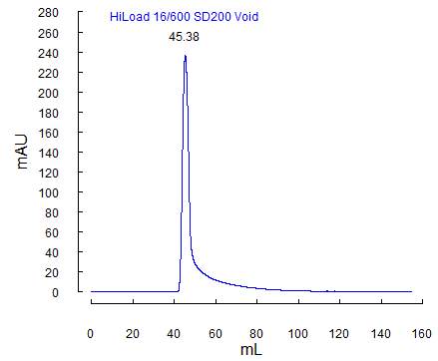

Calibration HiLoad SD200pg, HiLoad SD75pg: Void volume

Slide 7
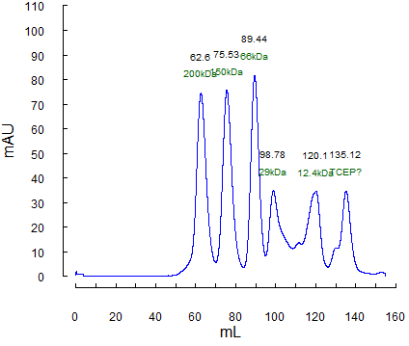
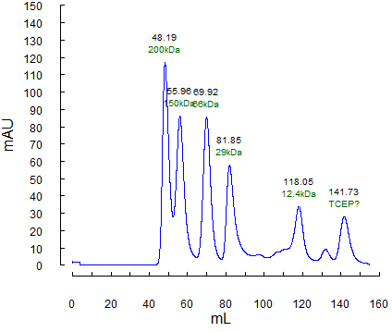
Calibration HiLoad SD200pg, HiLoad SD75pg: Standards
SD200pg
MW SD200.Position.mL SD75.Position.mL
2000kDa 45.38 44.95
200kDa 62.60 48.19
150kDa 75.53 55.96
66kDa 89.44 69.92
29kDa 98.78 81.85
12.4kDa 120.10 118.05
SD75pg

