Slide 1
Hospital Ratings
Shanshan Yu
Notes:
Intro - David

Slide 2
Hospital Ratings
Nowadays, we rate almost everything if we can, website, restaurant, houses, salaries, groceries, clothes, etc. Most of the ratings are informative (if they reflect true opinions), because the relationship between the contributing factors and outcome (the ratings) are straightforward.
But there are some ratings that are complicate, for example, hospital ratings. How could these rating be informative to us and what are the factors behind the scene? In this project, we will address multiple factors from multiple healthcare perspectives and explain how they potentially affect the hospital overall ratings.
Notes:
David – I need some assistance in what exactly is our Problem statement/Business questions
Otherwise I”ll revise this slide to state that we are looking at hospital data in order to assess factors that can affect a hospitals overall rating.

Slide 3
Hypothesis & Reasoning
The average overall ratings of private hospitals are higher rating than public ones, which could be further mapped into statistics of hospital service measurements
Reasoning:
Out of total 5,686 hospitals in the United States, 2,904 public hospitals and 1,060 private.
Public hospitals had about 33.6 million admissions annually while private hospitals had about 1.8 million admissions annually
Public hospitals are unable to turn away patients, while private hospitals tends to provide service to patients able to afford through their insurance.
Notes:
This is Shanshan’s part. She said she would do her slides Just providing overall framework for them.

Slide 4
Data Sources
Data Processing Skills & Techniques
Understand medical and policy terms related to healthcare
Data loading and redirecting output
Data cleaning
Statistics analysis
Convert data types in R
Adjust, reassign missing values
Data merging, subsetting, index, substitute/replacement
Graphic plotting and labeling
Kaggle
Centers for Medicare & Medicaid Services (CMS)
National Center for Health Statistics (NCHS)
Centers for Disease Control and Prevention (CDC)
Notes:
David – Our primary data source is from Kaggle where we got our first dataset.
Kaggle got the data from the CMS and we went further and collected more data from the CMS as well.
For some of our hypothesis we needed other data as well so we got some from the National Center for Health Statistics and from the Centers for Disease Control and Prevention

Slide 5
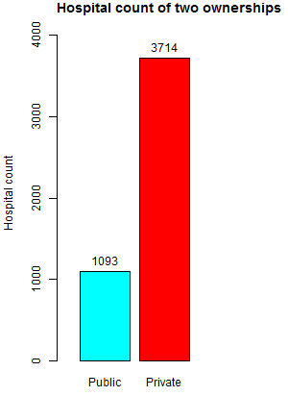
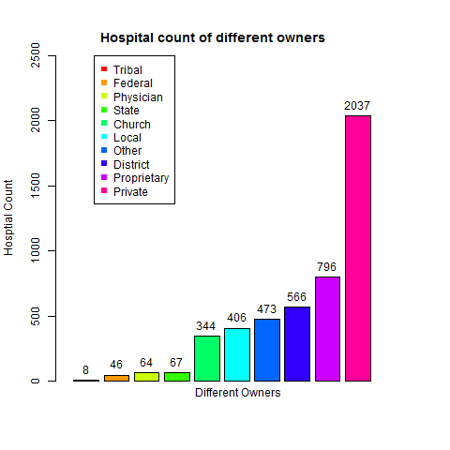
Hospital counts of different owners and ownerships

Slide 6
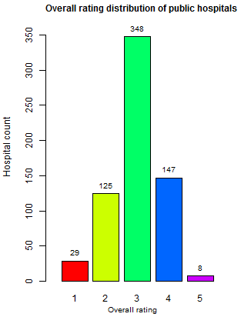
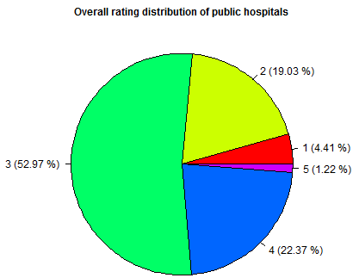
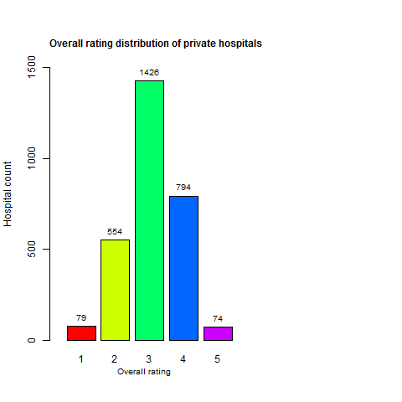
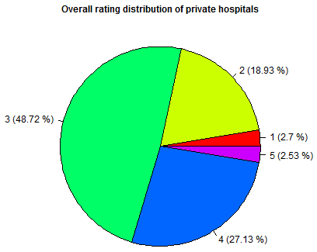
Overall rating distribution in public and private hospitals
Ownership Avg.overall.rating
1 Public 2.970
2 Private 3.079
Owners Avg.overall.rating
1 Federal 2.94
2 District 3.03
3 Local 2.95
4 State 2.64
5 Physician 3.89
6 Proprietary 2.85
7 Tribal 2.50
8 Church 3.19
9 Other 3.16
10 Private 3.12

Slide 7
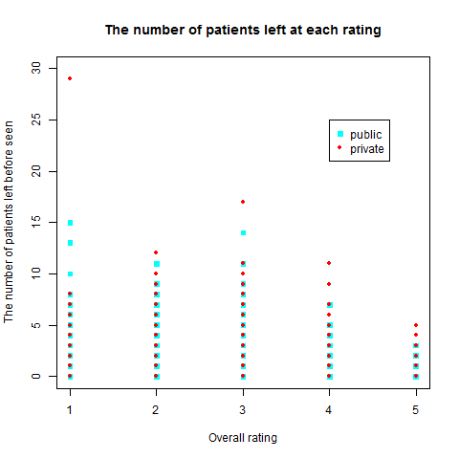
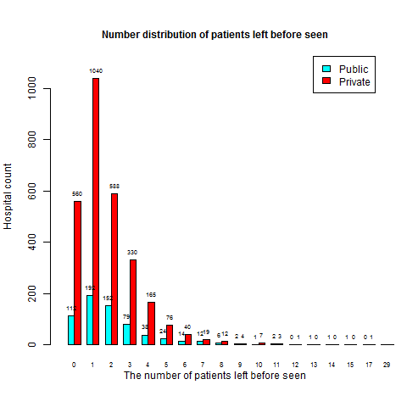
Timely and effective care, measured by how many patients Left before being seen

Slide 8
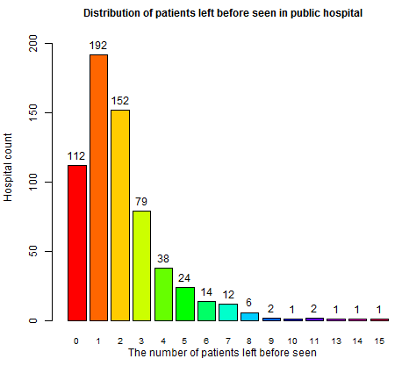
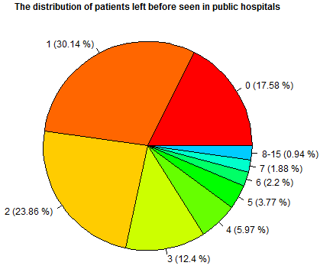
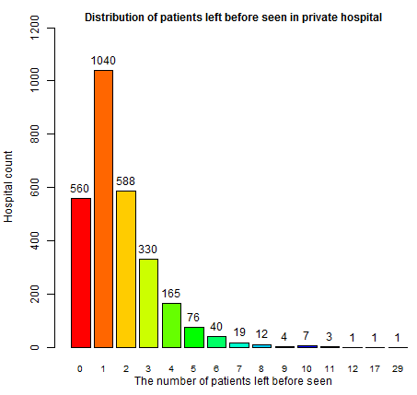
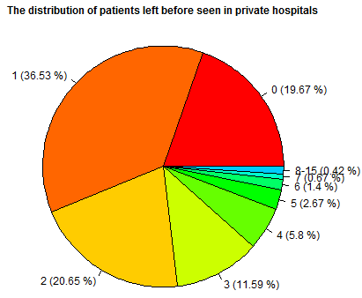
Timely and Effective Care, Measured by How Many Patients Left before Being Seen
ownership Avg.score Sum.patient.left
Private 1.76 4684
Public 1.89 1541
Owners Avg.score Sum.patient.left
Church 1.63 499
District 2.12 731
Federal 1.64 23
Local 1.83 423
Other 1.75 636
Physician 1.14 32
Private 1.76 2679
Proprietary 1.69 1066
State 2.77 130
Tribal 6.00 6

Slide 9
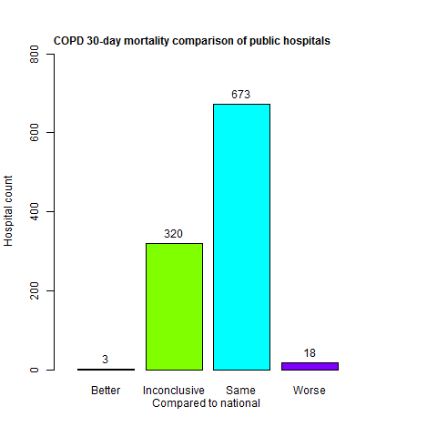
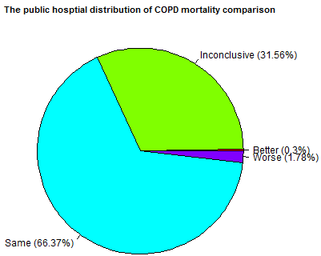
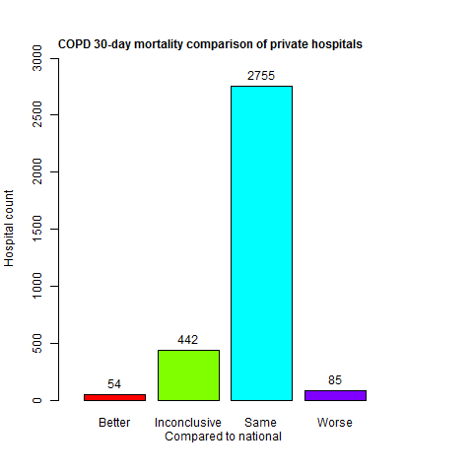
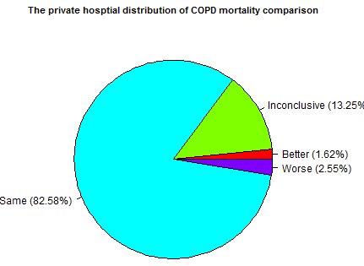
30-day Mortality Comparison, Measured on COPD(chronic Obstructive Pulmonary Disease)
Ownership Avg.score
Public 8.18
Private 8.06
Notes:
Shanshan - Mortality Comparison

Slide 10
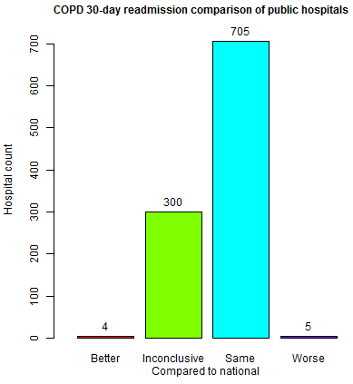
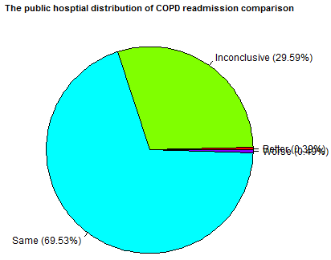
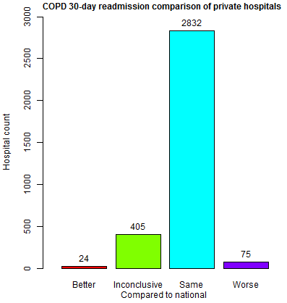
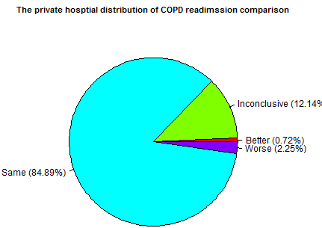
30-day Readmission Comparison, Measured on COPD (Chronic Obstructive Pulmonary Disease)
Ownership Avg.score
Public 19.90
Private 20.02
Notes:
Shanshan - Mortality Comparison

Slide 11
30-day Mortality And Readmission Comparison by Average Scores, Measured on 6-8 Measurements)
mortality.measurement Avg.score Federal District Local State Physician Proprietary Tribal
1 M30.AMI 14.06 14.00 14.33 14.28 14.07 13.28 14.18 <NA>
2 M30.CABG 3.33 3.20 3.36 3.31 2.87 3.28 3.48 <NA>
3 M30.COPD 8.08 7.61 8.25 8.16 7.92 7.92 8.01 8
4 M30.HF 12.16 12.12 12.40 12.53 11.86 11.51 11.97 11.55
5 M30.PN 16.40 15.99 16.67 16.75 15.92 15.44 16.48 15.76
6 M30.STK 14.93 14.55 15.28 15.31 15.42 13.81 14.83 <NA>
Church Other Private
1 14.06 14.00 13.98
2 3.38 3.41 3.27
3 8.10 8.12 8.06
4 12.20 12.19 12.11
5 16.47 16.45 16.2
6 14.95 14.83 14.89
readmission.measurement Avg.score Federal District Local State Physician Proprietary
1 ReAd30.AMI 16.89 16.33 16.77 16.74 17.12 16.05 17.08
2 ReAd30.CABG 14.41 13.80 14.44 14.61 14.37 13.40 14.58
3 ReAd30.COPD 20.00 20.11 19.79 20.00 20.10 19.57 20.11
4 ReAd30.HF 21.95 21.91 21.88 21.99 22.42 22.09 22.33
5 ReAd30.HIP_KNEE 4.61 4.75 4.63 4.58 4.81 4.44 4.69
6 ReAd30.HOSP_WIDE 15.58 15.50 15.52 15.66 15.99 14.92 15.76
7 ReAd30.PN 17.11 17.09 17.03 17.02 17.62 16.54 17.40
8 ReAd30.STK 12.56 12.34 12.52 12.39 12.96 12.69 12.74
Tribal Church Other Private
1 <NA> 16.87 16.77 16.88
2 <NA> 14.49 14.31 14.33
3 20.65 19.84 20.06 20.02
4 21.07 21.71 21.79 21.90
5 <NA> 4.60 4.55 4.59
6 15.57 15.41 15.48 15.57
7 17.11 16.96 16.98 17.09
8 <NA> 12.37 12.60 12.55
Public hospitals

Slide 12
Thank you for your attention!

