Slide 1
Review: Tree search
Initialize the frontier using the starting state
While the frontier is not empty
Choose a frontier node to expand according to search strategy and take it off the frontier
If the node contains the goal state, return solution
Else expand the node and add its children to the frontier
To handle repeated states:
Keep an explored set; add each node to the explored set every time you expand it
Every time you add a node to the frontier, check whether it already exists in the frontier with a higher path cost, and if yes, replace that node with the new one

Slide 2
Review: Uninformed search strategies
Breadth-first search
Depth-first search
Iterative deepening search
Uniform-cost search

Slide 3
Informed search strategies (Sections 3.5-3.6)
Idea: give the algorithm “hints” about the desirability of different states
Use an evaluation function to rank nodes and select the most promising one for expansion
Greedy best-first search
A* search

Slide 4

Heuristic function
Heuristic function h(n) estimates the cost of reaching goal from node n
Example:
Start state
Goal state

Slide 5
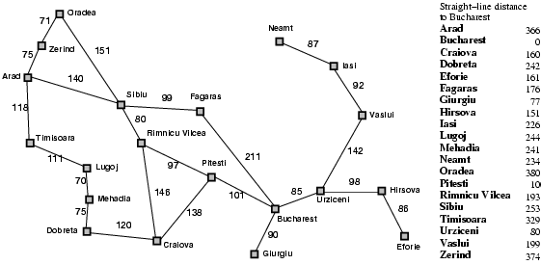
Heuristic for the Romania problem

Slide 6
Greedy best-first search
Expand the node that has the lowest value of the heuristic function h(n)

Slide 7

Greedy best-first search example

Slide 8
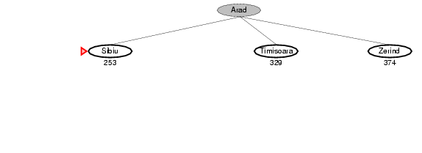
Greedy best-first search example

Slide 9
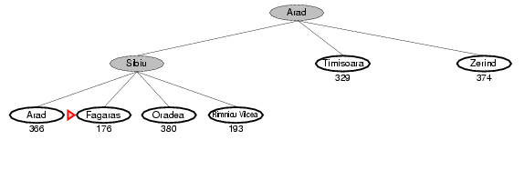
Greedy best-first search example

Slide 10
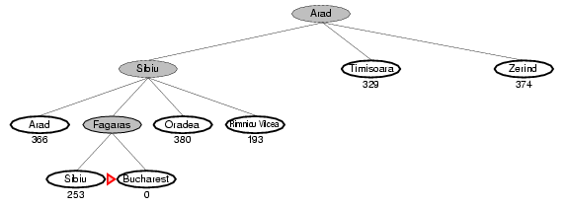
Greedy best-first search example

Slide 11
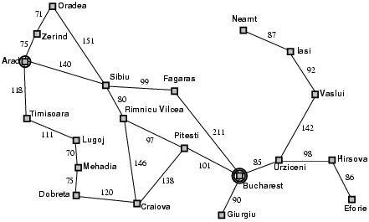
Properties of greedy best-first search
Complete?
No – can get stuck in loops
start
goal

Slide 12
Properties of greedy best-first search
Complete?
No – can get stuck in loops
Optimal?
No

Slide 13
Properties of greedy best-first search
Complete?
No – can get stuck in loops
Optimal?
No
Time?
Worst case: O(b^{m})
Can be much better with a good heuristic
Space?
Worst case: O(b^{m})

Slide 14
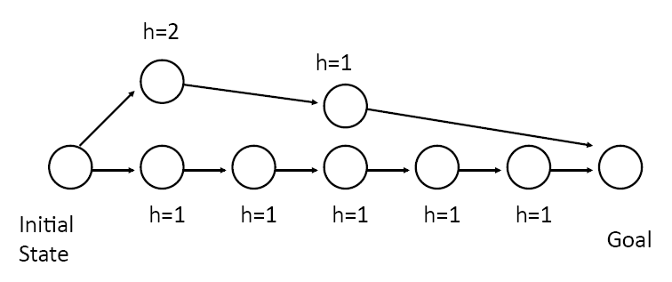
How can we fix the greedy problem?
3
3
2
3
4
3
How about keeping track of the distance already traveled in addition to the distance remaining?

Slide 15
A* search
Idea: avoid expanding paths that are already expensive
The evaluation function f(n) is the estimated total cost of the path through node n to the goal:
f(n) = g(n) + h(n)
g(n): cost so far to reach n (path cost)
h(n): estimated cost from n to goal (heuristic)
Notes:
Dates back to 1968

Slide 16

A* search example

Slide 17
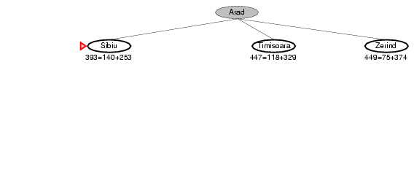
A* search example

Slide 18
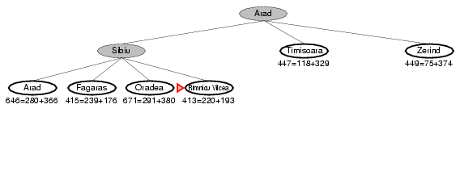
A* search example

Slide 19
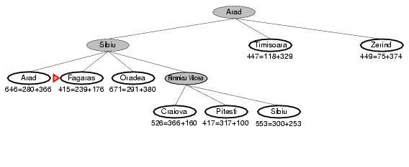
A* search example

Slide 20
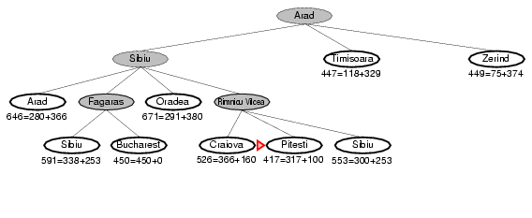
A* search example

Slide 21
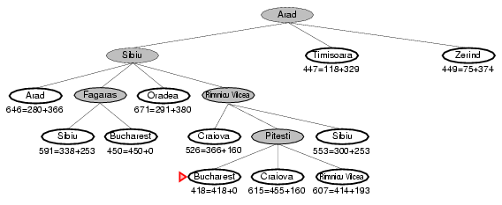
A* search example

Slide 22
Another example
Source: Wikipedia

Slide 23
Uniform cost search vs. A* search
Source: Wikipedia

Slide 24
Admissible heuristics
An admissible heuristic never overestimates the cost to reach the goal, i.e., it is optimistic
A heuristic h(n) is admissible if for every node n, h(n) ≤ h*(n), where h*(n) is the true cost to reach the goal state from n
Example: straight line distance never overestimates the actual road distance
Theorem: If h(n) is admissible, A* is optimal

Slide 25
Optimality of A*
Theorem: If the heuristic is admissible, A* without repeated state detection is optimal
Proof sketch:
Let C* be the evaluation function value (actual path cost) of the first goal node we select for expansion
Then all the other nodes on the frontier have estimated path costs to the goal that are at least as big as C*
Because we are using an admissible heuristic, the true path costs to the goal for those nodes cannot be less than C*
start
n
frontier
Estimated path costs to goal
Actual
path costs to goal

Slide 26
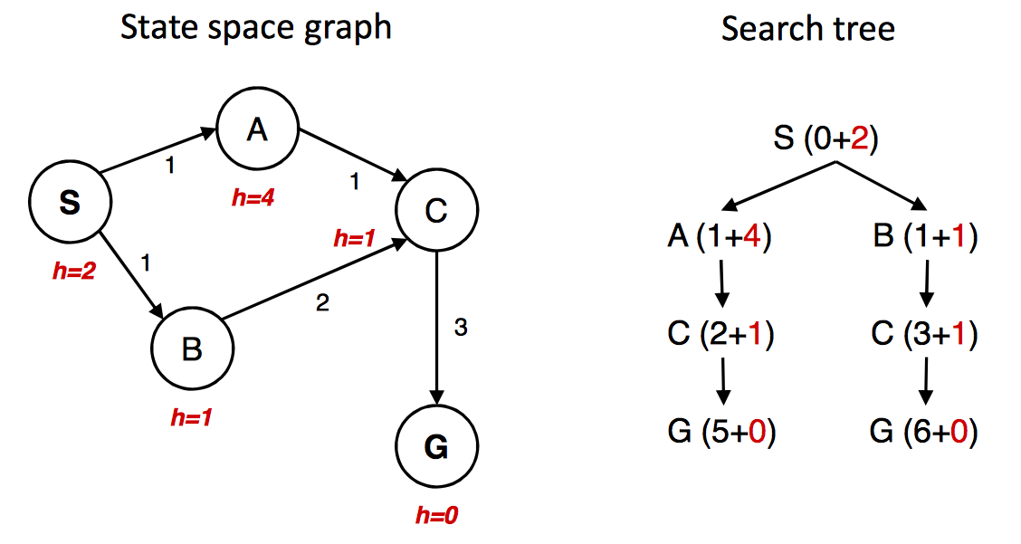
A* gone wrong?
Source: Berkeley CS188x

Slide 27
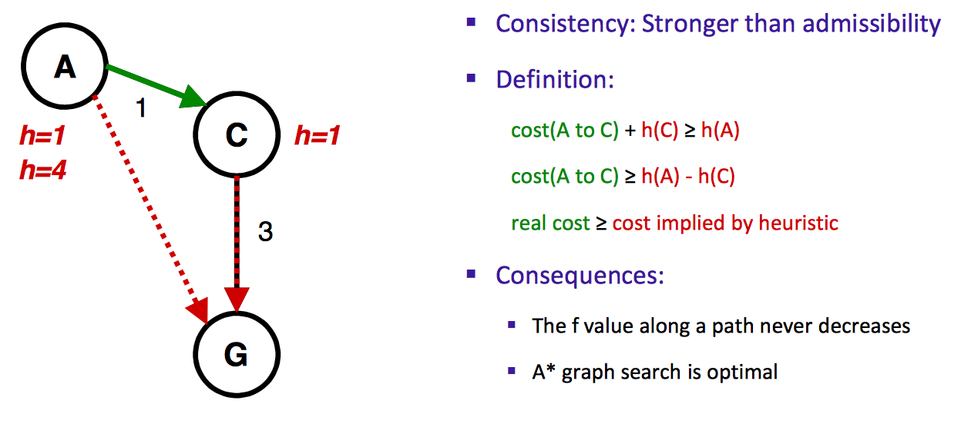
Consistency of heuristics
h=4
Source: Berkeley CS188x

Slide 28
Optimality of A*
Tree search (i.e., search without repeated state detection):
A* is optimal if heuristic is admissible (and non-negative)
Graph search (i.e., search with repeated state detection)
A* optimal if heuristic is consistent
Consistency implies admissibility
In general, most natural admissible heuristics tend to be consistent, especially if they come from relaxed problems
Source: Berkeley CS188x

Slide 29
Optimality of A*
A* is optimally efficient – no other tree-based algorithm that uses the same heuristic can expand fewer nodes and still be guaranteed to find the optimal solution
A* expands all nodes for which f(n) ≤ C*. Any algorithm that does not risks missing the optimal solution

Slide 30
Properties of A*
Complete?
Yes – unless there are infinitely many nodes with f(n) ≤ C*
Optimal?
Yes
Time?
Number of nodes for which f(n) ≤ C* (exponential)
Space?
Exponential

Slide 31
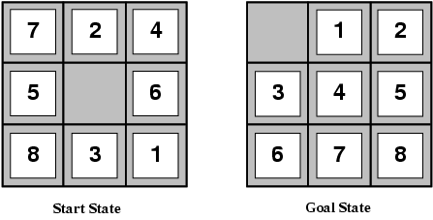
Designing heuristic functions
Heuristics for the 8-puzzle
h₁(n) = number of misplaced tiles
h₂(n) = total Manhattan distance (number of squares from desired location of each tile)
h₁(start) = 8
h₂(start) = 3+1+2+2+2+3+3+2 = 18
Are h₁ and h₂ admissible?

Slide 32
Heuristics from relaxed problems
A problem with fewer restrictions on the actions is called a relaxed problem
The cost of an optimal solution to a relaxed problem is an admissible heuristic for the original problem
If the rules of the 8-puzzle are relaxed so that a tile can move anywhere, then h₁(n) gives the shortest solution
If the rules are relaxed so that a tile can move to any adjacent square, then h₂(n) gives the shortest solution

Slide 33
Heuristics from subproblems
Let h₃(n) be the cost of getting a subset of tiles (say, 1,2,3,4) into their correct positions
Can precompute and save the exact solution cost for every possible subproblem instance – pattern database

Slide 34
Dominance
If h₁ and h₂ are both admissible heuristics and h₂(n) ≥ h₁(n) for all n, (both admissible) then h₂ dominates h₁
Which one is better for search?
A* search expands every node with f(n) < C* or h(n) < C* – g(n)
Therefore, A* search with h₁ will expand more nodes

Slide 35
Dominance
Typical search costs for the 8-puzzle (average number of nodes expanded for different solution depths):
d=12 IDS = 3,644,035 nodes A*(h₁) = 227 nodes A*(h₂) = 73 nodes
d=24 IDS ≈ 54,000,000,000 nodes A*(h₁) = 39,135 nodes A*(h₂) = 1,641 nodes

Slide 36
Combining heuristics
Suppose we have a collection of admissible heuristics h₁(n), h₂(n), …, h_{m}(n), but none of them dominates the others
How can we combine them?
h(n) = max{h₁(n), h₂(n), …, h_{m}(n)}

Slide 37
Weighted A* search
Idea: speed up search at the expense of optimality
Take an admissible heuristic, “inflate” it by a multiple α > 1, and then perform A* search as usual
Fewer nodes tend to get expanded, but the resulting solution may be suboptimal (its cost will be at most α times the cost of the optimal solution)

Slide 38
Example of weighted A* search
Heuristic: 5 * Euclidean distance from goal
Source: Wikipedia

Slide 39
Example of weighted A* search
Heuristic: 5 * Euclidean distance from goal
Source: Wikipedia
Compare: Exact A*

Slide 40
Additional pointers
Interactive path finding demo
Variants of A* for path finding on grids

Slide 41
All search strategies
Algorithm | Complete? | Optimal? | Time complexity | Space complexity
BFS
DFS
IDS
UCS
Greedy
A*
Yes
If all step costs are equal
O(b^{d})
O(b^{d})
No
No
O(b^{m})
O(bm)
Yes
If all step costs are equal
O(b^{d})
O(bd)
Yes
Yes
Number of nodes with g(n) ≤ C*
Worst case: O(b^{m})
No
No
Best case: O(bd)
Yes (if heuristic is
admissible)
Yes
Number of nodes with g(n)+h(n) ≤ C*

Slide 42
A note on the complexity of search
We said that the worst-case complexity of search is exponential in the length of the solution path
But the length of the solution path can be exponential in the number of “objects” in the problem!
Example: towers of Hanoi

