Slide 1
Advanced MPI
Slides are available at
http://www.mcs.anl.gov/~balaji/tmp/2013-06-11-ics-mpi.pptx
Pavan Balaji
Argonne National Laboratory
Email: balaji@mcs.anl.gov
Web: http://www.mcs.anl.gov/~balaji
Torsten Hoefler
ETH, Zurich
Email: htor@inf.ethz.ch
Web: http://htor.inf.ethz.ch/

Slide 2
What this tutorial will cover
Some advanced topics in MPI
Not a complete set of MPI features
Will not include all details of each feature
Idea is to give you a feel of the features so you can start using them in your applications
Hybrid Programming with Threads and Shared Memory
MPI-2 and MPI-3
One-sided Communication (Remote Memory Access)
MPI-2 and MPI-3
Nonblocking Collective Communication
MPI-3
Topology-aware Communication
MPI-1 and MPI-2.2

Slide 3
What is MPI?
MPI: Message Passing Interface
The MPI Forum organized in 1992 with broad participation by:
Vendors: IBM, Intel, TMC, SGI, Convex, Meiko
Portability library writers: PVM, p4
Users: application scientists and library writers
MPI-1 finished in 18 months
Incorporates the best ideas in a “standard” way
Each function takes fixed arguments
Each function has fixed semantics
Standardizes what the MPI implementation provides and what the application can and cannot expect
Each system can implement it differently as long as the semantics match
MPI is not…
a language or compiler specification
a specific implementation or product

Slide 4
Following MPI Standards
MPI-2 was released in 2000
Several additional features including MPI + threads, MPI-I/O, remote memory access functionality and many others
MPI-2.1 (2008) and MPI-2.2 (2009) were recently released with some corrections to the standard and small features
MPI-3 (2012) added several new features to MPI
The Standard itself:
at http://www.mpi-forum.org
All MPI official releases, in both postscript and HTML
Other information on Web:
at http://www.mcs.anl.gov/mpi
pointers to lots of material including tutorials, a FAQ, other MPI pages

Slide 5
Important considerations while using MPI
All parallelism is explicit: the programmer is responsible for correctly identifying parallelism and implementing parallel algorithms using MPI constructs

Slide 6
Parallel Sort using MPI Send/Recv
Rank 0
8
23
19
67
45
35
1
24
13
30
3
5
Rank 0
O(N log N)
Rank 1
8
19
23
35
45
67
1
3
5
13
24
30
Rank 0
8
19
23
35
45
67
1
3
5
13
24
30
Rank 0
1
3
5
8
13
19
23
24
30
35
45
67

Slide 7
Parallel Sort using MPI Send/Recv (contd.)
#include <mpi.h>
#include <stdio.h>
int main(int argc, char ** argv)
{
int rank;
int a[1000], b[500];
MPI_Init(&argc, &argv);
MPI_Comm_rank(MPI_COMM_WORLD, &rank);
if (rank == 0) {
MPI_Send(&a[500], 500, MPI_INT, 1, 0, MPI_COMM_WORLD);
sort(a, 500);
MPI_Recv(b, 500, MPI_INT, 1, 0, MPI_COMM_WORLD, &status);
/* Serial: Merge array b and sorted part of array a */
}
else if (rank == 1) {
MPI_Recv(b, 500, MPI_INT, 0, 0, MPI_COMM_WORLD, &status);
sort(b, 500);
MPI_Send(b, 500, MPI_INT, 0, 0, MPI_COMM_WORLD);
}
MPI_Finalize(); return 0;
}

Slide 8
A Non-Blocking communication example
P0
Blocking Communication
P1
P0
Non-blocking Communication
P1

Slide 9
A Non-Blocking communication example
int main(int argc, char ** argv)
{
[...snip...]
if (rank == 0) {
for (i=0; i< 100; i++) {
/* Compute each data element and send it out */
data[i] = compute(i);
MPI_Isend(&data[i], 1, MPI_INT, 1, 0, MPI_COMM_WORLD,
&request[i]);
}
MPI_Waitall(100, request, MPI_STATUSES_IGNORE)
}
else {
for (i = 0; i < 100; i++)
MPI_Recv(&data[i], 1, MPI_INT, 0, 0, MPI_COMM_WORLD,
MPI_STATUS_IGNORE);
}
[...snip...]
}

Slide 10
MPI Collective Routines
Many Routines: MPI_ALLGATHER, MPI_ALLGATHERV, MPI_ALLREDUCE, MPI_ALLTOALL, MPI_ALLTOALLV, MPI_BCAST, MPI_GATHER, MPI_GATHERV, MPI_REDUCE, MPI_REDUCESCATTER, MPI_SCAN, MPI_SCATTER, MPI_SCATTERV
“All” versions deliver results to all participating processes
“V” versions (stands for vector) allow the hunks to have different sizes
MPI_ALLREDUCE, MPI_REDUCE, MPI_REDUCESCATTER, and MPI_SCAN take both built-in and user-defined combiner functions

Slide 11
MPI Built-in Collective Computation Operations
MPI_MAX
MPI_MIN
MPI_PROD
MPI_SUM
MPI_LAND
MPI_LOR
MPI_LXOR
MPI_BAND
MPI_BOR
MPI_BXOR
MPI_MAXLOC
MPI_MINLOC
Maximum
Minimum
Product
Sum
Logical and
Logical or
Logical exclusive or
Bitwise and
Bitwise or
Bitwise exclusive or
Maximum and location
Minimum and location

Slide 12
Introduction to Datatypes in MPI
Datatypes allow to (de)serialize arbitrary data layouts into a message stream
Networks provide serial channels
Same for block devices and I/O
Several constructors allow arbitrary layouts
Recursive specification possible
Declarative specification of data-layout
“what” and not “how”, leaves optimization to implementation (many unexplored possibilities!)
Choosing the right constructors is not always simple

Slide 13
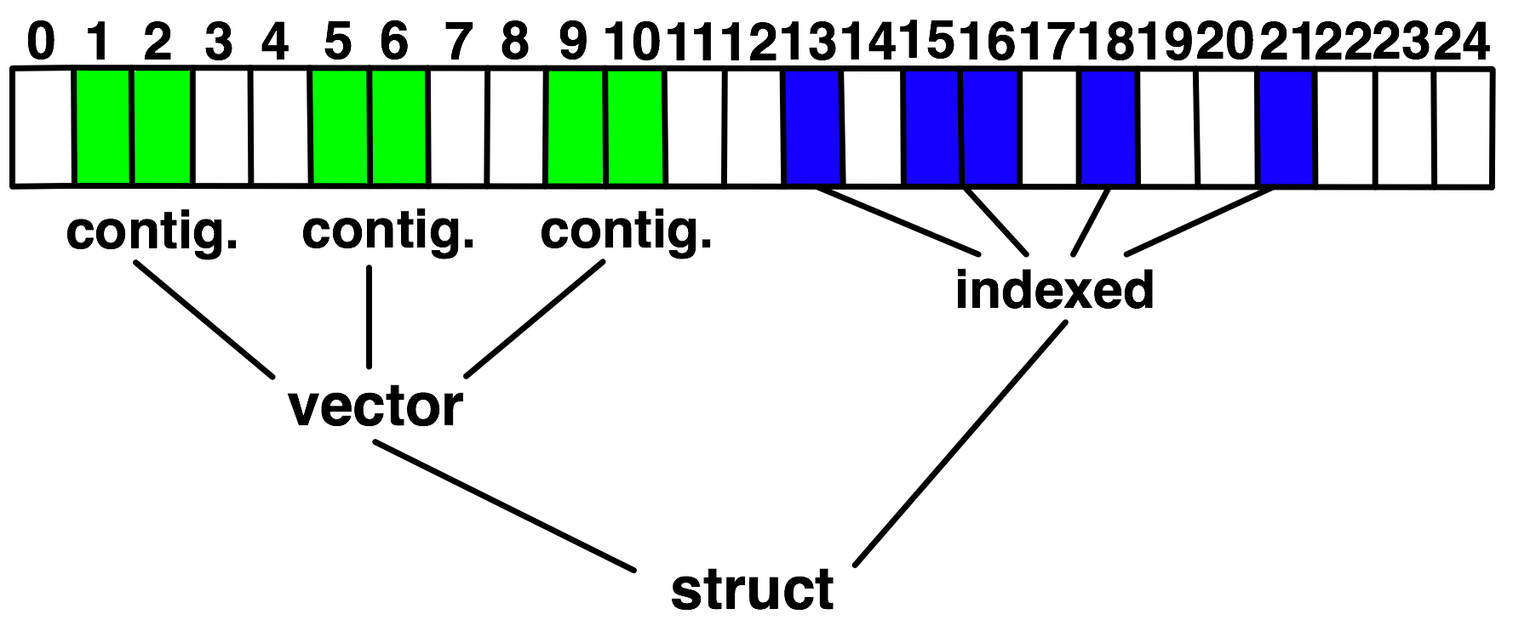
Derived Datatype Example
Explain Lower Bound, Size, Extent

Slide 14
Advanced Topics: Hybrid Programming with Threads and Shared Memory

Slide 15
MPI and Threads
MPI describes parallelism between processes (with separate address spaces)
Thread parallelism provides a shared-memory model within a process
OpenMP and Pthreads are common models
OpenMP provides convenient features for loop-level parallelism. Threads are created and managed by the compiler, based on user directives.
Pthreads provide more complex and dynamic approaches. Threads are created and managed explicitly by the user.

Slide 16
Programming for Multicore
Almost all chips are multicore these days
Today’s clusters often comprise multiple CPUs per node sharing memory, and the nodes themselves are connected by a network
Common options for programming such clusters
All MPI
MPI between processes both within a node and across nodes
MPI internally uses shared memory to communicate within a node
MPI + OpenMP
Use OpenMP within a node and MPI across nodes
MPI + Pthreads
Use Pthreads within a node and MPI across nodes
The latter two approaches are known as “hybrid programming”

Slide 17
MPI’s Four Levels of Thread Safety
MPI defines four levels of thread safety -- these are commitments the application makes to the MPI
MPI_THREAD_SINGLE: only one thread exists in the application
MPI_THREAD_FUNNELED: multithreaded, but only the main thread makes MPI calls (the one that called MPI_Init_thread)
MPI_THREAD_SERIALIZED: multithreaded, but only one thread at a time makes MPI calls
MPI_THREAD_MULTIPLE: multithreaded and any thread can make MPI calls at any time (with some restrictions to avoid races – see next slide)
MPI defines an alternative to MPI_Init
MPI_Init_thread(requested, provided)
Application indicates what level it needs; MPI implementation returns the level it supports

Slide 18
MPI+OpenMP
MPI_THREAD_SINGLE
There is no OpenMP multithreading in the program.
MPI_THREAD_FUNNELED
All of the MPI calls are made by the master thread. i.e. all MPI calls are
Outside OpenMP parallel regions, or
Inside OpenMP master regions, or
Guarded by call to MPI_Is_thread_main MPI call.
(same thread that called MPI_Init_thread)
MPI_THREAD_SERIALIZED
#pragma omp parallel
…
#pragma omp critical
{
…MPI calls allowed here…
}
MPI_THREAD_MULTIPLE
Any thread may make an MPI call at any time

Slide 19
Specification of MPI_THREAD_MULTIPLE
When multiple threads make MPI calls concurrently, the outcome will be as if the calls executed sequentially in some (any) order
Blocking MPI calls will block only the calling thread and will not prevent other threads from running or executing MPI functions
It is the user's responsibility to prevent races when threads in the same application post conflicting MPI calls
e.g., accessing an info object from one thread and freeing it from another thread
User must ensure that collective operations on the same communicator, window, or file handle are correctly ordered among threads
e.g., cannot call a broadcast on one thread and a reduce on another thread on the same communicator
Notes:
19

Slide 20
Threads and MPI
An implementation is not required to support levels higher than MPI_THREAD_SINGLE; that is, an implementation is not required to be thread safe
A fully thread-safe implementation will support MPI_THREAD_MULTIPLE
A program that calls MPI_Init (instead of MPI_Init_thread) should assume that only MPI_THREAD_SINGLE is supported
A threaded MPI program that does not call MPI_Init_thread is an incorrect program (common user error we see)
Notes:
20

Slide 21
An Incorrect Program
Process 0
MPI_Bcast(comm)
MPI_Barrier(comm)
Process 1
MPI_Bcast(comm)
MPI_Barrier(comm)
Thread 1
Thread 2
Here the user must use some kind of synchronization to ensure that either thread 1 or thread 2 gets scheduled first on both processes
Otherwise a broadcast may get matched with a barrier on the same communicator, which is not allowed in MPI

Slide 22
A Correct Example
Process 0
MPI_Recv(src=1)
MPI_Send(dst=1)
Process 1
MPI_Recv(src=0)
MPI_Send(dst=0)
Thread 1
Thread 2
An implementation must ensure that the above example never deadlocks for any ordering of thread execution
That means the implementation cannot simply acquire a thread lock and block within an MPI function. It must release the lock to allow other threads to make progress.

Slide 23
The Current Situation
All MPI implementations support MPI_THREAD_SINGLE (duh).
They probably support MPI_THREAD_FUNNELED even if they don’t admit it.
Does require thread-safe malloc
Probably OK in OpenMP programs
Many (but not all) implementations support THREAD_MULTIPLE
Hard to implement efficiently though (lock granularity issue)
“Easy” OpenMP programs (loops parallelized with OpenMP, communication in between loops) only need FUNNELED
So don’t need “thread-safe” MPI for many hybrid programs
But watch out for Amdahl’s Law!

Slide 24
Performance with MPI_THREAD_MULTIPLE
Thread safety does not come for free
The implementation must protect certain data structures or parts of code with mutexes or critical sections
To measure the performance impact, we ran tests to measure communication performance when using multiple threads versus multiple processes
Details in our Parallel Computing (journal) paper (2009)

Slide 25
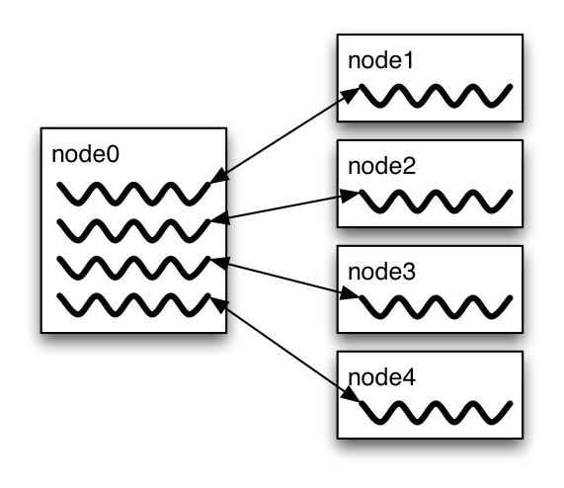
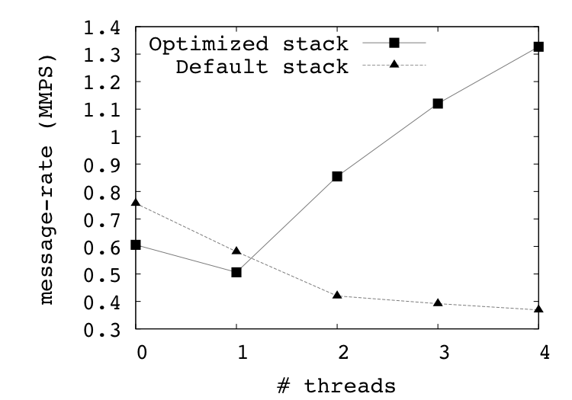
Message Rate Results on BG/P
Message Rate Benchmark

Slide 26
Why is it hard to optimize MPI_THREAD_MULTIPLE
MPI internally maintains several resources
Because of MPI semantics, it is required that all threads have access to some of the data structures
E.g., thread 1 can post an Irecv, and thread 2 can wait for its completion – thus the request queue has to be shared between both threads
Since multiple threads are accessing this shared queue, it needs to be locked – adds a lot of overhead
In MPI-3.1 (next version of the standard), we plan to add additional features to allow the user to provide hints (e.g., requests posted to this communicator are not shared with other threads)

Slide 27
Thread Programming is Hard
“The Problem with Threads,” IEEE Computer
Prof. Ed Lee, UC Berkeley
http://ptolemy.eecs.berkeley.edu/publications/papers/06/problemwithThreads/
“Why Threads are a Bad Idea (for most purposes)”
John Ousterhout
http://home.pacbell.net/ouster/threads.pdf
“Night of the Living Threads” http://weblogs.mozillazine.org/roc/archives/2005/12/night_of_the_living_threads.html
Too hard to know whether code is correct
Too hard to debug
I would rather debug an MPI program than a threads program
27

Slide 28
Ptolemy and Threads
Ptolemy is a framework for modeling, simulation, and design of concurrent, real-time, embedded systems
Developed at UC Berkeley (PI: Ed Lee)
It is a rigorously tested, widely used piece of software
Ptolemy II was first released in 2000
Yet, on April 26, 2004, four years after it was first released, the code deadlocked!
The bug was lurking for 4 years of widespread use and testing!
A faster machine or something that changed the timing caught the bug

Slide 29
An Example I encountered recently
We received a bug report about a very simple multithreaded MPI program that hangs
Run with 2 processes
Each process has 2 threads
Both threads communicate with threads on the other process as shown in the next slide
I spent several hours trying to debug MPICH2 before discovering that the bug is actually in the user’s program ☹

Slide 30
2 Proceses, 2 Threads, Each Thread Executes this Code
for (j = 0; j < 2; j++) {
if (rank == 1) {
for (i = 0; i < 3; i++)
MPI_Send(NULL, 0, MPI_CHAR, 0, 0, MPI_COMM_WORLD);
for (i = 0; i < 3; i++)
MPI_Recv(NULL, 0, MPI_CHAR, 0, 0, MPI_COMM_WORLD, &stat);
}
else { /* rank == 0 */
for (i = 0; i < 3; i++)
MPI_Recv(NULL, 0, MPI_CHAR, 1, 0, MPI_COMM_WORLD, &stat);
for (i = 0; i < 3; i++)
MPI_Send(NULL, 0, MPI_CHAR, 1, 0, MPI_COMM_WORLD);
}
}

Slide 31
What Happened
Rank 0
3 recvs
3 sends
3 recvs
3 sends
3 recvs
3 sends
3 recvs
3 sends
Rank 1
3 sends
3 recvs
3 sends
3 recvs
3 sends
3 recvs
3 sends
3 recvs
Thread 1
Thread 2
All 4 threads stuck in receives because the sends from one iteration got matched with receives from the next iteration
Solution: Use iteration number as tag in the messages

Slide 32
Hybrid Programming with Shared Memory
MPI-3 allows different processes to allocate shared memory through MPI
MPI_Win_allocate_shared
Uses many of the concepts of one-sided communication
Applications can do hybrid programming using MPI or load/store accesses on the shared memory window
Other MPI functions can be used to synchronize access to shared memory regions
Much simpler to program than threads

Slide 33
Advanced Topics: Nonblocking Collectives

Slide 34
Nonblocking Collective Communication
Nonblocking communication
Deadlock avoidance
Overlapping communication/computation
Collective communication
Collection of pre-defined optimized routines
Nonblocking collective communication
Combines both techniques (more than the sum of the parts ☺)
System noise/imbalance resiliency
Semantic advantages
Examples

Slide 35
Nonblocking Communication
Semantics are simple:
Function returns no matter what
No progress guarantee!
E.g., MPI_Isend(<send-args>, MPI_Request *req);
Nonblocking tests:
Test, Testany, Testall, Testsome
Blocking wait:
Wait, Waitany, Waitall, Waitsome

Slide 36
Nonblocking Communication
Blocking vs. nonblocking communication
Mostly equivalent, nonblocking has constant request management overhead
Nonblocking may have other non-trivial overheads
Request queue length
Linear impact on performance
E.g., BG/P: 100ns/request
Tune unexpected queue length!

Slide 37
Collective Communication
Three types:
Synchronization (Barrier)
Data Movement (Scatter, Gather, Alltoall, Allgather)
Reductions (Reduce, Allreduce, (Ex)Scan, Reduce_scatter)
Common semantics:
no tags (communicators can serve as such)
Not necessarily synchronizing (only barrier and all*)
Overview of functions and performance models

Slide 38
Nonblocking Collective Communication
Nonblocking variants of all collectives
MPI_Ibcast(<bcast args>, MPI_Request *req);
Semantics:
Function returns no matter what
No guaranteed progress (quality of implementation)
Usual completion calls (wait, test) + mixing
Out-of order completion
Restrictions:
No tags, in-order matching
Send and vector buffers may not be touched during operation
MPI_Cancel not supported
No matching with blocking collectives
Hoefler et al.: Implementation and Performance Analysis of Non-Blocking Collective Operations for MPI

Slide 39
Nonblocking Collective Communication
Semantic advantages:
Enable asynchronous progression (and manual)
Software pipelinling
Decouple data transfer and synchronization
Noise resiliency!
Allow overlapping communicators
See also neighborhood collectives
Multiple outstanding operations at any time
Enables pipelining window
Hoefler et al.: Implementation and Performance Analysis of Non-Blocking Collective Operations for MPI

Slide 40
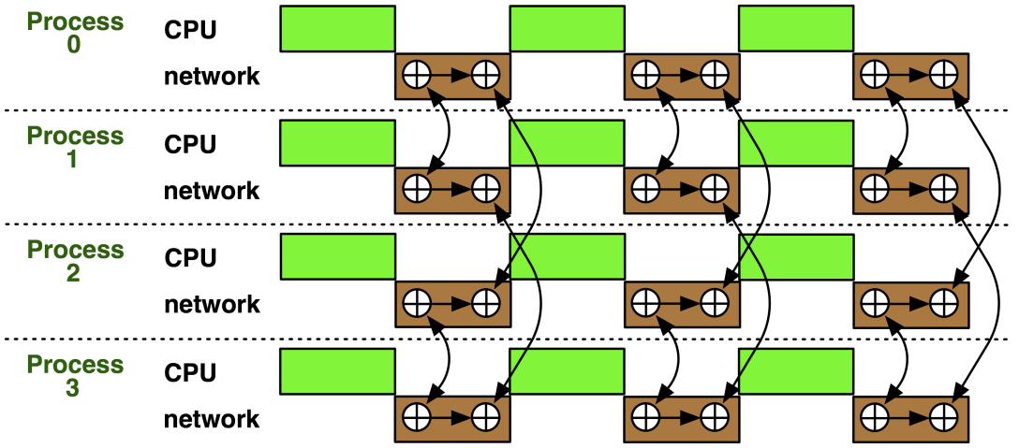
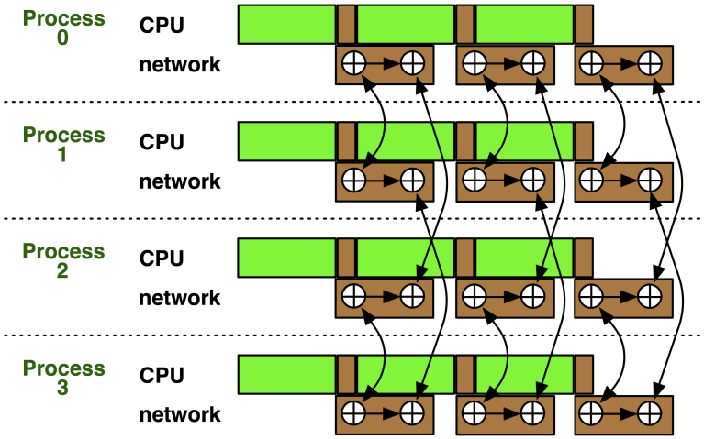
Nonblocking Collectives Overlap
Software pipelining
More complex parameters
Progression issues
Not scale-invariant
Hoefler: Leveraging Non-blocking Collective Communication in High-performance Applications

Slide 41
A Non-Blocking Barrier?
What can that be good for? Well, quite a bit!
Semantics:
MPI_Ibarrier() – calling process entered the barrier, no synchronization happens
Synchronization may happen asynchronously
MPI_Test/Wait() – synchronization happens if necessary
Uses:
Overlap barrier latency (small benefit)
Use the split semantics! Processes notify non-collectively but synchronize collectively!

Slide 42

A Semantics Example: DSDE
Dynamic Sparse Data Exchange
Dynamic: comm. pattern varies across iterations
Sparse: number of neighbors is limited ( )
Data exchange: only senders know neighbors
Hoefler et al.:Scalable Communication Protocols for Dynamic Sparse Data Exchange

Slide 43
Dynamic Sparse Data Exchange (DSDE)
Main Problem: metadata
Determine who wants to send how much data to me (I must post receive and reserve memory)
OR:
Use MPI semantics:
Unknown sender
MPI_ANY_SOURCE
Unknown message size
MPI_PROBE
Reduces problem to counting the number of neighbors
Allow faster implementation!
T. Hoefler et al.:Scalable Communication Protocols for Dynamic Sparse Data Exchange

Slide 44

Using Alltoall (PEX)
Bases on Personalized Exchange ( )
Processes exchange metadata (sizes) about neighborhoods with all-to-all
Processes post receives afterwards
Most intuitive but least performance and scalability!
T. Hoefler et al.:Scalable Communication Protocols for Dynamic Sparse Data Exchange

Slide 45
Reduce_scatter (PCX)
Bases on Personalized Census ( )
Processes exchange metadata (counts) about neighborhoods with reduce_scatter
Receivers checks with wildcard MPI_IPROBE and receives messages
Better than PEX but non-deterministic!
T. Hoefler et al.:Scalable Communication Protocols for Dynamic Sparse Data Exchange

Slide 46

MPI_Ibarrier (NBX)
Complexity - census (barrier): ( )
Combines metadata with actual transmission
Point-to-point synchronization
Continue receiving until barrier completes
Processes start coll. synch. (barrier) when p2p phase ended
barrier = distributed marker!
Better than PEX, PCX, RSX!
T. Hoefler et al.:Scalable Communication Protocols for Dynamic Sparse Data Exchange

Slide 47
Parallel Breadth First Search
On a clustered Erdős-Rényi graph, weak scaling
6.75 million edges per node (filled 1 GiB)
HW barrier support is significant at large scale!
BlueGene/P – with HW barrier!
Myrinet 2000 with LibNBC
T. Hoefler et al.:Scalable Communication Protocols for Dynamic Sparse Data Exchange
Notes:
PEX – All_to_all
PCS – Reduce_scatter
NBX – ISSEND / IBARRIER

Slide 48
A Complex Example: FFT
for(int x=0; x<n/p; ++x) 1d_fft(/* x-th stencil */);
// pack data for alltoall
MPI_Alltoall(&in, n/p*n/p, cplx_t, &out, n/p*n/p, cplx_t, comm);
// unpack data from alltoall and transpose
for(int y=0; y<n/p; ++y) 1d_fft(/* y-th stencil */);
// pack data for alltoall
MPI_Alltoall(&in, n/p*n/p, cplx_t, &out, n/p*n/p, cplx_t, comm);
// unpack data from alltoall and transpose
Hoefler: Leveraging Non-blocking Collective Communication in High-performance Applications

Slide 49
FFT Software Pipelining
MPI_Request req[nb];
for(int b=0; b<nb; ++b) { // loop over blocks
for(int x=b*n/p/nb; x<(b+1)n/p/nb; ++x) 1d_fft(/* x-th stencil*/);
// pack b-th block of data for alltoall
MPI_Ialltoall(&in, n/p*n/p/bs, cplx_t, &out, n/p*n/p, cplx_t, comm, &req[b]);
}
MPI_Waitall(nb, req, MPI_STATUSES_IGNORE);
// modified unpack data from alltoall and transpose
for(int y=0; y<n/p; ++y) 1d_fft(/* y-th stencil */);
// pack data for alltoall
MPI_Alltoall(&in, n/p*n/p, cplx_t, &out, n/p*n/p, cplx_t, comm);
// unpack data from alltoall and transpose
Hoefler: Leveraging Non-blocking Collective Communication in High-performance Applications

Slide 50
A Complex Example: FFT
Main parameter: nb vs. n → blocksize
Strike balance between k-1st alltoall and k^{th} FFT stencil block
Costs per iteration:
Alltoall (bandwidth) costs: T_{a2a} ≈ n²/p/nb * β
FFT costs: T_{fft} ≈ n/p/nb * T_{1DFFT}(n)
Adjust blocksize parameters to actual machine
Either with model or simple sweep
Hoefler: Leveraging Non-blocking Collective Communication in High-performance Applications
Notes:
Use blocks and compute/transmit in a more pipelined way

Slide 51
Nonblocking And Collective Summary
Nonblocking comm does two things:
Overlap and relax synchronization
Collective comm does one thing
Specialized pre-optimized routines
Performance portability
Hopefully transparent performance
They can be composed
E.g., software pipelining

Slide 52
Advanced Topics: One-sided Communication

Slide 53
One-sided Communication
The basic idea of one-sided communication models is to decouple data movement with process synchronization
Should be able move data without requiring that the remote process synchronize
Each process exposes a part of its memory to other processes
Other processes can directly read from or write to this memory
Process 0
Process 1
Process 2
Process 3
Public Memory Region
Private Memory Region
Public Memory Region
Private Memory Region
Public Memory Region
Private Memory Region
Public Memory Region
Global Address Space
Private Memory Region
Private Memory Region
Private Memory Region
Private Memory Region
Private Memory Region

Slide 54
Two-sided Communication Example
Memory
Processor
Processor
Memory
Memory
Segment
Memory
Segment
Memory
Segment
Memory
Segment
Memory
Segment
Send
Recv
Send
Recv
MPI implementation
MPI implementation

Slide 55
One-sided Communication Example
Memory
Processor
Processor
Memory
Memory
Segment
Memory
Segment
Memory
Segment
Memory
Segment
Send
Recv
Send
Recv
MPI implementation
MPI implementation

Slide 56
Comparing One-sided and Two-sided Programming
Process 0
Process 1
SEND(data)
DELAY
Even the sending process is delayed
RECV(data)
Process 0
Process 1
PUT(data)
DELAY
Delay in process 1 does not affect process 0
GET(data)

Slide 57
What we need to know in MPI RMA
How to create remote accessible memory?
Reading, Writing and Updating remote memory
Data Synchronization
Memory Model

Slide 58
Creating Public Memory
Any memory created by a process is, by default, only locally accessible
X = malloc(100);
Once the memory is created, the user has to make an explicit MPI call to declare a memory region as remotely accessible
MPI terminology for remotely accessible memory is a “window”
A group of processes collectively create a “window”
Once a memory region is declared as remotely accessible, all processes in the window can read/write data to this memory without explicitly synchronizing with the target process

Slide 59
Window creation models
Four models exist
MPI_WIN_CREATE
You already have an allocated buffer that you would like to make remotely accessible
MPI_WIN_ALLOCATE
You want to create a buffer and directly make it remotely accessible
MPI_WIN_CREATE_DYNAMIC
You don’t have a buffer yet, but will have one in the future
MPI_WIN_ALLOCATE_SHARED
You want multiple processes on the same node share a buffer
We will not cover this model today

Slide 60
MPI_WIN_CREATE
int MPI_Win_create(void *base, MPI_Aint size, int disp_unit, MPI_Info info, MPI_Comm comm, MPI_Win *win)
Expose a region of memory in an RMA window
Only data exposed in a window can be accessed with RMA ops.
Arguments:
base - pointer to local data to expose
size - size of local data in bytes (nonnegative integer)
disp_unit - local unit size for displacements, in bytes (positive integer)
info - info argument (handle)
comm - communicator (handle)

Slide 61
Example with MPI_WIN_CREATE
int main(int argc, char ** argv)
{
int *a; MPI_Win win;
MPI_Init(&argc, &argv);
/* create private memory */
a = (void *) malloc(1000 * sizeof(int));
/* use private memory like you normally would */
a[0] = 1; a[1] = 2;
/* collectively declare memory as remotely accessible */
MPI_Win_create(a, 1000, sizeof(int), MPI_INFO_NULL,
MPI_COMM_WORLD, &win);
/* Array ‘a’ is now accessibly by all processes in
* MPI_COMM_WORLD */
MPI_Win_free(&win);
MPI_Finalize(); return 0;
}

Slide 62
MPI_WIN_ALLOCATE
int MPI_Win_allocate(MPI_Aint size, int disp_unit, MPI_Info info, MPI_Comm comm, void *baseptr, MPI_Win *win)
Create a remotely accessible memory region in an RMA window
Only data exposed in a window can be accessed with RMA ops.
Arguments:
size - size of local data in bytes (nonnegative integer)
disp_unit - local unit size for displacements, in bytes (positive integer)
info - info argument (handle)
comm - communicator (handle)
base - pointer to exposed local data

Slide 63
Example with MPI_WIN_ALLOCATE
int main(int argc, char ** argv)
{
int *a; MPI_Win win;
MPI_Init(&argc, &argv);
/* collectively create remotely accessible memory in the
window */
MPI_Win_allocate(1000, sizeof(int), MPI_INFO_NULL,
MPI_COMM_WORLD, &a, &win);
/* Array ‘a’ is now accessible from all processes in
* MPI_COMM_WORLD */
MPI_Win_free(&win);
MPI_Finalize(); return 0;
}

Slide 64
MPI_WIN_CREATE_DYNAMIC
int MPI_Win_create_dynamic(…, MPI_Comm comm, MPI_Win *win)
Create an RMA window, to which data can later be attached
Only data exposed in a window can be accessed with RMA ops
Application can dynamically attach memory to this window
Application can access data on this window only after a memory region has been attached

Slide 65
Example with MPI_WIN_CREATE_DYNAMIC
int main(int argc, char ** argv)
{
int *a; MPI_Win win;
MPI_Init(&argc, &argv);
MPI_Win_create_dynamic(MPI_INFO_NULL, MPI_COMM_WORLD, &win);
/* create private memory */
a = (void *) malloc(1000 * sizeof(int));
/* use private memory like you normally would */
a[0] = 1; a[1] = 2;
/* locally declare memory as remotely accessible */
MPI_Win_attach(win, a, 1000);
/* Array ‘a’ is now accessible from all processes in
MPI_COMM_WORLD*/
/* undeclare public memory */
MPI_Win_detach(win, a);
MPI_Win_free(&win);
MPI_Finalize(); return 0;
}

Slide 66
Data movement
MPI provides ability to read, write and atomically modify data in remotely accessible memory regions
MPI_GET
MPI_PUT
MPI_ACCUMULATE
MPI_GET_ACCUMULATE
MPI_COMPARE_AND_SWAP
MPI_FETCH_AND_OP

Slide 67
Data movement: Get
MPI_Get(
origin_addr, origin_count, origin_datatype,
target_rank,
target_disp, target_count, target_datatype,
win)
Move data to origin, from target
Separate data description triples for origin and target
Target Process
RMA
Window
Local
Buffer
Origin Process

Slide 68
Data movement: Put
MPI_Put(
origin_addr, origin_count, origin_datatype,
target_rank,
target_disp, target_count, target_datatype,
win)
Move data from origin, to target
Same arguments as MPI_Get
Target Process
RMA
Window
Local
Buffer
Origin Process

Slide 69
Data aggregation: Accumulate
Like MPI_Put, but applies an MPI_Op instead
Predefined ops only, no user-defined!
Result ends up at target buffer
Different data layouts between target/origin OK, basic type elements must match
Put-like behavior with MPI_REPLACE (implements f(a,b)=b)
Atomic PUT
Target Process
+=
RMA
Window
Local
Buffer
Origin Process

Slide 70
Data aggregation: Get Accumulate
Like MPI_Get, but applies an MPI_Op instead
Predefined ops only, no user-defined!
Result at target buffer; original data comes to the source
Different data layouts between target/origin OK, basic type elements must match
Get-like behavior with MPI_NO_OP
Atomic GET
Target Process
+=
RMA
Window
Local
Buffer
Origin Process

Slide 71
Ordering of Operations in MPI RMA
For Put/Get operations, ordering does not matter
If you do two PUTs to the same location, the result can be garbage
Two accumulate operations to the same location are valid
If you want “atomic PUTs”, you can do accumulates with MPI_REPLACE
All accumulate operations are ordered by default
User can tell the MPI implementation that (s)he does not require ordering as optimization hints
You can ask for “read-after-write” ordering, “write-after-write” ordering, or “read-after-read” ordering

Slide 72
Additional Atomic Operations
Compare-and-swap
Compare the target value with an input value; if they are the same, replace the target with some other value
Useful for linked list creations – if next pointer is NULL, do something
Fetch-and-Op
Special case of Get_accumulate for predefined datatypes – faster for the hardware to implement

Slide 73
RMA Synchronization Models
RMA data visibility
When is a process allowed to read/write from remotely accessible memory?
How do I know when data written by process X is available for process Y to read?
RMA synchronization models provide these capabilities
MPI RMA model allows data to be accessed only within an “epoch”
Three types of epochs possible:
Fence (active target)
Post-start-complete-wait (active target)
Lock/Unlock (passive target)
Data visibility is managed using RMA synchronization primitives
MPI_WIN_FLUSH, MPI_WIN_FLUSH_ALL
Epochs also perform synchronization

Slide 74
Fence Synchronization
Target
Origin
MPI_Win_fence(assert, win)
Collective synchronization model -- assume it synchronizes like a barrier
Starts and ends access & exposure epochs (usually)
Everyone does an MPI_WIN_FENCE to open an epoch
Everyone issues PUT/GET operations to read/write data
Everyone does an MPI_WIN_FENCE to close the epoch
Fence
Fence
Get
Fence
Fence

Slide 75
PSCW Synchronization
Target: Exposure epoch
Opened with MPI_Win_post
Closed by MPI_Win_wait
Origin: Access epoch
Opened by MPI_Win_start
Closed by MPI_Win_compete
All may block, to enforce P-S/C-W ordering
Processes can be both origins and targets
Like FENCE, but the target may allow a smaller group of processes to access its data
Target
Origin
Post
Start
Get
Complete
Wait

Slide 76
Lock/Unlock Synchronization
Active Target Mode
Passive Target Mode
Post
Lock
Start
Get
Get
Complete
Unlock
Wait
Passive mode: One-sided, asynchronous communication
Target does not participate in communication operation
Shared memory like model

Slide 77
Passive Target Synchronization
int MPI_Win_lock(int lock_type, int rank, int assert, MPI_Win win)
int MPI_Win_unlock(int rank, MPI_Win win)
Begin/end passive mode epoch
Doesn’t function like a mutex, name can be confusing
Communication operations within epoch are all nonblocking
Lock type
SHARED: Other processes using shared can access concurrently
EXCLUSIVE: No other processes can access concurrently

Slide 78
When should I use passive mode?
RMA performance advantages from low protocol overheads
Two-sided: Matching, queueing, buffering, unexpected receives, etc…
Direct support from high-speed interconnects (e.g. InfiniBand)
Passive mode: asynchronous one-sided communication
Data characteristics:
Big data analysis requiring memory aggregation
Asynchronous data exchange
Data-dependent access pattern
Computation characteristics:
Adaptive methods (e.g. AMR, MADNESS)
Asynchronous dynamic load balancing
Common structure: shared arrays

Slide 79
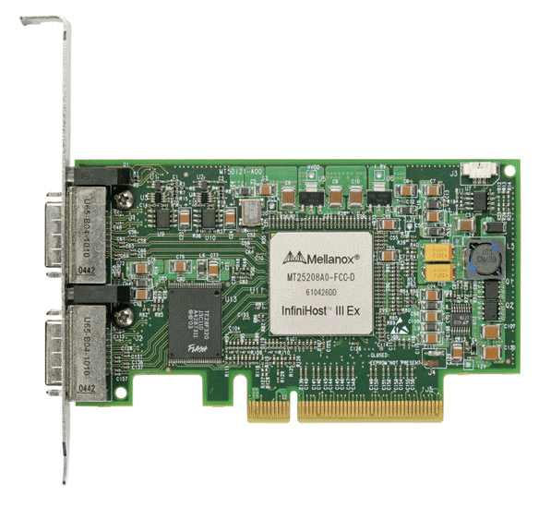
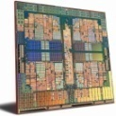
MPI RMA Memory Model
Window: Expose memory for RMA
Logical public and private copies
Portable data consistency model
Accesses must occur within an epoch
Active and Passive synchronization modes
Active: target participates
Passive: target does not participate
Rank 0
Rank 1
Begin Epoch
Put(X)
Get(Y)
Public
Copy
End Epoch
Completion
Unified
Copy
Private
Copy
Notes:
TODO: add epoch label, eliminate lock/unlock?

Slide 80
MPI RMA Memory Model (separate windows)
Same source
Same epoch
Diff. Sources
Public
Copy
X
X
Private
Copy
load
store
store
Compatible with non-coherent memory systems

Slide 81
MPI RMA Memory Model (unified windows)
Same source
Same epoch
Diff. Sources
Unified
Copy
load
store
store

Slide 82
MPI RMA Operation Compatibility (Separate)
 | Load | Store | Get | Put | Acc
Load | OVL+NOVL | OVL+NOVL | OVL+NOVL | X | X
Store | OVL+NOVL | OVL+NOVL | NOVL | X | X
Get | OVL+NOVL | NOVL | OVL+NOVL | NOVL | NOVL
Put | X | X | NOVL | NOVL | NOVL
Acc | X | X | NOVL | NOVL | OVL+NOVL
This matrix shows the compatibility of MPI-RMA operations when two or more processes access a window at the same target concurrently.
OVL – Overlapping operations permitted
NOVL – Nonoverlapping operations permitted
X – Combining these operations is OK, but data might be garbage

Slide 83
MPI RMA Operation Compatibility (Unified)
 | Load | Store | Get | Put | Acc
Load | OVL+NOVL | OVL+NOVL | OVL+NOVL | NOVL | NOVL
Store | OVL+NOVL | OVL+NOVL | NOVL | NOVL | NOVL
Get | OVL+NOVL | NOVL | OVL+NOVL | NOVL | NOVL
Put | NOVL | NOVL | NOVL | NOVL | NOVL
Acc | NOVL | NOVL | NOVL | NOVL | OVL+NOVL
This matrix shows the compatibility of MPI-RMA operations when two or more processes access a window at the same target concurrently.
OVL – Overlapping operations permitted
NOVL – Nonoverlapping operations permitted

Slide 84
Advanced Topics: Network Locality and Topology Mapping

Slide 85
Topology Mapping and Neighborhood Collectives
Topology mapping basics
Allocation mapping vs. rank reordering
Ad-hoc solutions vs. portability
MPI topologies
Cartesian
Distributed graph
Collectives on topologies – neighborhood collectives
Use-cases

Slide 86
Topology Mapping Basics
First type: Allocation mapping
Up-front specification of communication pattern
Batch system picks good set of nodes for given topology
Properties:
Not widely supported by current batch systems
Either predefined allocation (BG/P), random allocation, or “global bandwidth maximization”
Also problematic to specify communication pattern upfront, not always possible (or static)

Slide 87
Topology Mapping Basics
Rank reordering
Change numbering in a given allocation to reduce congestion or dilation
Sometimes automatic (early IBM SP machines)
Properties
Always possible, but effect may be limited (e.g., in a bad allocation)
Portable way: MPI process topologies
Network topology is not exposed
Manual data shuffling after remapping step

Slide 88
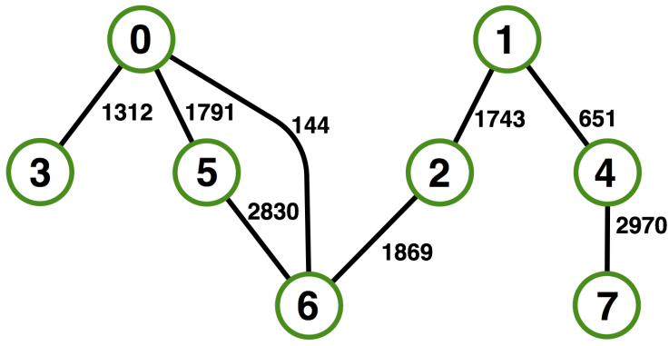

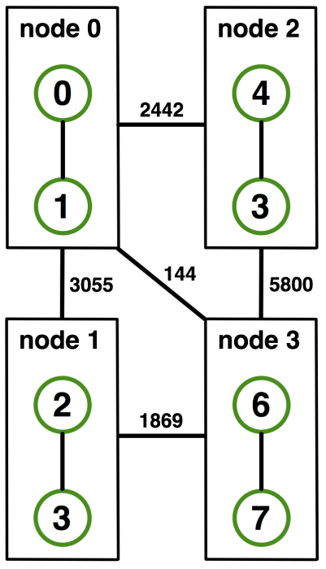
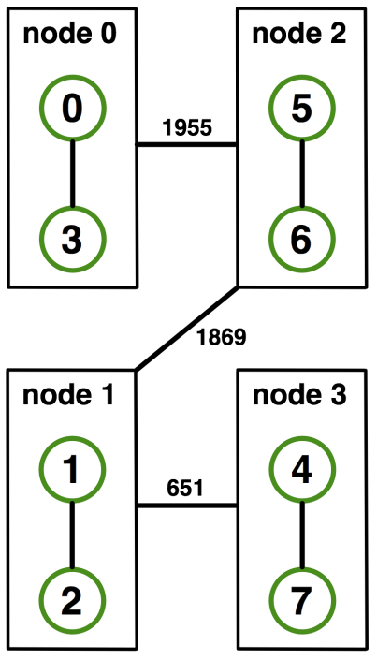
On-Node Reordering
Naïve Mapping
Optimized Mapping
Topomap
Gottschling et al.: Productive Parallel Linear Algebra Programming with Unstructured Topology Adaption

Slide 89
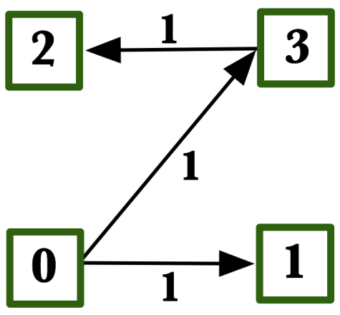
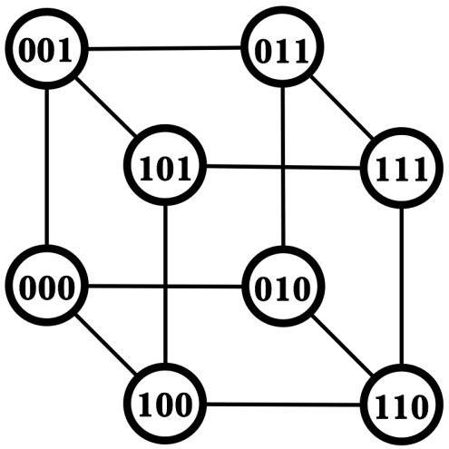
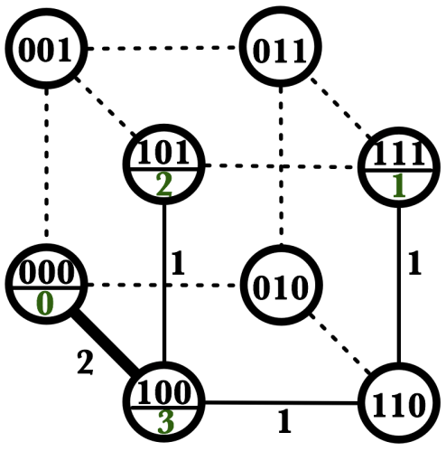
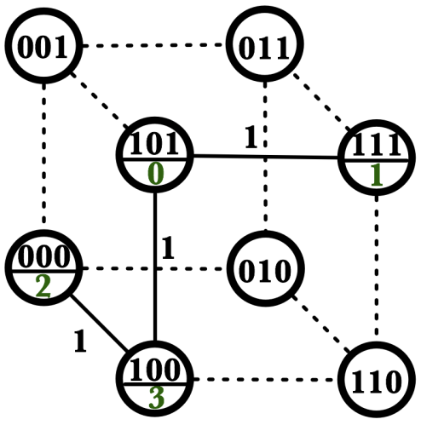
Off-Node (Network) Reordering
Application Topology
Network Topology
Naïve Mapping
Optimal Mapping
Topomap

Slide 90
MPI Topology Intro
Convenience functions (in MPI-1)
Create a graph and query it, nothing else
Useful especially for Cartesian topologies
Query neighbors in n-dimensional space
Graph topology: each rank specifies full graph ☹
Scalable Graph topology (MPI-2.2)
Graph topology: each rank specifies its neighbors or an arbitrary subset of the graph
Neighborhood collectives (MPI-3.0)
Adding communication functions defined on graph topologies (neighborhood of distance one)

Slide 91
MPI_Cart_create
MPI_Cart_create(MPI_Comm comm_old, int ndims, const int *dims, const int *periods, int reorder, MPI_Comm *comm_cart)
Specify ndims-dimensional topology
Optionally periodic in each dimension (Torus)
Some processes may return MPI_COMM_NULL
Product sum of dims must be <= P
Reorder argument allows for topology mapping
Each calling process may have a new rank in the created communicator
Data has to be remapped manually

Slide 92
MPI_Cart_create Example
Creates logical 3-d Torus of size 5x5x5
But we’re starting MPI processes with a one-dimensional argument (-p X)
User has to determine size of each dimension
Often as “square” as possible, MPI can help!
int dims[3] = {5,5,5};
int periods[3] = {1,1,1};
MPI_Comm topocomm;
MPI_Cart_create(comm, 3, dims, periods, 0, &topocomm);

Slide 93
MPI_Dims_create
Create dims array for Cart_create with nnodes and ndims
Dimensions are as close as possible (well, in theory)
Non-zero entries in dims will not be changed
nnodes must be multiple of all non-zeroes
MPI_Dims_create(int nnodes, int ndims, int *dims)

Slide 94
MPI_Dims_create Example
Makes life a little bit easier
Some problems may be better with a non-square layout though
int p;
MPI_Comm_size(MPI_COMM_WORLD, &p);
MPI_Dims_create(p, 3, dims);
int periods[3] = {1,1,1};
MPI_Comm topocomm;
MPI_Cart_create(comm, 3, dims, periods, 0, &topocomm);

Slide 95
Cartesian Query Functions
Library support and convenience!
MPI_Cartdim_get()
Gets dimensions of a Cartesian communicator
MPI_Cart_get()
Gets size of dimensions
MPI_Cart_rank()
Translate coordinates to rank
MPI_Cart_coords()
Translate rank to coordinates

Slide 96
Cartesian Communication Helpers
MPI_Cart_shift(MPI_Comm comm, int direction, int disp,
int *rank_source, int *rank_dest)
Shift in one dimension
Dimensions are numbered from 0 to ndims-1
Displacement indicates neighbor distance (-1, 1, …)
May return MPI_PROC_NULL
Very convenient, all you need for nearest neighbor communication
No “over the edge” though

Slide 97
MPI_Graph_create
Don’t use!!!!!
nnodes is the total number of nodes
index i stores the total number of neighbors for the first i nodes (sum)
Acts as offset into edges array
edges stores the edge list for all processes
Edge list for process j starts at index[j] in edges
Process j has index[j+1]-index[j] edges
MPI_Graph_create(MPI_Comm comm_old, int nnodes, const int *index, const int *edges, int reorder, MPI_Comm *comm_graph)

Slide 98

MPI_Graph_create
Don’t use!!!!!
nnodes is the total number of nodes
index i stores the total number of neighbors for the first i nodes (sum)
Acts as offset into edges array
edges stores the edge list for all processes
Edge list for process j starts at index[j] in edges
Process j has index[j+1]-index[j] edges
MPI_Graph_create(MPI_Comm comm_old, int nnodes, const int *index, const int *edges, int reorder, MPI_Comm *comm_graph)
Notes:
- Taschi: sieht seltsam aus

Slide 99
Distributed graph constructor
MPI_Graph_create is discouraged
Not scalable
Not deprecated yet but hopefully soon
New distributed interface:
Scalable, allows distributed graph specification
Either local neighbors or any edge in the graph
Specify edge weights
Meaning undefined but optimization opportunity for vendors!
Info arguments
Communicate assertions of semantics to the MPI library
E.g., semantics of edge weights
Hoefler et al.: The Scalable Process Topology Interface of MPI 2.2

Slide 100
MPI_Dist_graph_create_adjacent
MPI_Dist_graph_create_adjacent(MPI_Comm comm_old, int indegree, const int sources[], const int sourceweights[], int outdegree, const int destinations[], const int destweights[], MPI_Info info,int reorder, MPI_Comm *comm_dist_graph)
indegree, sources, ~weights – source proc. Spec.
outdegree, destinations, ~weights – dest. proc. spec.
info, reorder, comm_dist_graph – as usual
directed graph
Each edge is specified twice, once as out-edge (at the source) and once as in-edge (at the dest)
Hoefler et al.: The Scalable Process Topology Interface of MPI 2.2

Slide 101
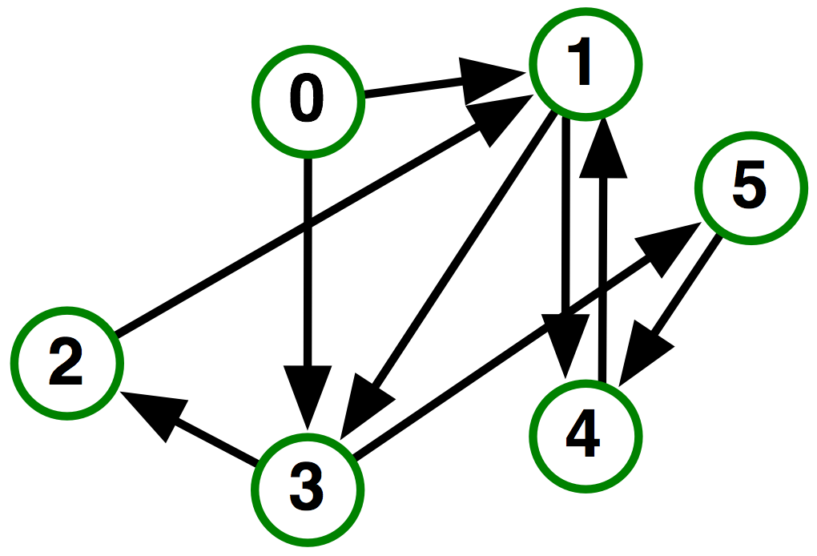
MPI_Dist_graph_create_adjacent
Process 0:
Indegree: 0
Outdegree: 2
Dests: {3,1}
Process 1:
Indegree: 3
Outdegree: 2
Sources: {4,0,2}
Dests: {3,4}
…
Hoefler et al.: The Scalable Process Topology Interface of MPI 2.2

Slide 102
MPI_Dist_graph_create
MPI_Dist_graph_create(MPI_Comm comm_old, int n, const int sources[], const int degrees[], const int destinations[], const
int weights[], MPI_Info info, int reorder, MPI_Comm *comm_dist_graph)
n – number of source nodes
sources – n source nodes
degrees – number of edges for each source
destinations, weights – dest. processor specification
info, reorder – as usual
More flexible and convenient
Requires global communication
Slightly more expensive than adjacent specification

Slide 103
MPI_Dist_graph_create
Process 0:
N: 2
Sources: {0,1}
Degrees: {2,1}
Dests: {3,1,4}
Process 1:
N: 2
Sources: {2,3}
Degrees: {1,1}
Dests: {1,2}
…
Hoefler et al.: The Scalable Process Topology Interface of MPI 2.2

Slide 104
Distributed Graph Neighbor Queries
MPI_Dist_graph_neighbors_count()
Query the number of neighbors of calling process
Returns indegree and outdegree!
Also info if weighted
MPI_Dist_graph_neighbors()
Query the neighbor list of calling process
Optionally return weights
MPI_Dist_graph_neighbors_count(MPI_Comm comm, int *indegree,int *outdegree, int *weighted)
MPI_Dist_graph_neighbors(MPI_Comm comm, int maxindegree, int sources[], int sourceweights[], int maxoutdegree, int destinations[],int destweights[])
Hoefler et al.: The Scalable Process Topology Interface of MPI 2.2

Slide 105
Further Graph Queries
Status is either:
MPI_GRAPH (ugs)
MPI_CART
MPI_DIST_GRAPH
MPI_UNDEFINED (no topology)
Enables to write libraries on top of MPI topologies!
MPI_Topo_test(MPI_Comm comm, int *status)

Slide 106
Neighborhood Collectives
Topologies implement no communication!
Just helper functions
Collective communications only cover some patterns
E.g., no stencil pattern
Several requests for “build your own collective” functionality in MPI
Neighborhood collectives are a simplified version
Cf. Datatypes for communication patterns!

Slide 107
Cartesian Neighborhood Collectives
Communicate with direct neighbors in Cartesian topology
Corresponds to cart_shift with disp=1
Collective (all processes in comm must call it, including processes without neighbors)
Buffers are laid out as neighbor sequence:
Defined by order of dimensions, first negative, then positive
2*ndims sources and destinations
Processes at borders (MPI_PROC_NULL) leave holes in buffers (will not be updated or communicated)!
T. Hoefler and J. L. Traeff: Sparse Collective Operations for MPI

Slide 108
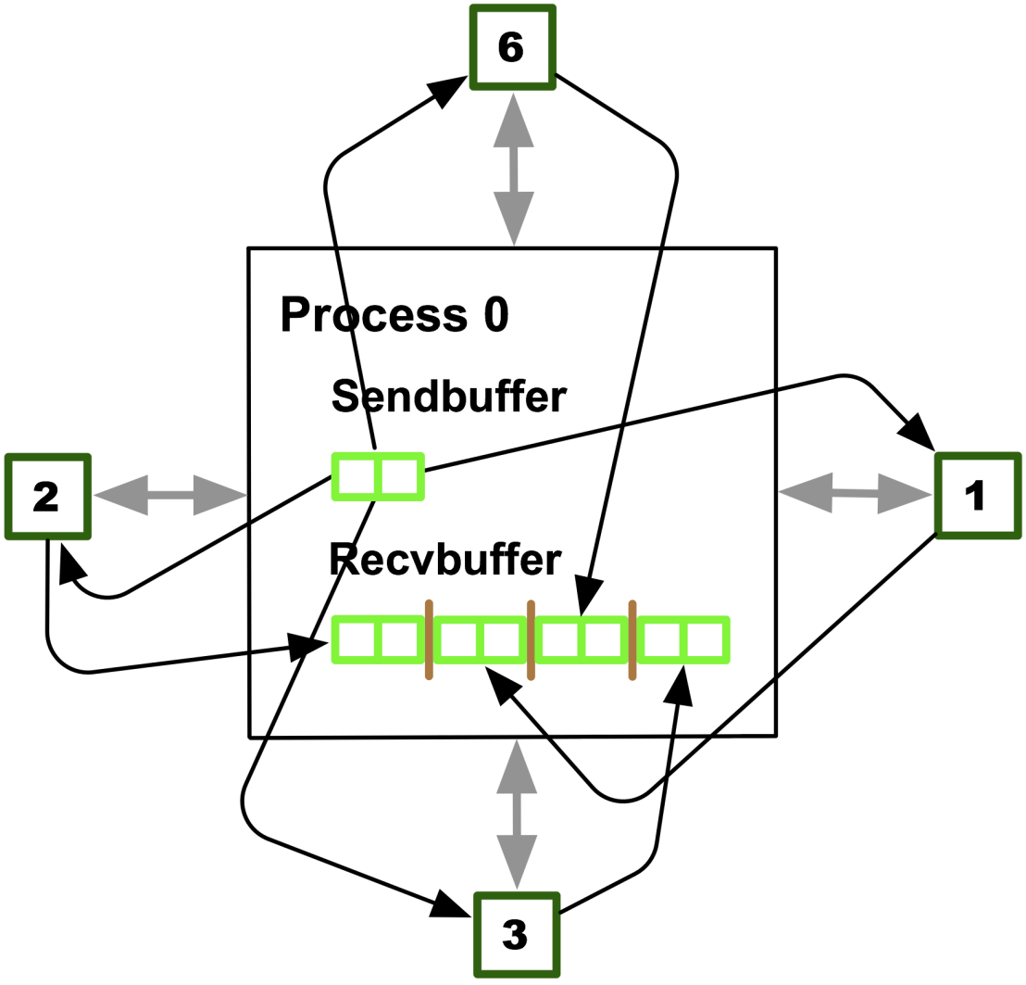
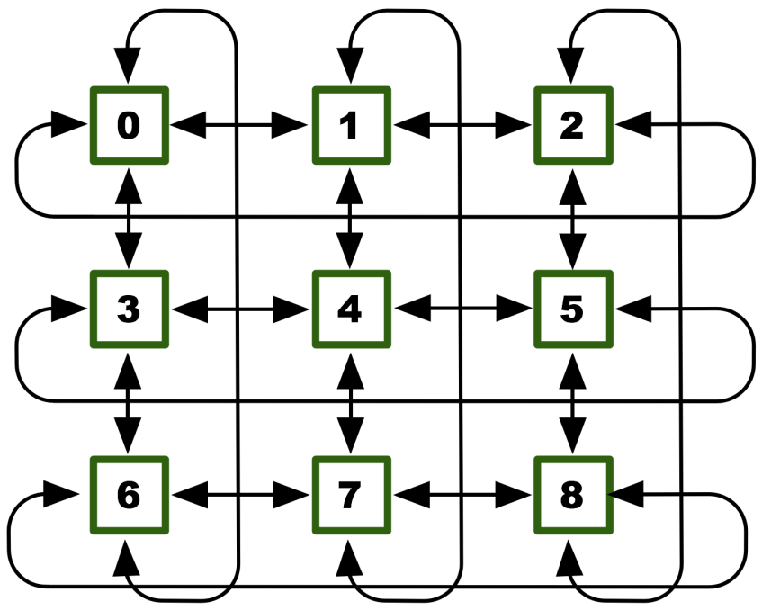
Cartesian Neighborhood Collectives
Buffer ordering example:
T. Hoefler and J. L. Traeff: Sparse Collective Operations for MPI

Slide 109
Graph Neighborhood Collectives
Collective Communication along arbitrary neighborhoods
Order is determined by order of neighbors as returned by (dist_)graph_neighbors.
Distributed graph is directed, may have different numbers of send/recv neighbors
Can express dense collective operations ☺
Any persistent communication pattern!
T. Hoefler and J. L. Traeff: Sparse Collective Operations for MPI

Slide 110
MPI_Neighbor_allgather
Sends the same message to all neighbors
Receives indegree distinct messages
Similar to MPI_Gather
The all prefix expresses that each process is a “root” of his neighborhood
Vector and w versions for full flexibility
MPI_Neighbor_allgather(const void* sendbuf, int sendcount, MPI_Datatype sendtype, void* recvbuf, int recvcount, MPI_Datatype recvtype, MPI_Comm comm)

Slide 111
MPI_Neighbor_alltoall
Sends outdegree distinct messages
Received indegree distinct messages
Similar to MPI_Alltoall
Neighborhood specifies full communication relationship
Vector and w versions for full flexibility
MPI_Neighbor_alltoall(const void* sendbuf, int sendcount, MPI_Datatype sendtype, void* recvbuf, int recvcount, MPI_Datatype recvtype, MPI_Comm comm)

Slide 112
Nonblocking Neighborhood Collectives
MPI_Ineighbor_allgather(…, MPI_Request *req); MPI_Ineighbor_alltoall(…, MPI_Request *req);
Very similar to nonblocking collectives
Collective invocation
Matching in-order (no tags)
No wild tricks with neighborhoods! In order matching per communicator!

Slide 113
Why is Neighborhood Reduce Missing?
MPI_Ineighbor_allreducev(…);
Was originally proposed (see original paper)
High optimization opportunities
Interesting tradeoffs!
Research topic
Not standardized due to missing use-cases
My team is working on an implementation
Offering the obvious interface
T. Hoefler and J. L. Traeff: Sparse Collective Operations for MPI

Slide 114
Topology Summary
Topology functions allow to specify application communication patterns/topology
Convenience functions (e.g., Cartesian)
Storing neighborhood relations (Graph)
Enables topology mapping (reorder=1)
Not widely implemented yet
May requires manual data re-distribution (according to new rank order)
MPI does not expose information about the network topology (would be very complex)

Slide 115
Neighborhood Collectives Summary
Neighborhood collectives add communication functions to process topologies
Collective optimization potential!
Allgather
One item to all neighbors
Alltoall
Personalized item to each neighbor
High optimization potential (similar to collective operations)
Interface encourages use of topology mapping!

Slide 116
Section Summary
Process topologies enable:
High-abstraction to specify communication pattern
Has to be relatively static (temporal locality)
Creation is expensive (collective)
Offers basic communication functions
Library can optimize:
Communication schedule for neighborhood colls
Topology mapping
Notes:
- Figure: summary

Slide 117
Concluding Remarks
Parallelism is critical today, given that that is the only way to achieve performance improvement with the modern hardware
MPI is an industry standard model for parallel programming
A large number of implementations of MPI exist (both commercial and public domain)
Virtually every system in the world supports MPI
Gives user explicit control on data management
Widely used by many many scientific applications with great success
Your application can be next!

Slide 118
Web Pointers
MPI standard : http://www.mpi-forum.org/docs/docs.html
MPICH : http://www.mpich.org
MPICH mailing list: discuss@mpich.org
MPI Forum : http://www.mpi-forum.org/
Other MPI implementations:
MVAPICH (MPICH on InfiniBand) : http://mvapich.cse.ohio-state.edu/
Intel MPI (MPICH derivative): http://software.intel.com/en-us/intel-mpi-library/
Microsoft MPI (MPICH derivative)
Open MPI : http://www.open-mpi.org/
Several MPI tutorials can be found on the web

