Slide 1
Implementing
Packet Transceiver
Jae Min Choi
SNUCSE

Slide 2
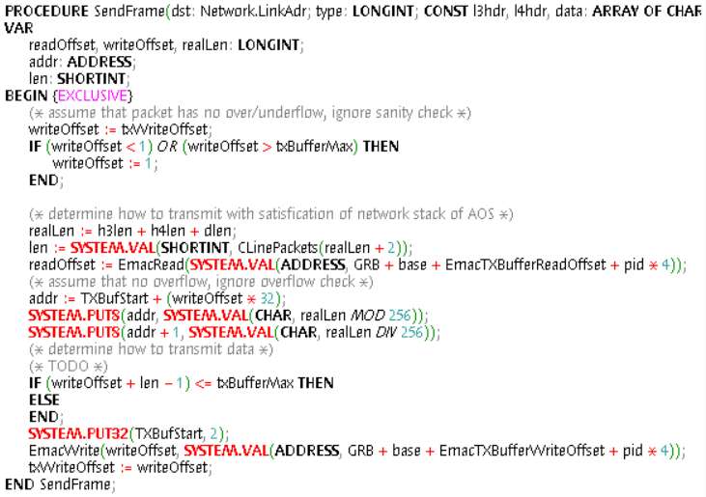
SendFrame (emac_tx)
(1)
(2)

Slide 3
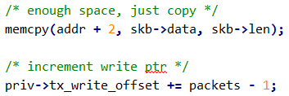
SendFrame (emac_tx)
(1) Enough space in buffer
  memcpy: use a while loop of SYSTEM.PUT of varying sizes

Slide 4
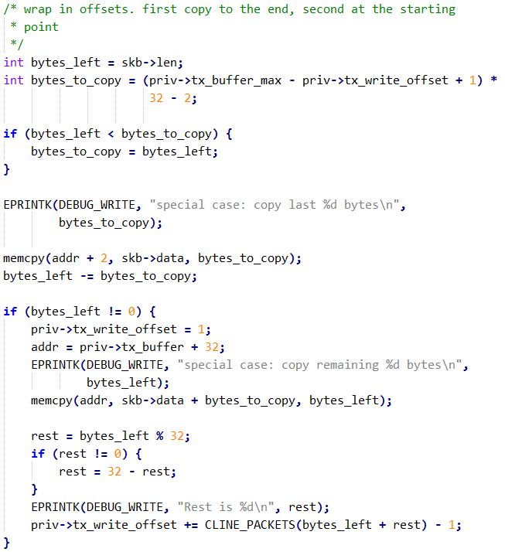
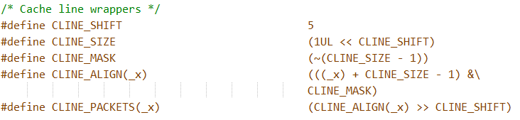
SendFrame (emac_tx)
(2) Not enough space in buffer, wrap to front
  memcpy: same as (1)
  CLINE_PACKETS: need to define macro?

Slide 5
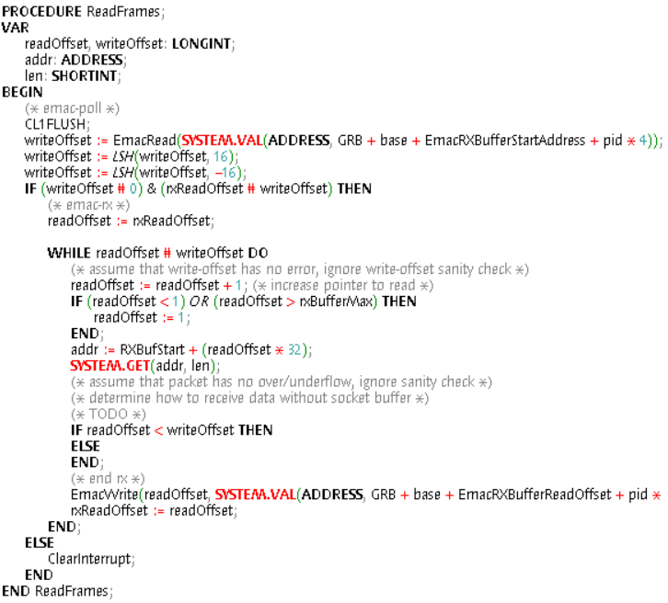
ReadFrames (emac_rx)

Slide 6
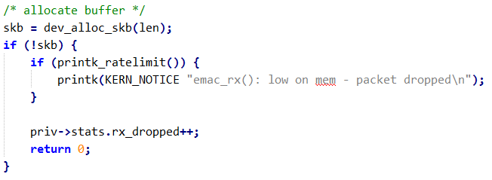
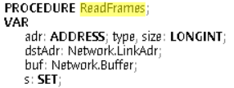
ReadFrames (emac_rx)
Allocating buffer
  We don’t use “sk_buff”
  Use “Network.Buffer” instead (From RTL8169.Mod)
Addresses should be of “Network.LinkAddr” type

Slide 7
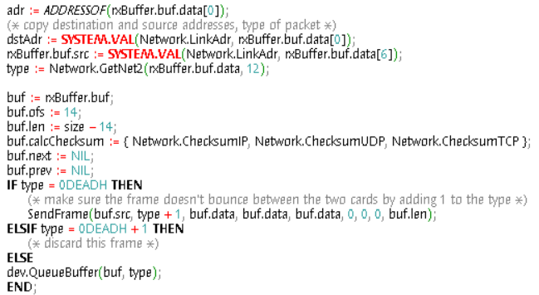
ReadFrames (emac_rx)
Set fields in buf (Network.Buffer) accordingly
  Use SYSTEM.PUT for memcpying data into buf
  size, ofs?
  More on the buffer structure in the next slide
type variable should be set
  Will be passed to dev.QueueBuffer(), which is equivalent to netif_rx()

Slide 8
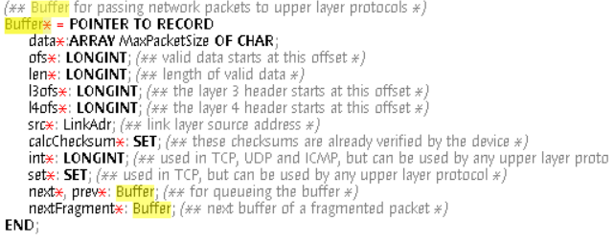
Buffer Structure
Defined in I386.Network.Mod
In ReadFrames, we need to set
  data
  ofs
  len
  next, prev

