Slide 1
AOS Network Stack
Jae Min Choi
SNUCSE

Slide 2
Function Call Procedure
FTP.PutText() in FTP.Mod {
FTPClient.FTPClient.OpenPut() in FTPClient.Mod {
FTPClient.FTPClient.GetDataConnection()
FTPClient.FTPClient.OpenDataConnection()
Streams.OpenWriter() in Streams.Mod
}
Streams.Writer.Char() in Streams.Mod {
TCP.Connection.Send() in TCP.Mod {
Network.Copy() in I386.Network.Mod
}
}
FTPClient.FTPClient.ClosePut() in FTPClient.Mod
}

Slide 3
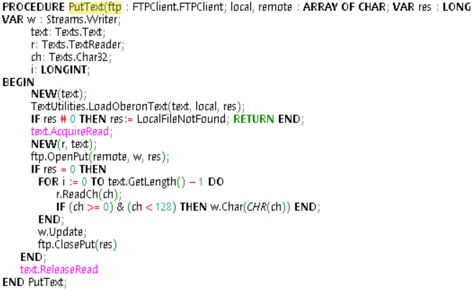
FTP.Mod
PutText()
  Put a text file in a remote address
  Load text
  FTPClient.FTPClient.OpenPut()
    Setup process that connects writer to remote address
  Streams.Writer.Char()
    Write characters
  FTPClient.FTPClient.ClosePut()
    Wrap up

Slide 4
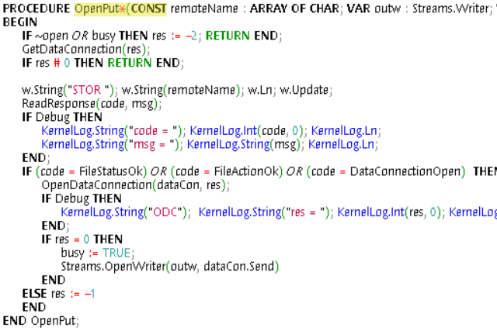
FTPClient.Mod
OpenPut()
  GetDataConnection()
    Get available connection
  ReadResponse()
    Poll for remote status
  OpenDataConnection()
    Establish connection
  Streams.OpenWriter()
    Link writer with data connection
Now ready to copy text

Slide 5
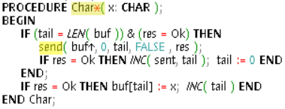
Streams.Mod
Writer.Char()
  Write a character
  send()
    A delegate function
    Calls Send() of the data connection

Slide 6
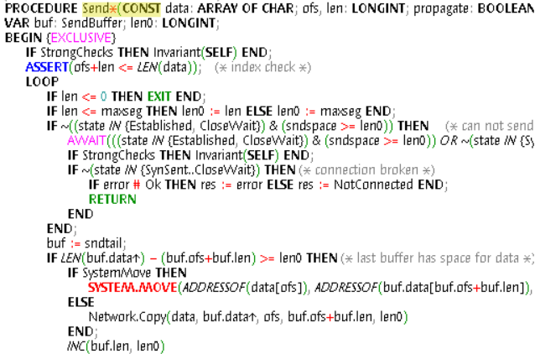
TCP.Mod
Connection.Send()
  With the data connection previously established, actually copy the data
  Network.Copy()

Slide 7
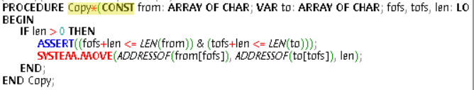
I386.Network.Mod
Copy()
  End of call stack
  Use SYSTEM.MOVE to copy the char
  Target address is probably memory mapped

