Slide 1
Rckemac in Detail
Jae min choi
SNUCSE

Slide 2
Flow
emac_module_init
emac_open
emac_tx
emac_rx
emac_stop
emac_module_exit

Slide 3
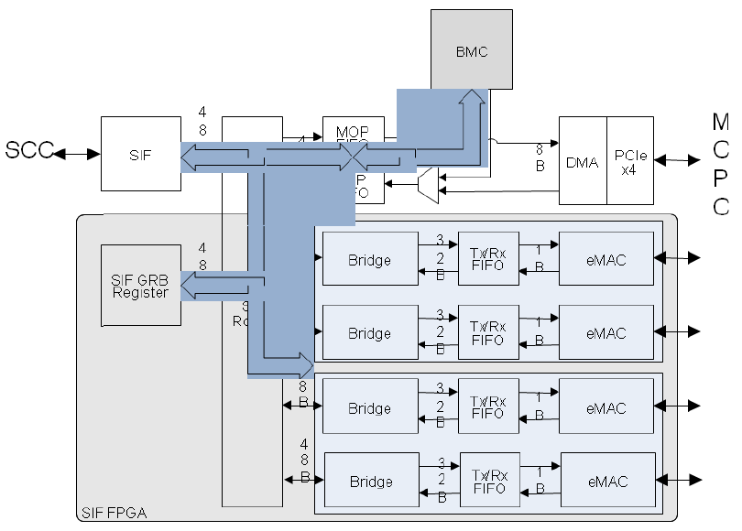
Registers in Use
Global Register Bank (GRB) : register located inside FPGA

Slide 4
Registers in Use
Configuration Register Bank (CRB) : set of configuration registers for SCC cores
Control enabling local reset, core initialization & configuration, core interrupt handling, and L2 cache configuration
Each SCC core, L2 cache controller, and global clocking unit (GCU) has a dedicated config register
Writable by any core or the system interface unit
Byte-wise access not supported
Should perform read-modify-write on all 32 bits of a config register

Slide 5
Helper functions & macros
static int emac_readl (void *addr)
Read long from eMAC at addr
Implemented with 2 readl calls
static void emac_writel (int value, void *addr)
Write long value to eMAC at addr
Implemented with writel
RA(_x, _y)
GRB address + (_x)+ (_y * 4)
RA_CRB(_x)
CRB address + (_x)
All accesses to the registers are done via these macros
Both polling and interrupts can be implemented
Will suppose using interrupt

Slide 6
emac_module_init
Map GRB to 0xF9000000 with size 0x10000
Map CRB to 0xF8000000 with size 2 * (page size)
Read tile ID from (CRB + 0x0100) and determine core position
Bits 06:03 – x
Bits 10:07 – y
Bits 02:00 – z
Set core number
Get FPGA/sccKit port settings from (GRB + 0x822C)
Create eMAC interface (emac0, …)
Initilize Xilinx IP port (init_xilinx_port)
Allocate netdev structure (alloc_netdev and emac_init)
Allocate priv structure (netdev_priv and memset)

Slide 7
init_xilinx_port
Called from emac_module_init to create an eMAC interface
Get transmitter & receiver address from GRB
Disable TX/RX flow control of eMAC (GRB + 0x32C0)
Set top 3 bits of flow control configuration to zero
Enable transmitter & set to full duplex mode (GRB + 0x3280)
Half duplex (Bit 26) = 0
Transmit enable (Bit 28) = 1
Reset (Bit 31) = 0
Enable receiver & set to full duplex mode (GRB + 0x3240)
Length/type error check disable (Bit 25) = 1
Half duplex (Bit 26) = 0
Receiver enable (Bit 28) = 1
Reset (Bit 31) = 0

Slide 8
init_xilinx_port
Set speed of eMAC to 1Gb/s (GRB + 0x3300)
Bit 31 = 1, Bit 30 = 0
Set to promiscuous mode (GRB + 0x3390)
Bit 31 = 1
Be sure to conduct sanity checks after changing register values

Slide 9
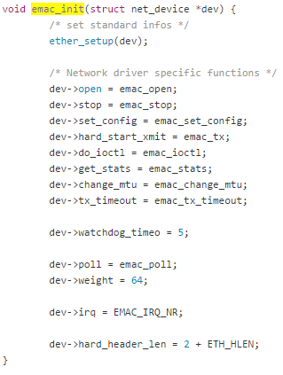
emac_init
Called by alloc_netdev
Setup net_device structure
ether_setup to setup standard infos
Assign driver specific functions (open, stop, ioctl, stats, …)

Slide 10
emac_open
Called when eMAC interface is opened
Read tile ID and determine core position
Set interrupt request (IRQ) address
Core 0: CRB + 0x10
Core 1 : CRB + 0x18
Get offset, subdest, route, mode
First read value from (CRB + 0x800, Core 0) or (CRB + 0x1000, Core 1)
Calculate offset, etc. by shifting this value
Setup Ethernet port (setup_emac)
Set network address
First get MAC address (get_mac_address)
And iterate for loop to consecutively save lower 8 bits of address in dev->dev_addr
Enable interrupt
Clear interrupt (emac_clear_interrupt)
Read value from (GRB + 0xD200 + priv->pid * 2 * 4) and change it
Change value in (GRB + 0xD800+ priv->pid * 4)
Call request_irq and check its return value
Start network queue (netif_start_queue)

Slide 11
setup_emac
Called from emac_open
Reception configuration
Set up ring buffer space
Set priv->rx_buffer_max
Allocate priv->rx_buffer using alloc_buffer
Set start address of RX buffer (GRB + 0x9000)
Read RX buffer write offset (GRB + 0x9200)
Set RX buffer read offset to write offset (GRB + 0x9100)
Set RX buffer size (GRB + 0x9300)
Set RX buffer threshold (GRB + 0x9400)
Set RX mode (GRB + 0x9500)
Save MAC address (HI: GRB + 0x9600, LO: GRB + 0x9700)
Activate network port (GRB + 0x9800)
Transmission configuration
Set up ring buffer space
Set start address of TX buffer (GRB + 0x9900)
Read TX buffer read offset (GRB + 0x9A00)
Set TX buffer write offset to read offset (GRB + 0x9B00)
Set TX buffer size (GRB + 0x9C00)
Set TX mode (GRB + 0x9D00)
Activate network port (GRB + 0x9E00)

Slide 12
TODO
emac_rx
emac_tx
emac_stop
emac_module_exit

