Slide 1
Pointnet++
2022.11.10
강경수

Slide 2
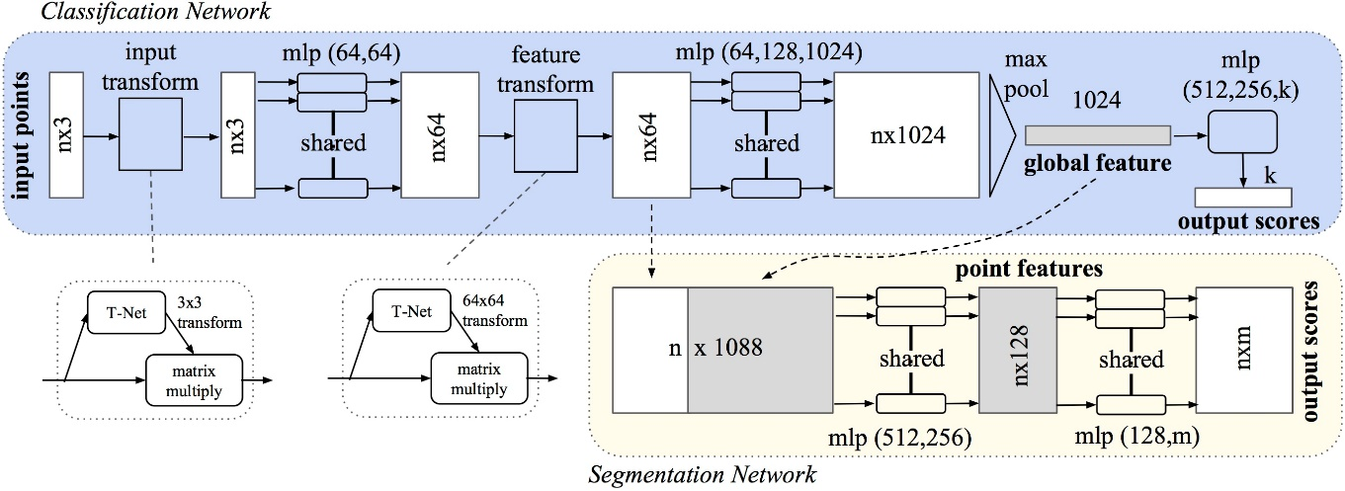
Topic – point cloud feature extract
2 /
- pointnet
PointNet model
PointNet extract Feature that only global(whole) point cloud

Slide 3
Motivation & contribute
3 /
- pointNet++
Extract local & global feature for classification and segmentation
Contribution (1). Local feature extract by ball query region
- by local feature, better representation of point cloud (set abstraction)
(2). Multi - scale vector using concatenate local & global feature
- by MSG, MRG

Slide 4
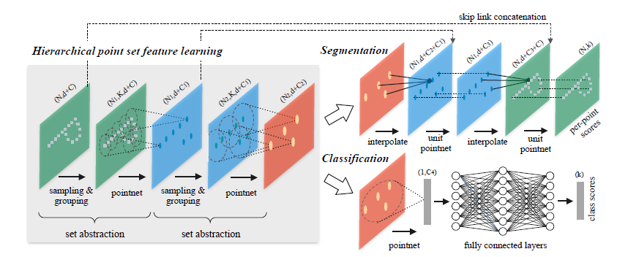
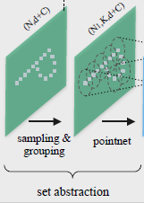
Pointnet++
4 /
- overview
Feature extract
Classification & segmentation
Sampling layer
Grouping layer
Pointnet layer

Slide 5
Pointnet++
5 /
- Set abstraction (sampling layer)
Sampling layer
Grouping layer
Pointnet layer
Point cloud sampling (red: sampling point)
For finding centroid, point cloud sampling
Determined by the farthest each other
(only xyz dimension)

Slide 6
Pointnet++
6 /
- Set abstraction (grouping layer)
Sampling layer
Grouping layer
Pointnet layer
Point cloud grouping (red: sampling point)
For grouping, using ball query

Slide 7
Pointnet++
7 /
- Set abstraction (pointnet layer)
Sampling layer
Grouping layer
Pointnet layer
Point cloud extract
Mini Pointnet (local) feature extract
Mini Pointnet doesn’t have T-net layer

Slide 8
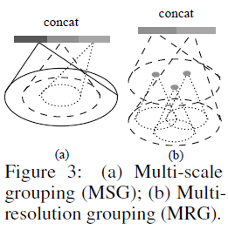
Pointnet++
8 /
- Multi Scale Grouping & Multi Resolution Grouping
Set 1
Set 2
Set 2 grouping radius(0.8)
Set 2 grouping radius(0.4)
Set 1 feature vector
Set 2 feature vector
MSG
MRG

Slide 9

Pointnet++
9 /
- segmentation

Slide 10
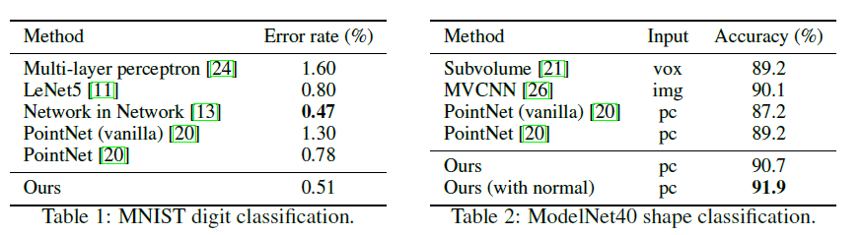

Pointnet++
10 /
- Experiments
Pointnet :
Pointnet++ :

Slide 11
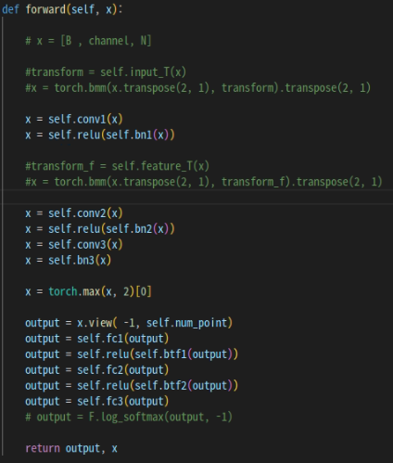


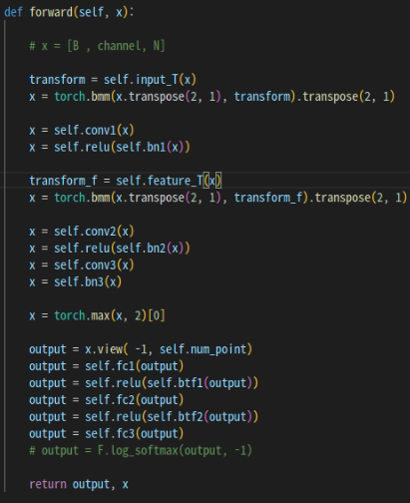
Pointnet++
11 /
- why use mini pointnet?
Dataset : modelnet40
classification
Pointnet (not using T - net) :
Pointnet (using T - net) :
Not much different?

Slide 12
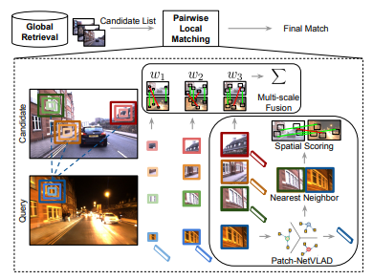
Research topic: Cluster–pointnetvlad
12 /
- contribution
Image feature Extraction method invariant
VGG-16,
Resnet,
…
?
Point feature Extraction method invariant
PointNet,
PointNet++,
…

Slide 13
Research topic: Cluster–pointnetvlad
13 /
- contribution
Using similar Patch-netvlad method at pointcloud - invariant extraction model
More accurate

Slide 14
Q & A.
14 /

