Slide 1
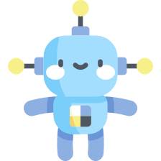
NeRF Uncertainty in Code
Minjae Lee

Slide 2
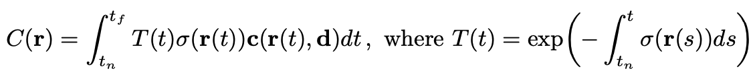
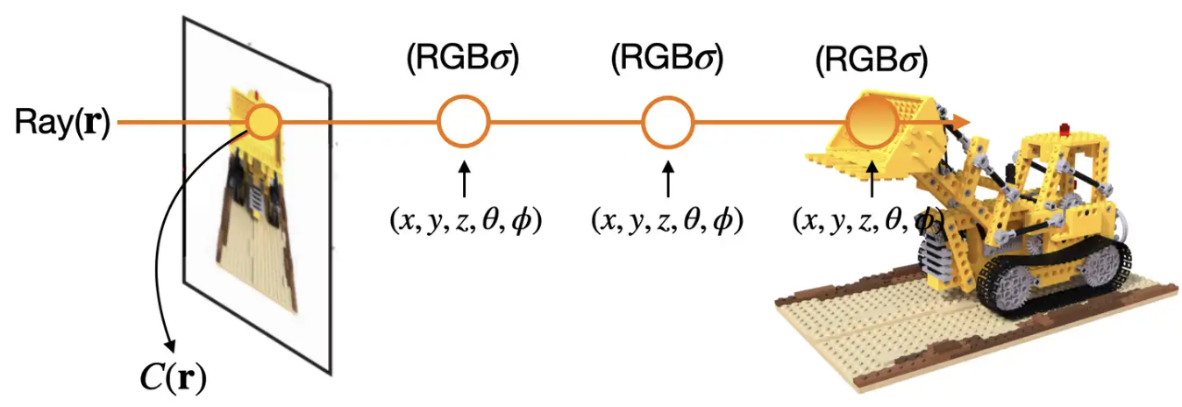
Volume Rendering Equation

Slide 3
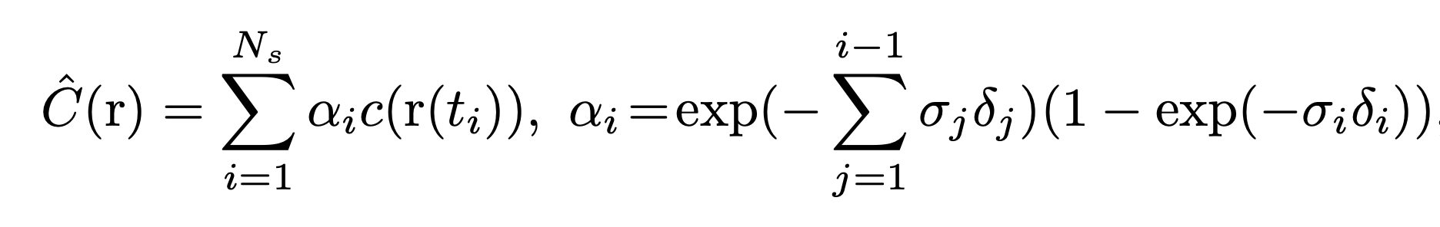
Equation in code

Slide 4
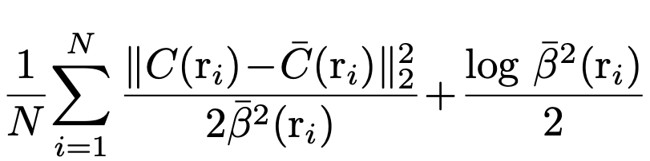
Loss Equation

Slide 5
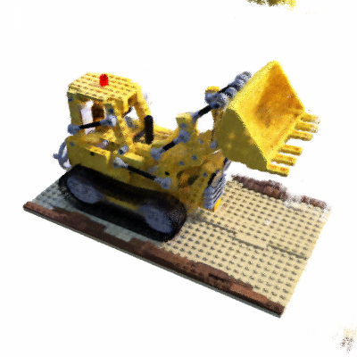
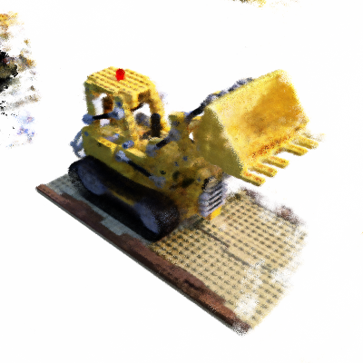
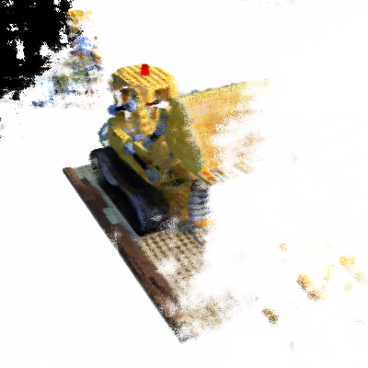
Experiment Result
Let’s See image result!

Slide 6
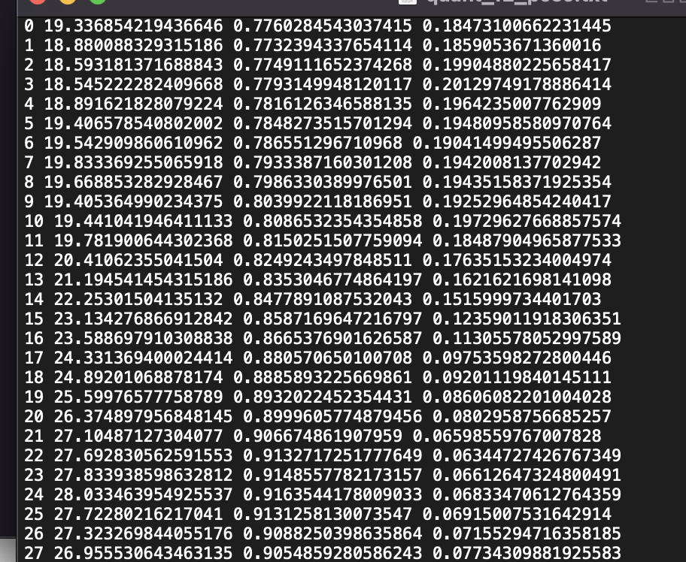
Experiment Result
Let’s see txt file!

Slide 7
Experiment Result (epoch = 50k)
 | PSNR | SSIM | LPIPS
6_ori w/o uncert | 14.95 | 0.76 | 0.38
6_ori w uncert | 13.58 | 0.66 | 0.50
12_flip w/o uncert | 19.39 | 0.81 | 0.19
12_flip w uncert | 17.42 | 0.77 | 0.24
12_upper | 24.34 | 0.87 | 0.11

Slide 8
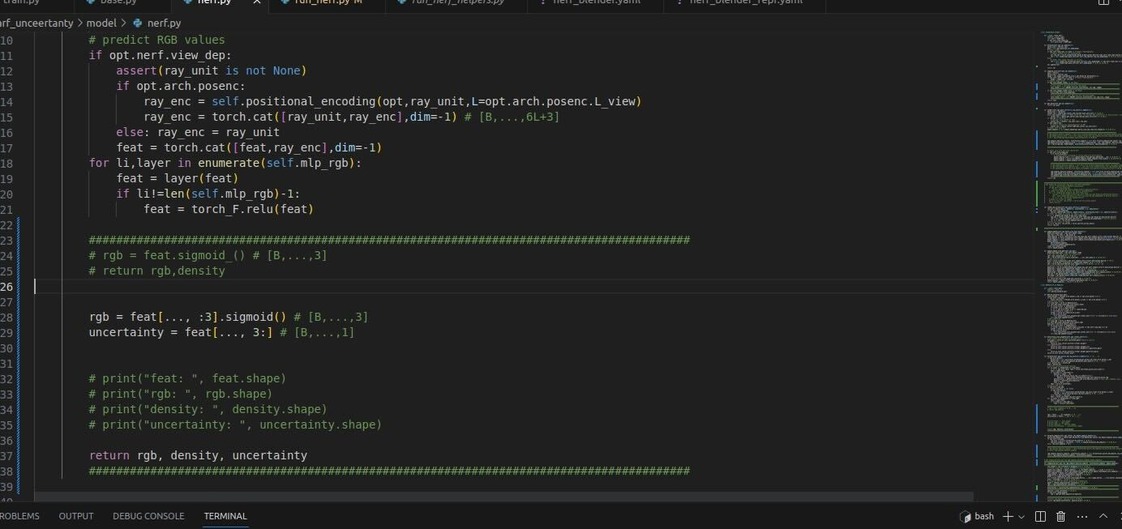
Code

Slide 9
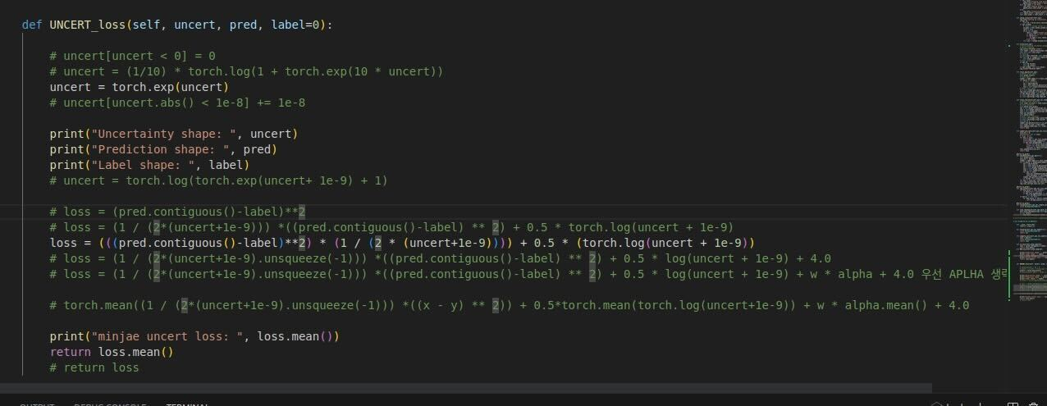
Code

Slide 10
What to do in the future
1. Add normalization term
2. Consider only Flip image’s uncertainty

Slide 11
Thank you for listening!

