Slide 1

Sensor Fusion in NeRF
Minjae Lee

Slide 2
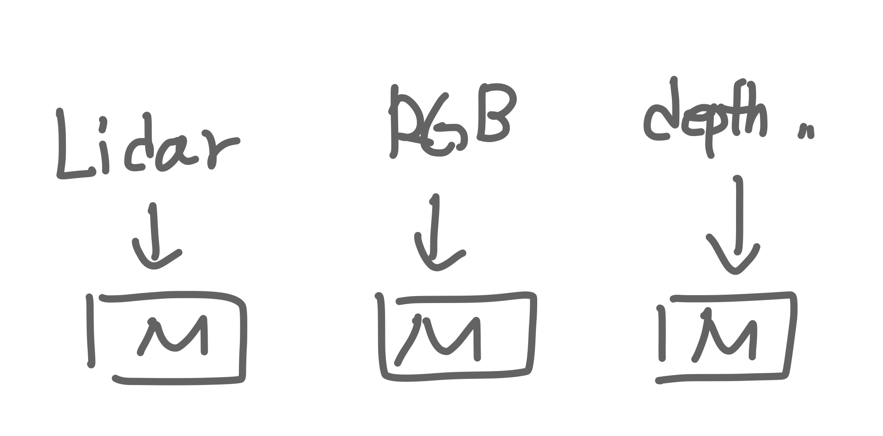
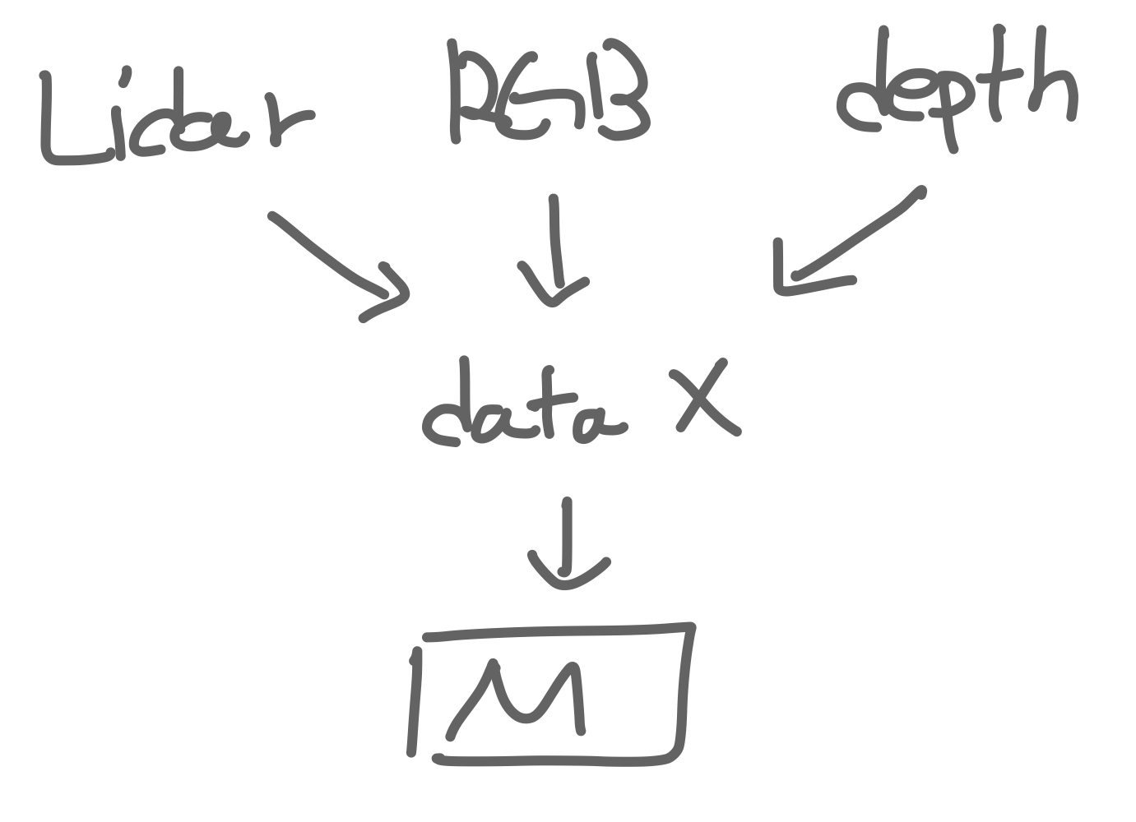
How can do sensor fusion?
To have the model for each sensor.
-> cost and time inefficient
Converting each data into one data.
-> Out of the existing frame
-> lose information

Slide 3
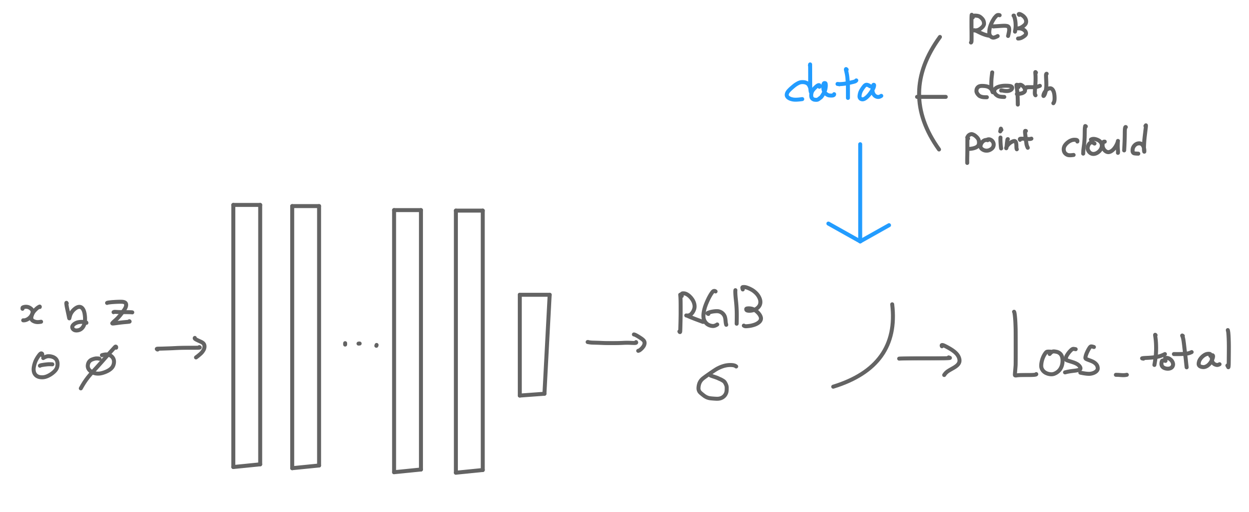
How can do sensor fusion?
Let's define a new loss
as a result of the existing model!

Slide 4
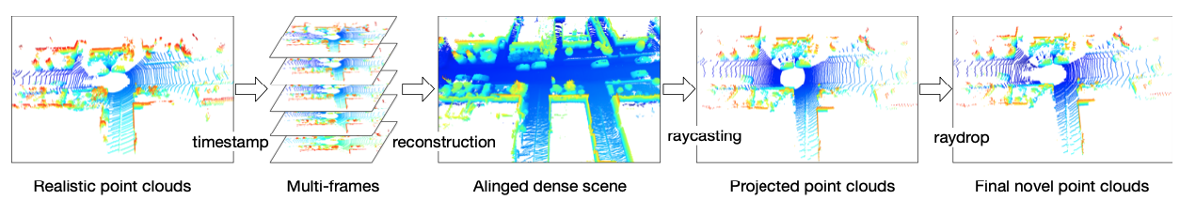
Consider Lidar data and input data pair.
Rendering lidar data to image.
Pairing lidar data and image data.
- Pair image data taken while stacking frames with lidar data

Slide 5
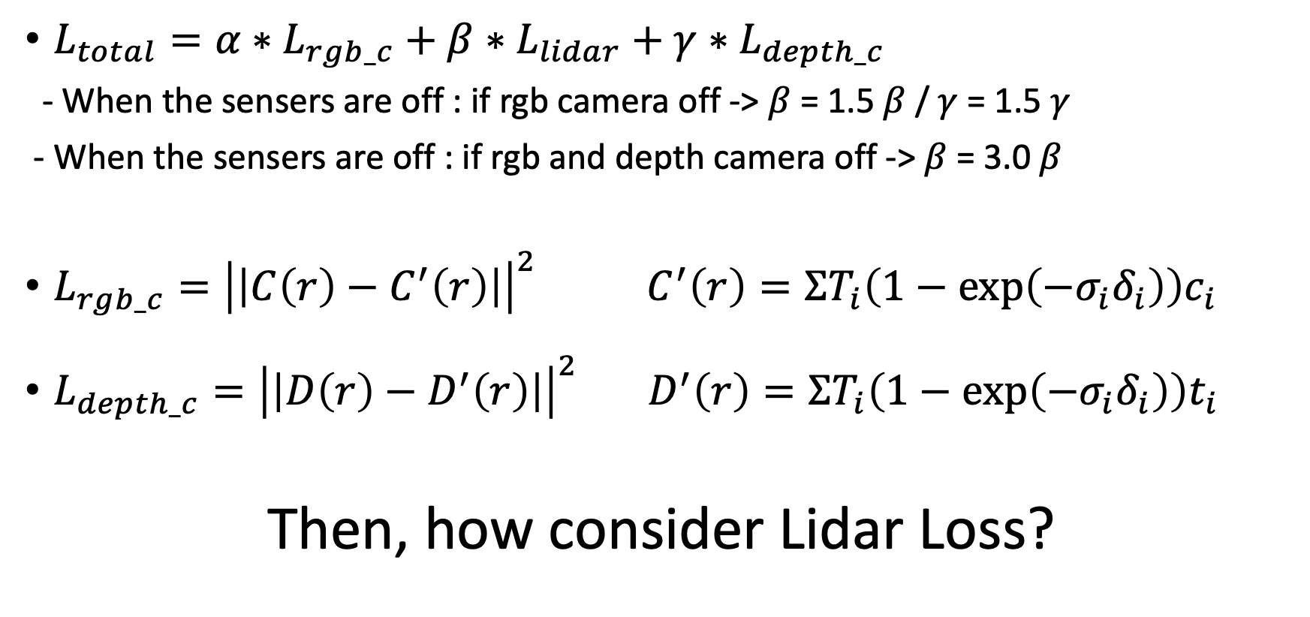
Loss_total
$L_{total}={α∗L}_{rgb_c}+β∗L_{lidar}+γ∗L_{depth_c}$
- When the sensers are off : if rgb camera off -> $β$ = 1.5 $β$ / $γ$ = 1.5 $γ$
- When the sensers are off : if rgb and depth camera off -> $β$ = 3.0 $β$
$L_{rgb_c}={\left|\left|C\left(r\right)−C^{′}\left(r\right)\right|\right|}^{2}$ $C^{′}\left(r\right)=ΣT_{i}\left(1−\exp\left(−σ_{i}δ_{i}\right)\right)c_{i}$
$L_{depth_c}={\left|\left|D\left(r\right)−D^{′}\left(r\right)\right|\right|}^{2}$ $D^{′}\left(r\right)=ΣT_{i}\left(1−\exp\left(−σ_{i}δ_{i}\right)\right)t_{i}$
Then, how consider Lidar Loss?
Notes:
Let's define a new loss as a result of the existing model

Slide 6
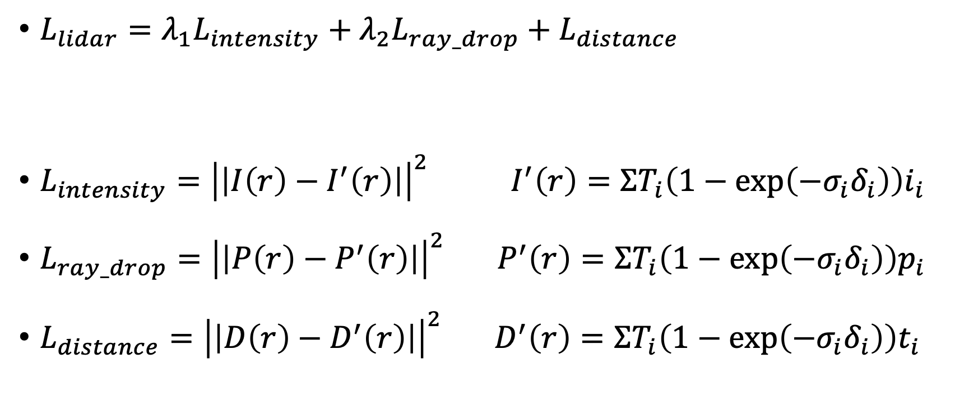
Lidar loss (Lidar NeRF 2023 arXiv)
$L_{lidar}={λ_{1}L}_{intensity}+{λ_{2}L}_{ray_drop}+L_{distance}$
$L_{intensity}={\left|\left|I\left(r\right)−I^{′}\left(r\right)\right|\right|}^{2}$ $I^{′}\left(r\right)=ΣT_{i}\left(1−\exp\left(−σ_{i}δ_{i}\right)\right)i_{i}$
$L_{ray_drop}={\left|\left|P\left(r\right)−P^{′}\left(r\right)\right|\right|}^{2}$ $P^{′}\left(r\right)=ΣT_{i}\left(1−\exp\left(−σ_{i}δ_{i}\right)\right)p_{i}$
$L_{distance}={\left|\left|D\left(r\right)−D^{′}\left(r\right)\right|\right|}^{2}$ $D^{′}\left(r\right)=ΣT_{i}\left(1−\exp\left(−σ_{i}δ_{i}\right)\right)t_{i}$
Notes:
Let's define a new loss as a result of the existing model

Slide 7
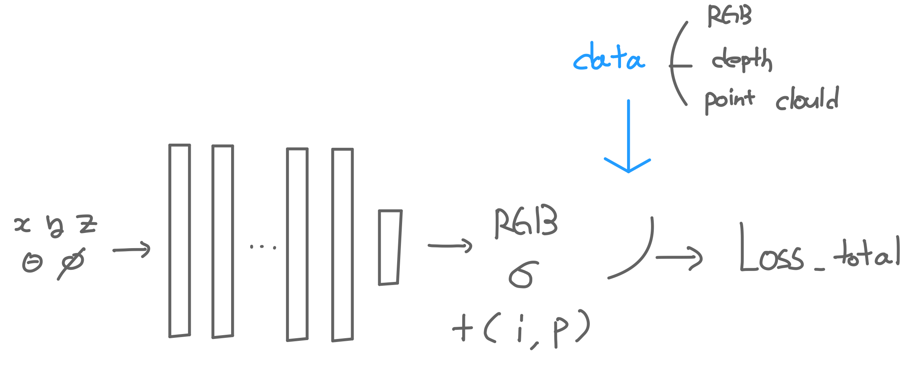

Total_Loss and model
$L_{total}={α∗L}_{rgb_c}+β∗L_{lidar}+γ∗({λ_{1}L}_{intensity}+{λ_{2}L}_{ray_drop}+L_{distance}$)
Notes:
Let's define a new loss as a result of the existing model

Slide 8
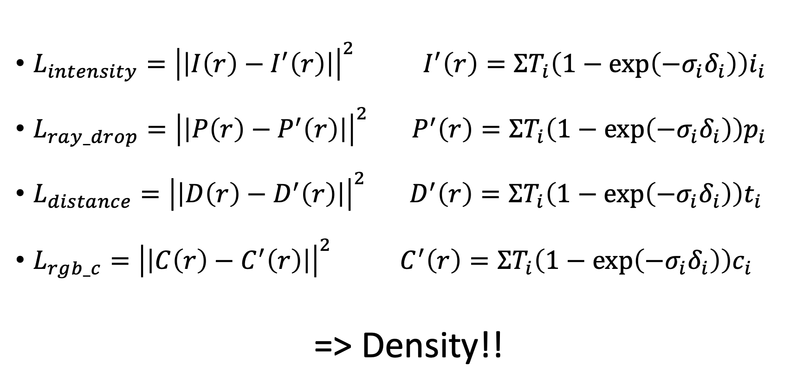
What should we consider when dealing with uncertainty?
$L_{intensity}={\left|\left|I\left(r\right)−I^{′}\left(r\right)\right|\right|}^{2}$ $I^{′}\left(r\right)=ΣT_{i}\left(1−\exp\left(−σ_{i}δ_{i}\right)\right)i_{i}$
$L_{ray_drop}={\left|\left|P\left(r\right)−P^{′}\left(r\right)\right|\right|}^{2}$ $P^{′}\left(r\right)=ΣT_{i}\left(1−\exp\left(−σ_{i}δ_{i}\right)\right)p_{i}$
$L_{distance}={\left|\left|D\left(r\right)−D^{′}\left(r\right)\right|\right|}^{2}$ $D^{′}\left(r\right)=ΣT_{i}\left(1−\exp\left(−σ_{i}δ_{i}\right)\right)t_{i}$
$L_{rgb_c}={\left|\left|C\left(r\right)−C^{′}\left(r\right)\right|\right|}^{2}$ $C^{′}\left(r\right)=ΣT_{i}\left(1−\exp\left(−σ_{i}δ_{i}\right)\right)c_{i}$
=> Density!!
Notes:
What should we consider when dealing with uncertainty?

Slide 9
Thank you for listening!
Notes:
Thank you for listening. Any question?

