Slide 1
Research Topic Presentation
Minjae Lee

Slide 2
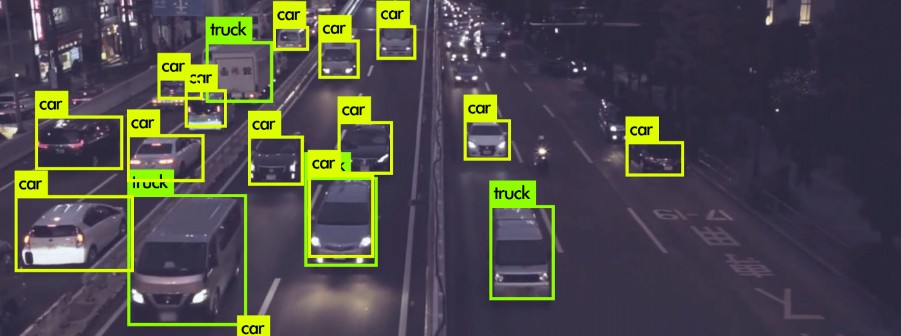
Topic : Object detection for SLAM
Suggest New 1 Stage detection algorithm
Develop the existing method

Slide 3
Related work
Traditional Detection Methods
VJ Det. (2001)
HOG Det. (2005)
DPM (2008)
2 – Stage Detector
RCNN (2013)
SPP Net (2014)
Fast RCNN (2015)
Faster RCNN (2015)
Mask RCNN (2018)
1 – Stage Detector
YOLO(2015)
SSD (2015)
Retina-Net (2017)
Refine-Net (2018)
M2Det (2019)
Efficient Det (2019)
Yolo Vn (~~)
1 – Stage, 2 – Stage -> accuracy, speed

Slide 4
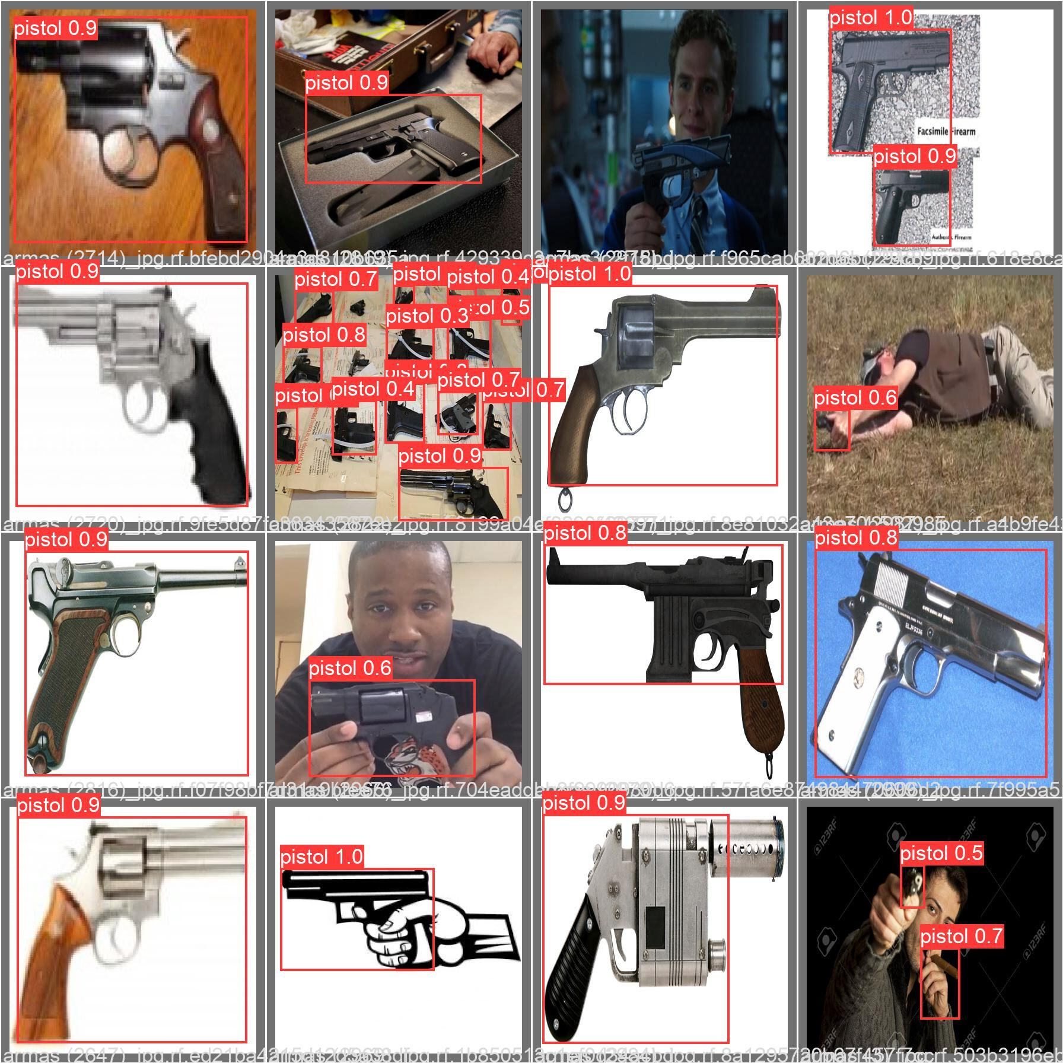
Implement YOLOv5

Slide 5
Research Topic
• Suggest New 1 Stage detection algorithm
• Develop the existing method
• A model good at detecting specific objects
• Find intermediate process to detect small objects well
• New CNN architecture for object detection
• Using Vision Transformer

Slide 6
Thank you

