Slide 1
Intro to HCI: Interim Presentation
Team Name | Penguin
Project Name | Pos-guin
Project Title | A notification app that uses Arduino to keep a good posture
Team Members | Park SooGeun, Lee MinSik, Lee MinJae Im GiBum, Jang InGyu, Han TaeJun
Notes:
Hello we are pes-guin team. Let’s starts presentation

Slide 2
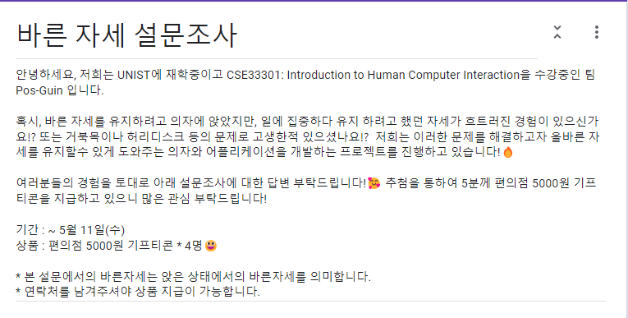
User Study
Before Presentation
41 participants
We conducted a survey of people using Google Forms in online.
Based on these results, we designed our prototypes
After Presentation
We’re going to experiment with people using real machines we’ve built. Through this, we plan to receive feedback from people on the machine and make modifications
Notes:
User study part.
Our team conducted a survey of people using Google Forms in online. Based on these results, we designed our prototypes.
And after presentation We’re going to experiment with people using real machines we’ve built. Through this, we plan to receive feedback from people on the machine and make modifications.

Slide 3
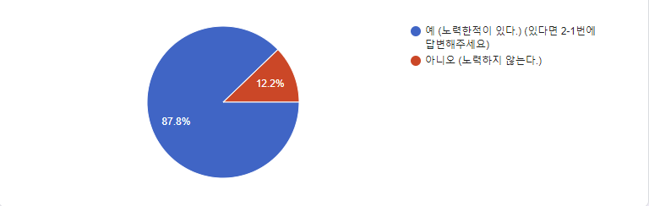
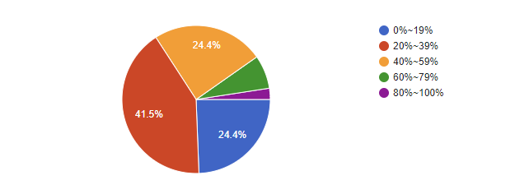
User Study
Have you ever tried to maintain good posture?
People want to maintain an upright posture when sitting in a chair.
How much time were you able to maintain the correct posture?
But most of the time it fails.
We really need a device that maintains people's correct posture.
Notes:
At the question, “Have you ever tried to maintain good posture?”
Most people want to maintain an correct posture when sitting in a chair.
But, at the question ” How much time were you able to maintain the correct posture? ”
People reply that they fail most of the time.
So our team think we really need a device that maintains people’s correct posture

Slide 4
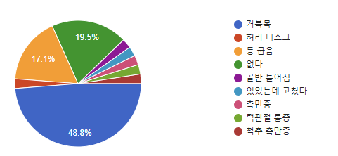
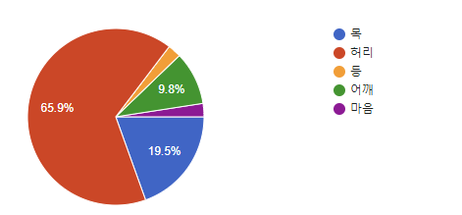
User Study
Do you have a disease you are suffering from due to incorrect posture?
People suffer from many diseases due to incorrect posture.
What part of the body do you think is the most important for maintaining good posture?
People value the neck and waist as important to maintain posture.
We build hardware prototypes around the neck and waist.
Notes:
At the disease question, People suffer from many diseases due to incorrect posture.
Especially, many people had turtle neck disease
And at the question of important part of the body, most people think waist.
So, We build hardware prototypes around the neck and waist by these user study.

Slide 5
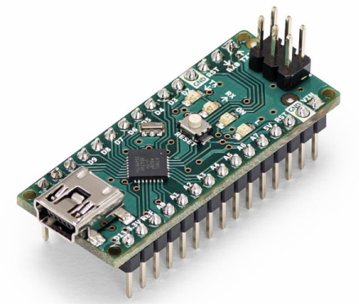
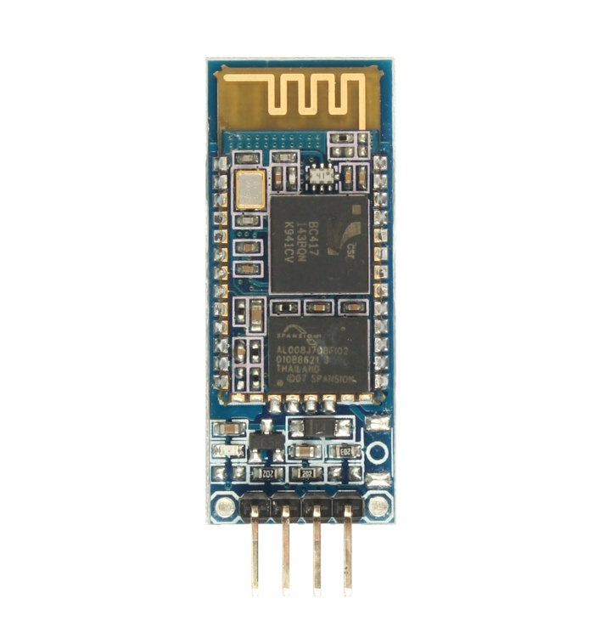
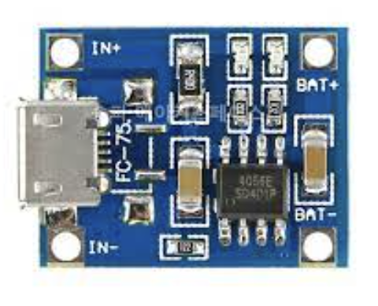
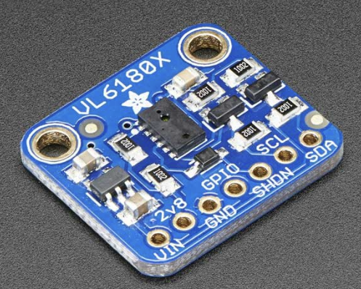
Hardware
Arduino Nano Board
Arduino Bluetooth Module HC-06
Size: 18mm x 45mm
Size: 28mm x 15mm x 2.35mm
TP4056 Lithium Battery Charging Module & tw-503040 600mAh Lithium Polymer Battery
VL6180X Laser Distanced Sensor
Notes:
Hardware part.We think 4 hardware. First, Arduino Nano Board
The reason select this nono board is that the small size does not cause discomfort. And we don’t need many devices to connect and don’t need many other functions.
Second is Arduino Bluetooth module hc 06.
It is the most widely used, and our member had experienced it. So we decide it.
Third item is Lithium Battery charging module and lithium polymer battery
We judged that it would be easy to use 600mAh by repeating charging and discharging.
Forth item is Laser distanced sensor.
This sensor was determined that the measurement range was appropriate at 5mm to 200mm, so it was possible to measure within a short distance required by our study, and the size was also selected as small.

Slide 6
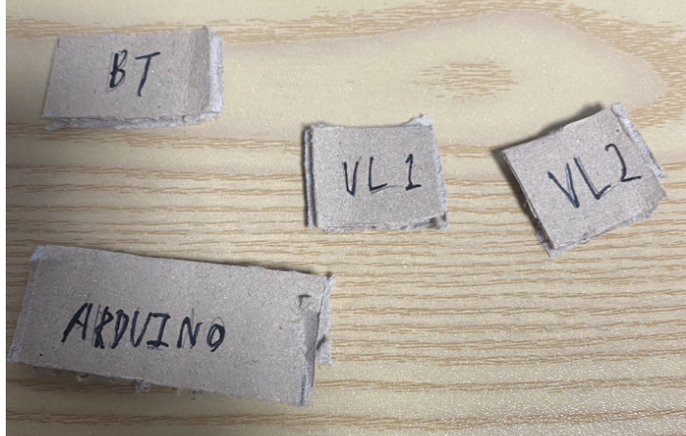
Paper Prototype
Arduino Bluetooth Module HC-06
VL6180X Laser Distanced Sensor
Arduino Nano Board
Notes:
This picture is a prototype of modules and sensors by cutting boxes for attaching them to chairs.

Slide 7
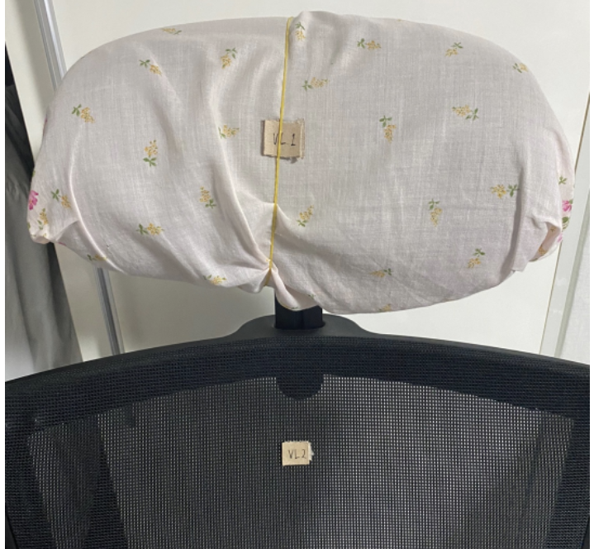
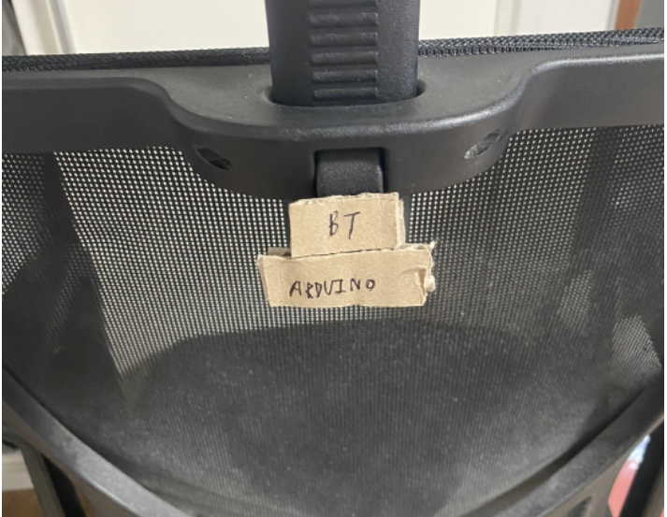
Paper Prototype
We will attach “Nanoboard” and” Bluetooth modules” to the back of the chair to ease user discomfort.
We measure the distance around the waist and neck
Notes:
We considered suitable fixing method for sensors and arduino to chairs. In the case of paper prototypes, rubber bands and double-sided tape were used as shown.
we thought of two ways to fix it using strap or double-sided. In the case of double-sided tape, it can be fixed easily, but it is inconvenient to remove.
In the case of straps, they are easy to attach and detach, but the straps could have caused inconvenience.
In the case of the prototype, we did not feel any inconvenience in actual use.

Slide 8
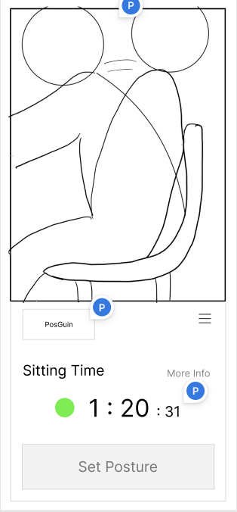
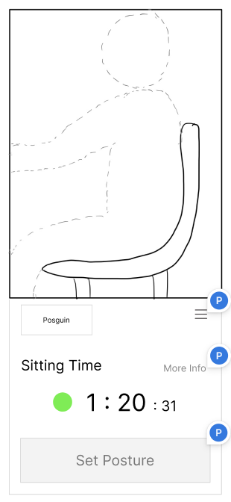
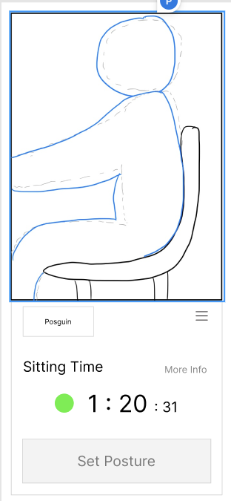
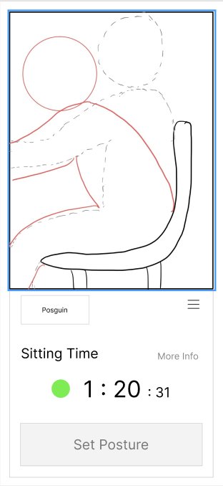
Software
Home Screen
Notes:
And next is software prototype
This screen is a home screen, and user can know user’s real-time posture information. Render an animation of a human model on the chair based on the distance information of the sensor attached to the chair.
If user click the set posture button, A dash-line is created.
After the baseline is created, the current posture is marked in blue color if it is located close to the baseline, and red line is marked if it is located away from the baseline.
If user maintain the wrong posture for more than a certain amount of time, the app will run in the background and receive push notifications that users posture are bad now.

Slide 9
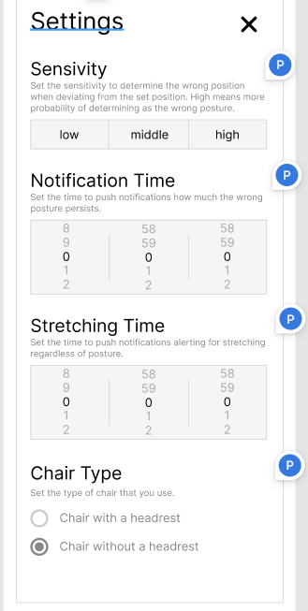
Setting Screen
Set the sensitivity of the measurement the higher the sensitivity, the more sophisticated the position is to be judged
Set the time to push the alarm after how long time the incorrect posture is maintained
Set the Stretch induction alarm
Set chair type with a headrest or without a headrest
Notes:
This page a page that user can set associated with notifications.
At first, Sensitivity part, Set the sensitivity of the measurement the higher the sensitivity, the more sophisticated the position is to be judged.
And at notification time, Set the time to push the alarm after how long time the incorrect posture is maintained
And also can set the stretching induction alarm.
Finally User can set chair type with a headrest or without a headrest

Slide 10
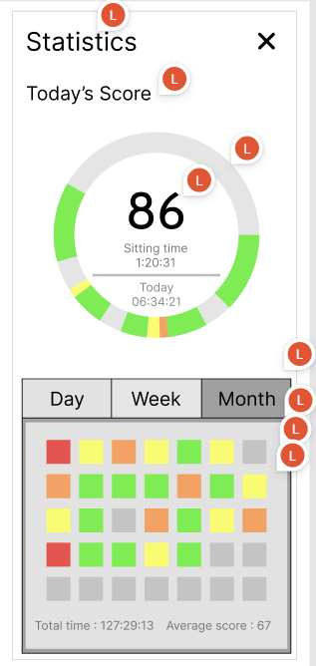
Statistics Screen
The time spent sitting on the chair is expressed by scoring the time spent sitting in the correct posture.
View daily, weekly, and monthly statistics. Each item can be easily identified through color.
Day: like home
Week: each day of week
Month: each day
Notes:
This is a Statistics page where user can view the history of user's posture.
They can see at once what time they were in the right posture through a circular graph.
And they can check the time spent sitting on the chair is expressed by scoring the time spent sitting in the correct posture.
Our prototype also supports viewing user’s records by day, week, and month.
It's expressed in various colors, like a grass in a github.

Slide 11

Notes:
Based on these two low prototypes, we plan to conduct a face to face user study and attempt to create a high prototype.
Thank you for listenign

