Slide 1

Homomorphic
Encryption
20161190 이민재
Notes:
Hello my name is leeminjae. My presentation is about homomorphic encryption. First Let’s see contests.

Slide 2

CONTENTS
2
1. Characteristics of HE
2. Various types of HE Scheme
3. Application of HE in real life
4. Reference
HE : homomorphic encryption
Notes:
Since homomorphic encryption appears frequently and has a long pronounciation, I will shorten it to HE.
First, I will present Characteristics of HE.
Second, Various types of HE scheme. Since each scheme has different features, we will look at its principles and pros and cons at this point.
Next, Application of HE in real life. HE is also called the 4th generation cipher and is used in many fields.
Forth is reference.

Slide 3
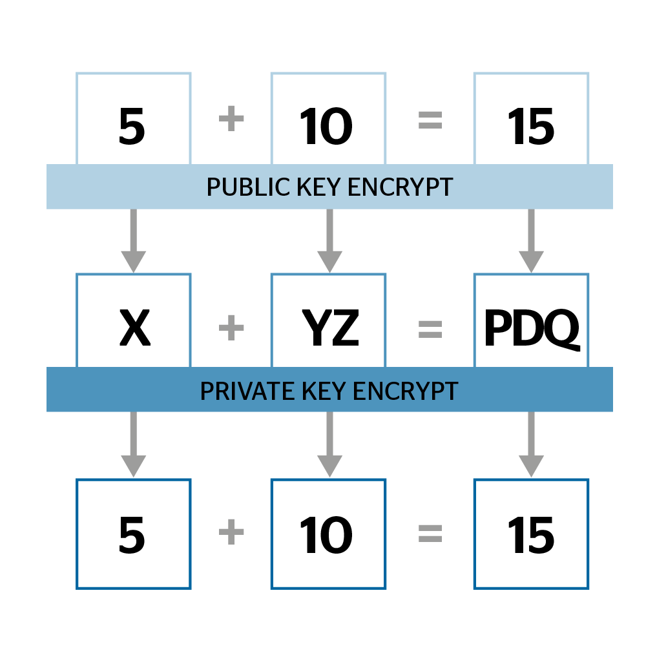
3
Characteristics of HE
Past : Just protecting
Modern : Meanigful apply
Notes:
In the past, encryption were simply used to protect data, but modern times, they have been developed to enable many meaningful applications.
HE, For example, five plus ten equal to fifteen.
Five encrypt to X, Five encrypto to YZ, , Fifthteen is encrypt to PDQ. And then X + YZ equal to PDQ
PDQ decrypto to 15. It is same with five plus ten.
This means that the addition operation is conserved. So HE can preserve operations. These characteristics make many things possible so can apply various field. Before we look at those things, let's look at a various of HE schemes.

Slide 4

Various types of HE Scheme
4
Paillier (1999)
1970 (SHE)
BGV/BFV (2011)
UNIST
FHEW (2014)
2009 (FHE)
TFHE (2016)
CKKS (2017)
Notes:
HE was actually presented in the late thousand nine hundred seventeenth, but it was difficult to put it into practical use due to a limit on the number of operations.
However in two thousand nine, Gentry announced paper about fully homomorphic encryption(FHE), which has no limit on the number of operations. Since then, research on HE has been actively conducted and developed practically.
Let's look at the pailier(빠이에) scheme, which is not fully homomorphic encryption, to the most used CKKS scheme recently.
Because it's hard to take a deep look at each skim, I focused on flow of the each scheme and these features. So let’s look at simple concept or idea, features, pros and cons.

Slide 5
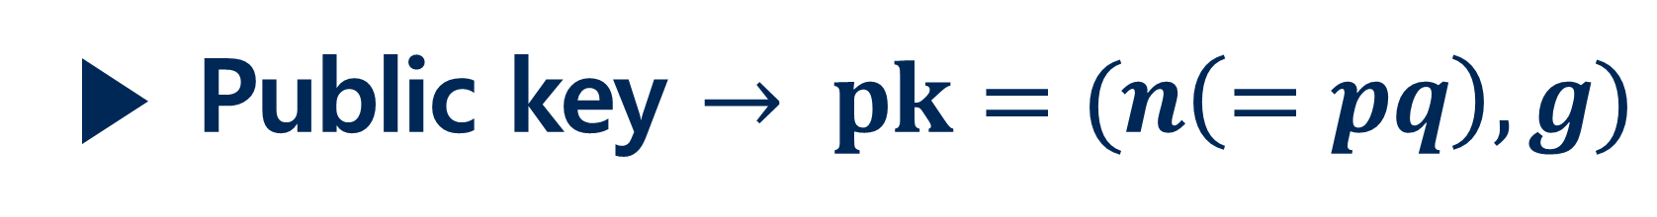

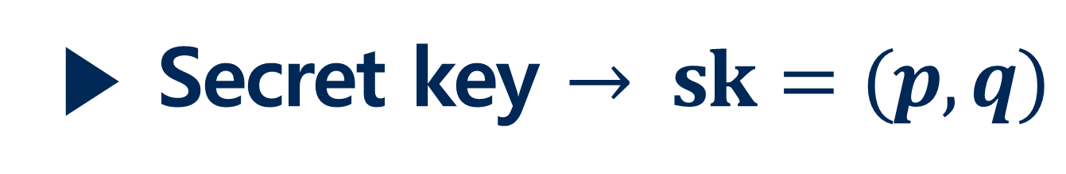
Paillier (1999)
5
▶ Secret key $→ sk=(p, q)$
▶ Public key $→ pk=(n\left(=pq\right), g)$
$\text{▶} Enc\left(pk,m\right)→c=g^{m}r^{n} (mod n^{2})$
$$\text{▶} Dec\left(sk,c\right)→m= \frac{L( c^{λ} mod n^{2})}{L(g^{λ} mod n^{2})} mod N$$
▶ Pros : fast
▶ Cons : SHE, Can’t ciphertext multiplication
Notes:
In paillier crypto system, first, pick two large prime p and q. These are secret key. And n is product of p and q. g is random select from relatively prime with n square. n and g are public key.
Let’s see encryption. Message m is smaller than n. random r is relatively prime with n.
Then, Chiphertext c is g’s m square product r’s n square mod n square.
And decryption. Using Carmichael’s theorem. This eqation’s result is message m
Pailler system advantage is relatively fast than fully homomorphic encryption. But this scheme is somewhat homomorphic encryption. And can’t ciphertext multiplication. This scheme can calcaulate ciphertext addition and constant multiplication.
So paillier scheme fits well in scenario where only ciphertext addition and constant multiplication is needed.
질문 가능 L이 뭔가? L_p(x) = x-1/p (x -1, p = x-1/p)

Slide 6

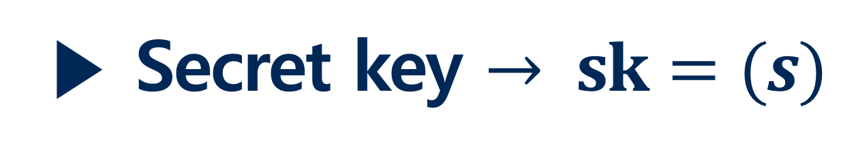
BGV/BFV Scheme (2011)
The Brakerski-Gentry-Vaikuntanathan
6
▶ Secret key $→ sk=(s)$
▶ Public key $→ pk=(a, b\left(=as+pe\right))$
$$\text{▶} Enc\left(pk,m\right)→\left(c_{0}, c_{1}\right)=(bv+pe_{0}+m, av+pe_{1})$$
$$\text{▶} Dec\left(sk,c\right)→m=(\left(\left(c_{0}−c_{1}s\right)mod q\right)mod p)$$
▶ Pros : Efficient and precise calculating(Add, Mul) at integer
▶ Cons : Impossible to calculate at real and complex number.
Notes:
Next is BGV and BFV scheme. BGV came out in two thousand eleven. And one year later, they improved the speed of BGV then announced BFV.
P is message space, q is ciphertext space. ///
Secret key is s and public key is a,b. b is as+pe. This s in b, can decrypt by delete the value of asv. I will explain later.
Encryption function result is c0 and c1. It will use decryption.
Decryption function is like this. //// At the c0 – c1s , c0 is bv+pe0+m , c1 is av+pe1. b is as+pe. Then arrange the equation. Asv – asv so removed, and tie with p. this p delete by the mod p. As a result remain value is m.
BGV can add and multiplication of two ciphertext. Pros is efficient and precise calculating at integer.
But it can’t calculate at decimal and complex number.

Slide 7
7
FHEW Scheme (2014)
Leo Ducas, Daniele Micciancio
▶ Feature : New fast boostrapping method
Establish a fully homomorphic encryption without relinearization
▶ Pros : fast
▶ Cons : can use only NAND operation at bit
Notes:
FHEW scheme announced in two thousand forteen. // This feature is new fast boostrapping method.
In particular, when multiplication is performed, noise accumulates. So there is a limit to the operation. However, by using bootstrapping, bring the noise of the ciphertexts back to acceptable levels.
In the past, most bootstrapping method based on the Linearization method.
This bootstrapping method allows to homomorphically evaluate arbitrary circuits, but it is also the main bottleneck in any practical implementation due to the complexity of homomorphic decryption.
FHEW suggest new Fully HE boostrapping method that can reduced the running time. So this scheme’s advantage is fast because no relinearization. But it can operate only NAND operation at bit.

Slide 8
8
TFHE Scheme (2016)
Ilaria Chillotti, Nicolas Gama, Mariya Georgieva, Malika Izabachene
▶ Feature : upgrade version of FHEW
Less than 1 second -> Less than 0.1 second
▶ Pros : more fast
▶ Cons : can use only NAND operation at bit
Notes:
This TFHE scheme is upgrade version of FHEW scheme.
TFHE scheme obtain a speed up from FHEW scheme (less than 1 second) to less than 0.1(zero point one) seconds. And also reduce bootstrapping key size 1GB to 24MB preserving the same security levels.
This scheme is upgrade version of FHEW scheme. So, pros and cons is equal to FHEW.

Slide 9
CKKS Scheme (2017)
JungHee Cheon, Andrey Kim, Miran Kim, Yongsoo Song
9
▶ Feature : Approximate arithmetic -> quick -> machine learning
▶ Rescaling : truncates a ciphertext into a smaller modulus
▶ Main idea : treat an encryption noise as part of error
occurring during approximate computation
▶ Pros : It is possible calculate real and complex number quickly
▶ Cons : It can’t precise calculation.
Notes:
Last scheme is ckks scheme. This scheme’s feature is approximate arithmetic. In real-word there are many data has some errors. When we want to know the average value, it’s enough to know the reasonable approximate value rather than the exact value.
By this feature, it improve the speed which is a disadvantage of HE. So it can be used machine learning that does not need precise value. (for example linear regression.)
It uses a technique called rescalling. Trubcates a ciphertext into a smaller moduus. This occur error. but it treat an encryption noise as part of error occurring during approximate computation.
The main idea is to treat an encryption noise as part of error occurring during approximate computations.

Slide 10
HE in real life
10
01
02
03
04
Health care
Cloud service
AI
Post quantum Cryptography
Notes:
As mentioned earlier, Unlike Past crypto system’s purpose is only protect data. HE can preserve arithmetic so apply meaningful applications
HE can be applied in many fields. Health care, Cloud service, Ai and Post quantum cryptography.

Slide 11

11
Health care
Past encryption system -> privacy problem
HE system -> resolve issue 😆
Notes:
Health care
The existing healthcare industry has not grown significantly due to privacy regulations. Information related to the patient's disease is sensitive so regulated.
However, HE can preprocess these data and store it in an encrypted form, and secure computational processing is possible without knowing the contents of the data.

Slide 12


Cloud service
12
Past system -> Information leakage or abuse
HE system -> resolve issue 😆
Metaverse
Notes:
Cloud Service
Cloud services provide many services based on user information. But adoption of cloud services by consumers and businesses is limited by concerns over the loss of privacy or business value of their private data.
But User data can be encrypted using HE and can provide various services without leakage.
And I think the metabus industry will soon grow very big. I think metabuses Users will also provide sensitive data such as house structure and body information to the cloud as well as basic information. So HE will become more used in future.

Slide 13

13
Artificial intelligence
Privacy issue -> De-identification data
-> low performance
HE system -> resolve issue 😆
Notes:
Artificial intelligence
AI is developing rapidly these days. Machine learning requires a large amount of data. However, due to personal information issues, de-identification data is used.
As a result, low performance comes out. To overcome this situation, pure data is encrypted using HE as it is, and machine learning is processed without leaking personal information.

Slide 14

14
Post Quantum Cryptography
Shore algorithm + quantum computer
=> RSA will be break
HE system(Lattice-based)
-> quantum-resistant 😆
Notes:
Post Quantum Cryptography
Cryptographic systems such as Internet banking, e-commerce, and telecommunications are made based on RSA.
RSA is a system that uses features that take a very long time to factorize multiple of two large prime numbers.
However, there is a shore algorithm that can efficiently factorization, and as quantum computers develop further, RSA will be breaks.
HE is a lattice-based encryption system. The lattice problem is classified as an NP complete problem which is a problem that has not been proven to be solved in polynomial time.
So HE is a quantum-resistant encryption

Slide 15
Reference
15
▶ Public-Key Cryptosystems Based on Composite Degree Residuosity Classes
▶ Fully Homomorphic Encryption without Bootstrapping
▶ FHEW: Bootstrapping Homomorphic Encryption in less than a second
▶ Faster Fully Homomorphic Encryption: Bootstrapping in less than0.1 Seconds
▶ Can Homomorphic Encryption be Practical?
Notes:
Reference papers are these things. If you want more deeply about HE scheme. You also can read these papers.

Slide 16

Thank you
20161190 이민재
Notes:
Thank you!

