Slide 1
W4111 – Introduction to Databases Section 002, Fall 2025 Lecture 8: Module II DBMS Architecture (2), NoSQL (2)

Slide 2
Introduction

Slide 3
Contents

Slide 4
Content

Slide 5
Course Overview and Discussion

Slide 6
Course Overview and Discussion

Slide 7
Module II

Slide 8
Introduction and Reminder

Slide 9
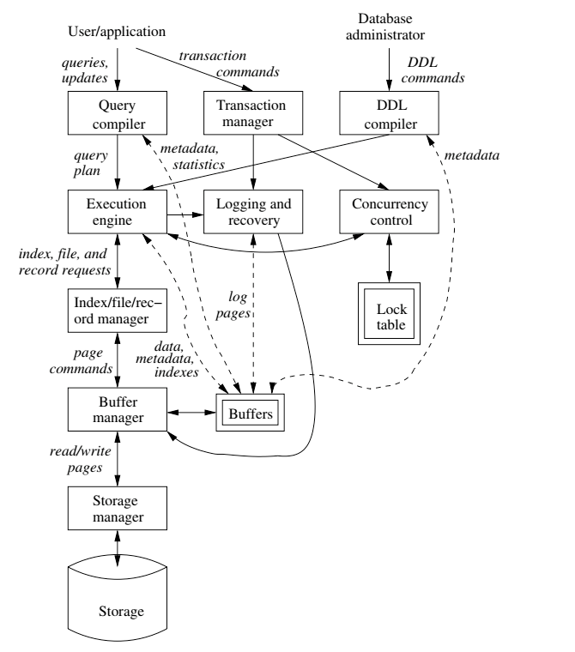
Buffer/Index/Query
Today
Find things quickly.
Query things quickly and efficiently.
Database Systems: The Complete Book (2nd Edition) by Hector Garcia-Molina (Author), Jeffrey D. Ullman (Author), Jennifer Widom (Author)

Slide 10
Buffer Pool/Buffer Manager

Slide 11
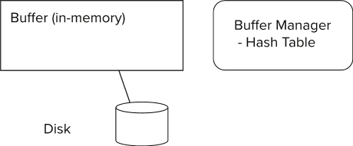
Storage Access
Blocks are units of both storage allocation and data transfer.
Database system seeks to minimize the number of block transfers between the disk and memory. We can reduce the number of disk accesses by keeping as many blocks as possible in main memory.
Buffer – portion of main memory available to store copies of disk blocks.
Buffer manager – subsystem responsible for allocating buffer space in main memory.
Notes:
11

Slide 12
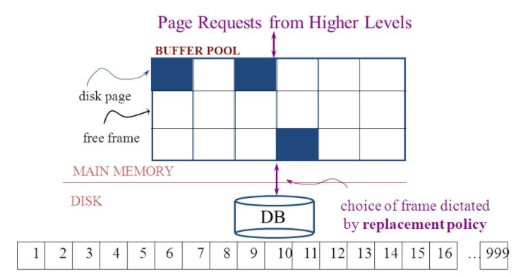
The Logical Concept
The DBMS and queries can only manipulate in-memory blocks and records.
A very, very, very small fraction of all blocks fit in memory.

Slide 13
Buffer Manager
Programs call on the buffer manager when they need a block from disk.
If the block is already in the buffer, buffer manager returns the address of the block in main memory
If the block is not in the buffer, the buffer manager
Allocates space in the buffer for the block
Replacing (throwing out) some other block, if required, to make space for the new block.
Replaced block written back to disk only if it was modified since the most recent time that it was written to/fetched from the disk.
Reads the block from the disk to the buffer, and returns the address of the block in main memory to requester.
Notes:
13

Slide 14
Buffer Manager
Buffer replacement strategy (details coming up!)
Pinned block: memory block that is not allowed to be written back to disk
Pin done before reading/writing data from a block
Unpin done when read /write is complete
Multiple concurrent pin/unpin operations possible
Keep a pin count, buffer block can be evicted only if pin count = 0
Shared and exclusive locks on buffer
Needed to prevent concurrent operations from reading page contents as they are moved/reorganized, and to ensure only one move/reorganize at a time
Readers get shared lock, updates to a block require exclusive lock
Locking rules:
Only one process can get exclusive lock at a time
Shared lock cannot be concurrently with exclusive lock
Multiple processes may be given shared lock concurrently

Slide 15
Buffer-Replacement Policies
Most operating systems replace the block least recently used (LRU strategy)
Idea behind LRU – use past pattern of block references as a predictor of future references
LRU can be bad for some queries
Queries have well-defined access patterns (such as sequential scans), and a database system can use the information in a user’s query to predict future references
Mixed strategy with hints on replacement strategy provided by the query optimizer is preferable
Example of bad access pattern for LRU: when computing the join of 2 relations r and s by a nested loops
for each tuple tr of r do for each tuple ts of s do if the tuples tr and ts match …
Notes:
15

Slide 16
Buffer-Replacement Policies (Cont.)
Toss-immediate strategy – frees the space occupied by a block as soon as the final tuple of that block has been processed
Most recently used (MRU) strategy – system must pin the block currently being processed. After the final tuple of that block has been processed, the block is unpinned, and it becomes the most recently used block.
Buffer manager can use statistical information regarding the probability that a request will reference a particular relation
E.g., the data dictionary is frequently accessed. Heuristic: keep data-dictionary blocks in main memory buffer
Operating system or buffer manager may reorder writes
Can lead to corruption of data structures on disk
E.g., linked list of blocks with missing block on disk
File systems perform consistency check to detect such situations
Careful ordering of writes can avoid many such problems
Notes:
16

Slide 17
Replacement Policy
The replacement policy is one of the most important factors in database management system implementation and configuration.
A very simple, introductory explanation is (https://en.wikipedia.org/wiki/Cache_replacement_policies).
There are a lot of possible policies.
The most efficient caching algorithm would be to always discard the information that will not be needed for the longest time in the future. This optimal result is referred to as Bélády's optimal algorithm/simply optimal replacement policy or the clairvoyant algorithm.
All implementable policies are an attempt to approximate knowledge of the future based on knowledge of the past.
Least Recently Used is based on the simplest assumption
The information that will not be needed for the longest time.
Is the information that has not been accessed for the longest time.

Slide 18
Replacement Algorithm
The algorithms are more sophisticated in the real world, e.g.
“Scans” are common, e.g. go through a large query result in order (will be more clear when discussing cursors).
The engine knows the current position in the result set.
Uses the sort order to determine which records will be accessed soon.
Tags those blocks as not replaceable.
(A form of clairvoyance).
Not all users/applications are equally “important.”
Classify users/applications into priority 1, 2 and 3.
Sub-allocate the buffer pool into pools P1, P2 and P3.
Apply LRU within pools and adjust pool sizes based on relative importance.
This prevents
A high access rate, low-priority application from taking up a lot of frames
Result in low access, high priority applications not getting buffer hits.

Slide 19
Optimization of Disk Block Access (Cont.)
Buffer managers support forced output of blocks for the purpose of recovery (more in Chapter 19)
Nonvolatile write buffers speed up disk writes by writing blocks to a non-volatile RAM or flash buffer immediately
Writes can be reordered to minimize disk arm movement
Log disk – a disk devoted to writing a sequential log of block updates
Used exactly like nonvolatile RAM
Write to log disk is very fast since no seeks are required
Journaling file systems write data in-order to NV-RAM or log disk
Reordering without journaling: risk of corruption of file system data

Slide 20
Indexes

Slide 21
Basic Concepts
Indexing mechanisms used to speed up access to desired data.
E.g., author catalog in library
Search Key - attribute to set of attributes used to look up records in a file.
An index file consists of records (called index entries) of the form
Index files are typically much smaller than the original file
Two basic kinds of indices:
Ordered indices: search keys are stored in sorted order
Hash indices: search keys are distributed uniformly across “buckets” using a “hash function”.
search-key
pointer
search-key
pointer
(“c:\”, LBN, offset)
search-key
pointer
search-key
pointer

Slide 22
Ordered Indices
In an ordered index, index entries are stored sorted on the search key value.
Clustering index: in a sequentially ordered file, the index whose search key specifies the sequential order of the file.
Also called primary index
The search key of a primary index is usually but not necessarily the primary key.
Secondary index: an index whose search key specifies an order different from the sequential order of the file. Also called nonclustering index.
Index-sequential file: sequential file ordered on a search key, with a clustering index on the search key.

Slide 23
Dense Index Files
Dense index — Index record appears for every search-key value in the file.
E.g. index on ID attribute of instructor relation

Slide 24
Dense Index Files (Cont.)
Dense index on dept_name, with instructor file sorted on dept_name

Slide 25
Sparse Index Files
Sparse Index: contains index records for only some search-key values.
Applicable when records are sequentially ordered on search-key
To locate a record with search-key value K we:
Find index record with largest search-key value < K
Search file sequentially starting at the record to which the index record points

Slide 26
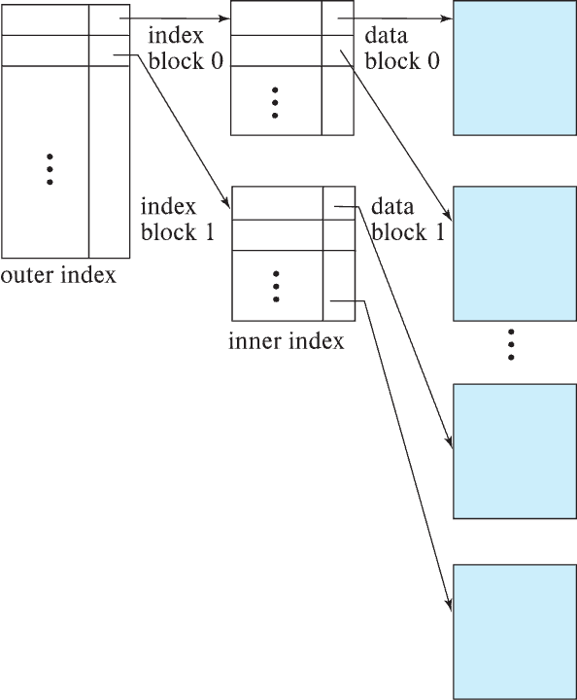
Sparse Index Files (Cont.)
Compared to dense indices:
Less space and less maintenance overhead for insertions and deletions.
Generally slower than dense index for locating records.
Good tradeoff:
for clustered index: sparse index with an index entry for every block in file, corresponding to least search-key value in the block.
For unclustered index: sparse index on top of dense index (multilevel index)

Slide 27
Secondary Indices Example
Secondary index on salary field of instructor
Index record points to a bucket that contains pointers to all the actual records with that particular search-key value.
Secondary indices have to be dense

Slide 28
Clustering vs Nonclustering Indices
Indices offer substantial benefits when searching for records.
BUT: indices imposes overhead on database modification
when a record is inserted or deleted, every index on the relation must be updated
When a record is updated, any index on an updated attribute must be updated
Sequential scan using clustering index is efficient, but a sequential scan using a secondary (nonclustering) index is expensive on magnetic disk
Each record access may fetch a new block from disk
Each block fetch on magnetic disk requires about 5 to 10 milliseconds

Slide 29
Indices on Multiple Keys
Composite search key
E.g., index on instructor relation on attributes (name, ID)
Values are sorted lexicographically
E.g. (John, 12121) < (John, 13514) and (John, 13514) < (Peter, 11223)
Can query on just name, or on (name, ID)
(nameLast, nameFirst, birthyear)
nameLast [nameLast = “Ferguson”] [nameLast like “Fer%”]
nameLast, nameFirst
nameLast, nameFirst, birthyear
NOT and index on
nameFirst, nameLast
birthyear
nameLast like [%er%]

Slide 30
B⁺-Tree Index Files
Disadvantage of indexed-sequential files
Performance degrades as file grows, since many overflow blocks get created.
Periodic reorganization of entire file is required.
Advantage of B⁺-tree index files:
Automatically reorganizes itself with small, local, changes, in the face of insertions and deletions.
Reorganization of entire file is not required to maintain performance.
(Minor) disadvantage of B⁺-trees:
Extra insertion and deletion overhead, space overhead.
Advantages of B⁺-trees outweigh disadvantages
B⁺-trees are used extensively

Slide 31
Example of B⁺-Tree

Slide 32
B⁺-Tree Index Files (Cont.)
A B⁺-tree is a rooted tree satisfying the following properties:
All paths from root to leaf are of the same length
Each node that is not a root or a leaf has between ⎡n/2⎤ and n children.
A leaf node has between ⎡(n–1)/2⎤ and n–1 values
Special cases:
If the root is not a leaf, it has at least 2 children.
If the root is a leaf (that is, there are no other nodes in the tree), it can have between 0 and (n–1) values.

Slide 33
B⁺-Tree Node Structure
Typical node
K_{i} are the search-key values
P_{i} are pointers to children (for non-leaf nodes) or pointers to records or buckets of records (for leaf nodes).
The search-keys in a node are ordered
K₁ < K₂ < K₃ < . . . < K_{n–1}
(Initially assume no duplicate keys, address duplicates later)

Slide 34
Leaf Nodes in B⁺-Trees
Properties of a leaf node:
For i = 1, 2, . . ., n–1, pointer P_{i} points to a file record with search-key value K_{i},
If L_{i}, L_{j} are leaf nodes and i < j, L_{i}’s search-key values are less than or equal to L_{j}’s search-key values
P_{n} points to next leaf node in search-key order

Slide 35
Non-Leaf Nodes in B⁺-Trees
Non leaf nodes form a multi-level sparse index on the leaf nodes. For a non-leaf node with m pointers:
All the search-keys in the subtree to which P₁ points are less than K₁
For 2 ≤ i ≤ n – 1, all the search-keys in the subtree to which P_{i} points have values greater than or equal to K_{i–1} and less than K_{i}
All the search-keys in the subtree to which P_{n} points have values greater than or equal to K_{n–1}
General structure

Slide 36
Example of B⁺-tree
B⁺-tree for instructor file (n = 6)
Leaf nodes must have between 3 and 5 values (⎡(n–1)/2⎤ and n –1, with n = 6).
Non-leaf nodes other than root must have between 3 and 6 children (⎡(n/2⎤ and n with n =6).
Root must have at least 2 children.

Slide 37
Observations about B⁺-trees
Since the inter-node connections are done by pointers, “logically” close blocks need not be “physically” close.
The non-leaf levels of the B⁺-tree form a hierarchy of sparse indices.
The B⁺-tree contains a relatively small number of levels
Level below root has at least 2* ⎡n/2⎤ values
Next level has at least 2* ⎡n/2⎤ * ⎡n/2⎤ values
.. etc.
If there are K search-key values in the file, the tree height is no more than ⎡ log_{⎡n/2⎤}(K)⎤
thus searches can be conducted efficiently.
Insertions and deletions to the main file can be handled efficiently, as the index can be restructured in logarithmic time (as we shall see).

Slide 38
Show the Simulator
https://www.cs.usfca.edu/~galles/visualization/BPlusTree.html

Slide 39
Hashing

Slide 40
Static Hashing
A bucket is a unit of storage containing one or more entries (a bucket is typically a disk block).
we obtain the bucket of an entry from its search-key value using a hash function
Hash function h is a function from the set of all search-key values K to the set of all bucket addresses B.
Hash function is used to locate entries for access, insertion as well as deletion.
Entries with different search-key values may be mapped to the same bucket; thus entire bucket has to be searched sequentially to locate an entry.
In a hash index, buckets store entries with pointers to records
In a hash file-organization buckets store records

Slide 41
Handling of Bucket Overflows (Cont.)
Overflow chaining – the overflow buckets of a given bucket are chained together in a linked list.
Above scheme is called closed addressing (also called closed hashing or open hashing depending on the book you use)
An alternative, called open addressing (also called open hashing or closed hashing depending on the book you use) which does not use over- flow buckets, is not suitable for database applications.

Slide 42
Example of Hash File Organization
Hash file organization of instructor file, using dept_name as key.

Slide 43
Deficiencies of Static Hashing
In static hashing, function h maps search-key values to a fixed set of B of bucket addresses. Databases grow or shrink with time.
If initial number of buckets is too small, and file grows, performance will degrade due to too much overflows.
If space is allocated for anticipated growth, a significant amount of space will be wasted initially (and buckets will be underfull).
If database shrinks, again space will be wasted.
One solution: periodic re-organization of the file with a new hash function
Expensive, disrupts normal operations
Better solution: allow the number of buckets to be modified dynamically.

Slide 44
Show the Simulator
https://www.cs.usfca.edu/~galles/visualization/OpenHash.html
https://visualgo.net/en/hashtable
http://iswsa.acm.org/mphf/openDSAPerfectHashAnimation/perfectHashAV.html
https://opendsa-server.cs.vt.edu/ODSA/AV/Development/hashAV.html

Slide 45
Query Compilation

Slide 46
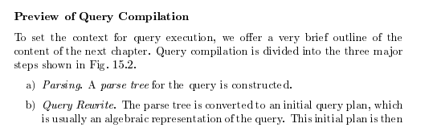
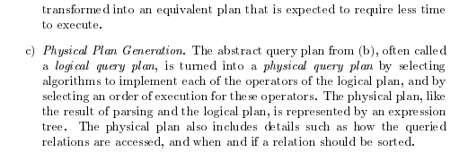
Query Compilation
Database Systems: The Complete Book (2nd Edition) 2nd Edition
by Hector Garcia-Molina (Author), Jeffrey D. Ullman (Author), Jennifer Widom (Author)

Slide 47
Basic Steps in Query Processing
1. Parsing and translation
2. Optimization
3. Evaluation

Slide 48
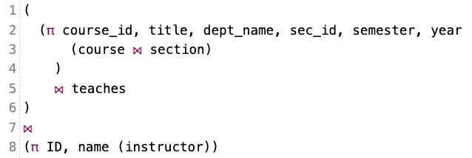
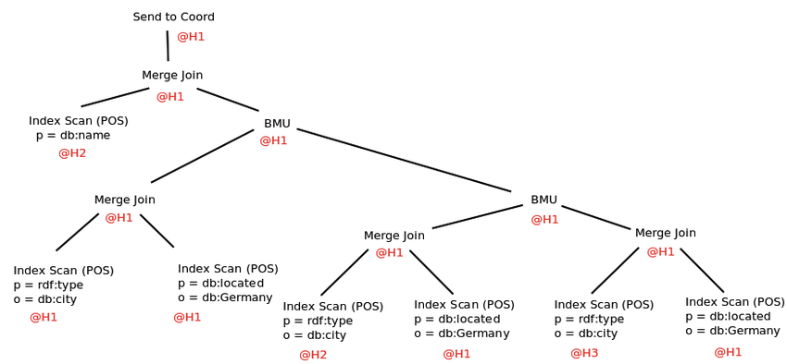
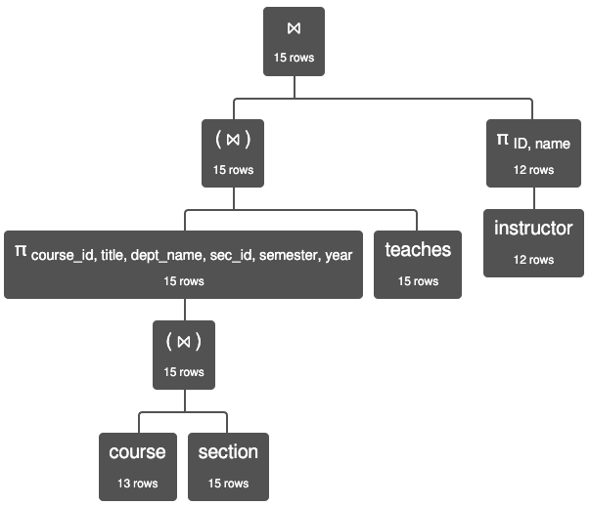
Query Processing

Slide 49
Query Plan and Algorithms

Slide 50
Parsing and Execution
Parser/Translator
Verifies syntax correctness and generates a parse tree.
Converts to logical plan tree that defines how to execute the query.
Tree nodes are operator(tables, parameters)
Edges are the flow of data “up the tree” from node to node.
Optimizer
Modifies the logical plan to define an improved execution.
Query rewrite/transformation.
Determines how to choose among multiple implementations of operators.
Engine
Executes the plan
May modify the plan to optimize execution, e.g. using indexes.

Slide 51
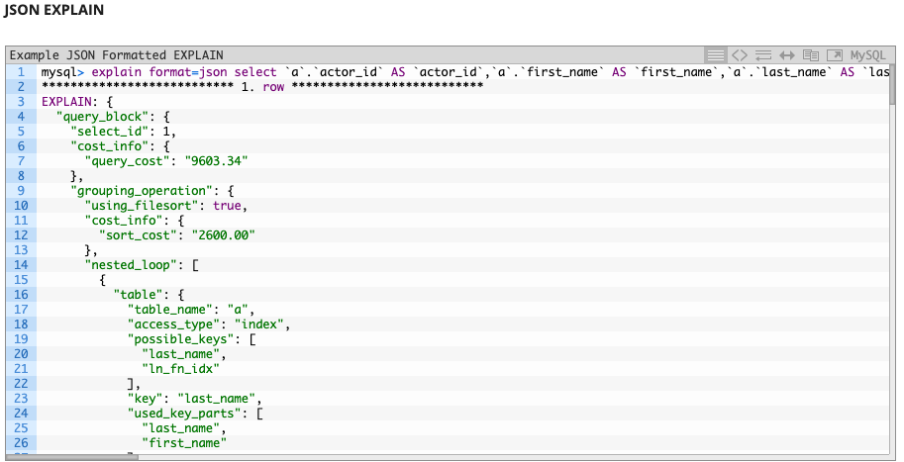
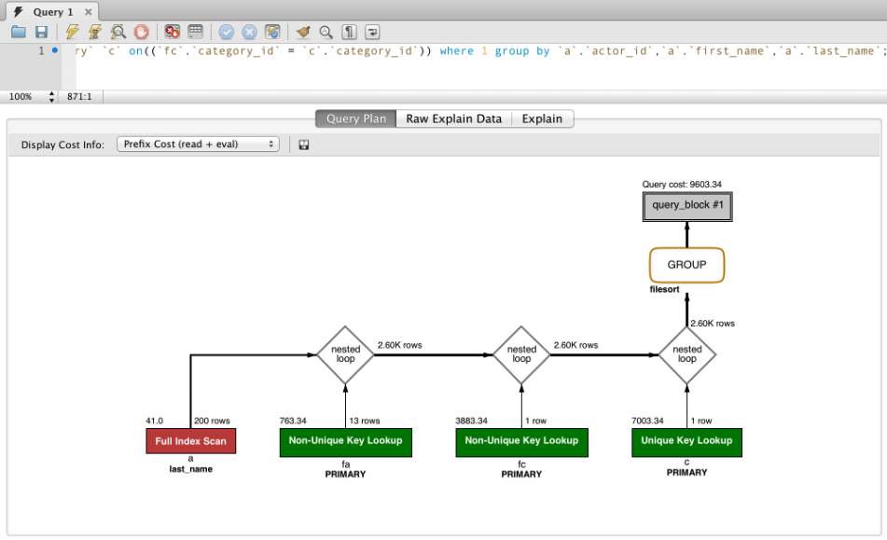
EXPLAIN Example

Slide 52
Basic Steps in Query Processing: Optimization
A relational algebra expression may have many equivalent expressions
E.g., σ_{salary<75000}(∏_{salary}(instructor)) is equivalent to ∏_{salary}(σ_{salary<75000}(instructor))
Each relational algebra operation can be evaluated using one of several different algorithms
Correspondingly, a relational-algebra expression can be evaluated in many ways.
Annotated expression specifying detailed evaluation strategy is called an evaluation-plan. E.g.,:
Use an index on salary to find instructors with salary < 75000,
Or perform complete relation scan and discard instructors with salary ≥ 75000

Slide 53
Basic Steps: Optimization (Cont.)
Query Optimization: Amongst all equivalent evaluation plans choose the one with lowest cost.
Cost is estimated using statistical information from the database catalog
e.g.. number of tuples in each relation, size of tuples, etc.
In this chapter we study
How to measure query costs
Algorithms for evaluating relational algebra operations
How to combine algorithms for individual operations in order to evaluate a complete expression
In Chapter 16
We study how to optimize queries, that is, how to find an evaluation plan with lowest estimated cost

Slide 54
Query Cost

Slide 55
Measures of Query Cost
Many factors contribute to time cost
disk access, CPU, and network communication
Cost can be measured based on
response time, i.e. total elapsed time for answering query, or
total resource consumption
We use total resource consumption as cost metric
Response time harder to estimate, and minimizing resource consumption is a good idea in a shared database
We ignore CPU costs for simplicity
Real systems do take CPU cost into account
Network costs must be considered for parallel systems
We describe how estimate the cost of each operation
We do not include cost to writing output to disk

Slide 56
Measures of Query Cost
Disk cost can be estimated as:
Number of seeks * average-seek-cost
Number of blocks read * average-block-read-cost
Number of blocks written * average-block-write-cost
For simplicity we just use the number of block transfers from disk and the number of seeks as the cost measures
t_{T} – time to transfer one block
Assuming for simplicity that write cost is same as read cost
t_{S} – time for one seek
Cost for b block transfers plus S seeks b * t_{T} + S * t_{S}
t_{S} and t_{T} depend on where data is stored; with 4 KB blocks:
High end magnetic disk: t_{S} = 4 msec and t_{T} =0.1 msec
SSD: t_{S} = 20-90 microsec and t_{T} = 2-10 microsec for 4KB
If I ask a query cost estimation question on a HW or exam, you only need to estimate the number of block transfers.

Slide 57
Measures of Query Cost (Cont.)
Required data may be buffer resident already, avoiding disk I/O
But hard to take into account for cost estimation
Several algorithms can reduce disk IO by using extra buffer space
Amount of real memory available to buffer depends on other concurrent queries and OS processes, known only during execution
Worst case estimates assume that no data is initially in buffer and only the minimum amount of memory needed for the operation is available
But more optimistic estimates are used in practice
Notes:
57

Slide 58
Algorithm Selection for SELECT

Slide 59
Selection Operation
File scan
Algorithm A1 (linear search). Scan each file block and test all records to see whether they satisfy the selection condition.
Cost estimate = b_{r} block transfers + 1 seek
b_{r} denotes number of blocks containing records from relation r
If selection is on a key attribute, can stop on finding record
cost = (b_{r} /2) block transfers + 1 seek
Linear search can be applied regardless of
selection condition or
ordering of records in the file, or
availability of indices
Note: binary search generally does not make sense since data is not stored consecutively
except when there is an index available,
and binary search requires more seeks than index search
This seems to assume that all blocks for the relation are on the same cylinder.

Slide 60
Selections Using Indices
Index scan – search algorithms that use an index
selection condition must be on search-key of index.
A2 (clustering index, equality on key). Retrieve a single record that satisfies the corresponding equality condition
Cost = (h_{i} + 1) * (t_{T} + t_{S})
A3 (clustering index, equality on nonkey) Retrieve multiple records.
Records will be on consecutive blocks
Let b = number of blocks containing matching records
Cost = h_{i} * (t_{T} + t_{S}) + t_{S} + t_{T} * b

Slide 61

Selections Using Indices
Index scan – search algorithms that use an index
selection condition must be on search-key of index.
A2 (clustering index, equality on key). Retrieve a single record that satisfies the corresponding equality condition
Cost = (h_{i} + 1) * (t_{T} + t_{S})
A3 (clustering index, equality on nonkey) Retrieve multiple records.
Records will be on consecutive blocks
Let b = number of blocks containing matching records
Cost = h_{i} * (t_{T} + t_{S}) + t_{S} + t_{T} * b
Replace (t_{T} + t_{S}) with t_{B}, the time/cost for reading a block.
In my way of thinking, h_{i} is the “height” of the index tree.
The cost to find the index block is h_{i}* t_{B.} We then read the referenced data block, which happens once because it is a key.
If it is a non-key, we may retrieve multiple records ➔ reading multiple blocks.
But, clustering index on the non-key field ➔ the data records are sorted by the non-key ➔ records are probably on consecutive sectors on the same track ➔ one seek and then some number of block reads.

Slide 62
Selections Using Indices
A4 (secondary index, equality on key/non-key).
Retrieve a single record if the search-key is a candidate key
Cost = (h_{i} + 1) * (t_{T} + t_{S})
Retrieve multiple records if search-key is not a candidate key
each of n matching records may be on a different block
Cost = (h_{i} + n) * (t_{T} + t_{S})
Can be very expensive!
h_{i}* t_{B} to get the leaf node in the index.
Each entry in the leaf node may reference a different block in the data file.
If there are n matching records, we get
(h_{i} + n) * t_{B}
Notes:
62

Slide 63
Selections Involving Comparisons
Can implement selections of the form σ_{A≤V} (r) or σ_{A ≥ V}(r) by using
a linear file scan,
or by using indices in the following ways:
A5 (clustering index, comparison). (Relation is sorted on A)
For σ_{A ≥ V}(r) use index to find first tuple ≥ v and scan relation sequentially from there
For σ_{A≤V} (r) just scan relation sequentially till first tuple > v; do not use index
A6 (clustering index, comparison).
For σ_{A ≥ V}(r) use index to find first index entry ≥ v and scan index sequentially from there, to find pointers to records.
For σ_{A≤V} (r) just scan leaf pages of index finding pointers to records, till first entry > v
In either case, retrieve records that are pointed to
requires an I/O per record; Linear file scan may be cheaper!

Slide 64
Implementation of Complex Selections
Conjunction: σ_{θ1}∧ _{θ2}∧. . . _{θn}(r)
A7 (conjunctive selection using one index).
Select a combination of θ_{i} and algorithms A1 through A7 that results in the least cost for σ_{θi} (r).
Test other conditions on tuple after fetching it into memory buffer.
A8 (conjunctive selection using composite index).
Use appropriate composite (multiple-key) index if available.
A9 (conjunctive selection by intersection of identifiers).
Requires indices with record pointers.
Use corresponding index for each condition, and take intersection of all the obtained sets of record pointers.
Then fetch records from file
If some conditions do not have appropriate indices, apply test in memory.

Slide 65
Algorithms for Complex Selections
Disjunction:σ_{θ1}∨ _{θ2} ∨. . . _{θn} (r).
A10 (disjunctive selection by union of identifiers).
Applicable if all conditions have available indices.
Otherwise use linear scan.
Use corresponding index for each condition, and take union of all the obtained sets of record pointers.
Then fetch records from file
Negation: σ_{¬θ}(r)
Use linear scan on file
If very few records satisfy ¬θ, and an index is applicable to θ
Find satisfying records using index and fetch from file

Slide 66
Conjunctive and Disjunctive
Assume there is an index on name but not on dept_name.
Consider two simple use cases
select * from student where name=“Smith” AND dept_name=“Comp. Sci.”
select * from student where name=“Smith” OR dept_name=“Comp. Sci.”
With a conjunction, the engine must
Find and read the blocks with the correct name.
Scan each block to evaluate the rest of the AND, but this is not an I/O.
The index does not help for the disjunction because the engine still needs to scan the data file and read blocks looking for the matching OR conditions.

Slide 67
Algorithm Selection for JOIN

Slide 68
Join Operation
Several different algorithms to implement joins
Nested-loop join
Block nested-loop join
Indexed nested-loop join
Merge-join
Hash-join
Choice based on cost estimate
Examples use the following information
Number of records of student: 5,000 takes: 10,000
Number of blocks of student: 100 takes: 400

Slide 69
Nested-Loop Join
To compute the theta join r ⨝ _{θ} s for each tuple t_{r} in r do begin for each tuple t_{s} in s do begin test pair (t_{r},t_{s}) to see if they satisfy the join condition θ if they do, add t_{r} • t_{s} to the result. end end
r is called the outer relation and s the inner relation of the join.
Requires no indices and can be used with any kind of join condition.
Expensive since it examines every pair of tuples in the two relations.
For clarity (or confusion), I sometimes use the terms:
Scan table for the outer relation
Probe table for the inner relation

Slide 70
Nested-Loop Join (Cont.)
In the worst case, if there is enough memory only to hold one block of each relation, the estimated cost is n_{r} ∗ b_{s} + b_{r} block transfers, plus n_{r} + b_{r} seeks
If the smaller relation fits entirely in memory, use that as the inner relation.
Reduces cost to b_{r} + b_{s} block transfers and 2 seeks
Assuming worst case memory availability cost estimate is
with student as outer relation:
5000 ∗ 400 + 100 = 2,000,100 block transfers,
5000 + 100 = 5100 seeks
with takes as the outer relation
10000 ∗ 100 + 400 = 1,000,400 block transfers and 10,400 seeks
If smaller relation (student) fits entirely in memory, the cost estimate will be 500 block transfers.
Block nested-loops algorithm (next slide) is preferable.
R JOIN S on (…) S JOIN R on (…)

Slide 71


Well, That was a Clear as Mud
SELECT * from L JOIN R on L.x=R.y
The algorithm reads each block of L one time and never reads it again in JOIN.
For each record l in L, the algorithm must read each block of R one time.
The number of blocks in a relation S is, over simplistically,
#(S) is the number of records.
s(S) is the average record size.
S(b) is the block size ➔ number of blocks is #(S)/(s(b)/s(S)), which is O(#(S))
So, the number of blocks read is O(#(L))*O(#(R)) = O(#(L)*#(R))
“shmath” – Something that is completely made up but presented as precise and accurate using math symbols.

Slide 72
Indexed Nested-Loop Join
Index lookups can replace file scans if
join is an equi-join or natural join and
an index is available on the inner relation’s join attribute
Can construct an index just to compute a join.
For each tuple t_{r} in the outer relation r, use the index to look up tuples in s that satisfy the join condition with tuple t_{r}.
Worst case: buffer has space for only one page of r, and, for each tuple in r, we perform an index lookup on s.
Cost of the join: b_{r} (t_{T} + t_{S}) + n_{r} ∗ c
Where c is the cost of traversing index and fetching all matching s tuples for one tuple or r
c can be estimated as cost of a single selection on s using the join condition.
If indices are available on join attributes of both r and s, use the relation with fewer tuples as the outer relation.
r.X = s.Y AND r.P = s.Q
(X, Y) → (P, Q)

Slide 73
Sorting
We may build an index on the relation, and then use the index to read the relation in sorted order. May lead to one disk block access for each tuple.
For relations that fit in memory, techniques like quicksort can be used.
For relations that don’t fit in memory, external sort-merge is a good choice.
The engine may build either a sorted index or a hash index.
The key idea is:
The cost of building the index and then using the index in the algorithm
Is cheaper than running the default algorithm with an index

Slide 74

We Really Hate this Class
One way to overly simplify these analyses is realizing that the no. of blocks is “linear” with the number of records/ tuples in a relation. ➔
Overly simplify and assume that the block size is one record.
Analyze using the number of reads as a function of no. of rows.
Assume that relation R has #(R) rows:
A tree-based lookup when you can use a key is O(log(#R)). The base of the logarithm does not materially change the analysis.
A hash-based lookup is O(1).
A scan or scan-based look up is O(#R).
Index creation cost:
Hash is O(#(R))
Tree is O(#(R)*Log(#R))
So, very roughly an index join is either
O(#(L)*Log(#(R)) + O(#(R)*Log(#(R))) = Log(#(R))*(#(L) + #(R)) or … …
O(#(L) + #(R)), but this only works for equality.
#(R)= 100
#(S) 1000000
Build index = 6 million
700 + 6 million

Slide 75
Merge-Join
1. Sort both relations on their join attribute (if not already sorted on the join
attributes).
2. Merge the sorted relations to join them
1. Join step is similar to the merge stage of the sort-merge algorithm.
2. Main difference is handling of duplicate values in join attribute —
every pair with same value on join attribute must be matched
3. Detailed algorithm in book
#(A) = n, #(B) = m
n*m
n*log(n) + m*log(m) + n + m

Slide 76
Merge-Join (Cont.)
Can be used only for equi-joins and natural joins
Each block needs to be read only once (assuming all tuples for any given value of the join attributes fit in memory
Thus the cost of merge join is: b_{r} + b_{s} block transfers + ⎡b_{r} / b_{b}⎤ + ⎡b_{s} / b_{b}⎤ seeks
+ the cost of sorting if relations are unsorted.
hybrid merge-join: If one relation is sorted, and the other has a secondary B⁺-tree index on the join attribute
Merge the sorted relation with the leaf entries of the B⁺-tree .
Sort the result on the addresses of the unsorted relation’s tuples
Scan the unsorted relation in physical address order and merge with previous result, to replace addresses by the actual tuples
Sequential scan more efficient than random lookup

Slide 77
Hash-Join
Applicable for equi-joins and natural joins.
A hash function h is used to partition tuples of both relations
h maps JoinAttrs values to {0, 1, ..., n}, where JoinAttrs denotes the common attributes of r and s used in the natural join.
r₀, r₁, . . ., r_{n} denote partitions of r tuples
Each tuple t_{r} ∈ r is put in partition r_{i} where i = h(t_{r} [JoinAttrs]).
r₀,, r₁. . ., r_{n} denotes partitions of s tuples
Each tuple t_{s} ∈s is put in partition s_{i}, where i = h(t_{s} [JoinAttrs]).
Note: In book, Figure 12.10 r_{i} is denoted as H_{ri,} s_{i} is denoted as H_{si} and n is denoted as n_{h.}
On A.x=b.y and A.z=b.q (z,q)
(x,y)

Slide 78
Hash-Join (Cont.)
On a.X=b.Z

Slide 79
Hash-Join (Cont.)
r tuples in r_{i} need only to be compared with s tuples in s_{i} Need not be compared with s tuples in any other partition, since:
an r tuple and an s tuple that satisfy the join condition will have the same value for the join attributes.
If that value is hashed to some value i, the r tuple has to be in r_{i} and the s tuple in s_{i}.

Slide 80
Hash-Join Algorithm
The hash-join of r and s is computed as follows.
1. Partition the relation s using hashing function h. When partitioning a relation, one block of memory is reserved as the output buffer for each partition.
2. Partition r similarly.
3. For each i:
(a) Load s_{i} into memory and build an in-memory hash index on it using the join attribute. This hash index uses a different hash function than the earlier one h.
(b) Read the tuples in r_{i} from the disk one by one. For each tuple t_{r} locate each matching tuple t_{s} in s_{i} using the in-memory hash index. Output the concatenation of their attributes.
Relation s is called the build input and r is called the probe input.

Slide 81
Hash-Join algorithm (Cont.)
The value n and the hash function h is chosen such that each s_{i} should fit in memory.
Typically n is chosen as ⎡b_{s}/M⎤ * f where f is a “fudge factor”, typically around 1.2
The probe relation partitions s_{i} need not fit in memory
Recursive partitioning required if number of partitions n is greater than number of pages M of memory.
instead of partitioning n ways, use M – 1 partitions for s
Further partition the M – 1 partitions using a different hash function
Use same partitioning method on r
Rarely required: e.g., with block size of 4 KB, recursive partitioning not needed for relations of < 1GB with memory size of 2MB, or relations of < 36 GB with memory of 12 MB

Slide 82
Algorithm Selection for Other Operations

Slide 83
Other Operations
Duplicate elimination can be implemented via hashing or sorting.
On sorting duplicates will come adjacent to each other, and all but one set of duplicates can be deleted.
Optimization: duplicates can be deleted during run generation as well as at intermediate merge steps in external sort-merge.
Hashing is similar – duplicates will come into the same bucket.
Projection:
perform projection on each tuple
followed by duplicate elimination.
Select b,c,f from A
Union
Select a,q,r from B

Slide 84
Other Operations : Aggregation
Aggregation can be implemented in a manner similar to duplicate elimination.
Sorting or hashing can be used to bring tuples in the same group together, and then the aggregate functions can be applied on each group.
Optimization: partial aggregation
combine tuples in the same group during run generation and intermediate merges, by computing partial aggregate values
For count, min, max, sum: keep aggregate values on tuples found so far in the group.
When combining partial aggregate for count, add up the partial aggregates
For avg, keep sum and count, and divide sum by count at the end

Slide 85
Evaluation

Slide 86
Evaluation of Expressions
So far: we have seen algorithms for individual operations
Alternatives for evaluating an entire expression tree
Materialization: generate results of an expression whose inputs are relations or are already computed, materialize (store) it on disk. Repeat.
Pipelining: pass on tuples to parent operations even as an operation is being executed
We study above alternatives in more detail

Slide 87
Materialization
Materialized evaluation: evaluate one operation at a time, starting at the lowest-level. Use intermediate results materialized into temporary relations to evaluate next-level operations.
E.g., in figure below, compute and store then compute the store its join with instructor, and finally compute the projection on name.

Slide 88
Materialization (Cont.)
Materialized evaluation is always applicable
Cost of writing results to disk and reading them back can be quite high
Our cost formulas for operations ignore cost of writing results to disk, so
Overall cost = Sum of costs of individual operations + cost of writing intermediate results to disk
Double buffering: use two output buffers for each operation, when one is full write it to disk while the other is getting filled
Allows overlap of disk writes with computation and reduces execution time

Slide 89
Pipelining
Pipelined evaluation: evaluate several operations simultaneously, passing the results of one operation on to the next.
E.g., in previous expression tree, don’t store result of
instead, pass tuples directly to the join.. Similarly, don’t store result of join, pass tuples directly to projection.
Much cheaper than materialization: no need to store a temporary relation to disk.
Pipelining may not always be possible – e.g., sort, hash-join.
For pipelining to be effective, use evaluation algorithms that generate output tuples even as tuples are received for inputs to the operation.
Pipelines can be executed in two ways: demand driven and producer driven

Slide 90
Pipelining (Cont.)
In demand driven or lazy evaluation
system repeatedly requests next tuple from top level operation
Each operation requests next tuple from children operations as required, in order to output its next tuple
In between calls, operation has to maintain “state” so it knows what to return next
In producer-driven or eager pipelining
Operators produce tuples eagerly and pass them up to their parents
Buffer maintained between operators, child puts tuples in buffer, parent removes tuples from buffer
if buffer is full, child waits till there is space in the buffer, and then generates more tuples
System schedules operations that have space in output buffer and can process more input tuples
Alternative name: pull and push models of pipelining

Slide 91
Pipelining (Cont.)
Implementation of demand-driven pipelining
Each operation is implemented as an iterator implementing the following operations
open()
E.g., file scan: initialize file scan
state: pointer to beginning of file
E.g., merge join: sort relations;
state: pointers to beginning of sorted relations
next()
E.g., for file scan: Output next tuple, and advance and store file pointer
E.g., for merge join: continue with merge from earlier state till next output tuple is found. Save pointers as iterator state.
close()

Slide 92
NoSQL

Slide 93
Reminder

Slide 94
Simplistic Classification (https://medium.com/swlh/4-types-of-nosql-databases-d88ad21f7d3b)
Relational is the foundational model.
We will see OLAP in a future lecture.
Subject of this lecture and part of HW3
We covered graphs and examples.

Slide 95
Graphs

Slide 96
Graph Database
Exactly what it sounds like
Two core types
Node
Edge (link)
Nodes and Edges have
Label(s) = “Kind”
Properties (free form)
Query is of the form
p1(n)-p2(e)-p3(m)
n, m are nodes; e is an edge
p1, p2, p3 are predicates on labels and properties
N->R->M

Slide 97
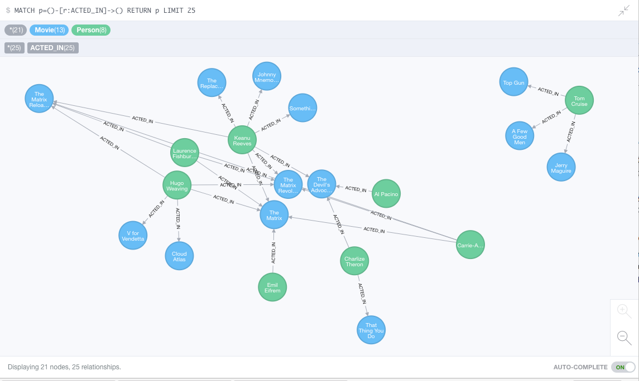
Neo4J Graph Query

Slide 98
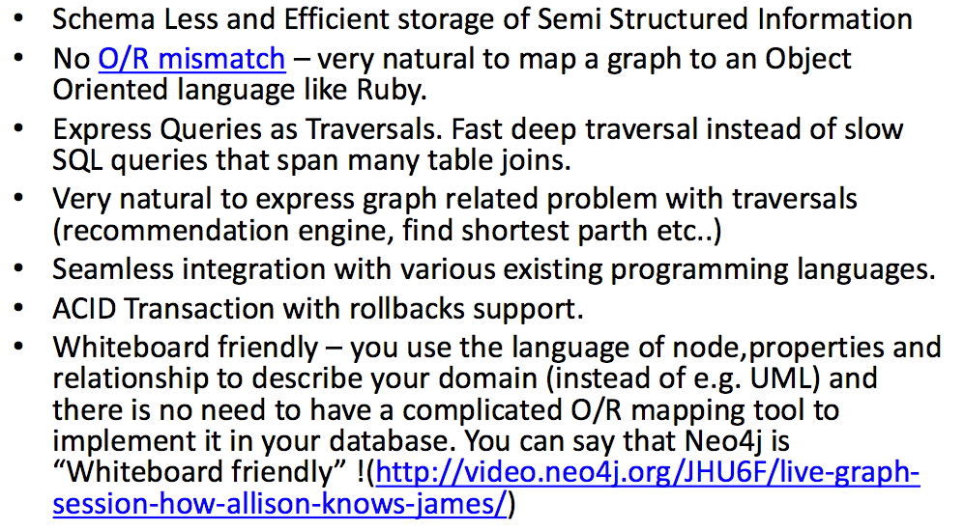
Why Graph Databases?

Slide 99
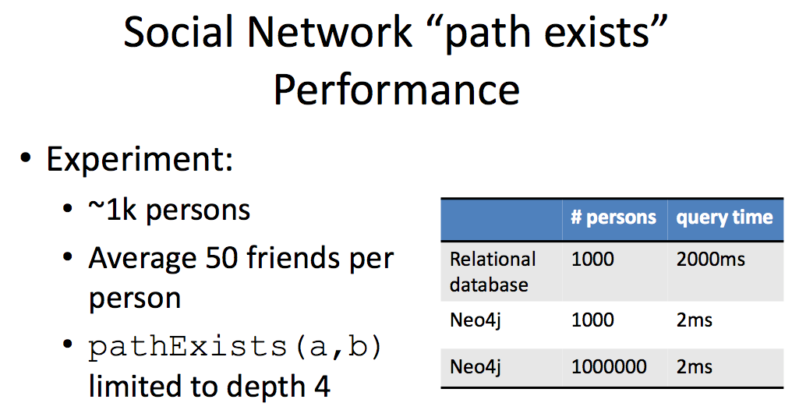
Graph Databases
Graph databases are
Extremely fast for some queries and data models.
Implement a language that vastly simplifies writing queries.

Slide 100
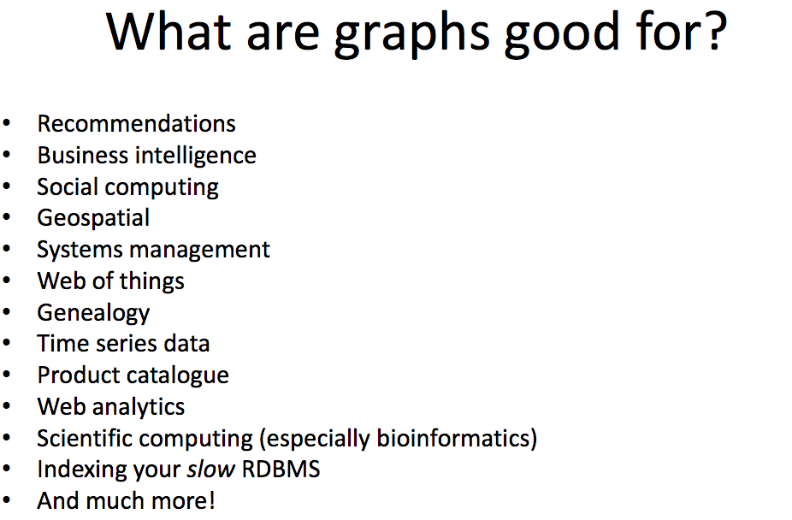

Slide 101
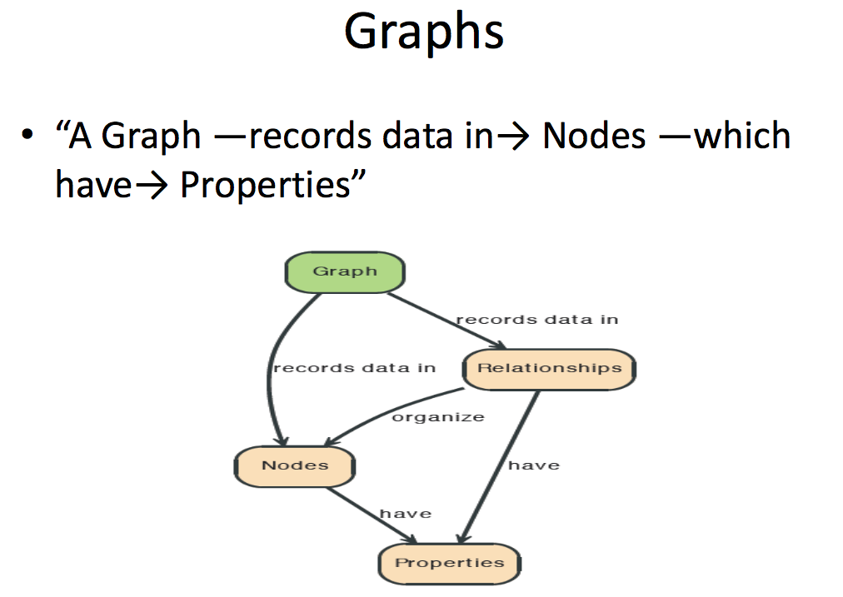

Slide 102
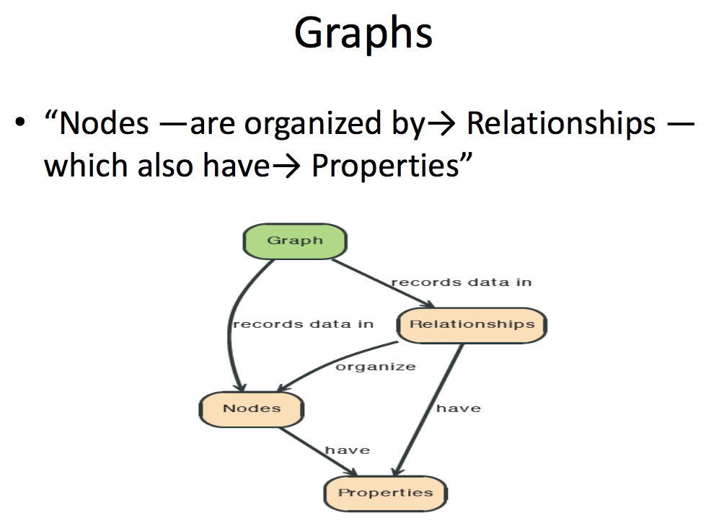

Slide 103
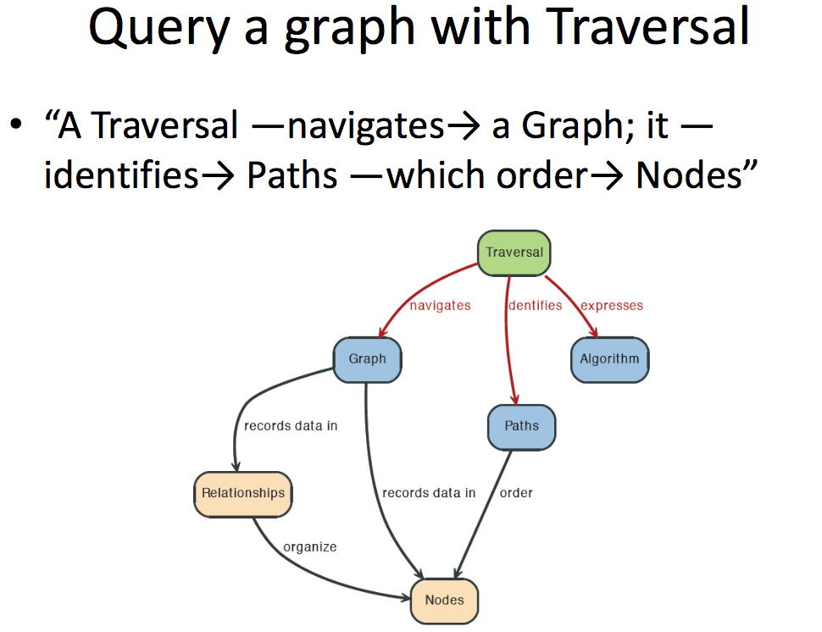

Slide 104
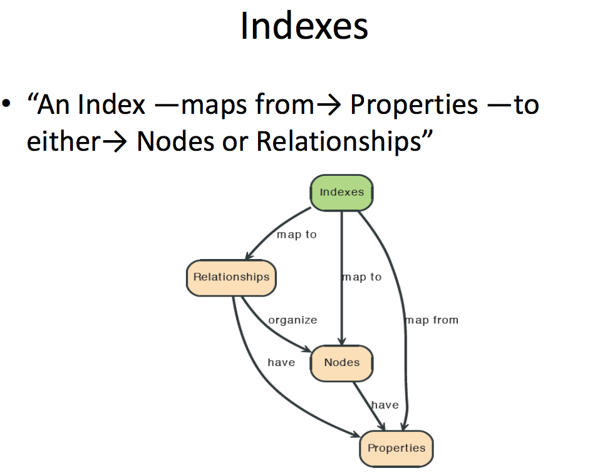

Slide 105
Neo4j

Slide 106
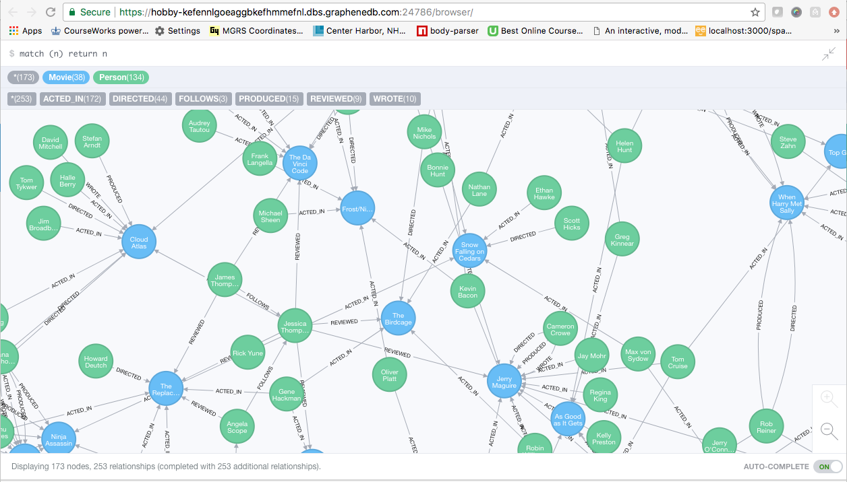
A Graph Database (Sample)

Slide 107
Neo4J Graph Query
Who acted in which movies?

Slide 108
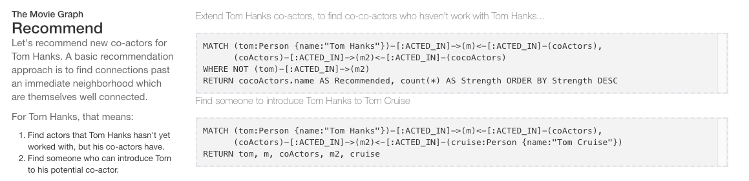
Big Deal. That is just a JOIN.
Yup. But that is simple.
Try writing the queries below in SQL.

Slide 109
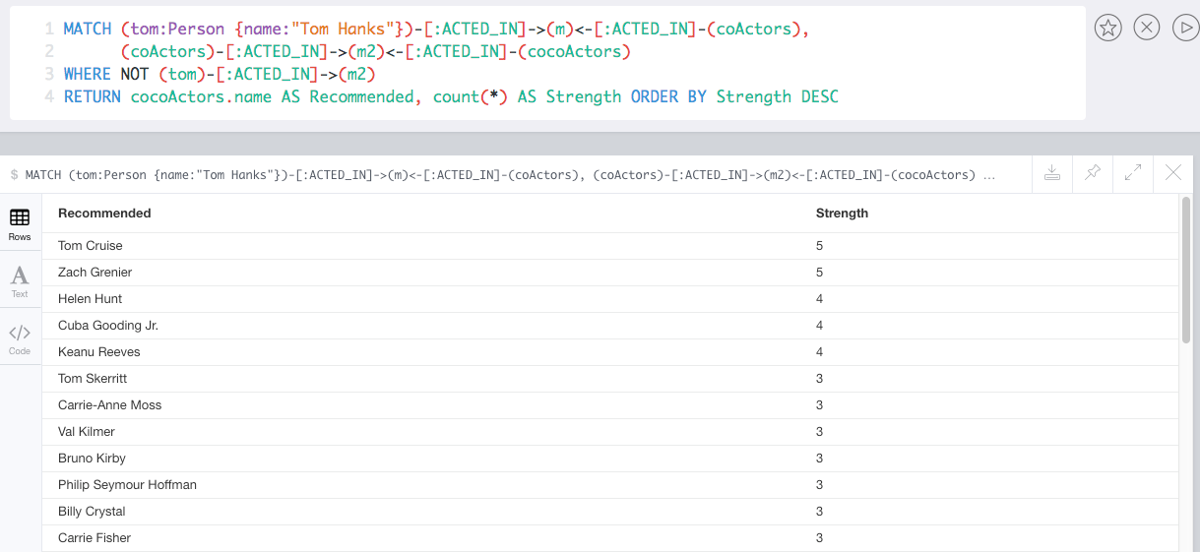
Recommend

Slide 110
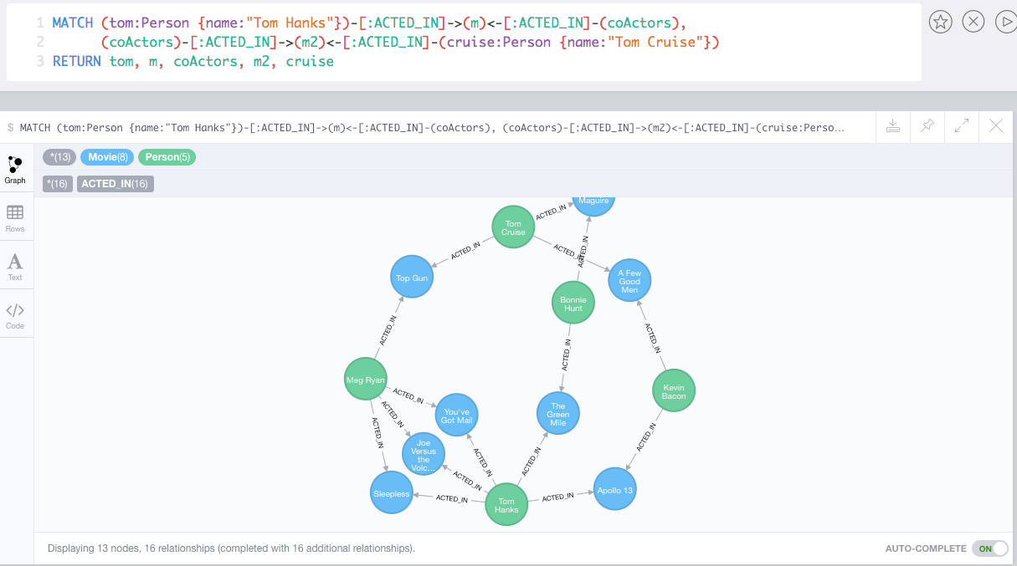
Which actors have worked with both Tom Hanks and
Tom Cruise?

Slide 111
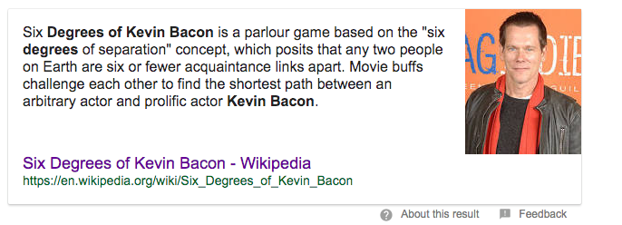
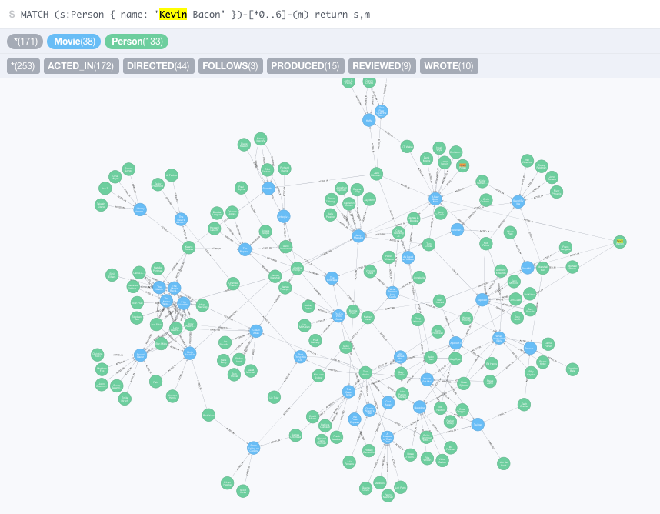


Slide 112
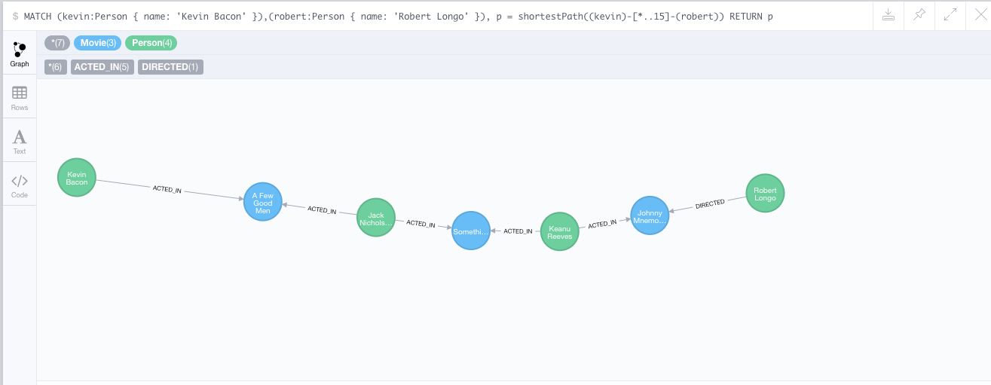
How do you get from Kevin Bacon to
Robert Longo?

