Slide 1
Understanding the Role of Trade-Ins in Durable Goods Markets: Theory and Evidence
Our paper expands on extant work in several ways. First we use infinite period model structure and a stationary equilibrium concept accompanying it. This help us reveal the unique role trade-ins as a device to mitigate the lemon problem. Second, our model accommodates the cannibalization arising from the coexistence of new and used goods markets, as well as customer heterogeneity and information asymmetry. Finally, we offer empirical evidence about trade-ins by testing a number of refutable predictions from our model.

Slide 2
Data Sources
CES panel from The Bureau of Labor Statistics (Consumer Price Index)
Each CES observation in the automobile ownership section of the survey includes information about the brand, model year, purchase year and month, and various household demographic variables. The make model of any vehicle traded-in is also recorded, along with its odometer reading and other trim-level details.
Annul issues of KBB (Benchmark resale prices, deterioration measure)
A syndicated data source that assembles price information for various models and vintages of automobiles derived from auctions and other dealer-dealer transaction.
Annul issues of Consumer Reports (Vehicle reliability measure)
A well-respected magazine that collects and publishes a variety of performance and reliability information on a variety of consumer products.

Slide 3
Measures
Net Price Paid
Reliability
Deterioration
Volume of Used Good Trade (VOT)
Vehicle Characteristics
Household Characteristics
Year Dummies
Quarter Dummies

Slide 4
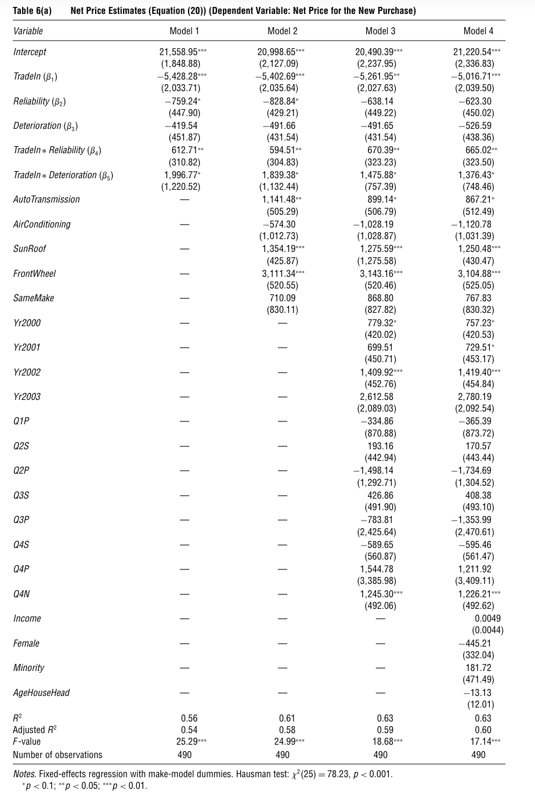
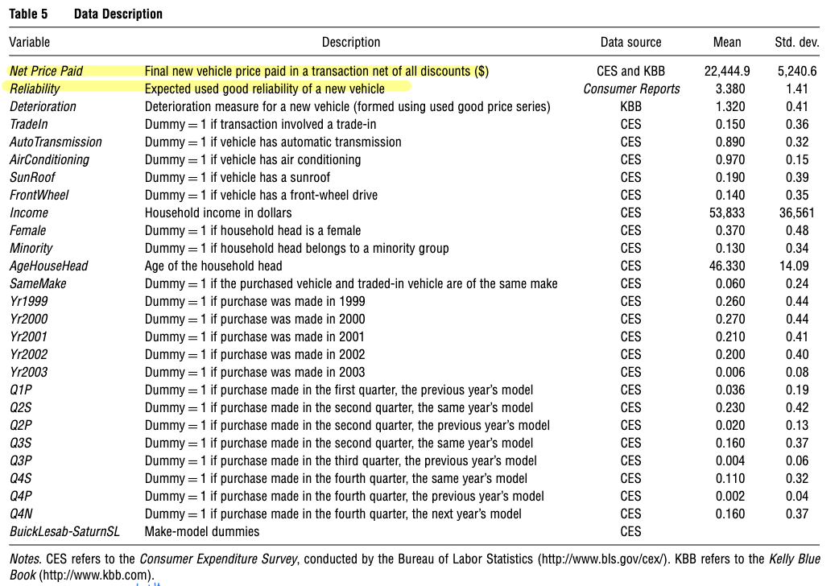

Slide 5
Results
An increase in reliability leads to a fall in the trade-in incentive
An increase in the deterioration rate reduces the size of the trade-in incentive
The volume of used good trade for a make-model increases in its reliability
The volume of used good trade of a make-model increases with the deterioration rate

