Slide 1
Time Series Monitoring Application For Root Cause Analysis
Min Jeong Kang

Slide 2
Problem
Dependency on an expert
Absence of a centralized application for monitoring all systems
Usability problems in analyzing time series data

Slide 3
Approach
Web application which models a heuristic
Easy-to-use interface to minimize the need for training
Allow monitoring all Brown systems by visualizing their time series
Give suggestions on which systems to examine based on their likelihood of having an issue

Slide 4
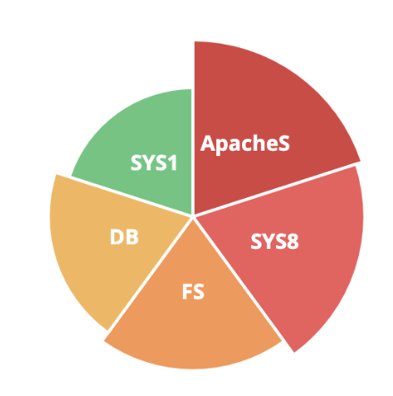
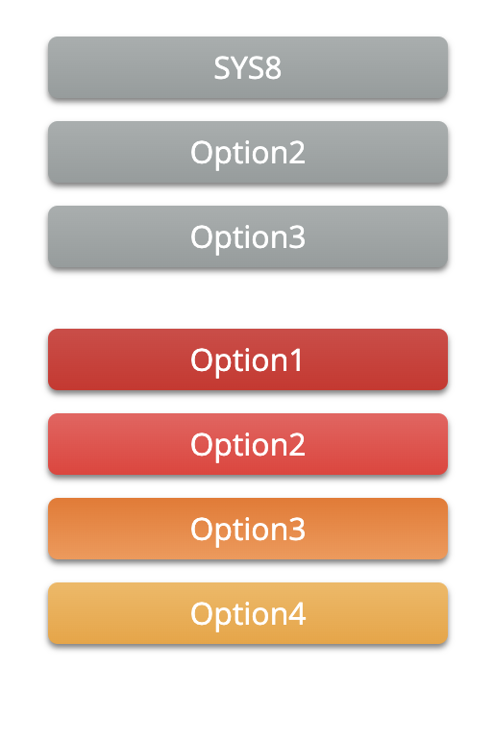
Details
Pie Chart
Initial high level overview of systems
Starting point of the user's selection of Views
Vertical Stack
Shows the history of visited Views and current option
Current options are sorted by ‘priority’
Populates the View

Slide 5
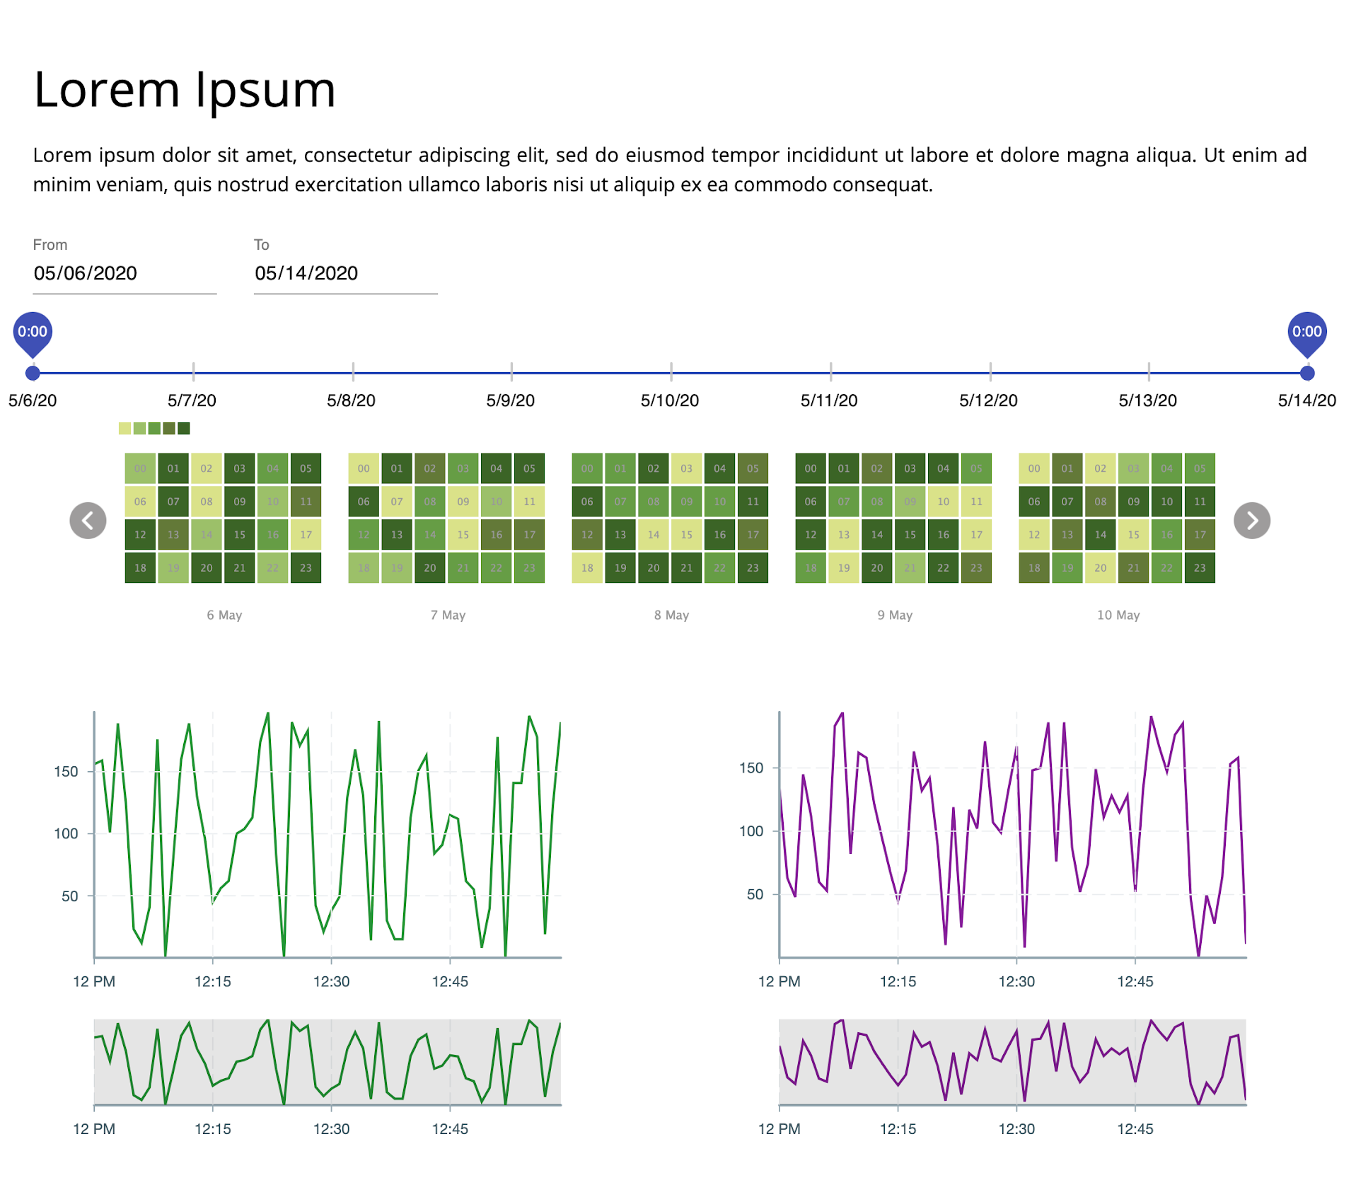
Details
View
Date input fields + sliding bar
Heatmap - general overview of time series
Line graphs - individual time series

Slide 6
Results
(Demo)

Slide 7
Conclusion
Connect to the back-end: API
Evaluate the effectiveness of the application: User testing
Automated generation of a heuristic: AI modeling

Slide 8
Thank you

