Slide 1


Deepspeed - Alphafold3
–Minjia Zhang, Hoa La–
CS 498: Machine Learning System
Spring 2026
Minjia Zhang
The Grainger College of Engineering

Slide 2
Today
DL Inference
Paged Attention
Objective: Learn why KV cache is important for LLM inference and how to manage KV cache efficiently
Notes:
Second half of the semester, let’s move to ML system for inference.
This lecture will first give an overview of DL inference optimization before we deep diving into more details. After this lecture, you will get an overview of the background, challenges, system and algorithm optimizations people have done to improve inference efficiency.

Slide 3
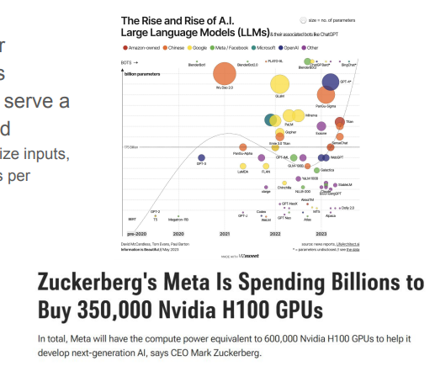
Serving LLMs is Expensive
A ton of GPUs are required for production scale LLM services
Nevertheless, each GPU only serve a handful of requests per second
For LLaMA-13B and moderate-size inputs, 1 A100 process < 1 request per second
Notes:
LLM expensive tons of GPUs
One reason: models are large. Each GPU only serve a handful of request per second. LLMaa13B, moderate input size, 1 A100 process < 1 request per second.
Meta spent billions and bought hundreds of thousands of h100. Cost billions or tens of billions.
Improve throughput reduce cost.

Slide 4
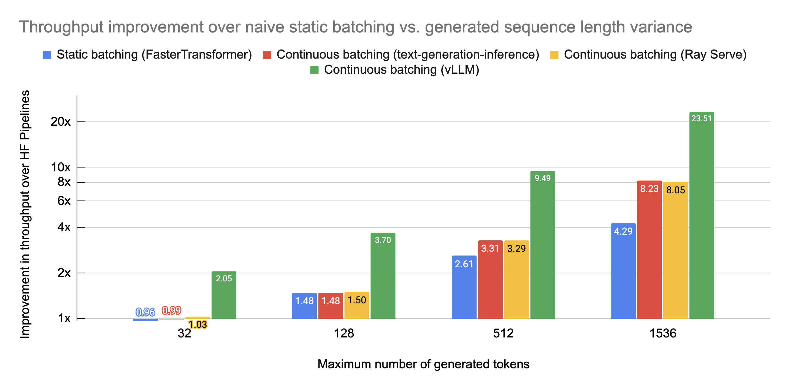
Throughput Improvement from Continuous Batching
https://www.anyscale.com/blog/continuous-batching-llm-inference
Notes:
CB already improve, but same technology, vlmm has higher throughput why?
Key is in kv cache management. But how?

Slide 5
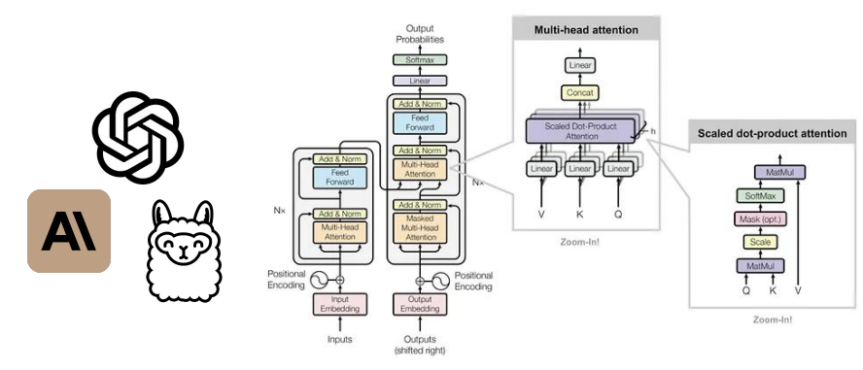
KV Cache
Notes:
Need to first understand what kv cache is
Highly related to transformer. Used by all LLms.
Transfomer has mult-head attention. Each attention head does scaled dot-product attention.

Slide 6
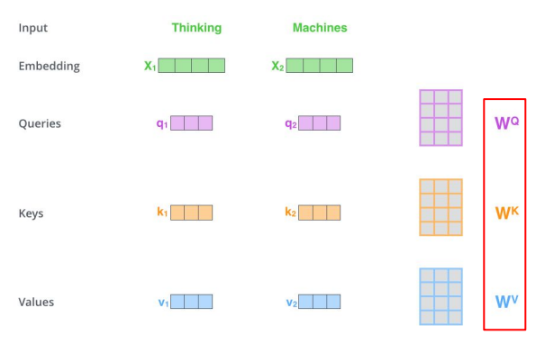
Self-Attention
Notes:
Input embedding needs transformation QKV projection, get projected query, key, value embeddings.

Slide 7
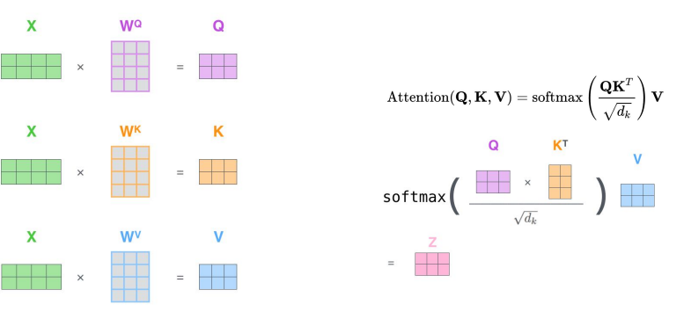
Self-Attention
Notes:
Softmax, after weighted sum.
Forget, check the content in 2nd or 3rd lecture. Deep dive into transformer.

Slide 8
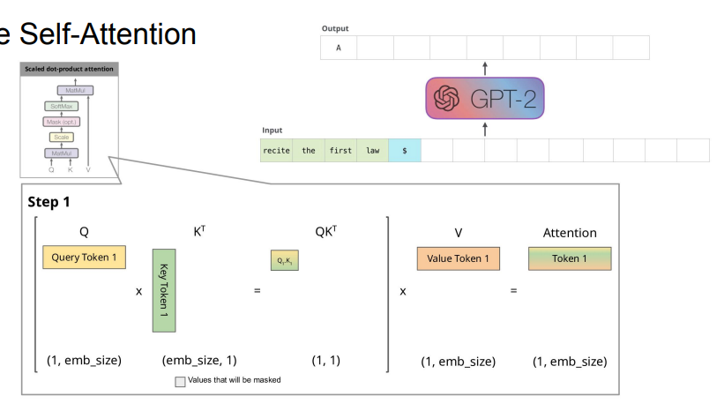
Naïve Self-Attention
output
Notes:
Autoregressive inference, one token at a time. Need to decode one token at a time. Get a new context. Predict the next token. Repeat.
One token in the system. Q, * K = QK transpose. For simplificity, let’s assume key is 1, but in the example showed, k is 5. For simplificity, assume input token is 1. QK, multiple V, get the weighted sum of token representation.

Slide 9
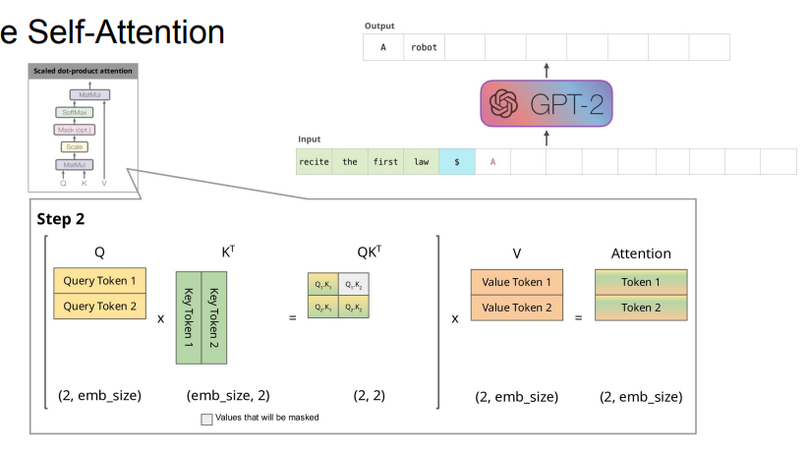
Naïve Self-Attention
output
Notes:
New sentence now has two tokens. QK transpose. Only need to attend tokens on the left. The QK transpose is triangular matrix. Softmax, then weighted sum.

Slide 10
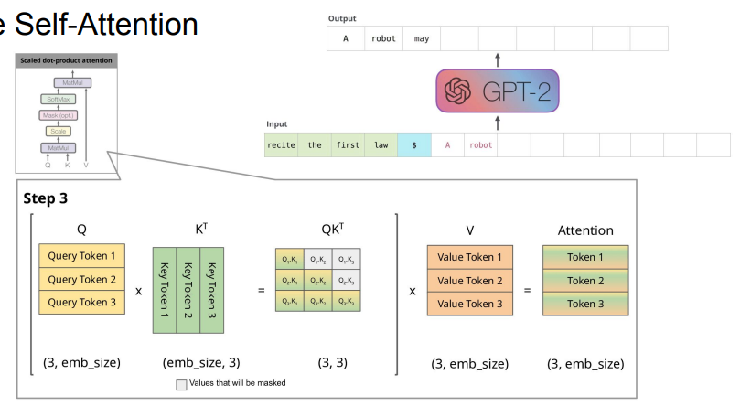
Naïve Self-Attention
output
Notes:
Second half of the semester, let’s move to ML system for inference.
This lecture will first give an overview of DL inference optimization before we deep diving into more details. After this lecture, you will get an overview of the background, challenges, system and algorithm optimizations people have done to improve inference efficiency.

Slide 11
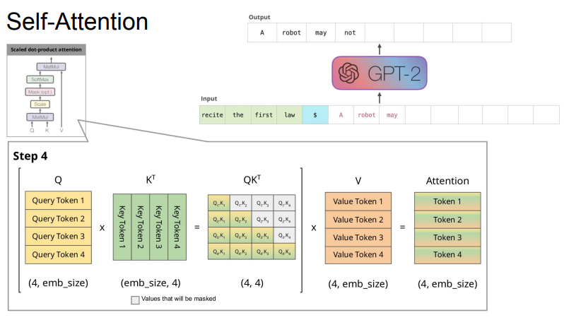
Naïve Self-Attention
output
Notes:
Second half of the semester, let’s move to ML system for inference.
This lecture will first give an overview of DL inference optimization before we deep diving into more details. After this lecture, you will get an overview of the background, challenges, system and algorithm optimizations people have done to improve inference efficiency.

Slide 12
Naïve Self-Attention
output
Question: Issue with naive attention?
Notes:
Second half of the semester, let’s move to ML system for inference.
This lecture will first give an overview of DL inference optimization before we deep diving into more details. After this lecture, you will get an overview of the background, challenges, system and algorithm optimizations people have done to improve inference efficiency.
Every step, need to calculate the attention, and attention is quadratic the sequence length. Repeated projection of Q, K, V.

Slide 13
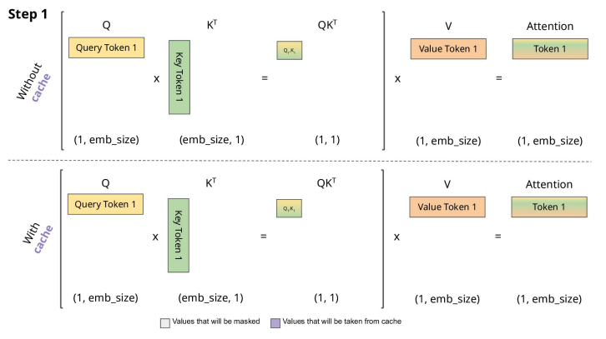
Self-Attention with KV Cache
output
output
Notes:
KV cache. Noticed redundant computation. Query token 1 multiple key token 1 has already been done.
Same example, without cache, and with cache.
All you need is just the attention to get the weighted sum for the new token. Don’t really care about the output token that has already been predicted.

Slide 14
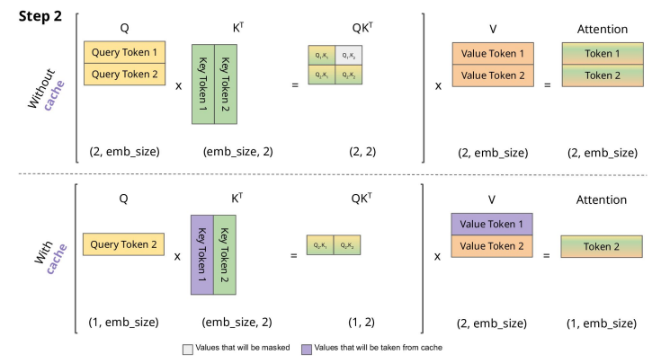
Self-Attention with KV Cache
output
output
Notes:
No need to project key for token 1.
Because we also don’t really need token 1 output

Slide 15
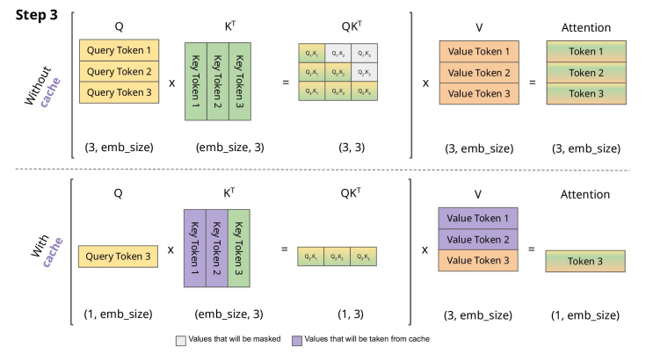
Self-Attention with KV Cache
output
output
Notes:
Many components

Slide 16
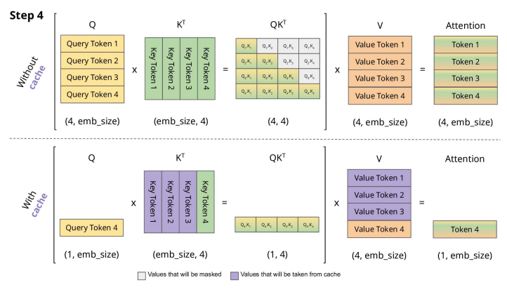
Self-Attention with KV Cache
output
output
Notes:
Many components

Slide 17
Self-Attention with KV Cache
S: sequence length
H: model embedding size
output
Question: Time and memory complexity without and with cache?
output
Notes:
Many components

Slide 18
Self-Attention with KV Cache
S: sequence length
H: model embedding size
output
O(S²H) Time
output
Notes:
Many components

Slide 19
Self-Attention with KV Cache
S: sequence length
H: model embedding size
output
O(S²H) Time
output
O(SH)Time
O(SH) Memory
Notes:
Now SH memory

Slide 20
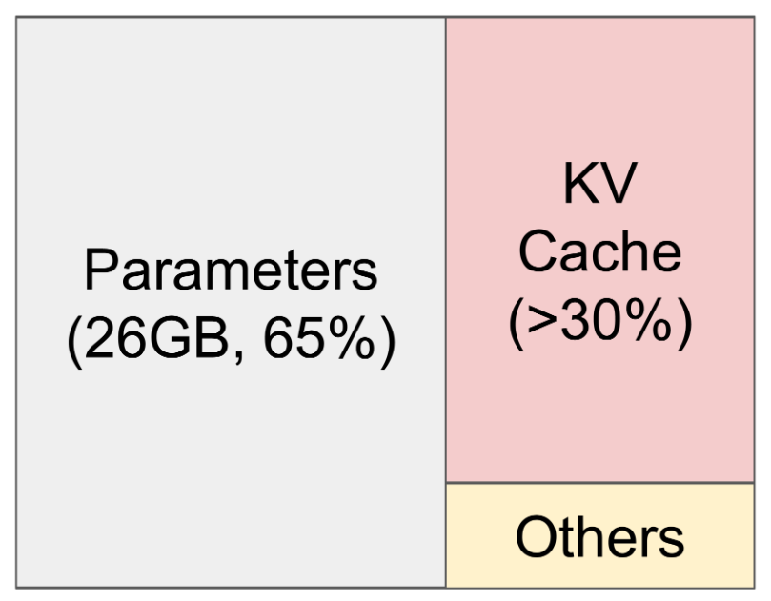
Inference Challenge: Large Memory Increases Cost
KV cache
Sequence length
# Hidden
# Layers
Batch size
LLaMA-13B on A100 40 GB
Notes:
KV cache also depends on layers. Every layer. How efficient we can manage KV cache depends on how large the batch size we can set or max sequence length.
In overview.
LLama3-13b on A100GB. Parameter alone takes 26GB. KV cache only 30%. KV cache is linear with respect to batch size, sequence length, #hidden. Serve LLMs under severe memory pressure. Increase the GPUs increases the cost.

Slide 21
Inference Challenge: Large Memory Increases Cost
KV cache
Sequence length
# Hidden
# Layers
Batch size
How about we allocate some contiguous memory per request: max-seq-len * hidden-dim * num-layers?
LLaMA-13B on A100 40 GB
Notes:
Weights,
KV cache
Activation
LLama3-13b on A100GB. Parameter alone takes 26GB. KV cache only 30%. KV cache is linear with respect to batch size, sequence length, #hidden. Serve LLMs under severe memory pressure. Increase the GPUs increases the cost.

Slide 22
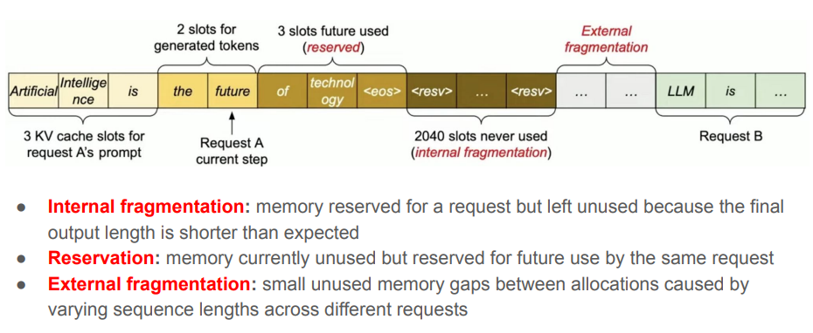
Motivation: Memory Waste in KV Cache
Notes:
Short answer, waste a lot of memory.
Two requests A and B. A prompt of length 3 tokens. Currently executing 2 generation steps. May generate more.

Slide 23
Motivation: Memory Waste in KV Cache
Question: Where is memory being wasted?
Notes:
Many components

Slide 24
Motivation: Memory Waste in KV Cache
Notes:
Internal fragmentation. Reserved for a request but left unused by the output sequence is smaller than max. Say max is 2048, then 2040 slots left unused.
2048

Slide 25
Motivation: Memory Waste in KV Cache
Notes:
However reservation?
Tokens that are actually used for future prediction by the same request? Not wasted.

Slide 26
Motivation: Memory Waste in KV Cache
Notes:
external fragmentation.
May have variable sequence length. Small unused allocation from GPU memory allocator.

Slide 27
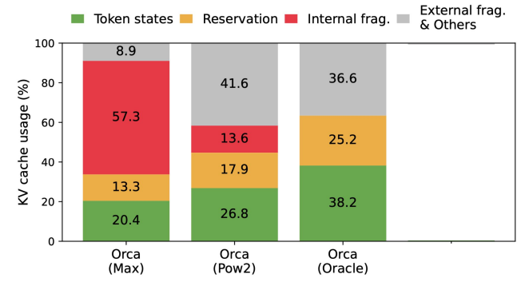
Motivation: Memory Waste in KV Cache
Only 20-40% of KV cache is used to store the actual token states
Notes:
Max, pow2, oracle, different paging strategy.
Max: always max sequence length, simple but lots of internal fragments
Pow2: pages are allocated power of 2, like buddy system. More efficient than max but still moderate fragmentation. Drop in internal fragmentation. But external fragmentation increases. Pow2 often over reserve space.
Perfect knowledge Ideally lower bound. No internal frag.
Oracle, ideal length. System allocates just enough kv cache. Page granularity.

Slide 28
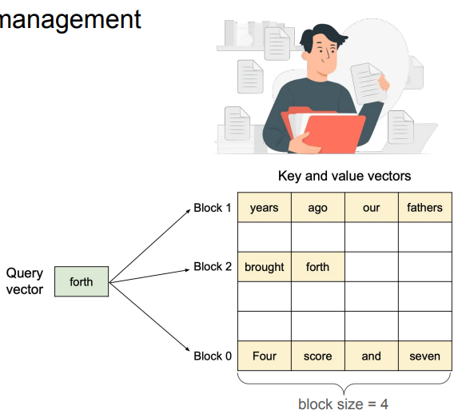
vLLM: Efficient Memory Management using PagedAttention
PagedAttention algorithm allows for storing attention key-value pairs in non-contiguous blocks in the memory
Each KV block is a fixed-size contiguous chunk of memory that stores KV cache from left to right
Attention for each new token is computed across all tokens in the non-contiguous KV block
Notes:
Many components

Slide 29
vLLM: Efficient Memory Management using PagedAttention
PagedAttention algorithm allows for storing attention key-value pairs in non-contiguous blocks in the memory
Each KV block is a fixed-size contiguous chunk of memory that stores KV cache from left to right
Attention for each new token is computed across all tokens in the non-contiguous KV block
Notes:
Within a block, it follows left to right order.

Slide 30
vLLM: Efficient Memory Management using PagedAttention
PagedAttention algorithm allows for storing attention key-value pairs in non-contiguous blocks in the memory
Each KV block is a fixed-size contiguous chunk of memory that stores KV cache from left to right
Attention for each new token is computed across all tokens in the non-contiguous KV block
Notes:
Many components

Slide 31
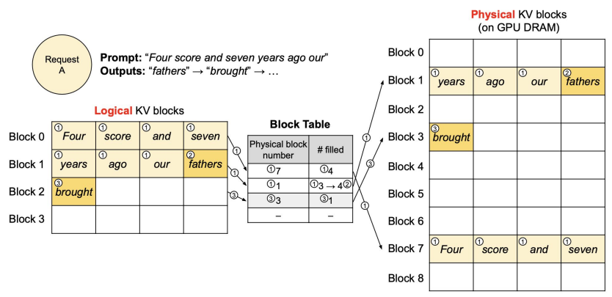
Block Table For Managing KV Cache Blocks
Notes:
Originally consecutive. Now does not seem to follow the order. Similar as paging in OS. TLB. Translation lookaside buffer. Virtual to physical mapping.
For each request. Still see logical blocks in consecutive space. Physical block may be out of oder. Or even on GPU or CPU. Mapping of virtual block to physical block
Paging. Virtual page to physical page mapping
From attention calculation. Everything is consecutive. Logical kv block, but just the metadata, which request kv blocks belong to.
7, 1, 3, each correspond to

Slide 32
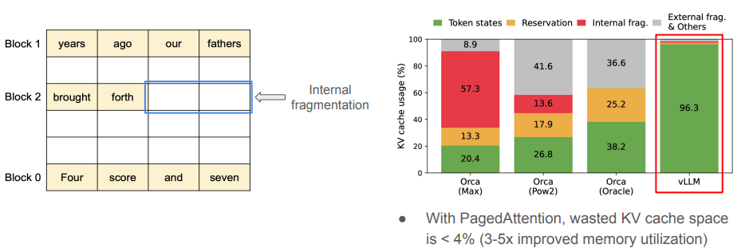
Memory Efficiency of PagedAttention
Minimal internal fragmentation
# of wasted tokens per sequence < block size
No external fragmentation
Notes:
Minimal internal frag. Only the last block may not be fully filled.

Slide 33
Memory Efficiency of PagedAttention
Minimal internal fragmentation
# of wasted tokens per sequence < block size
No external fragmentation
Notes:
Largely eliminate external frag.
Very fine-grained, easy to be satifised by Gpu allocation.
As a result, wasted kv cache space is <4%. Improved Gpu utilization.

Slide 34
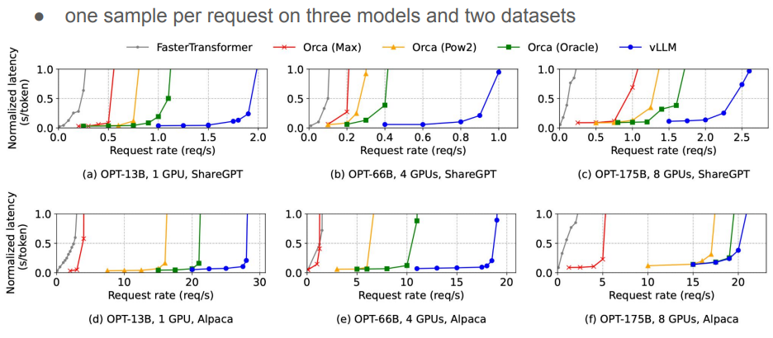
vLLM Performance with Basic Generation
Notes:
Three models, two datasets. High request rage same latency. Same arrival rate, lower latency. With CB enabled. More request processed in a given time frame.

Slide 35
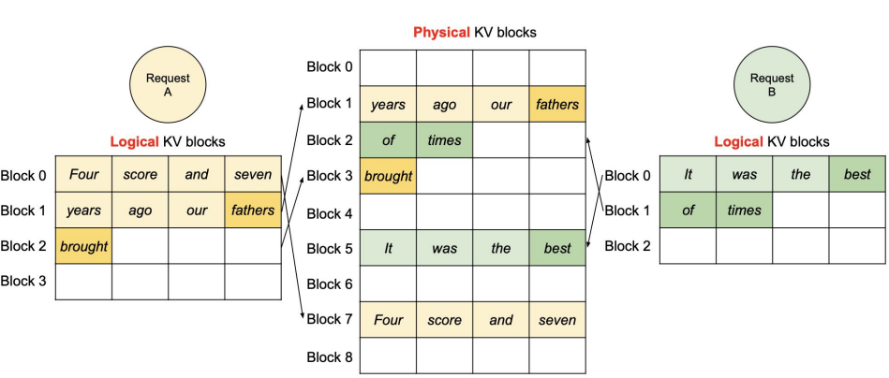
Handling Multiple Requests
Notes:
Flexible handling multiple request. A block manager maps requests to blocks.

Slide 36
Application to Other Decoding Scenarios
E.g.
- Parallel sampling
- Beam search
…

Slide 37
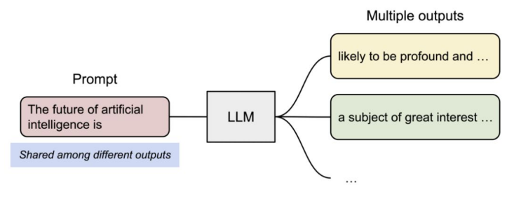
Parallel Sampling

Slide 38
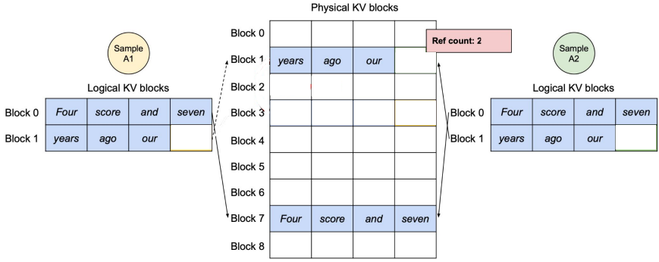
Parallel Sampling with PagedAttention
Dynamic block mapping enables sharing of KV blocks
Reference count keeps track of the number of logical KV blocks that are mapped to each physical KV block

Slide 39
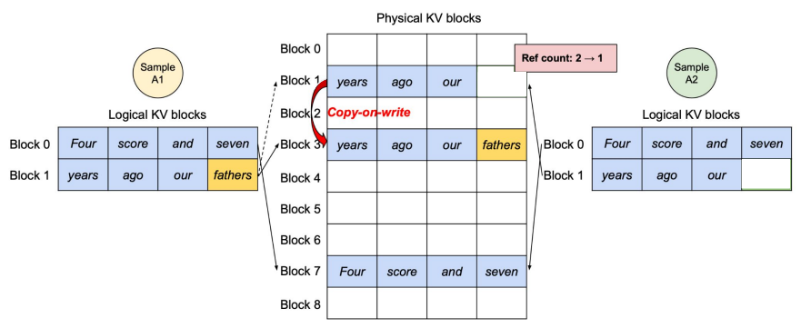
Parallel Sampling with PagedAttention
At the generation phase, copy-on-write copies info to a newly allocated physical KV block when reference count > 1

Slide 40
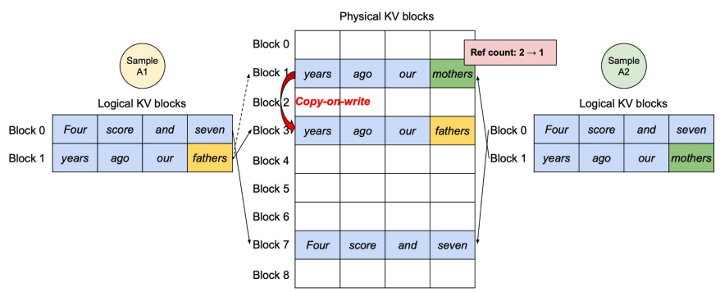
Parallel Sampling with PagedAttention
At the generation phase, copy-on-write copies info to a newly allocated physical KV block when reference count > 1

Slide 41
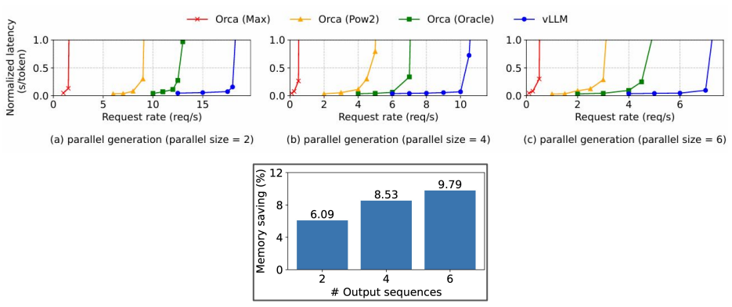
Parallel Sampling with PagedAttention

Slide 42
Parallel Sampling with PagedAttention

Slide 43
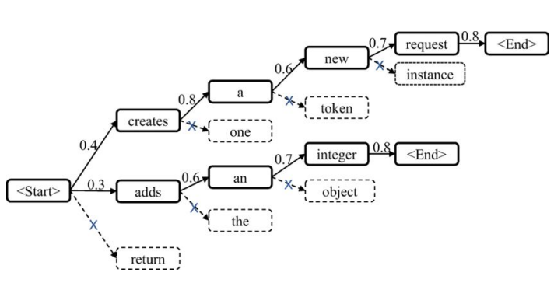
Beam Search

Slide 44
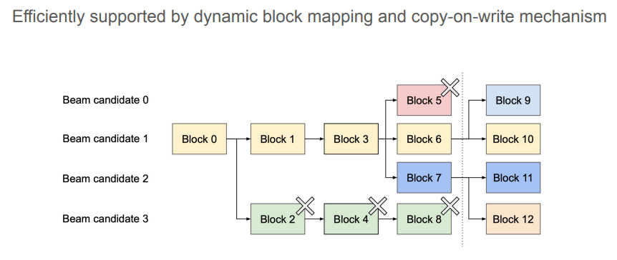
Beam Search with PagedAttention

Slide 45
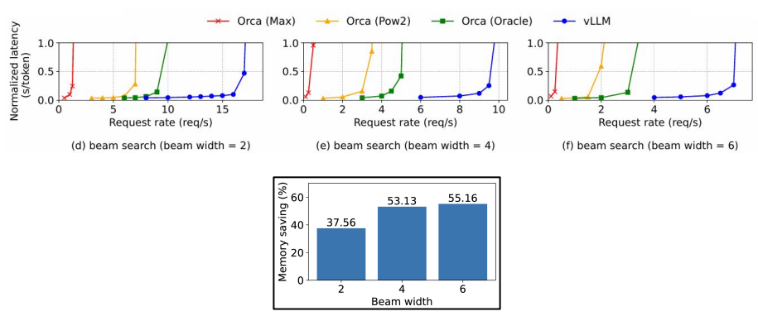
Beam Search with PagedAttention

Slide 46
Limitations?

Slide 47
Main Takeaways
Reduces memory fragmentation with paging
Reduces memory usage with KV block sharing
Enables batching of more requests, increasing the throughput of LLM inference

Slide 48
Questions?
COMPUTER SCIENCE
GRAINGER ENGINEERING

