Slide 1
Scalable Diffusion Models with Transformers
William Peebles* UC Berkeley Saining Xie New York University Presentor: Haoran Yuan 11/22/2024

Slide 2
Outline ● Background ● Motivation ● Related Work ● DiT: Diffusion Transformers
Preliminaries
Diffusion Transformer Design Space
● Experiment Results
● Future Work
Notes:
And the presentation consists of the following components

Slide 3
Background
Most diffusion models use the U-Net architecture for model building.
This paper proposes using Transformers to replace the U-Net backbone in diffusion models, called Diffusion Transformers (DiTs). It also explores the scalability of the Transformer architecture in diffusion models, evaluating the DiTs method in terms of network complexity and sampling quality.
Analysis shows that this type of DiT not only achieves faster performance (higher Gflops, measuring the complexity of model architecture) but also achieves state-of-the-art FID scores for class-conditional image generation tasks on ImageNet 512×512 and 256×256 images, with better results on 256×256 images.

Slide 4
Motivation
The limitation of U-Net backbone:
Scalability Challenge
Computational and Memory Bottlenecks
The benefit of Diffusion Transformer:
Address these issues by utilizing transformers' ability to capture long-range dependencies, their scalability, and flexibility for handling high-resolution data.
Notes:
1. Scalability Challenges
Local Receptive Field: U-Net relies on convolutions with local receptive fields, making it inefficient at capturing long-range dependencies or global context. This is a limitation for tasks involving high-resolution images or large datasets.
Manual Architecture Scaling: Scaling U-Net for larger datasets or more complex tasks requires manual tuning of architecture parameters (e.g., depth, width, filter size), which is not flexible or generalizable.
2. Computational and Memory Bottlenecks
High Memory Usage: As input resolutions increase, U-Net’s memory requirements grow significantly due to the large number of intermediate feature maps generated by its encoder-decoder structure.
Inefficient Parallelization: Convolutional operations in U-Net are less efficient to parallelize compared to self-attention mechanisms, resulting in slower processing speeds on modern hardware.

Slide 5
Related Work
Transformers for Pixels Generation
Denoising diffusion probabilistic models (DDPMs)

Slide 6
Transformers for Pixels Generation
Applications in Image Generation: Transformers have been applied to autoregressive pixel prediction and masked generation models, showing strong scalability in large-scale models with billions of parameters.
Integration with Diffusion Models: Transformers have been used in combination with diffusion models (e.g., DALL·E 2) to synthesize non-spatial data, such as generating CLIP image embeddings, highlighting their potential in data synthesis and generation.

Slide 7
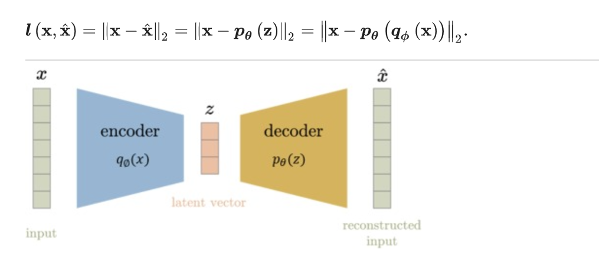
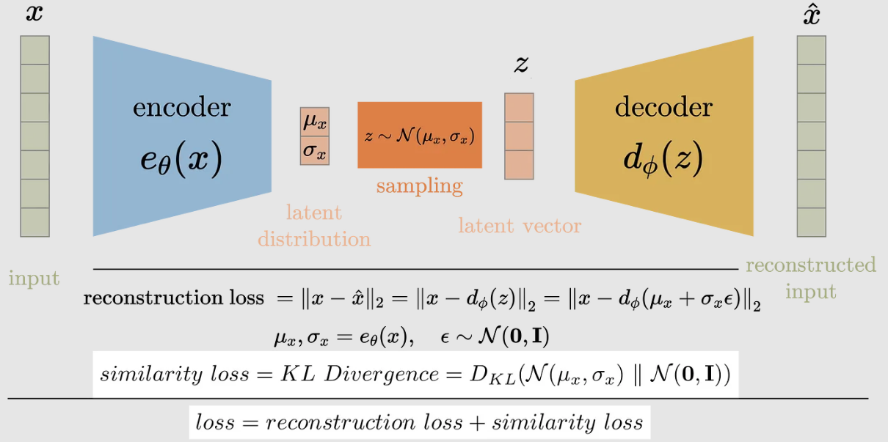
VAE

Slide 8
Auto Encoder
Clustering model rather than a generative model.
Unsupervised learning, with the core goal of obtaining high-dimensional representations of low-dimensional data.
Difficult to generate models (no sampling steps).

Slide 9
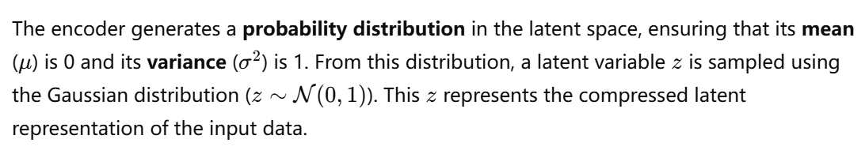
VAE

Slide 10
DDPM
DDPMs' Success in Image Generation: DDPMs have outperformed GANs in many image generation tasks, achieving state-of-the-art results.
Advancements in DDPMs: Innovations include non-noisy data prediction, hierarchical pipelines, and improved sampling techniques.
U-Net as Backbone: U-Net is the default backbone for DDPMs due to its efficiency and universality.
Notes:
English Translation:
Success of DDPMs in Image Generation: Denoising Diffusion Probabilistic Models (DDPMs) and generative models based on diffusion have achieved significant success in the field of image generation, often surpassing the state-of-the-art techniques of the past, such as Generative Adversarial Networks (GANs), in many cases.
Improvements and Technological Innovations in DDPMs: Over the past two years, improvements in DDPMs have primarily come from better sampling techniques. These include techniques such as reformulating the diffusion model to directly predict non-noisy data and using hierarchical DDPM pipelines, where low-resolution diffusion models are used as the basis for super-resolution sampling and training.
U-Net as the Preferred Backbone Architecture: (In the above-mentioned diffusion models, the convolutional U-Net has become the backbone architecture of choice. This highlights the universality and efficiency of U-Net in this domain.)

Slide 11
Preliminary
DDPM
Latent Diffusion Transformer

Slide 12
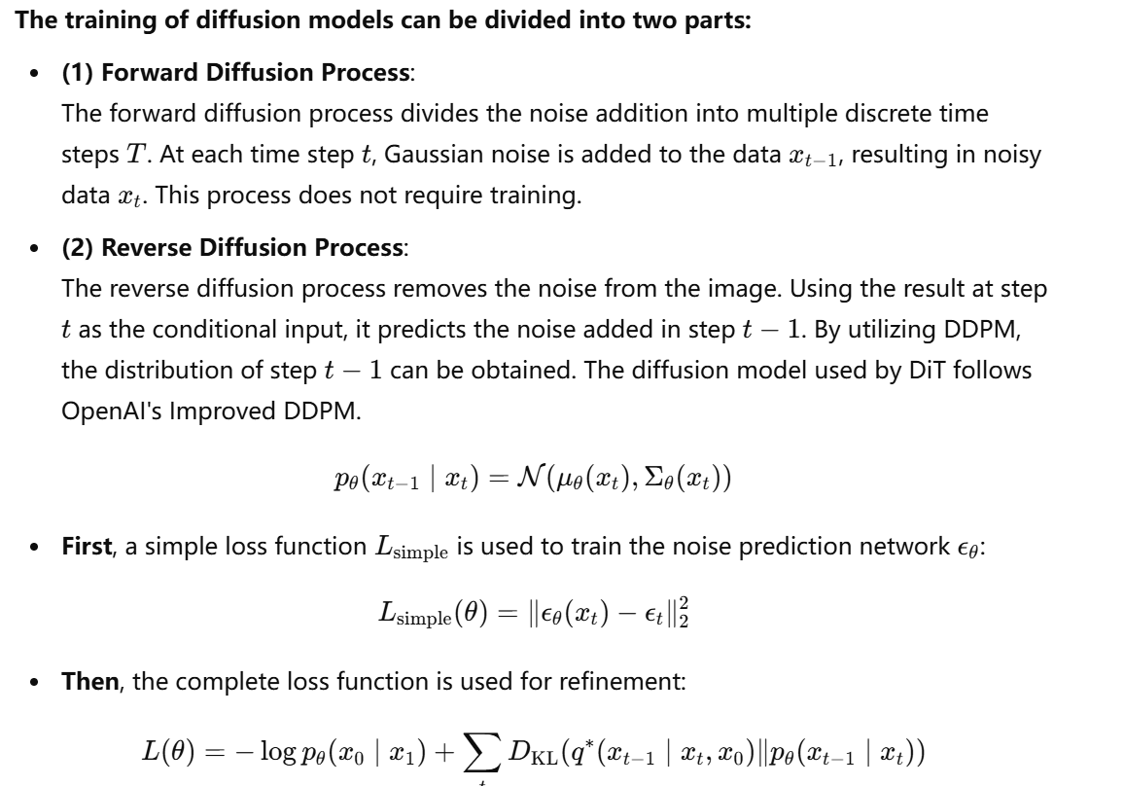
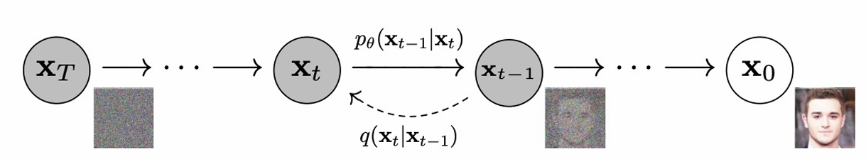
DDPM

Slide 13
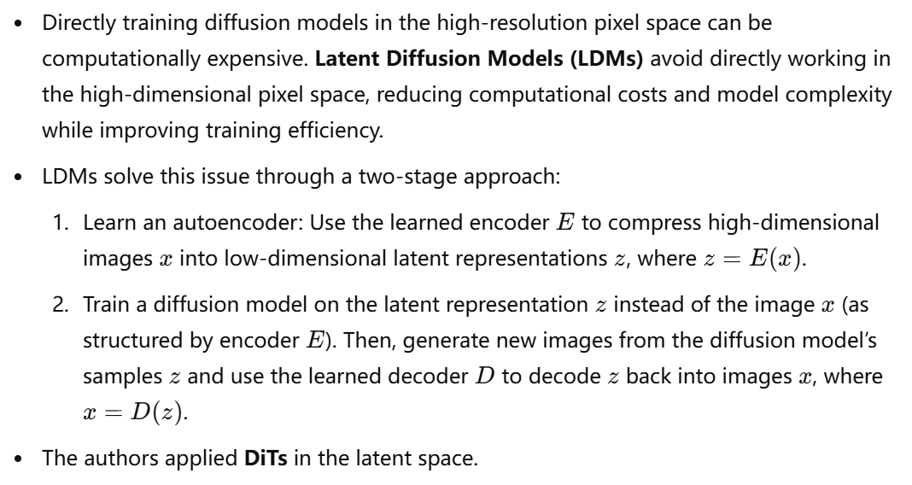
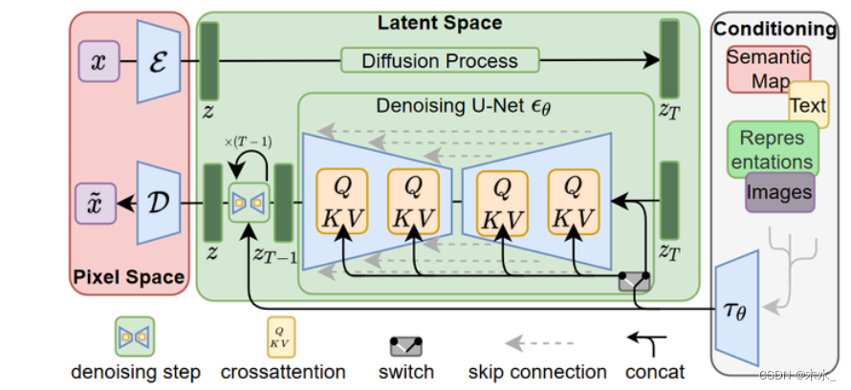
Latent Diffusion Transformer

Slide 14
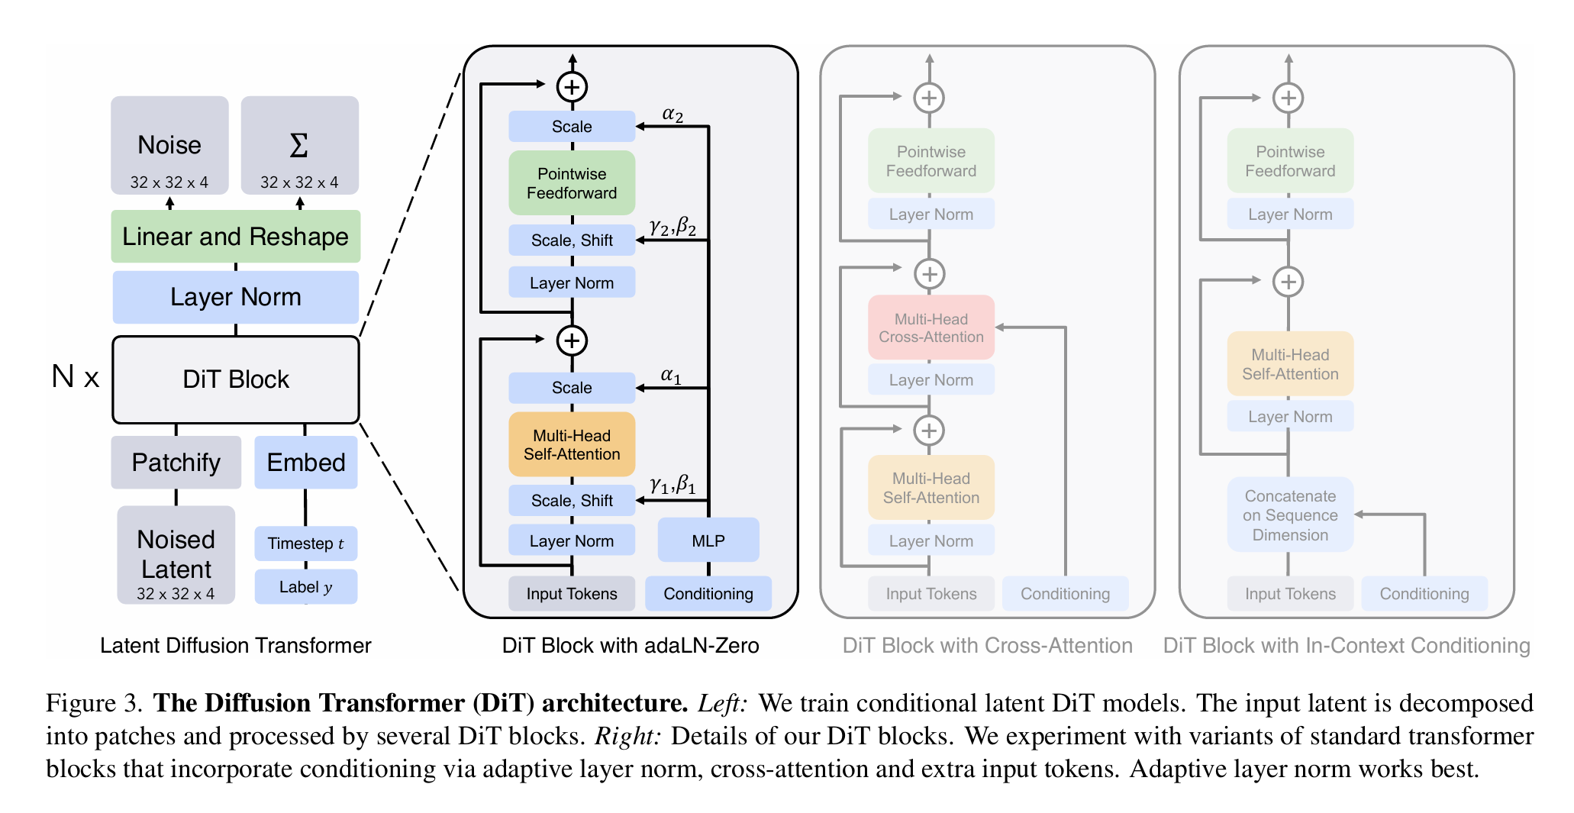
Diffusion Transformer Design Space
CS598 AI Efficiency and Algorithum
Notes:
Let’s see the components step by step

Slide 15
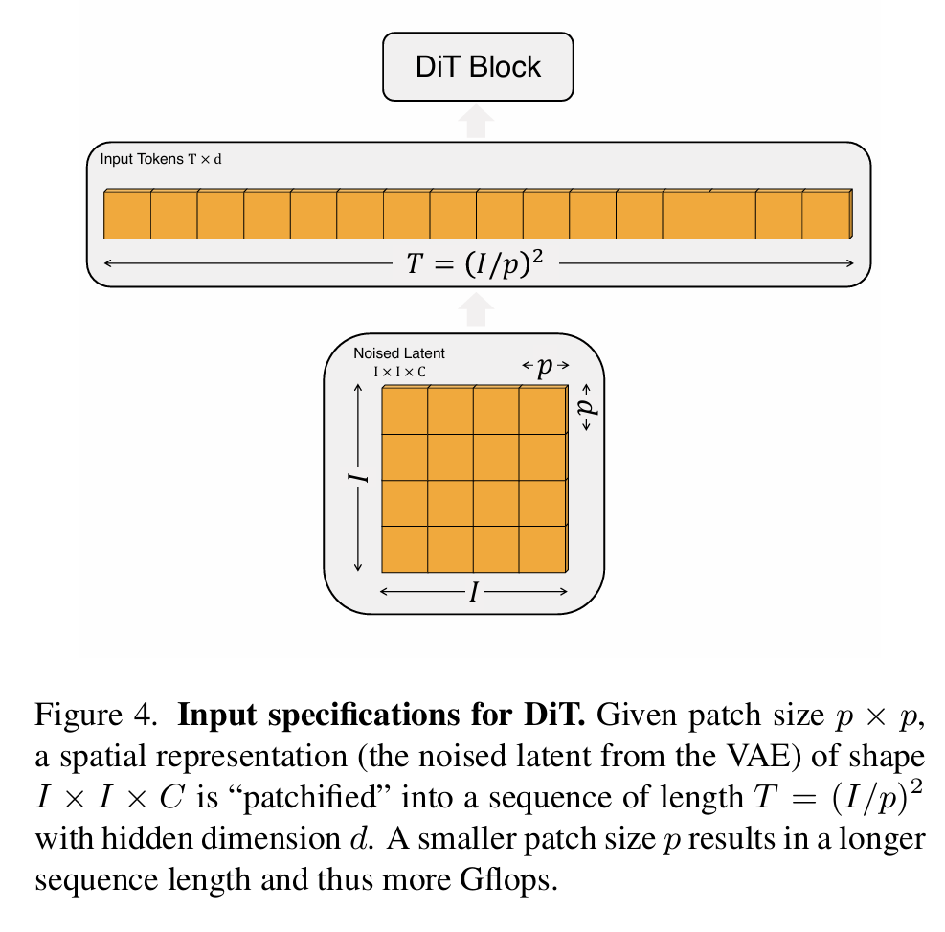
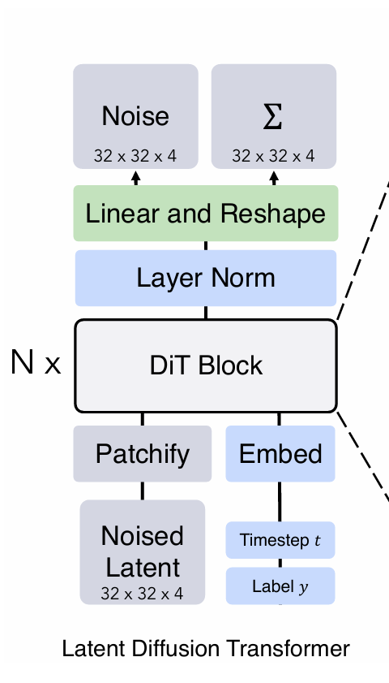
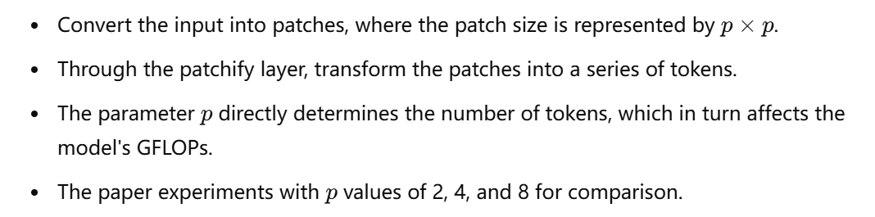
Patchify

Slide 16
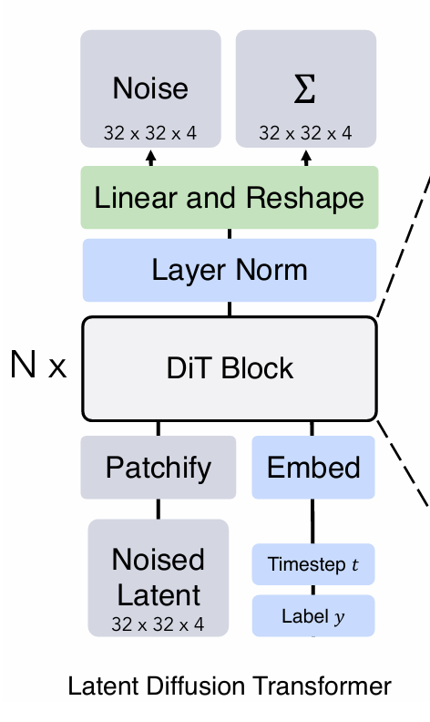
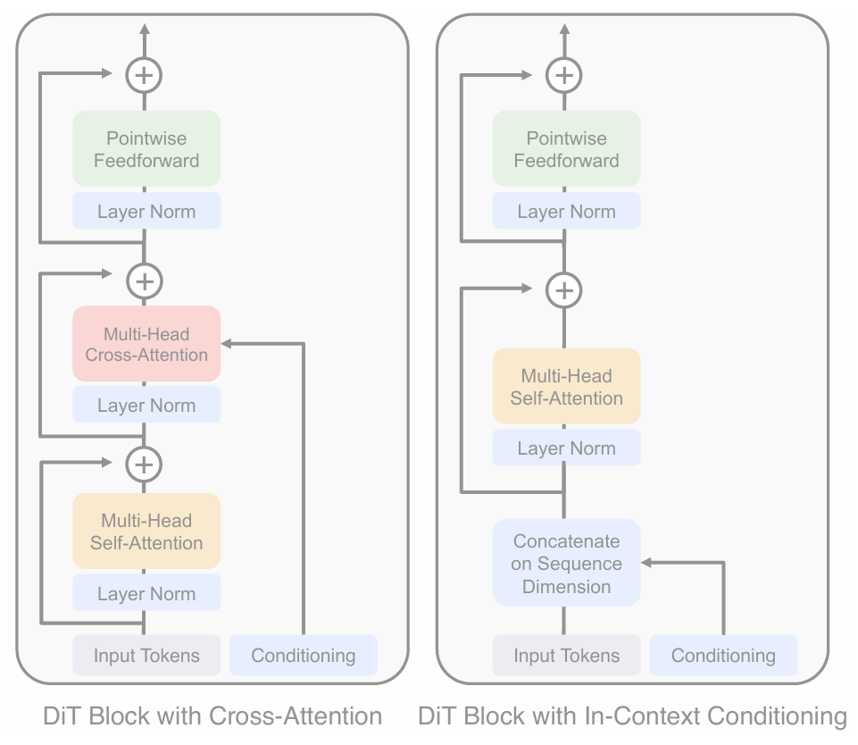
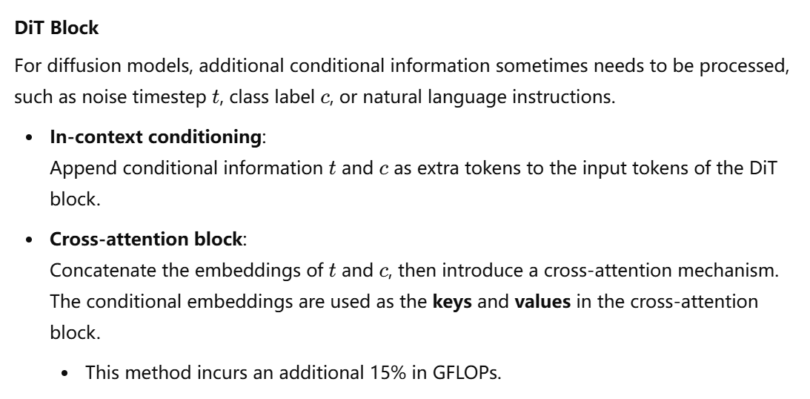
DiT Block
Notes:
The Paper implement three versions of DiT Block.

Slide 17
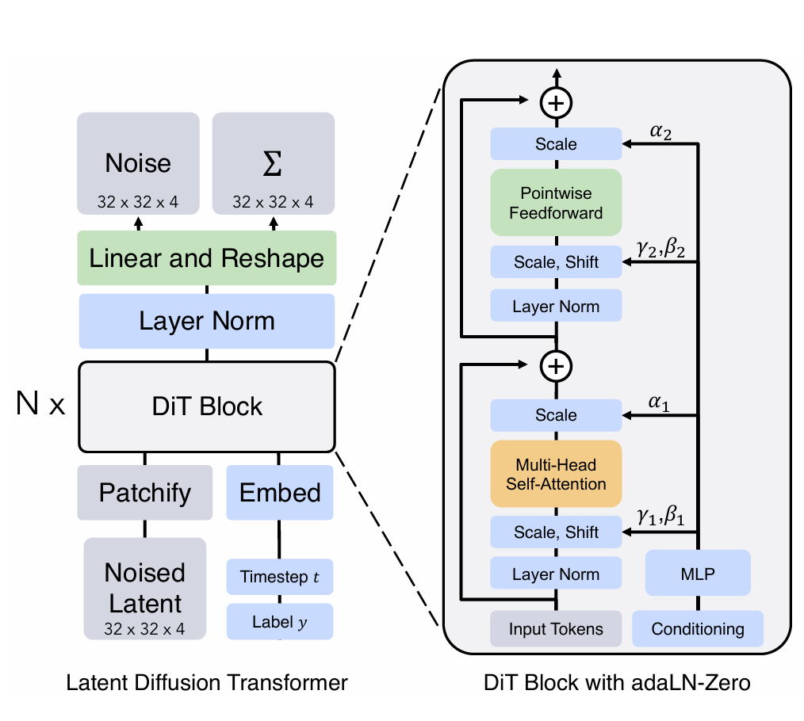
DiT with adaLN-Zero
The adaLN block replaces the original Layer Norm.
adaLN-Zero Block:
Initializes the batch normalization parameters of adaLN to zero.
After Layer Norm, a scale adjustment is reintroduced at the end of each residual block.
adaLN-Zero is lightweight, adding a negligible amount to the model's GFLOPs.
After the final DiT block, the token sequence is decoded to output noise predictions and coordinate predictions.
Notes:
In the image, adaptive layer norm (adaLN) is represented within the DiT Block with adaLN-Zero. It replaces the traditional layer normalization process, allowing for dynamic adjustments during training.
adaLN-Zero Block:
Initializes the batch normalization parameters of adaLN to zero.
After Layer Norm, a scale adjustment is reintroduced at the end of each residual block.
adaLN-Zero is lightweight, adding a negligible amount to the model's GFLOPs.
After the final DiT block, the token sequence is decoded to output noise predictions and coordinate predictions.

Slide 18
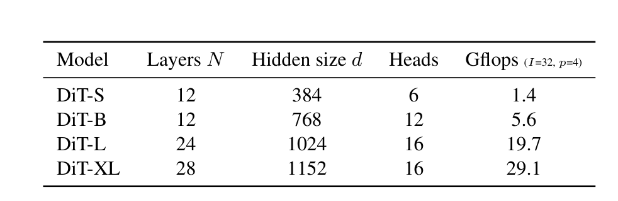
Experiment Configuration
DiT-S, DiT-B, DiT-L, and DiT-XL.
Model Structure / Patch Number Representation: For example, DiT-XL/2 indicates the model uses DiT-XL with a patch size of 2.
Training:
Trained on datasets with resolutions of 256×256 and 512×512 from ImageNet.
The final LayerNorm layer is initialized to 0, while other initialization follows the ViT (Vision Transformer) settings.
Training uses AdamW optimizer, with a learning rate of 1e-4 and a batch size of 256.
Data augmentation includes only horizontal flipping. No learning rate warm-up or regularization is applied.
Diffusion:
Uses a VAE to encode 256×256×3 images into a latent space of size 32×32×4.
After applying the reverse diffusion process of the diffusion model, the latent space is decoded back into 256×256×3 images.
Evaluation Metric:
Uses FID (Fréchet Inception Distance) to measure image fidelity.
Results are calculated based on FID-50K with 250-step DDPM sampling.

Slide 19
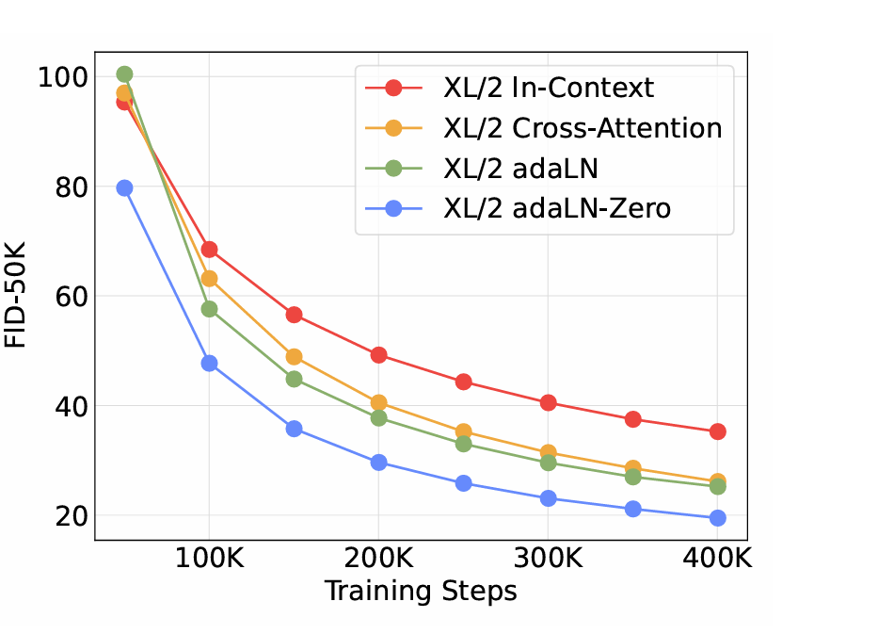
DiT Block result
The adaLN-Zero method performs significantly better than cross-attention and in-context conditioning. Therefore, the experiments uniformly use the adaLN-Zero method for context interaction.

Slide 20
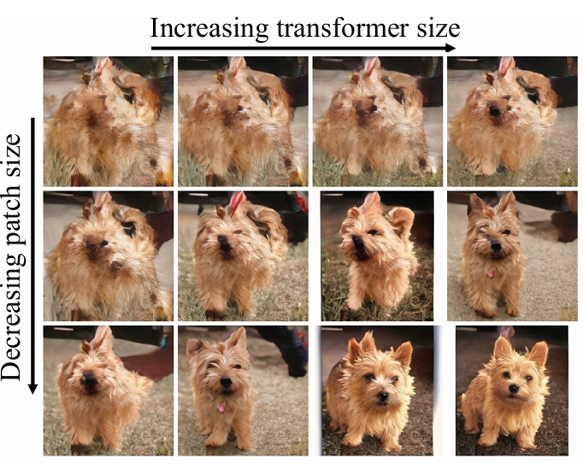
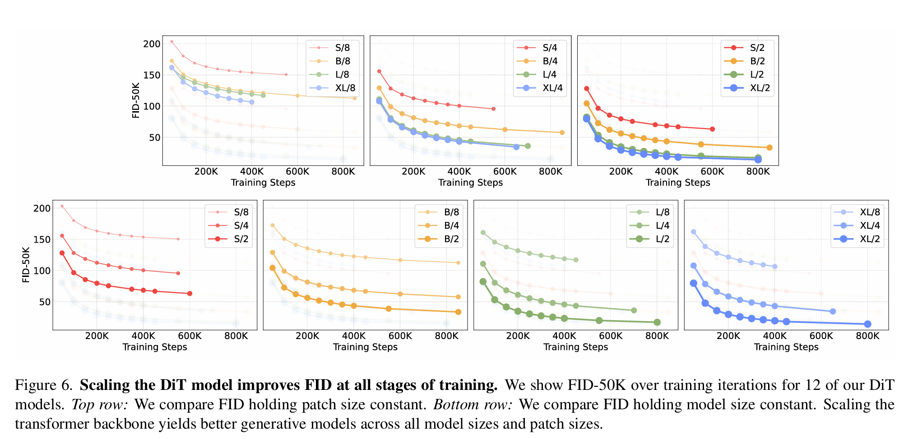
Model Size and Patch Size
The larger the model, the smaller the patch, the better the performance

Slide 21
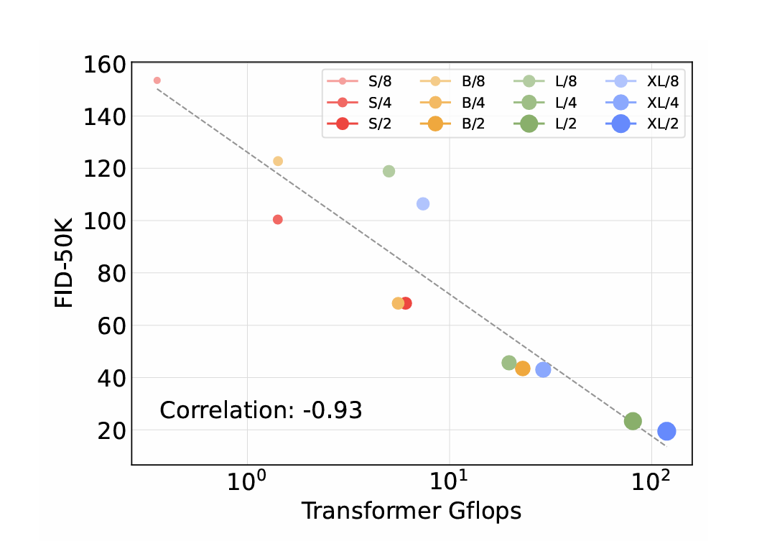
GFLOPs and FIO
The relationship between model GFLOPS and generation quality (FID) shows a strong negative correlation between GFLOPS and FID-50K. This indicates that the model's GFLOPS is crucial for achieving high-quality generation results.
Note:
GFLOPS quantifies the total number of floating-point operations required to process a single forward or backward pass.
FID measures the similarity between the distributions of the generated images and the real images in a feature space.
The smaller FID is, the better the image quality is.

Slide 22
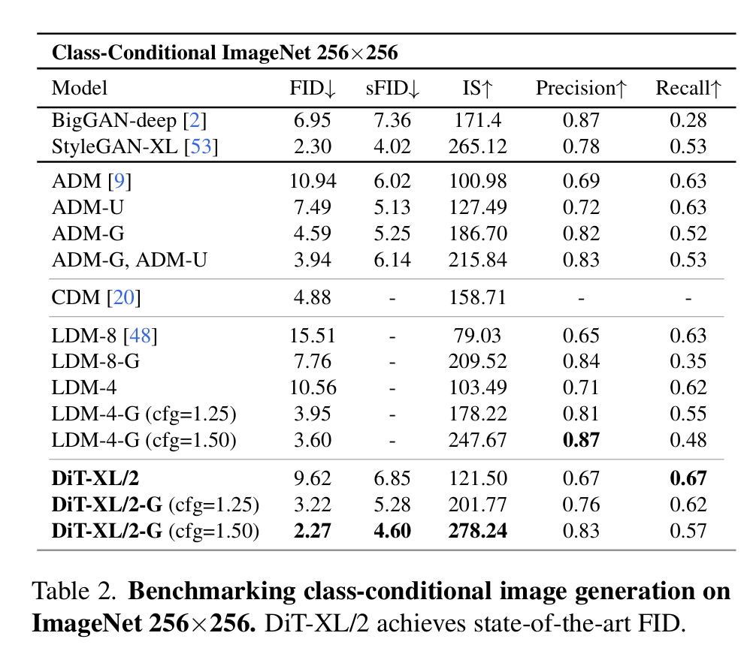
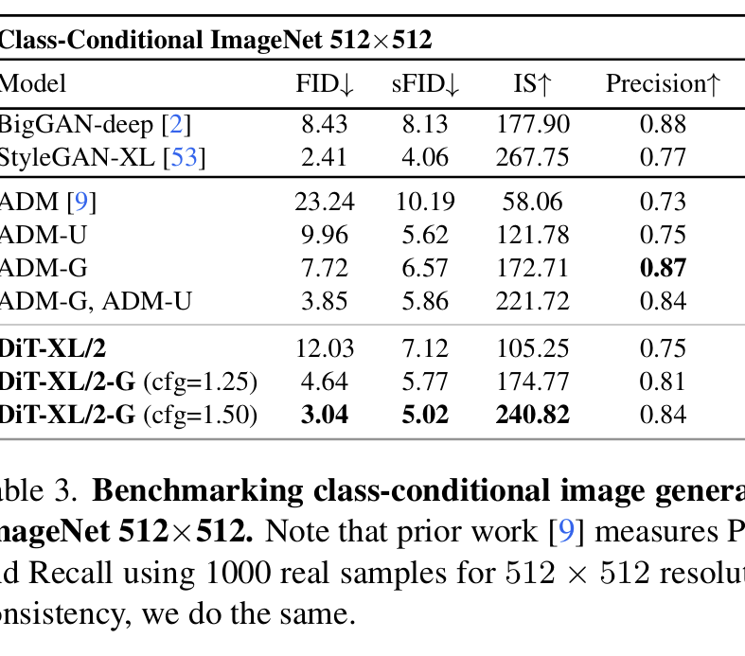
SOTA Diffusion Models
The largest model, DiT-XL/2, achieves current state-of-the-art (SOTA) performance on ImageNet tasks with resolutions of 256×256 and 512×512.

Slide 23
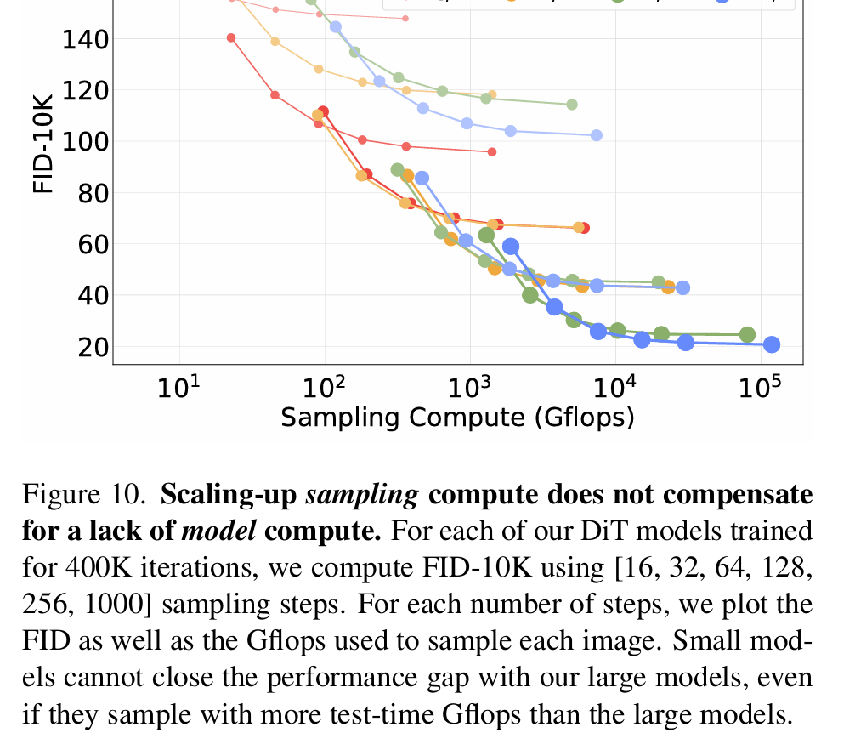
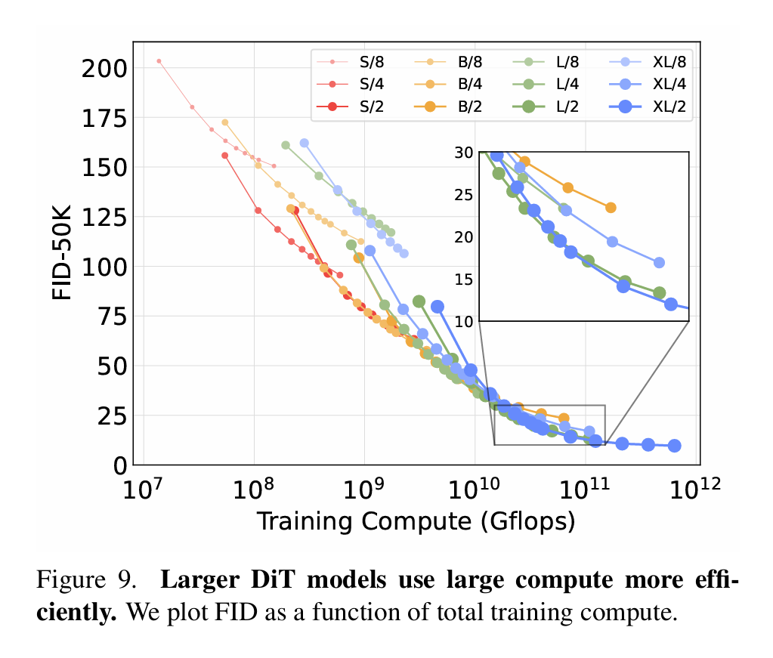
Scaling Model Size vs Scaling Sampling compute Steps
Notes:
Overall Findings and Insights:
Training Compute Matters More Than Sampling Compute:
Investing in training a larger model with more training compute results in better FID scores than compensating with more sampling compute at test time.
Larger Models Are More Compute-Efficient:
Larger models like DiT-L and DiT-XL utilize computational resources more effectively during both training and sampling, achieving better results for the same GFLOPS.
Scaling Sampling Compute Has Limits:
While increasing sampling steps can slightly improve FID, it cannot close the performance gap caused by small models or insufficient training compute.

Slide 24
Future Work
Multi-Modality:
Extend DiT to tasks like text-to-image, audio-visual generation, and 3D data synthesis.
Advanced Conditioning:
Develop better conditioning mechanisms for spatial, temporal, or semantic constraints.
Generation Efficiency
Accelerate sampling with fewer steps while maintaining quality.

Slide 25
Thanks for Listening!

