Slide 1
CAGRA: Highly Parallel Graph Construction and Approximate Nearest Neighbor Search for GPUs
Hiroyuki Ootomo et al.
Presented by Yan (Simon) Sun

Slide 2
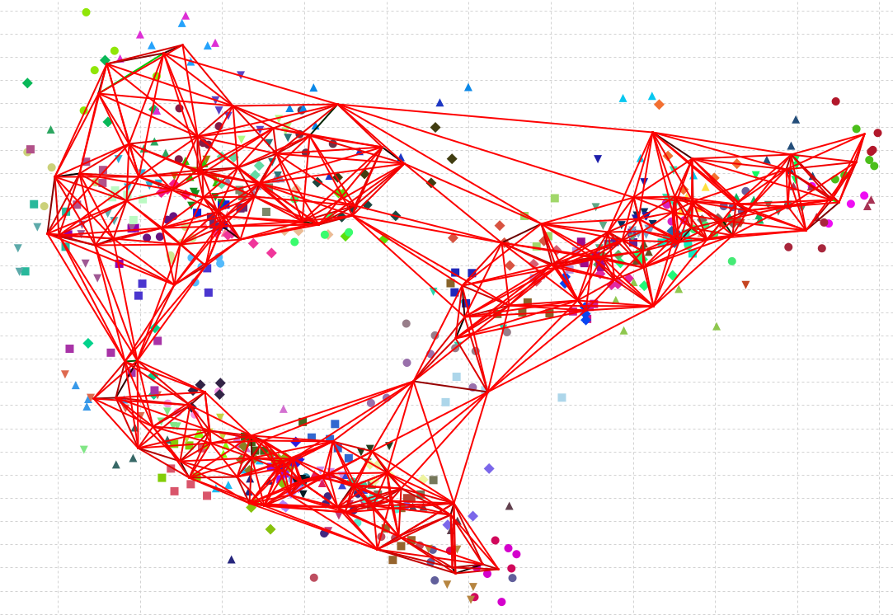
Agenda
Nearest neighbors search
GPU-accelerated ANNS
CAGRA
CAGRA graph construction
CAGRA graph search
Evaluation
Conclusion

Slide 3
Nearest neighbors search
<NNS NNS NNS>

Slide 4
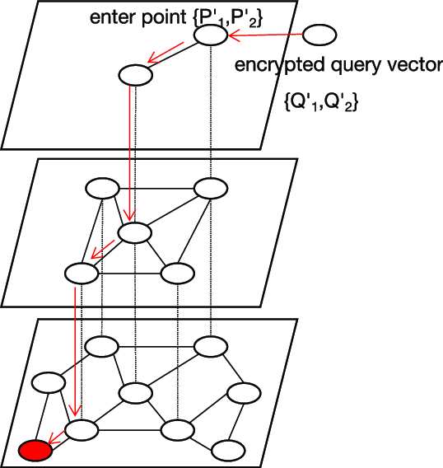
Approximate Nearest Neighbor Search
Given a point (vector)
Find the closest K points
L2 norm
K-NNS:
Naïve approach:
Calculate L2 norm for a given query to all nodes
Graph-based
Build a proximity graph, then traverse it to find K nearest points

Slide 5
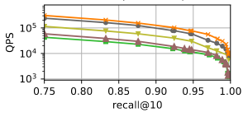

Approximate Nearest Neighbor Search
Given a point (vector)
Find the closest K points
L2 norm
Approximate (ANNS):
A trade off between QPS & Recall
Notation:
k-NNS
Recall @ k

Slide 6
Why is this hard
Graph-based k-NNS
Constructing the graph
Searching for k nearest neighbors
SONG
The first GPU-based graph search
GANNS & GGNN
GPU-friendly graph construction & search
But
They all builds on existing graph designed for CPU
They are not designed for single-query
Needs large batch of query to saturate the GPU computing power

Slide 7
This paper (CAGRA)
Cuda Anns GRAph-based
Design a graph that’s optimized for CUDA
Instead of optimizing existing graph for CUDA
Goal
Fast graph build
High graph search quality
High performance in both
Single-query
Large-batch

Slide 8
CAGRA
<GPU optimized graph construction & traversal>

Slide 9
Graph construction
<Building the graph, fast & good … >

Slide 10
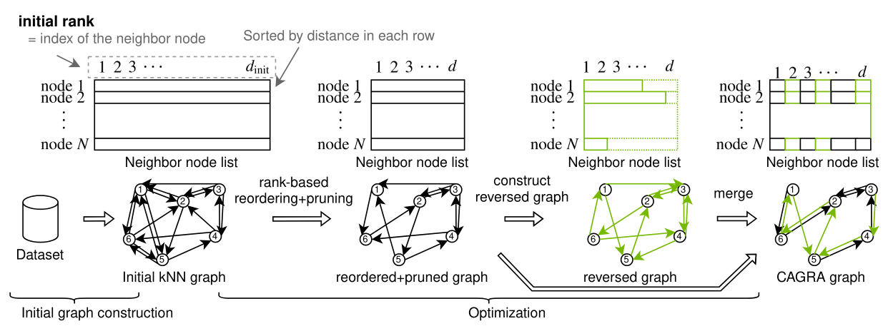
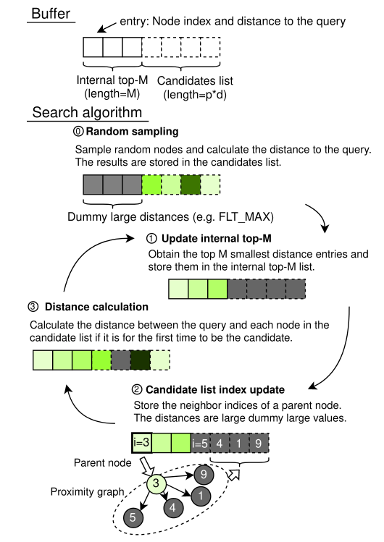
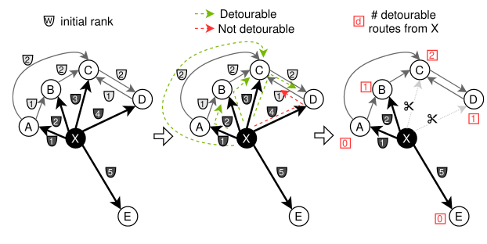
CAGRA graph
Cuda Anns GRAph-based
Graph features
Fixed out-degree
Directional
No hierarchy
Search
GPU-optimized
Works well with
Single query
Batched query

Slide 11
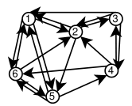
Building CAGRA graph
A good graph:
Can traverse from any node to any other nodes
Step to reach from Node A to Node B
Strongly connected components (CC)
# subgraph (1 = no subgraph)
Number of reachable nodes
Average reachable node in 2-hop

Slide 12
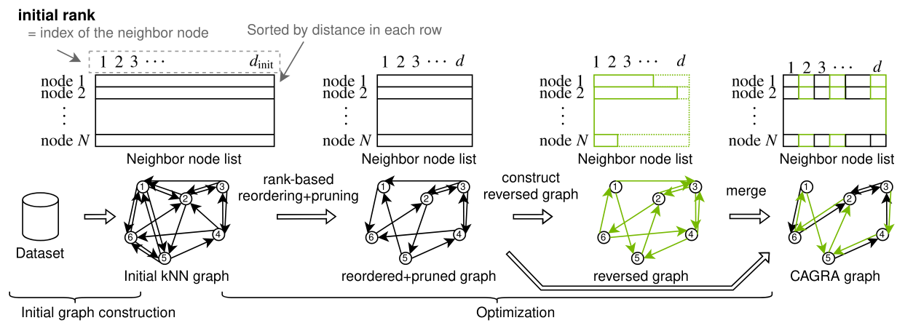
Building CAGRA graph
Workflow
Initial graph is done with NN-Descent
Final CAGRA graph has degree “d”, initial graph has degree 2d – 3d.

Slide 13
NN-Descent

Slide 14
Building CAGRA graph
Initial graph
Sort node list by distance
Position in list = rank

Slide 15
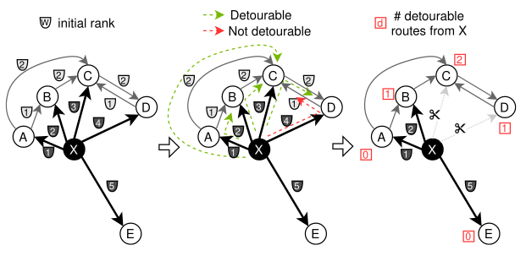
Building CAGRA graph
Optimization
Reordering + pruning edges
Detourable
X -> Z -> Y
If max(X->Z, Z->Y) < X->Y
Then X-> Y is detourable
Metric
Distance
Rank

Slide 16
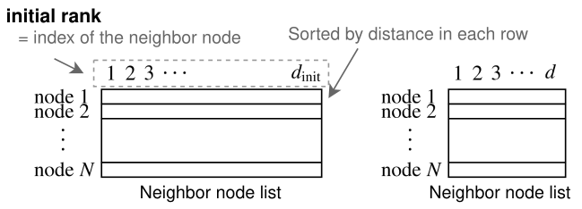
Building CAGRA graph
Optimization
Reordering + pruning edges
Detourable
X -> Z -> Y
Metric = Rank
Approximated distance
Rank (order of distance)
~= true distance
Count deroutable
Sort edge by # drtb, keep “d” edge
Few detour = important edge
High rank

Slide 17
Building CAGRA graph
Optimization
Reordering + pruning edges
Reverse edge
Build graph with reverse edge
Such that out degree <= “d”
Same rank as the original edge
If I am important to you, you are also important to me.

Slide 18
Building CAGRA graph
Optimization
Reordering + pruning edges
Reverse edge
Merge graphs
Keep d/2 edge
Interleave edges

Slide 19
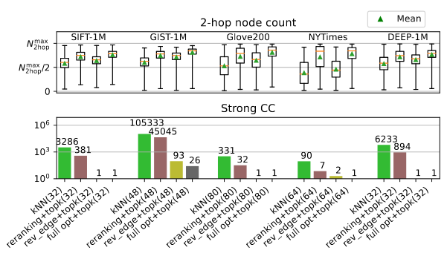
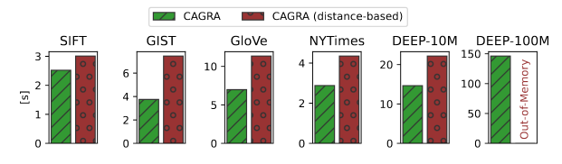
CARGA quality
Testing
kNN, opt1, opt2, full_opt
2-hop node count
Strong CC
Approaching 1
Build speed
Rank base is better than distance-based
Less computation
Lower memory usage

Slide 20
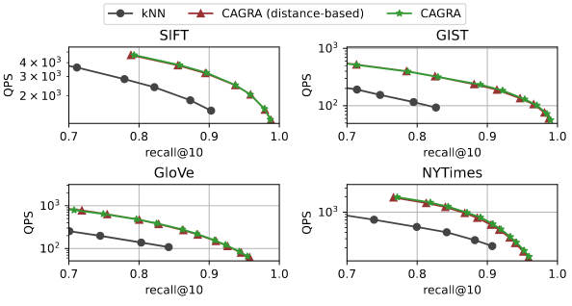
CARGA quality
Testing
kNN, opt1, opt2, full_opt
2-hop node count
Strong CC
Build speed
QPS vs. recall
Significantly improved after optimization

Slide 21
Graph traversal
<aka search, fast … >

Slide 22
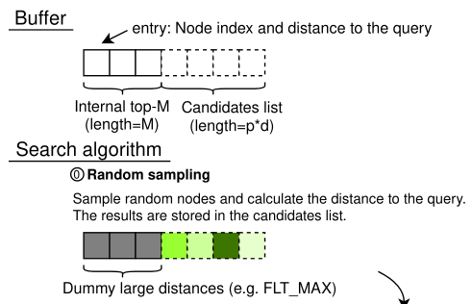
Traversal
Memory buffer
Internal top (M entries)
Candidate list (p x d entries)
P = # of source node per traversal
d = degree of CAGRA graph
Each entry
Key = node index
Value = distance to query
Initial random sampling
M – set to float max
p x d – sampled randomly

Slide 23
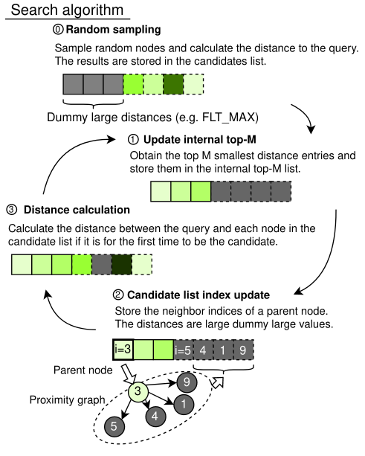
Traversal
Update top-M
Sort, find M nodes with smallest distance
Update p x d
For each node in top-M
Find top-p node that has NOT been parent node before
Check ”has_been_parent”
Use the most significant bit of the node index ( 0x1 -> 0x70000001)
Calculate distance

Slide 24
Traversal
Update top-M
Update p x d
Calculate distance
For each node
Calculate distance if the node appears for the first time
Check “never_seen_before”
Fixed-size hash table
Size = max iteration x p x d
Periodically reset (forgettable)
Allows false positive
Penalty = recomputing distance

Slide 25
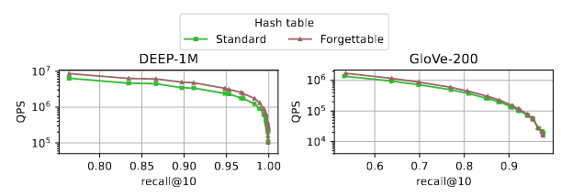
Traversal
Update top-M
Update p x d
Calculate distance
For each node
Calculate distance if the node appears for the first time
Check “never_seen_before”
Fixed-size hash table
Size = max iteration x p x d
Periodically reset (forgettable)
Allows false positive
Penalty = recomputing distance

Slide 26

GPU
SIMT
Single-instruction multi-threading
Grid
CTA
< 32x Wrap
32x Threads
Terminology
CTA = Cooperative Thread Array
SM = Streaming multiprocessor
Wrap = Threads with same instructions
Threads = CUDA instructions
Global memory (device mem)
Share memory (Cluster / CTA)
Local memory
Register

Slide 27
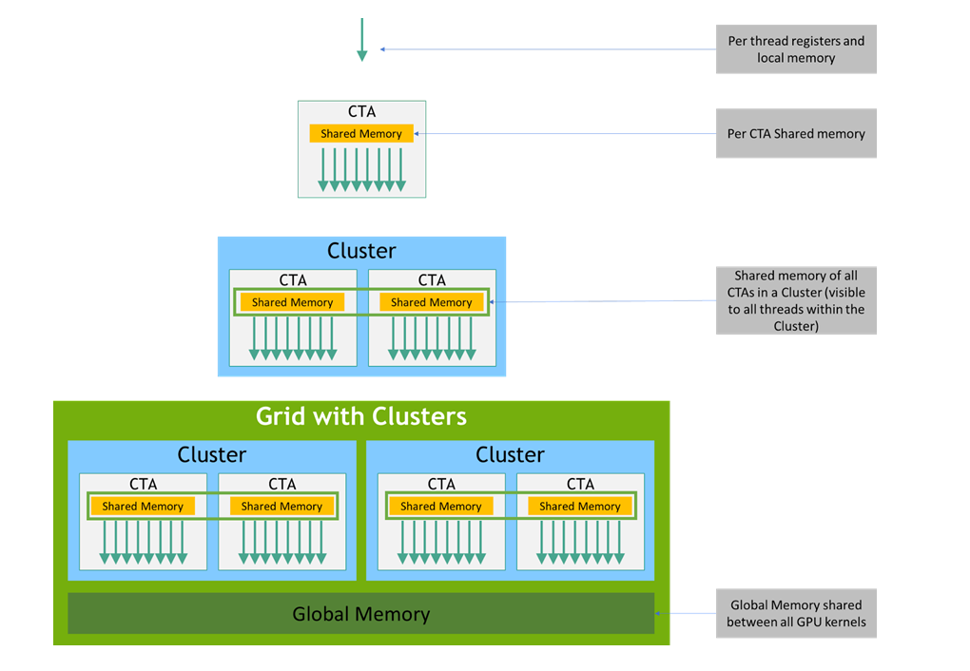
GPU

Slide 28
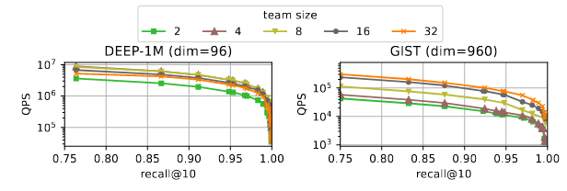
Traversal (CUDA)
Teams
Sub clustering within CTA
Needs to match with graph degree
When d=96
Vector len = 96 * 32 bits
Load inst loads 128 bits
Need 8 warp load 3 times
8 * 3 * 128 = 96 * 32
Team = 8

Slide 29
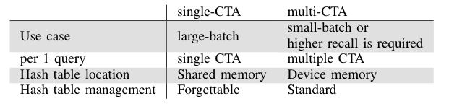
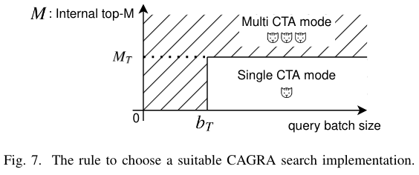
Traversal (CUDA)
Single CTA
Each query maps to 1 CTA
1 kernel does all steps (0, 1, 2, 3)
Targets high perf in batched queries
Multi CTA
Each query maps to 1-100 CTA
Targets high perf in 1 query
Independent top-M per CTA

Slide 30
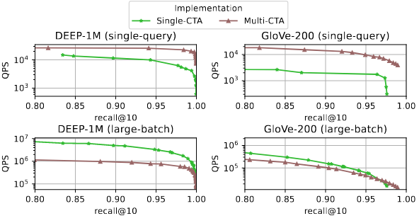
Traversal (CUDA)
Single CTA
Each query maps to 1 CTA
1 kernel does all steps (0, 1, 2, 3)
Targets high perf in batched queries
Multi CTA
Each query maps to 1-100 CTA
Targets high perf in 1 query
Independent top-M per CTA
Determining M_{T} and b_{T}
M_{T} = 512, = b_{T} number of SM

Slide 31
Evaluation
<aka search, fast … >

Slide 32
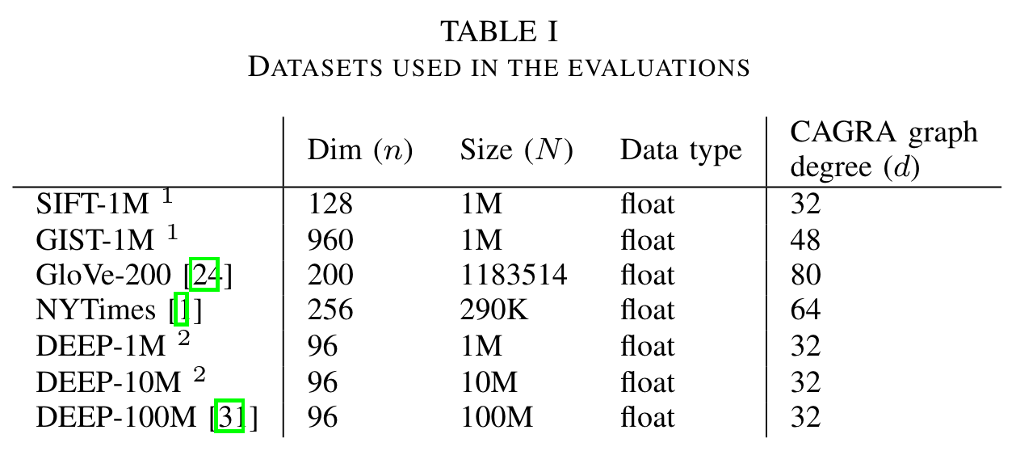
Baselines
GGNN, GANNS,
SOTA GPU implementation for kNN search
HNSW
SOTA CPU optimized kNN search
NSSG
Build graph like CARGA
Runs on CPU

Slide 33
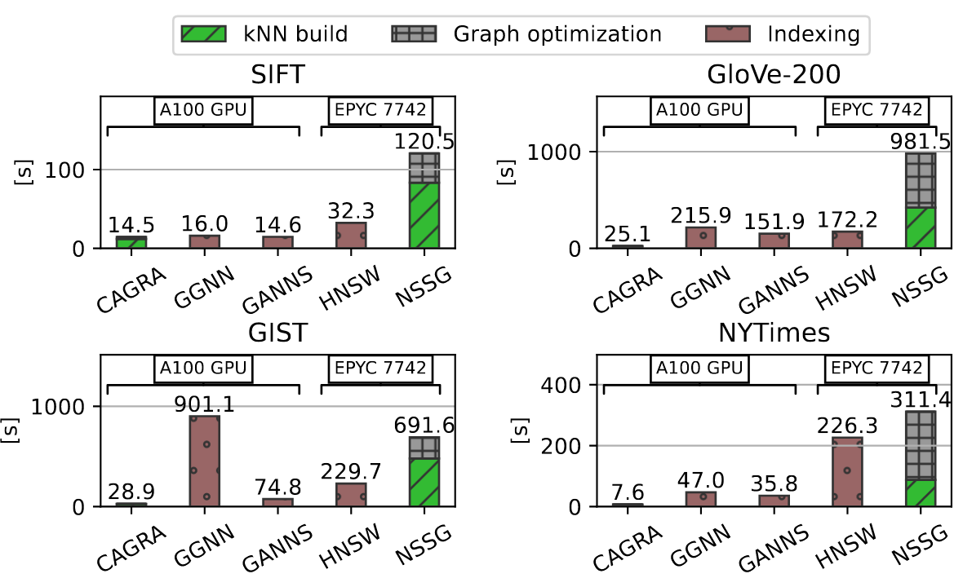
Graph build time
CARGA builds graph very fast
1.1x – 27x faster than the baselines

Slide 34
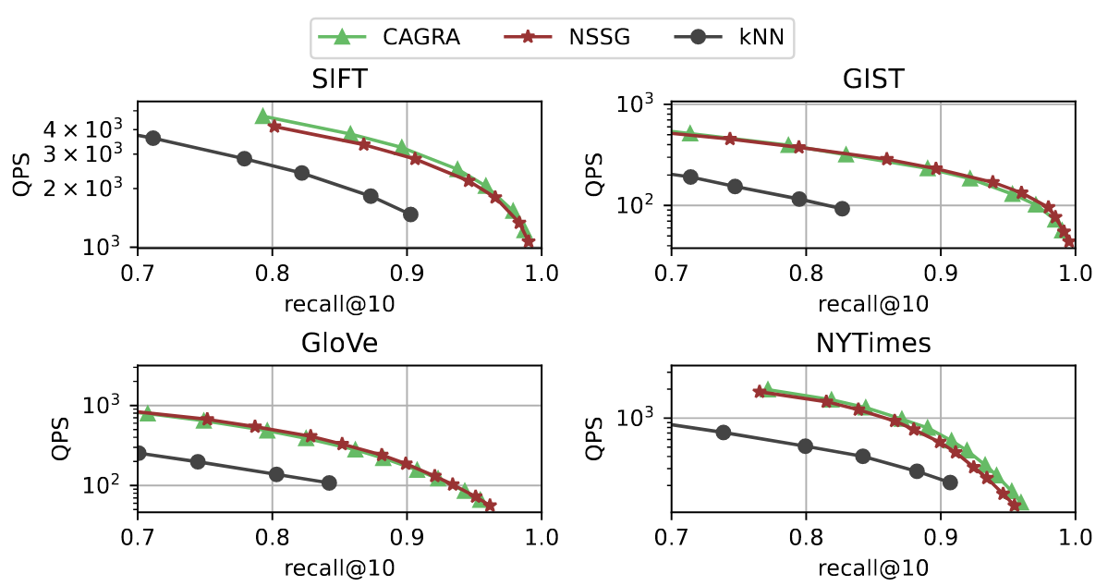
Graph quality
CARGA builds graph very fast
CARGA’s graph has good quality
All tested with NSSG search
High QPS vs. Recall

Slide 35
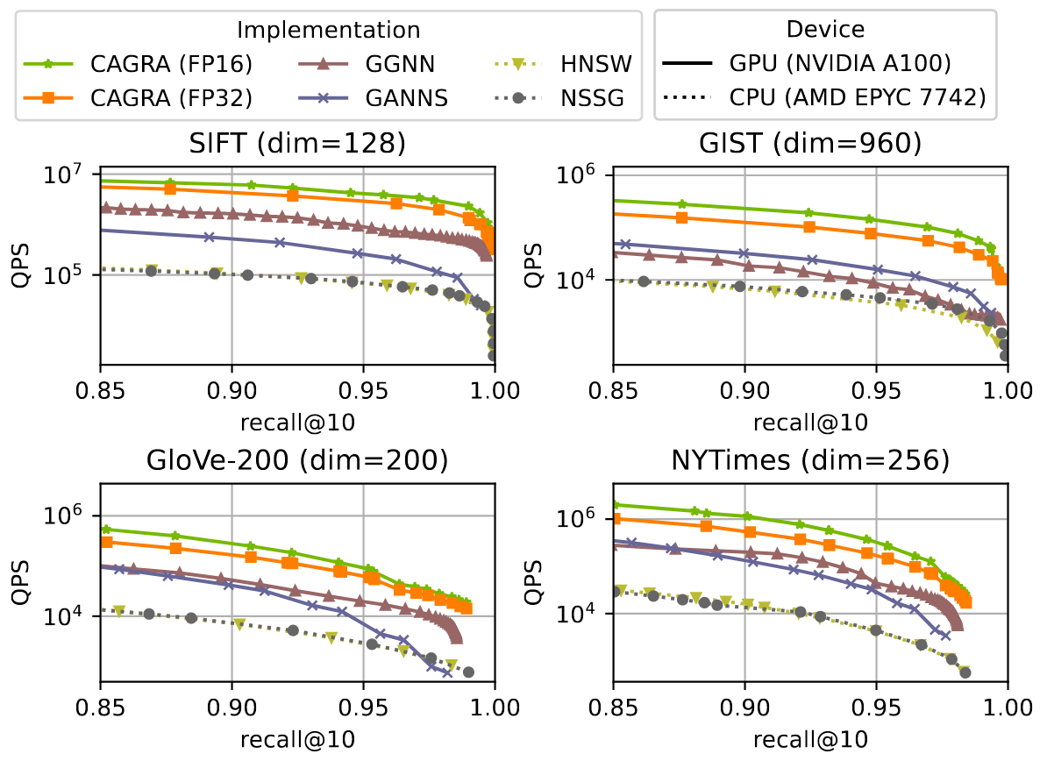
Overall performance
CARGA builds graph very fast, and with good quality
Large-batch performance
CAGRA use single-CTA
33 - 77x faster than CPU-based schemes
3.8x – 8.8x faster than GPU-based schemes

Slide 36
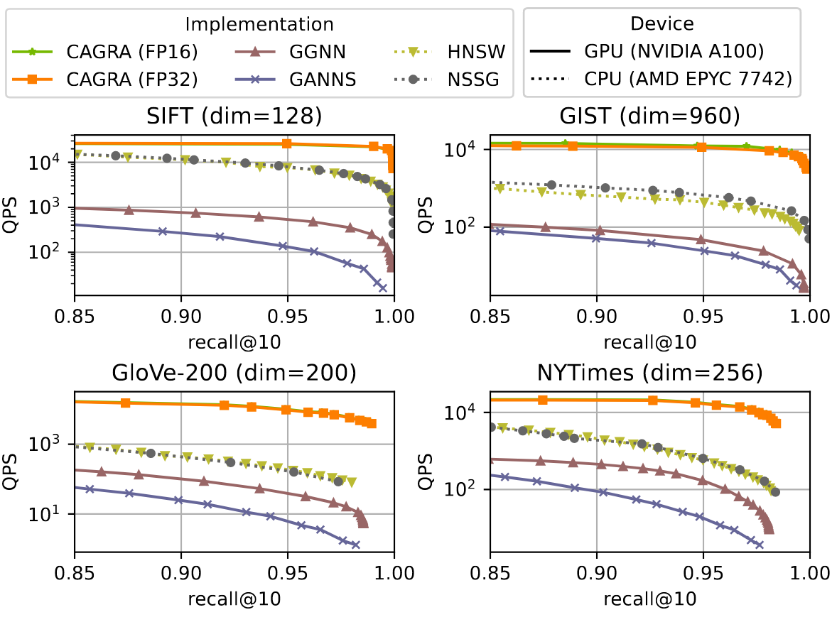
Overall performance
CARGA builds graph very fast, and with good quality
Large-batch performance
Single-query performance
GPU-based scheme usually perform poorly (GGNN, GANNS)

Slide 37
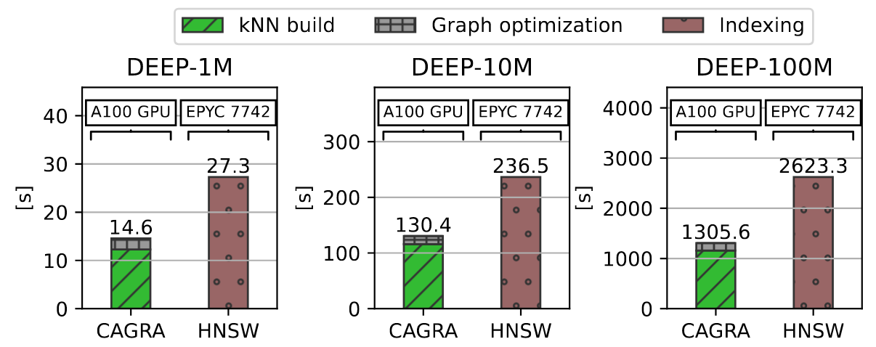
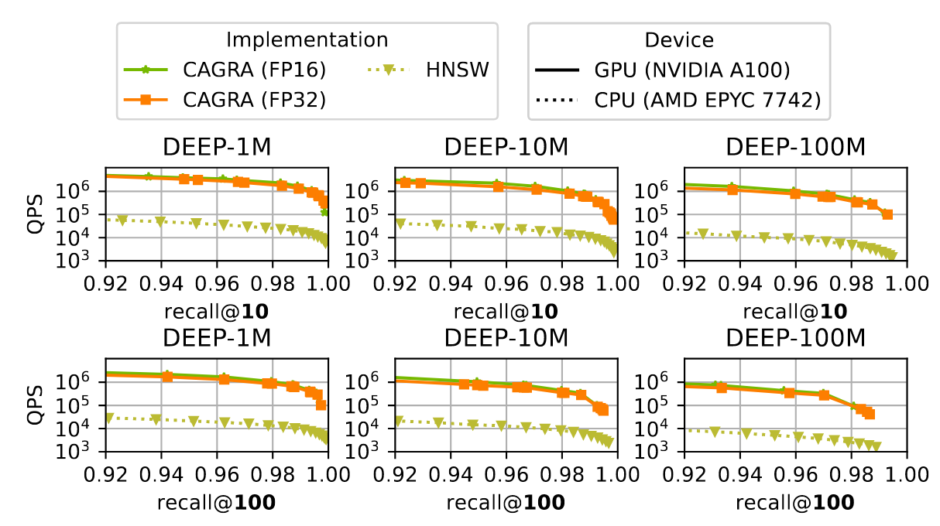
Overall performance
Large dataset
Build time scales linearly
Performance drops slightly
DEEP-100M
What if GPU mem can’t fit anymore
Authors suggest that CARGA can scale to multiple devices

Slide 38
Conclusion
CAGRA
Builds a GPU friendly graph on-top of kNN
Fast
Good quality (low CC, high 2-hop node count)
Use a GPU friendly searching scheme
Optimized for single-query (multi-CTA)
Optimized for large-batch (single-CTA)
Overall performance
Splendid

Slide 39
IMO
<In my opinion>

Slide 40
Pros / Cons
Pros
Build GPU-optimized graph from ground up.
The optimization is generalizable to most if not all graphs.
The performance of CAGRA is exceptional!
Cons
Although well-justified, some parameters needs manual tunning.
The decision of using single-CTA vs. multiple-CTA
Dimension “d”, team size, is also empirically determined
Some of the design assumption are limited to the current generation of hardware
Questions
GPU memory size < CPU memory size, will there be a limit in CARGA performance when the dataset’s size grows further?

Slide 41
GPU / CUDA
UIUC fauculty Wen-mei Hwu wrote the CUDA textbook

Slide 42
GPU
SIMT
Single-instruction multi-threading
Grid
CTA
< 32x Wrap
32x Threads
Terminology
CTA = Cooperative Thread Array
SM = Streaming multiprocessor
Wrap = Threads with same instructions
Threads = CUDA instructions
Global memory (device mem)
Share memory (Cluster / CTA)
Local memory
Register

Slide 43
GPU

Slide 44
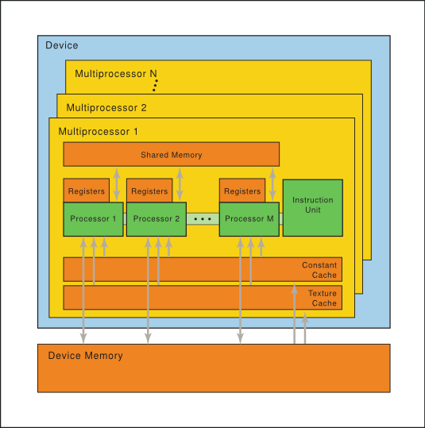
GPU

