Slide 1
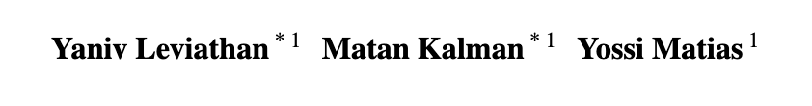

Fast Inference from Transformers via Speculative Decoding
Presenter: Hanyang

Slide 2
Background

Slide 3
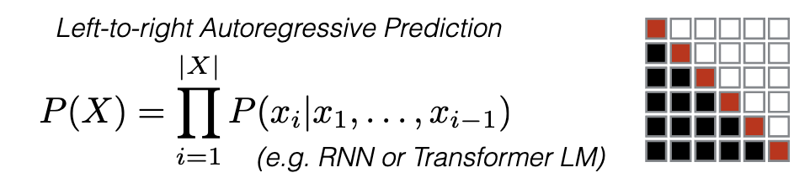

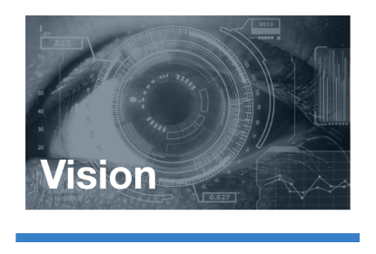

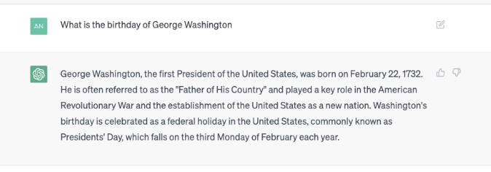
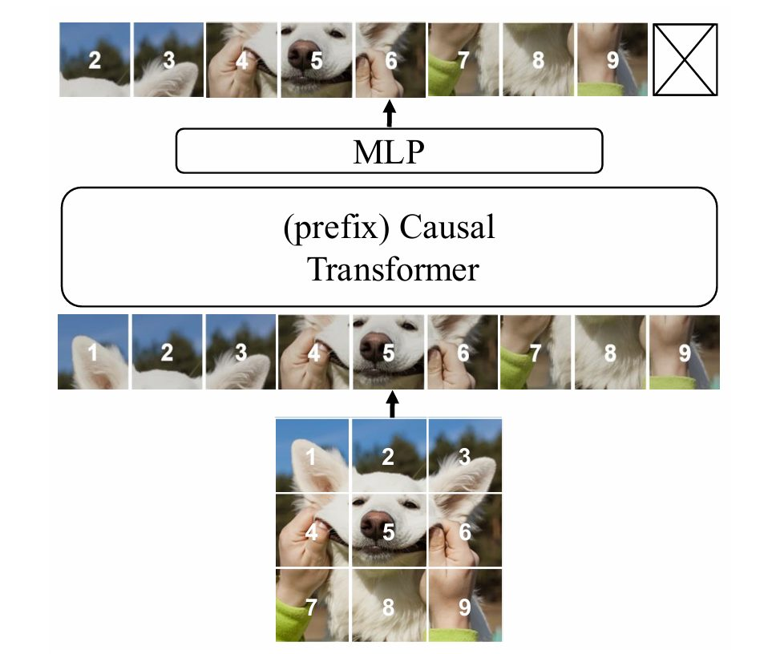
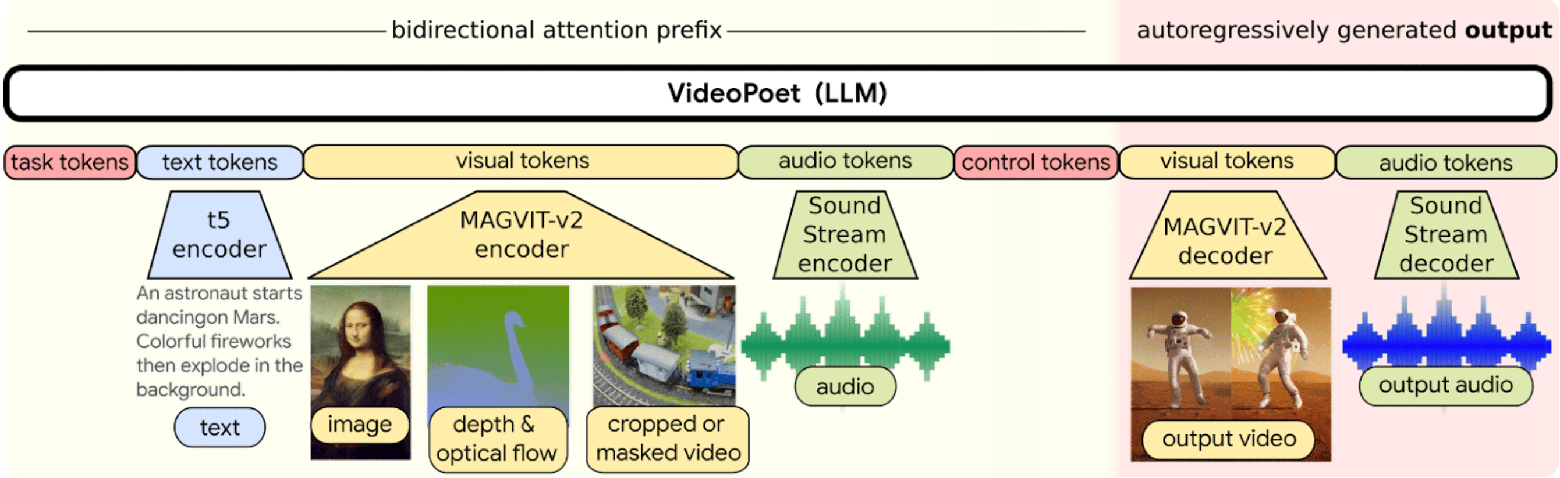
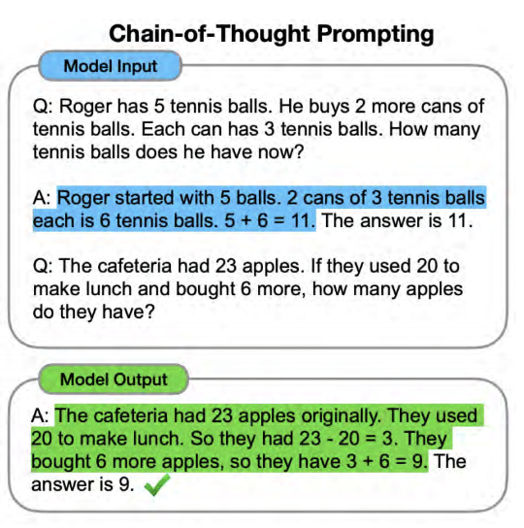
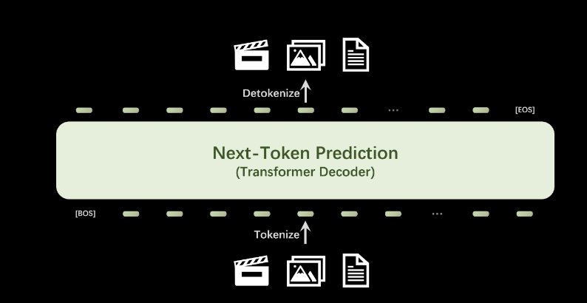
Background
Auto-regressive Modeling as a “Go-To Modelling” for numerous tasks
1. From Conditional modeling to Generation
2. Auto-regressive -> Arbitrary length

Slide 4
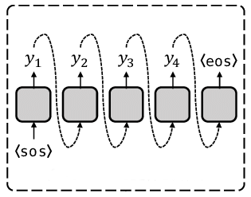
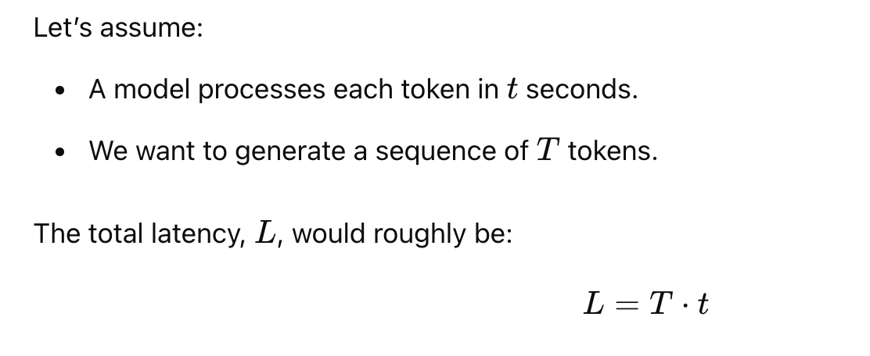
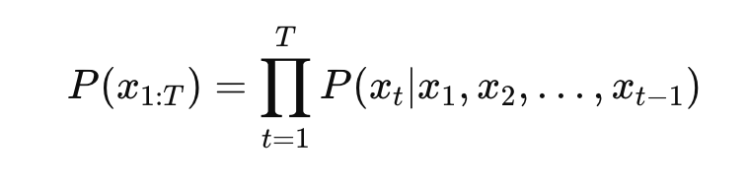
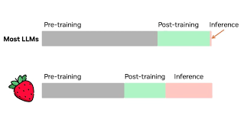
Challenges
1. Temporal dependency make the latency goes linearly with # of Token to be generated
2. Translation from Training-time Scaling to Inference-time Scaling

Slide 5
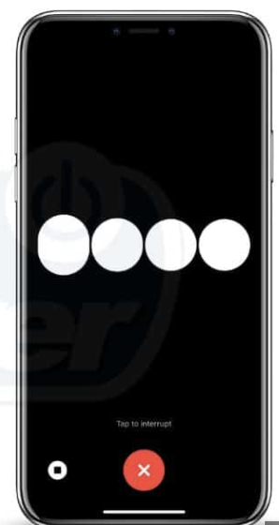
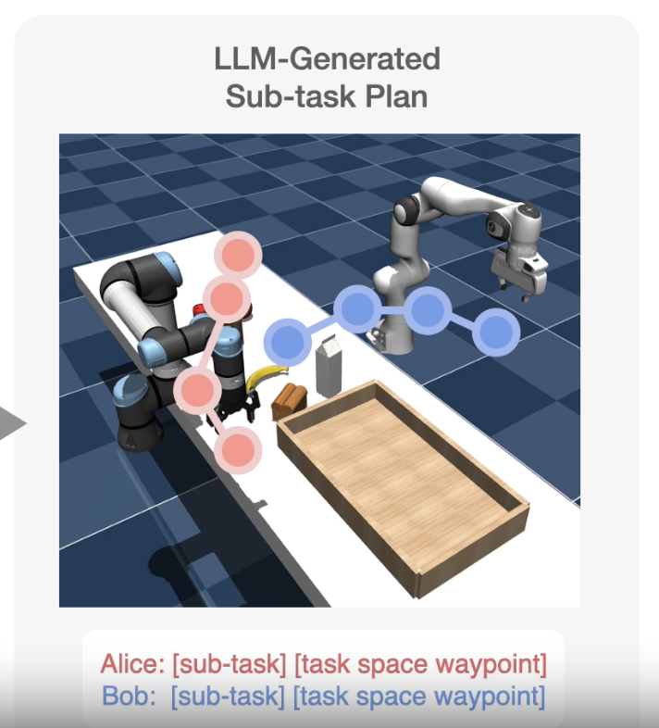
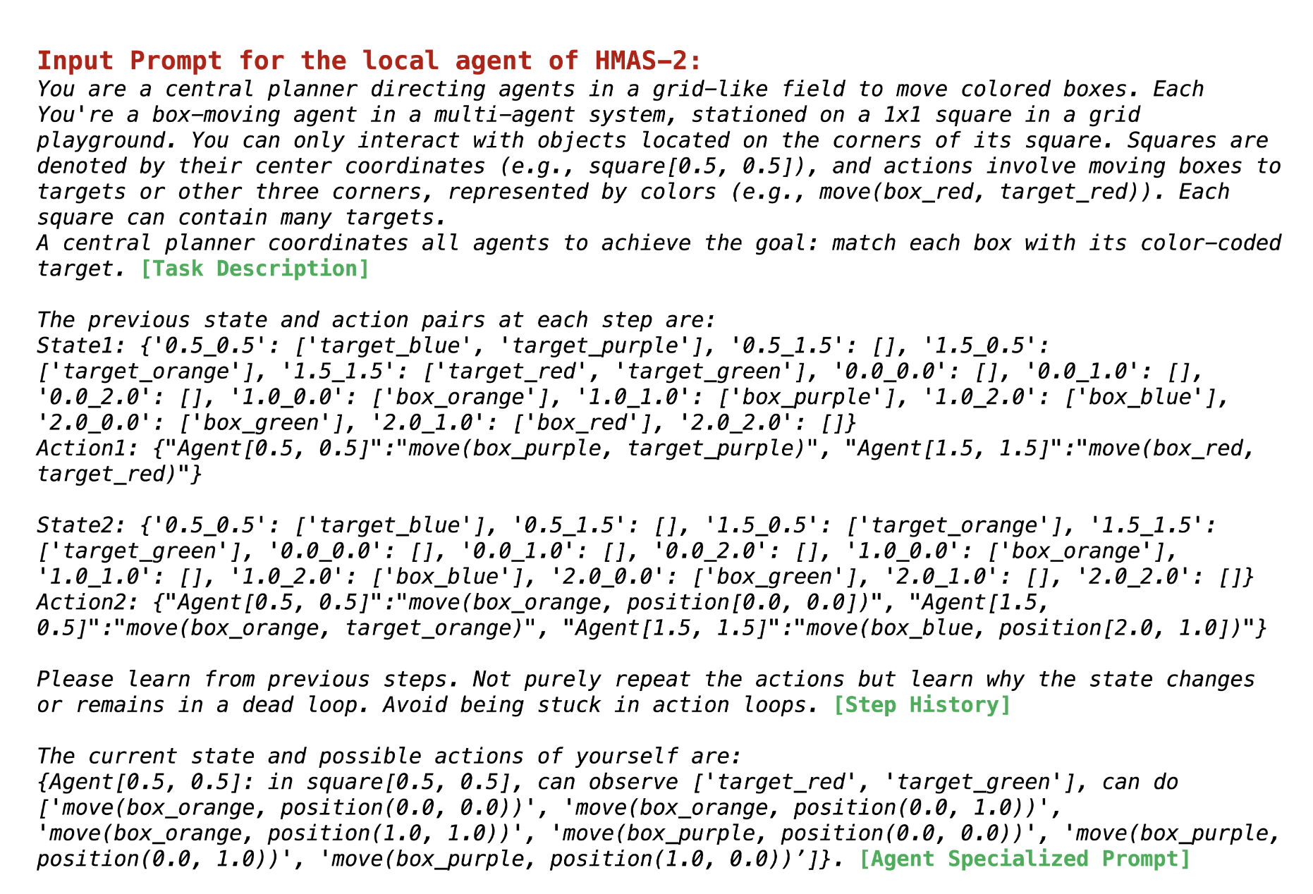
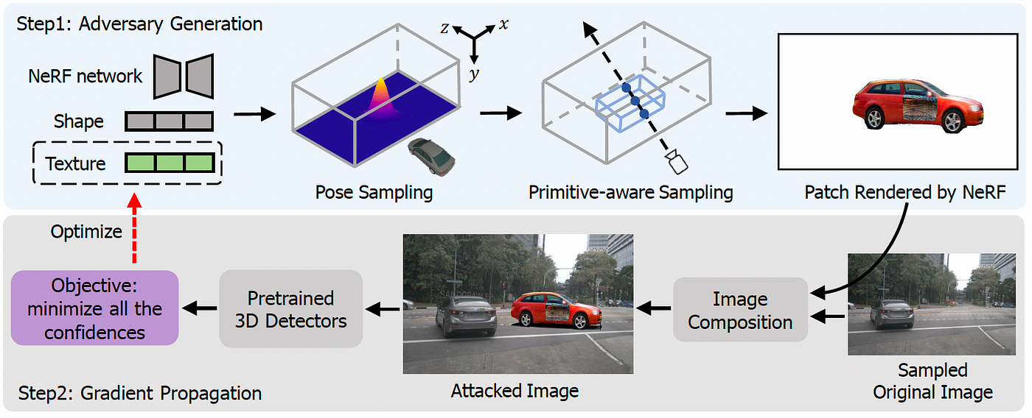
Spec-Decoding is about latency, which we care
Quality of Experience
Safety
Productivity

Slide 6
Motivation

Slide 7
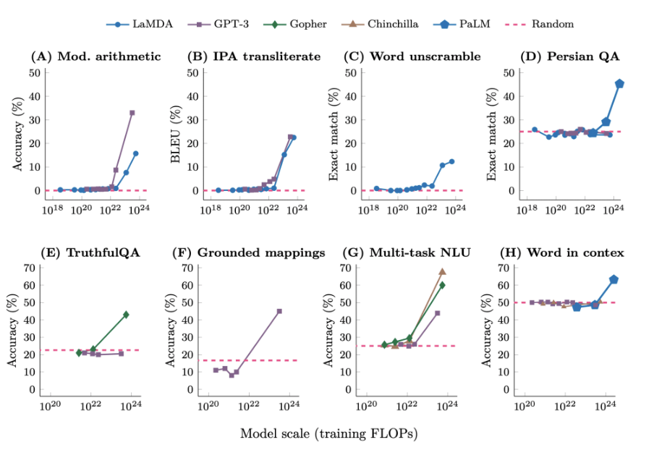
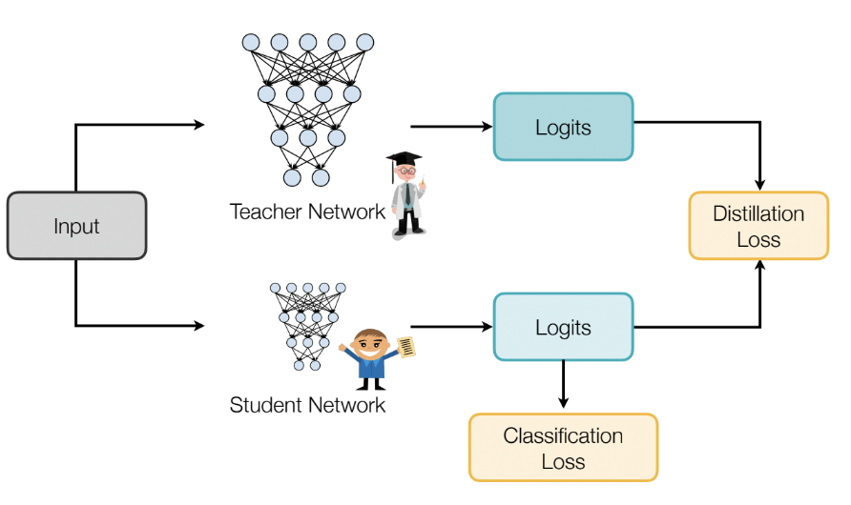
Smaller model for generation
Smaller models are faster by reducing the time to generate each simple token
Performance degradation with harder tasks

Slide 8
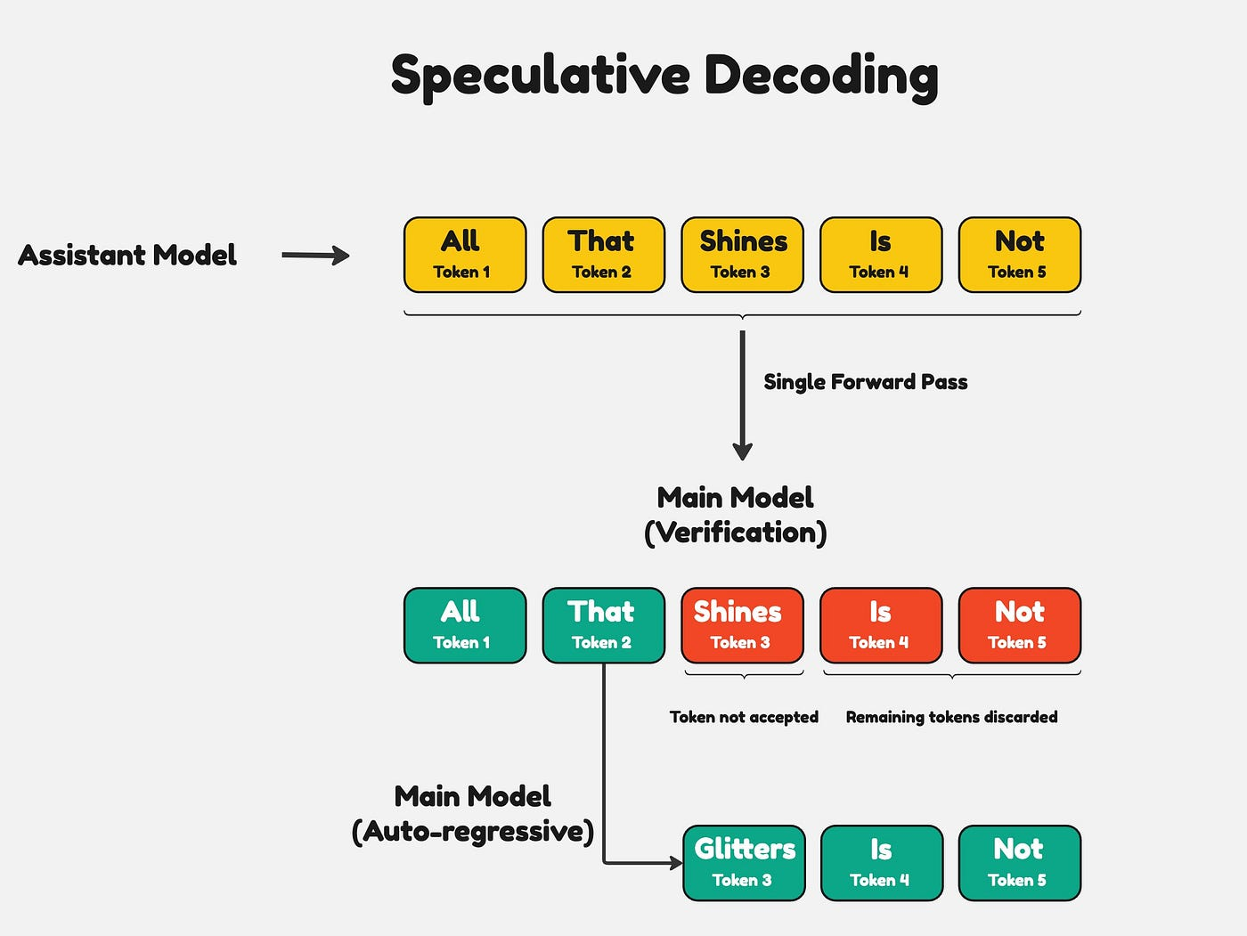
Intuition
Distinguish between simple task and hard task:
Small model for simple token; Large model for harder ones?

Slide 9
Algorithm

Slide 10
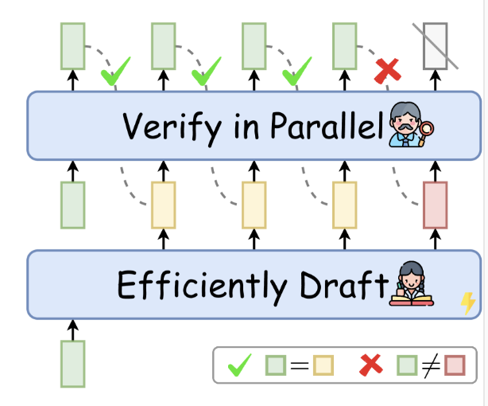
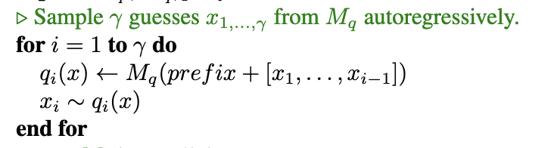


Step1: Use Draft model to generate a sequence of tokens
x₁
x₂
x₃
x₄
x₀
Time_{step1} = K * T_{draft_model}(.)

Slide 11
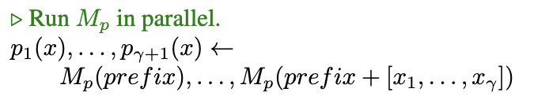
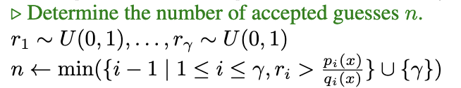
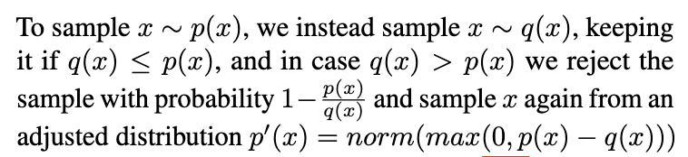
Step2: Parallelized Verification
y₁
y₂
y₃
y₄
x₀
x₁
x₂
x₃
x₄
x₀
Time_{step2} = 1 * T_{target_model}(.)

Slide 12
Step3: Select First Consecutive n Accepted Draft Tokens
y₁
y₂
y₃
y₄
x₀
x₁
x₂
x₃
x₄
x₀
Find the first “invalid” token t_{invlid} , and Discard everything from there(inclusive)
Everything from t_{invlid} , is based on the wrong conditions

Slide 13
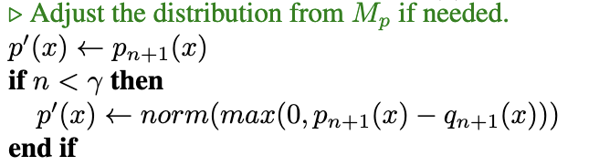

Step4: Use the target model‘s suggestion for the first invalid token
y₁
y₂
y₃
y₄
x₀
x₁
x₂
x₃
x₄
x₀
Time_{total} = K * T_{draft_model}(.) + T_{target_model}(.)

Slide 14
Analysis

Slide 15
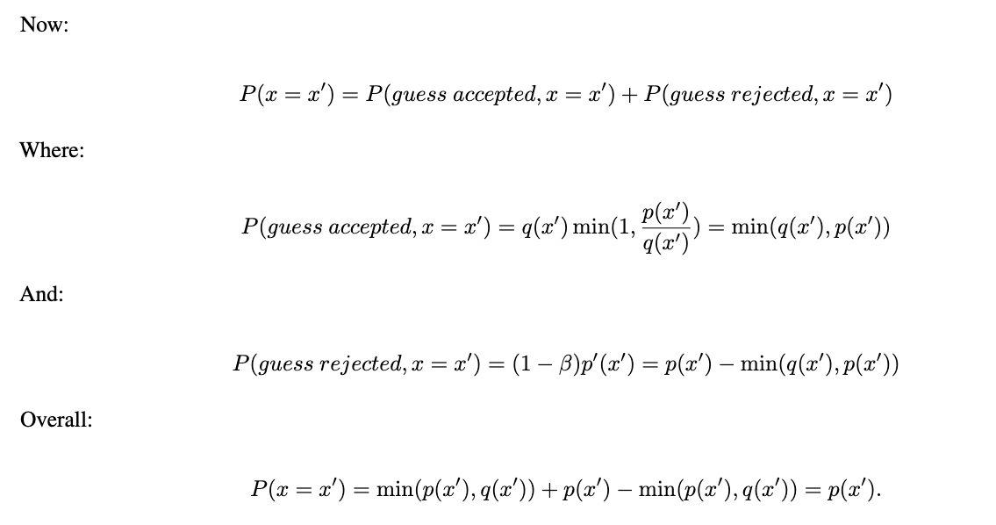
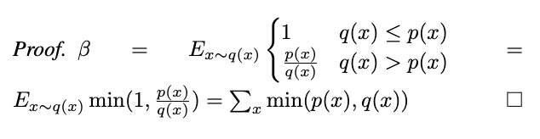
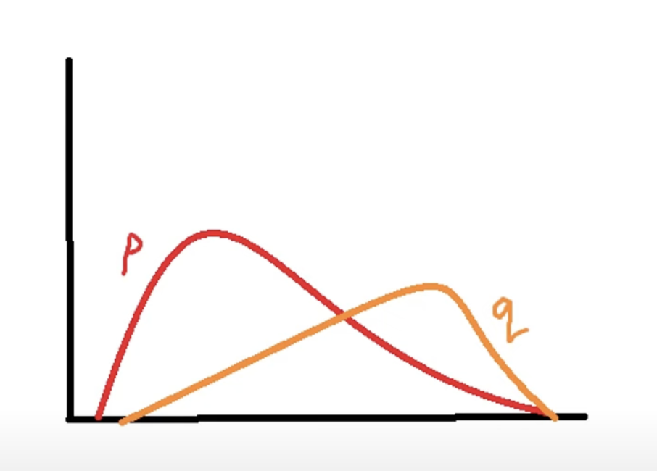
Perform Exact Sampling from Target Distribution with NO Approximation
Definition of β : Acceptance Rate

Slide 16
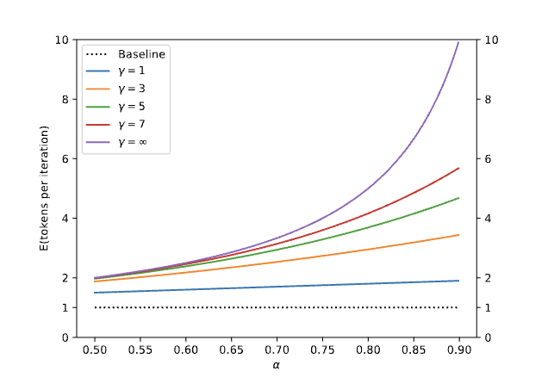
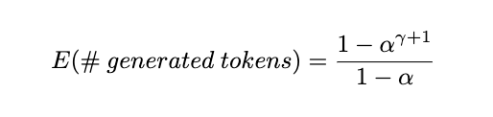
Expected number of tokens to generate in a single run of “the Algorithm”
Definition of ⍺ : the Average of β

Slide 17
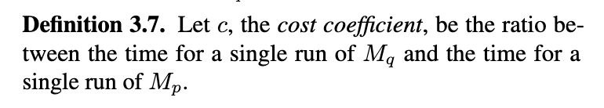
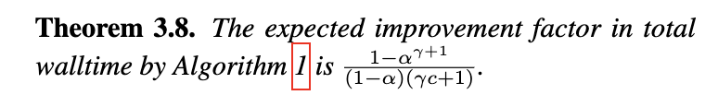
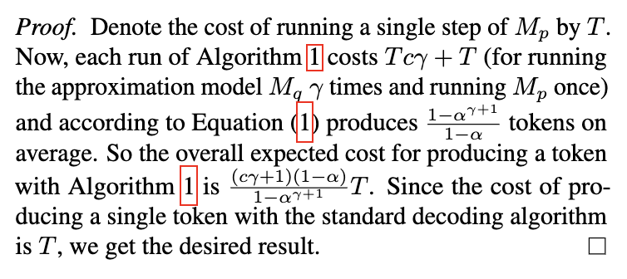
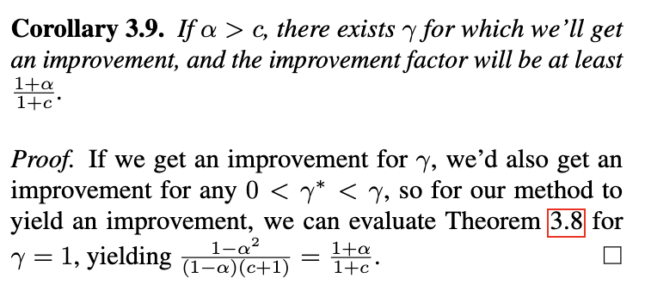
Walltime speedup
Recall Time_{total} = K * T_{draft_model}(.) + T_{target_model}(.)

Slide 18

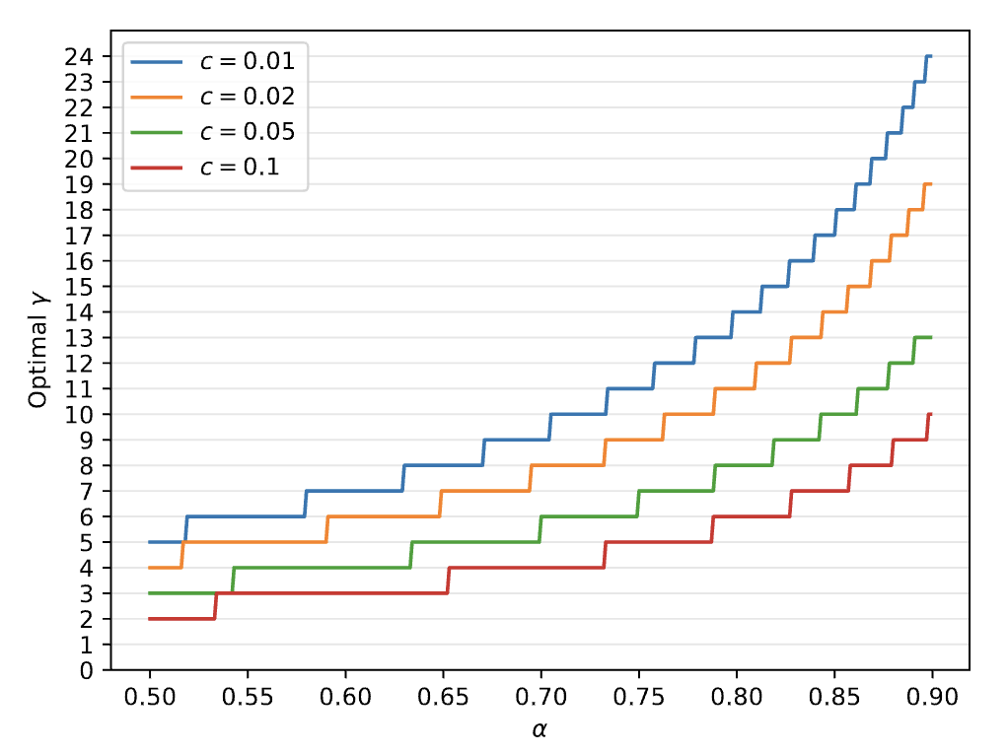
Choosing 𝛾
Recall Improvement Factor:
1. Larger ⍺ suggests larger 𝛾
2. Given ⍺, larger c suggests larger 𝛾

Slide 19
Experiment

Slide 20
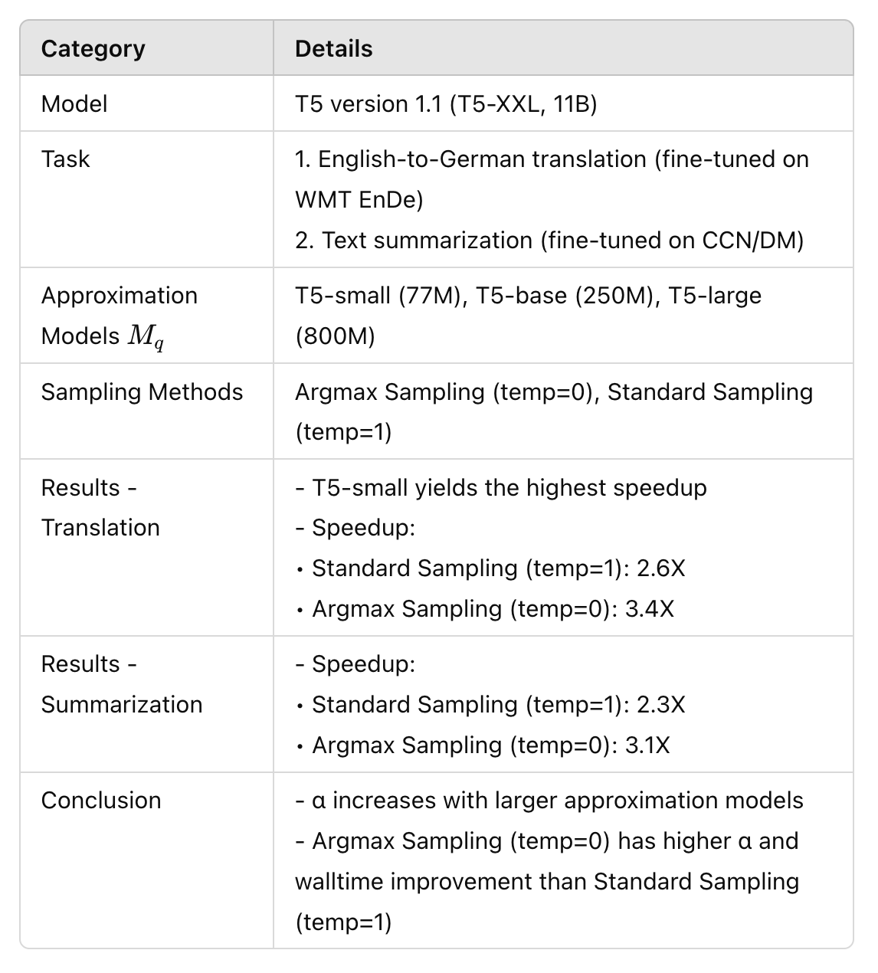
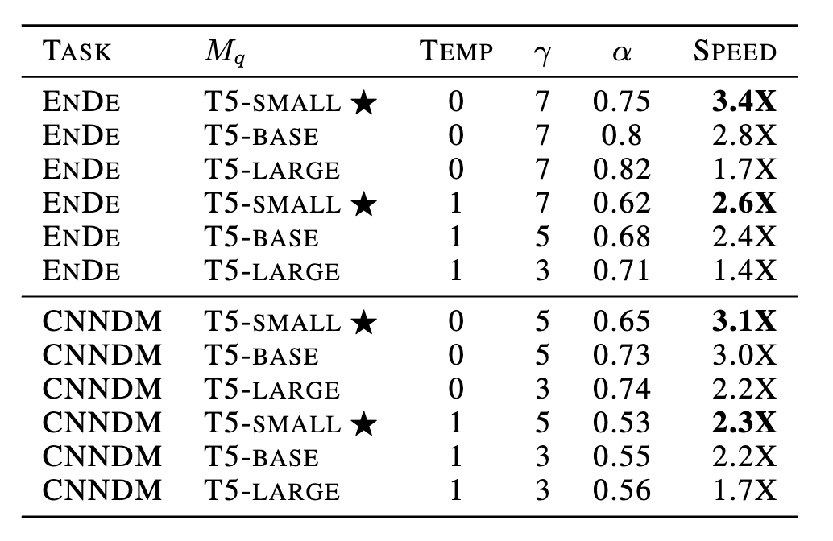
Empirical Result on Walltime Speedup
α increases with larger approximation models
Argmax Sampling has higher α and walltime improvement than Standard Sampling

Slide 21
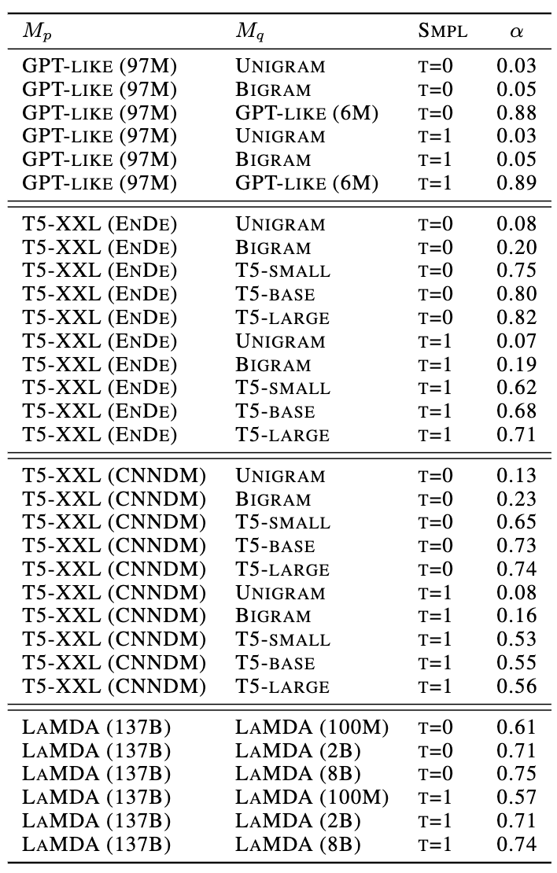
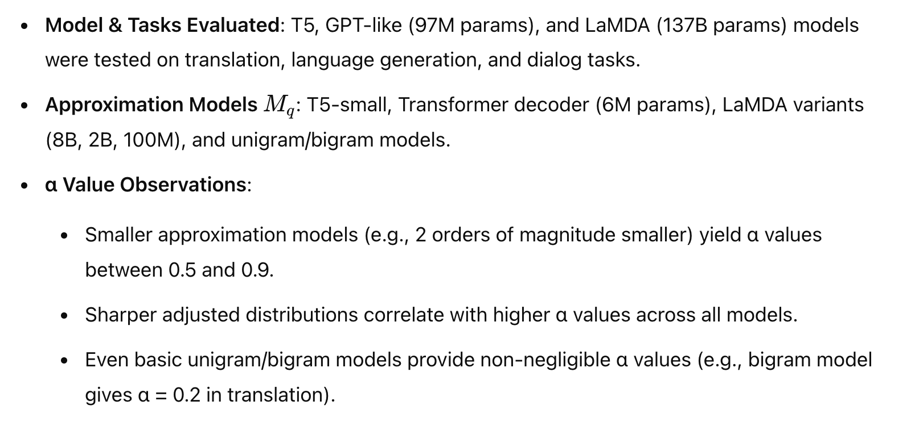
Empirical Result on ⍺

Slide 22
Following Work

Slide 23
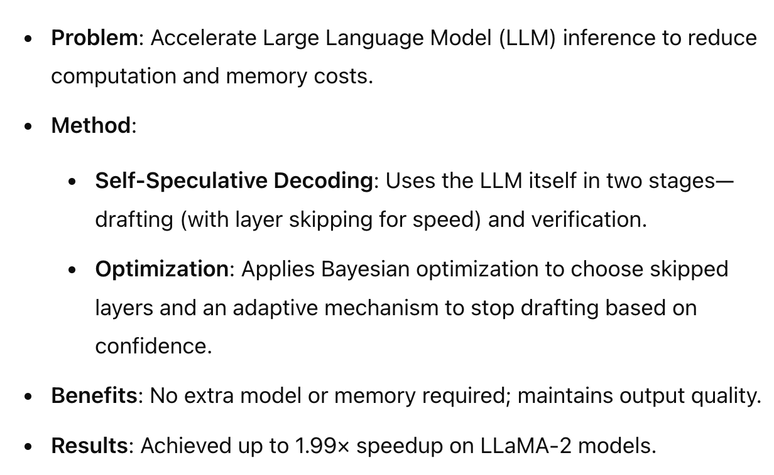
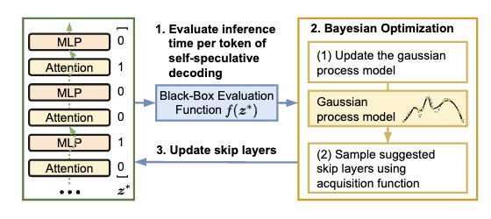
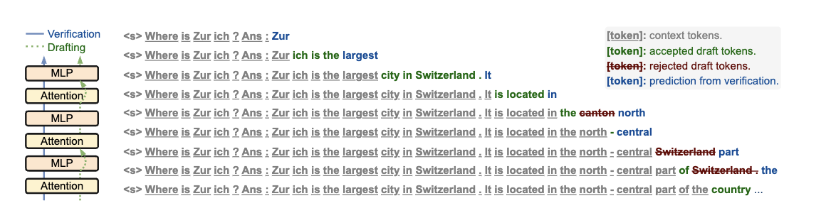
Self Drafting & Adaptive Drafting

Slide 24
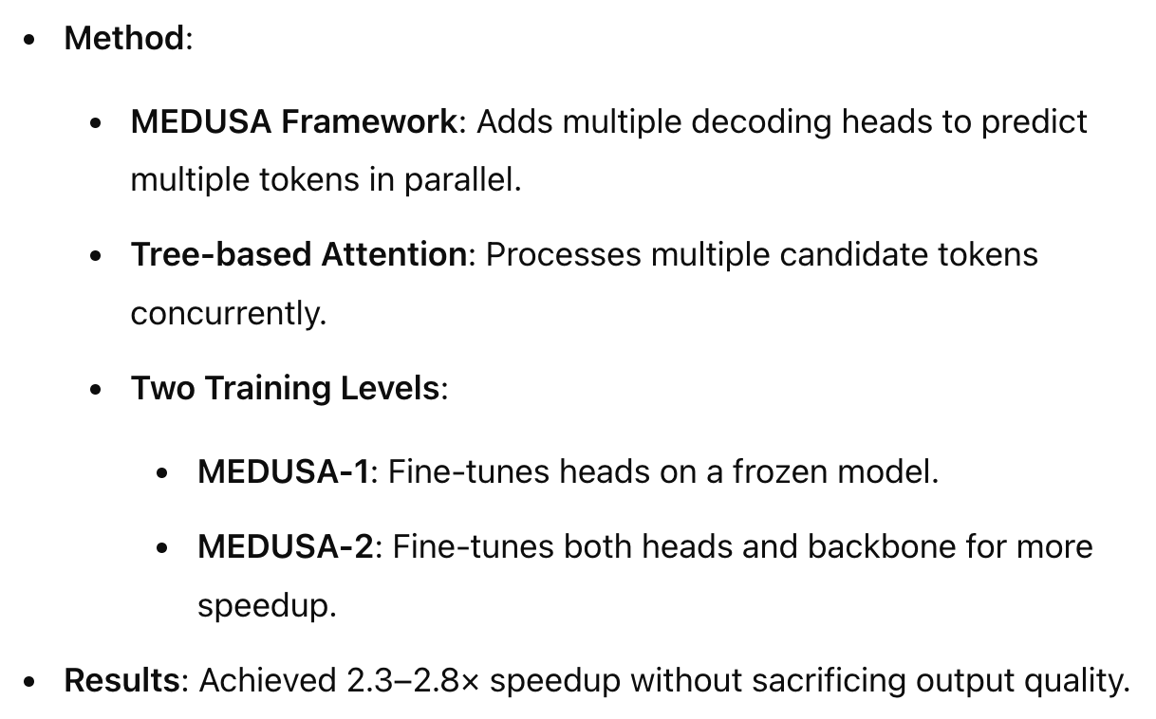
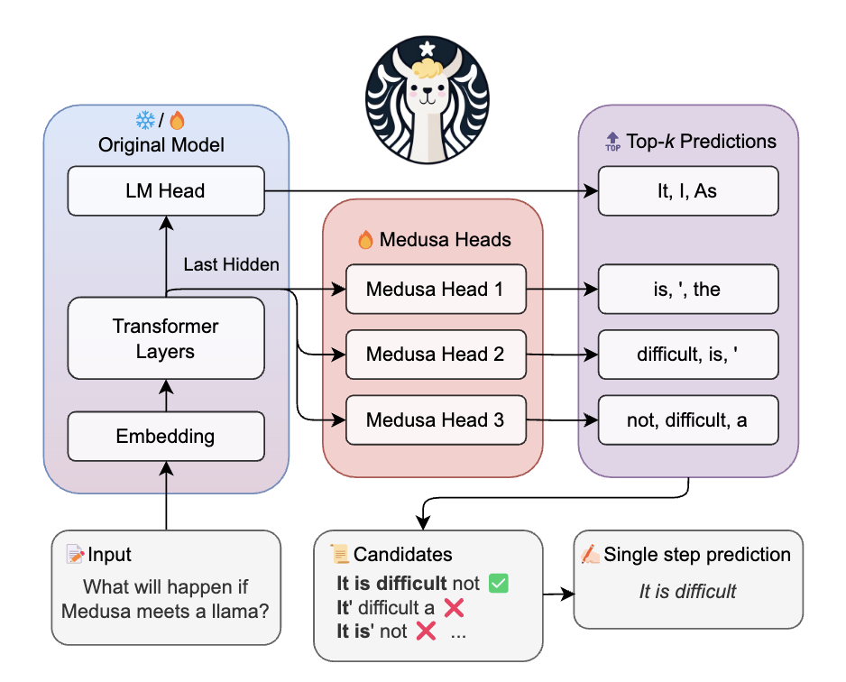
Parallel Decoding

Slide 25
Usage

Slide 26
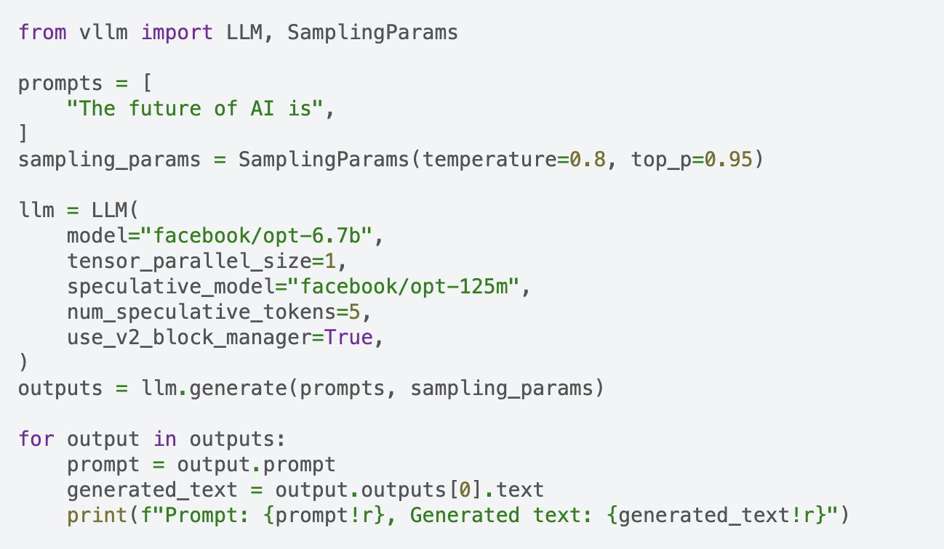
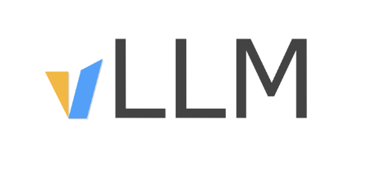
vLLM Support

Slide 27
Thanks

