Slide 1
Demo Login
Manufacturing
Repair Assistant
hana
123
A RAG-based troubleshooting assistant for repair engineers
Simple login and assistant chat for the assessment demo.
Uses SOP evidence, mock factory data, and local model reasoning to return practical repair guidance.
01

Slide 2
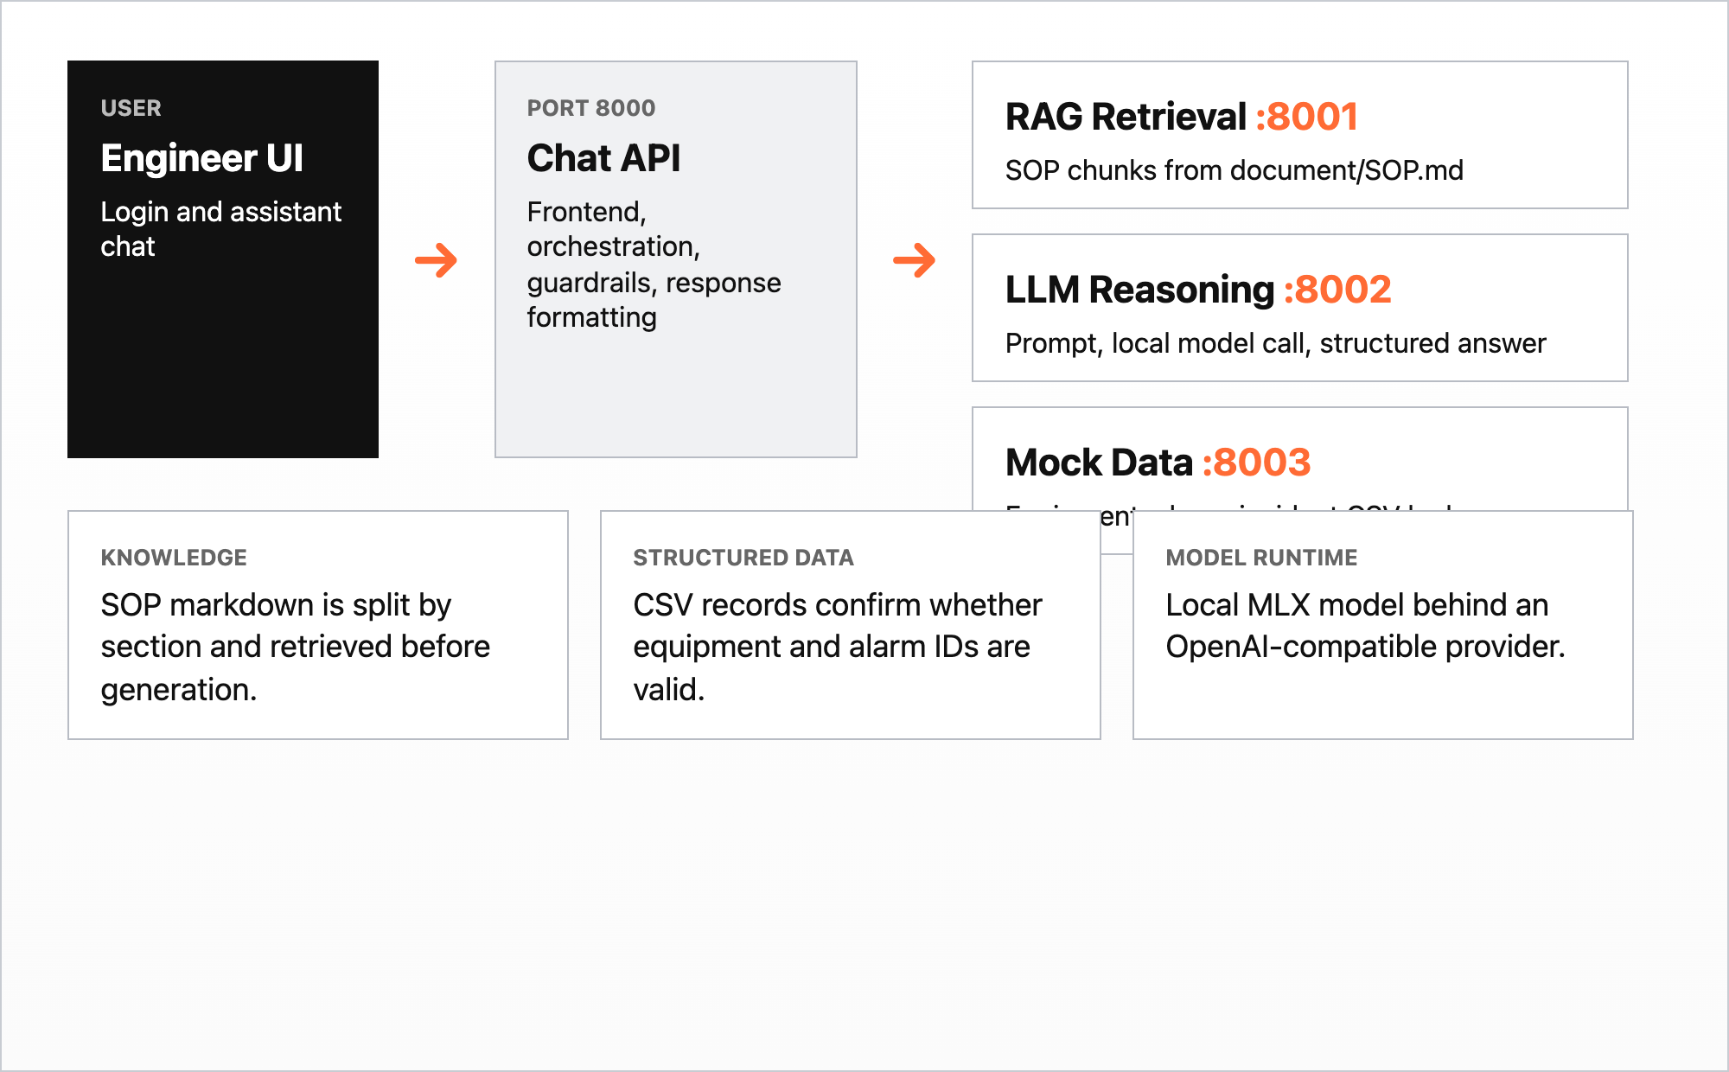
The system is split into four FastAPI services
The design separates frontend orchestration, retrieval, model reasoning, and structured data lookup.
• Chat API is the public entry point.
• RAG Retrieval owns SOP search.
• LLM Reasoning owns generation.
• Mock Data confirms equipment and alarms.
02

Slide 3
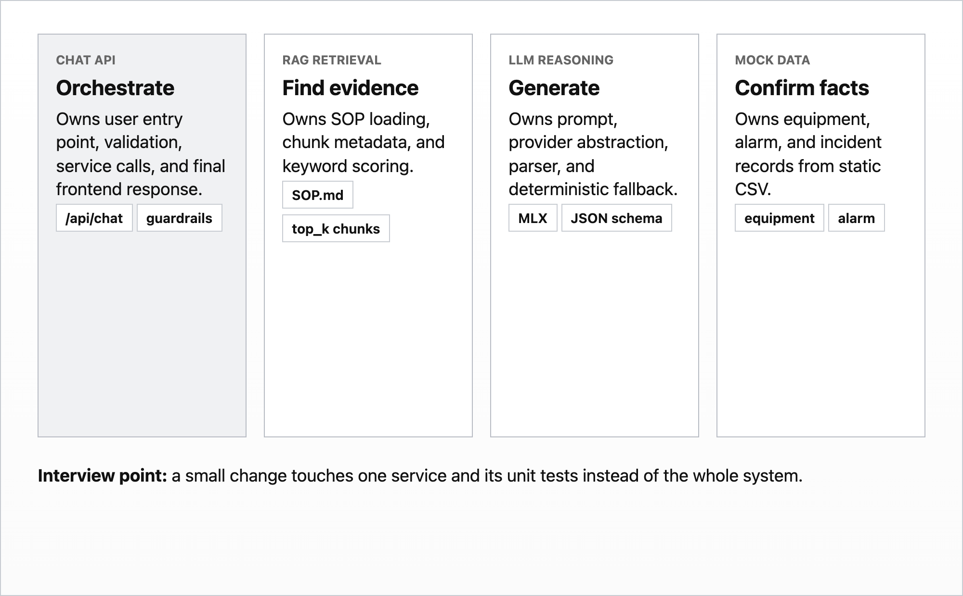
Each service owns one responsibility
The boundary is deliberate: simple changes should stay inside one service and one focused test area.
• Orchestration belongs to Chat API.
• SOP evidence belongs to Retrieval.
• Prompting and fallback belong to Reasoning.
• Factory facts belong to Mock Data.
03

Slide 4
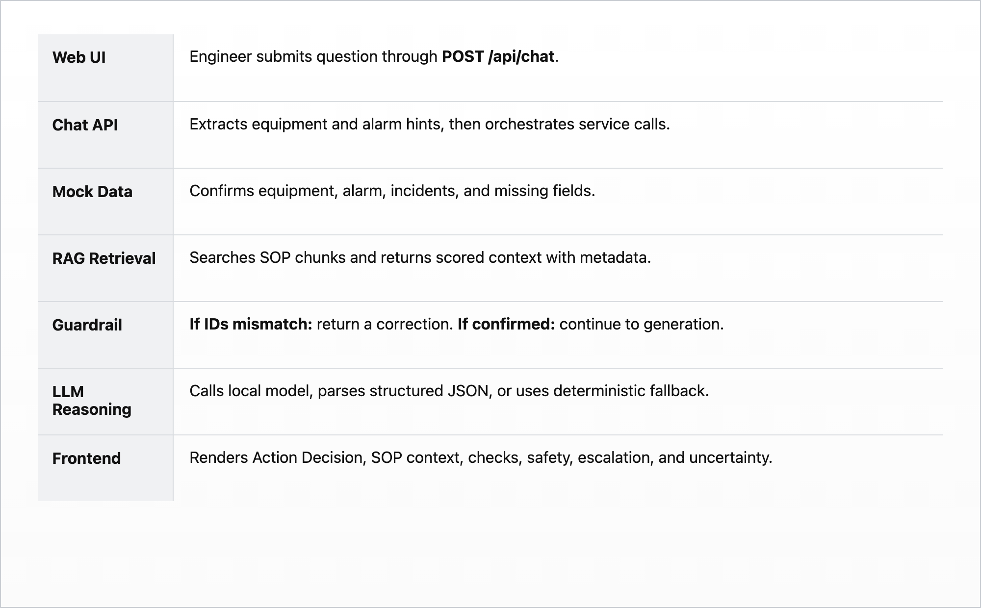
The sequence validates IDs before generation
The key guardrail is before the LLM call: retrieved SOP metadata must match the confirmed equipment and alarm.
Wrong ID -> correction
Confirmed ID -> LLM
04

Slide 5
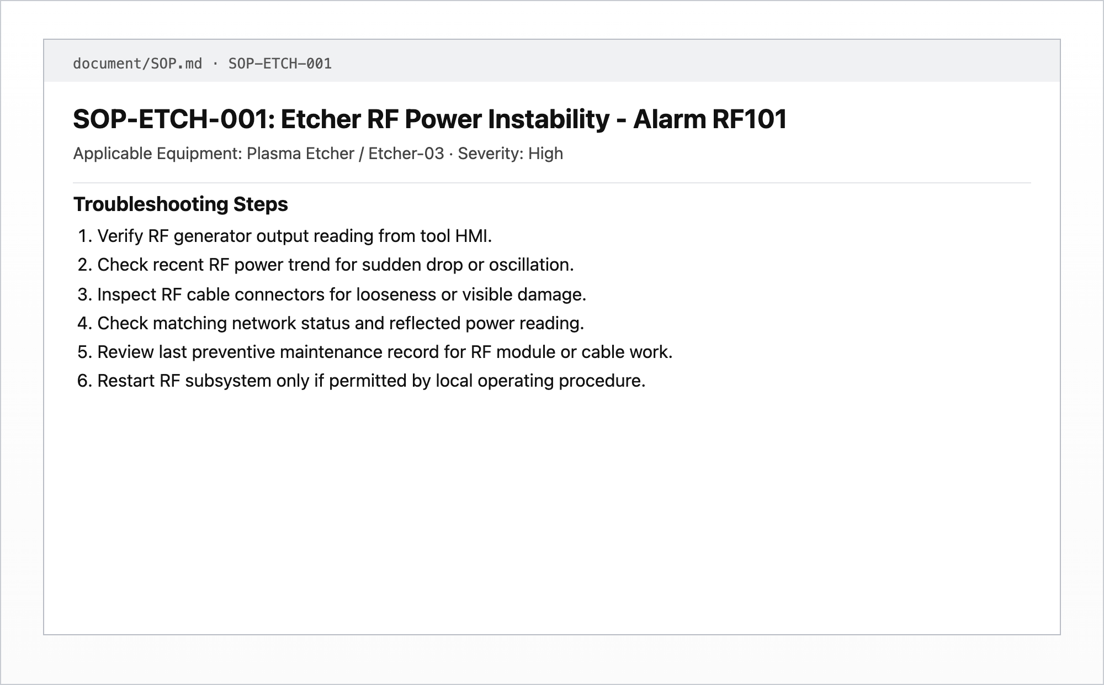
Workflow 1 shows the first action to take
Question
Etcher-03 triggered RF101 during plasma ignition. What should I check first?
Expected behavior
• Confirm Etcher-03 and RF101.
• Retrieve SOP-ETCH-001.
• Recommend RF generator, trend, cable, and matching network checks.
05

Slide 6
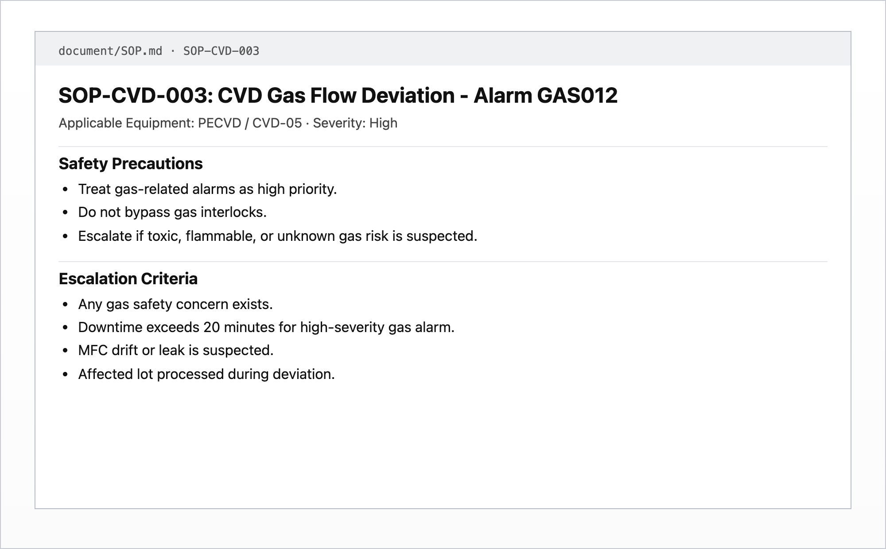
Workflow 2 answers whether to escalate
Question
CVD-05 triggered GAS012 during deposition. Should I escalate?
Expected behavior
• Recognize high severity GAS012.
• Put escalation decision near the top.
• Use gas safety and downtime criteria from SOP-CVD-003.
06

Slide 7
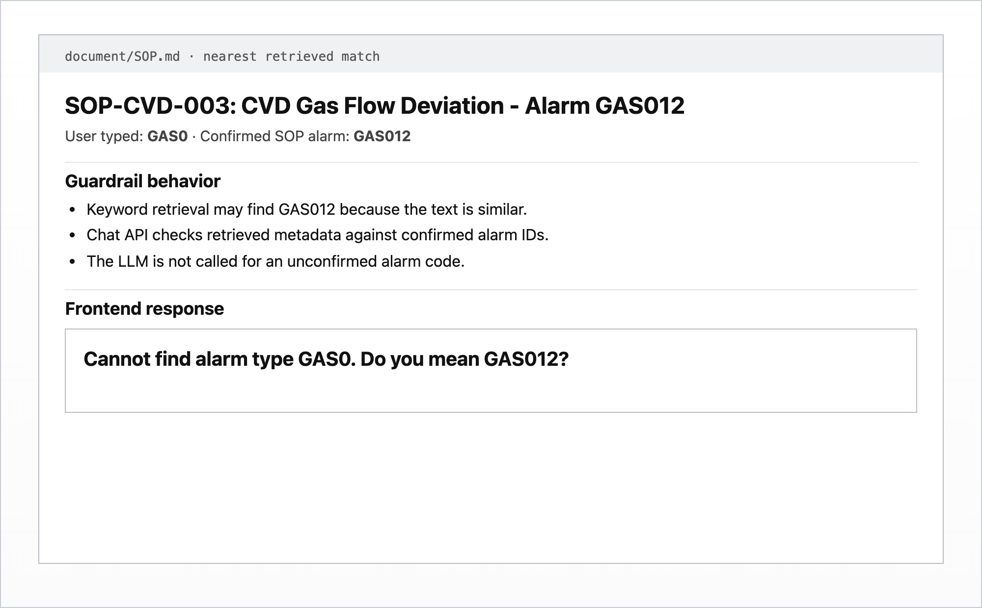
Workflow 3 handles a wrong alarm safely
Question
CVD-05 triggered GAS0 during deposition. Should I escalate?
Expected behavior
Cannot find alarm type GAS0.
Do you mean GAS012?
The LLM is not called until the alarm is confirmed.
07

Slide 8
The current solution is small by design
Current limitations
Future approach
• Keyword retrieval, not vector or hybrid retrieval.
• Static CSV mock data, not live factory integrations.
• Hardcoded demo login.
• No persisted conversation history.
• No human approval workflow for safety-critical escalation.
• Add hybrid retrieval and evaluation tests.
• Connect to alarm history and maintenance systems.
• Add audit logs and role-based access.
• Add human-in-the-loop escalation approval.
08

Slide 9
The project demonstrates the core assessment skills
Takeaway
A practical troubleshooting assistant, not a generic chat endpoint.
• RAG over SOP context.
• Agentic workflow from intent to retrieval to reasoning.
• Clear FastAPI service boundaries.
• Responsible handling of wrong or missing information.
• Structured answers for repair engineers.
09

