Slide 1
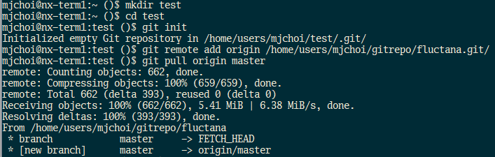
How to get fluctana Python codes on iKSTAR
Login iKSTAR server
Make a directory for fluctana
Git initialize
Add the iKSTAR ‘fluctana’ repo and pull the code
[M.J. Choi, IAEA TM, July, 2020]

Slide 2
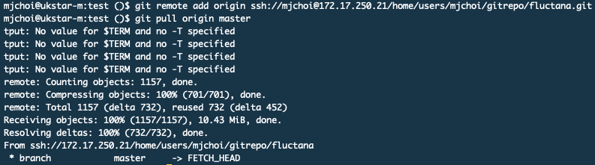
How to get fluctana Python codes on uKSTAR
Login uKSTAR server
Make a directory for fluctana
Git initialize
Add the iKSTAR ‘fluctana’ repo and pull the code
your iKSTAR id

Slide 3
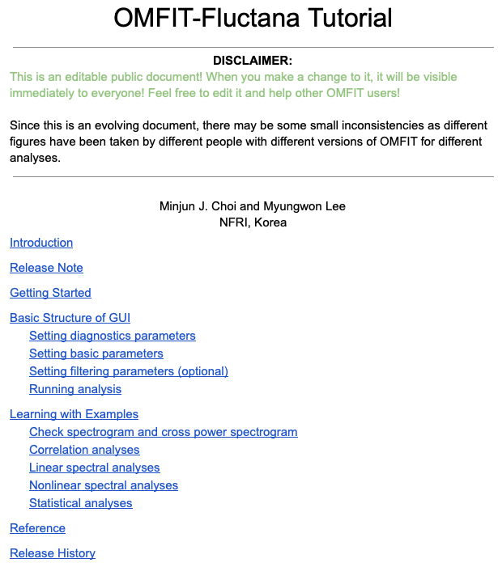
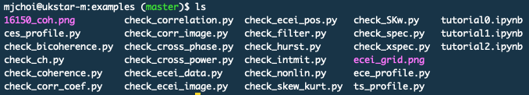
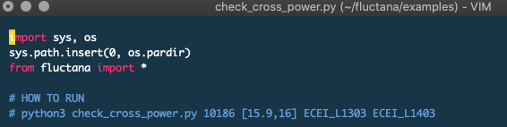
Example scripts
There are Python scripts in ‘examples’ folder of ‘fluctana’
Please refer to comments in the script and ‘OMFIT-Fluctana tutorial.pdf’ in ‘docs’ folder of ‘fluctana’

Slide 4
A guideline to play with ‘fluctana’
Please make the folder named ‘analysis’ under ‘fluctana’
Any change in ‘analysis’ will be ignored from Git, and so you can make your own analysis scripts based on ‘examples’ scripts.
[Caution] During the KSTAR campaign, the ECEI storage server is busy archiving the data for about ~3 minutes after the shot finished. PLEASE DO NOT access the ECEI data using ‘fluctana’ during the data archiving period.

