Slide 1
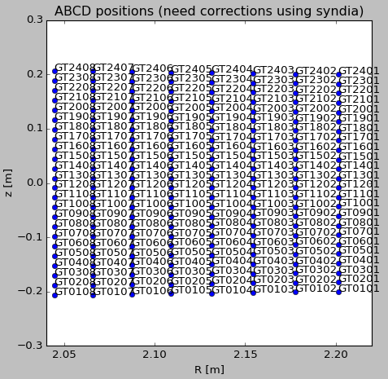
Check ECEI positions using check_ecei_pos.py
Names of the KSTAR ECEI system
Since 2018 : GT, GR, HT (two systems at G-port and one system at H-port)
Before 2018 : L, H, G (two systems (L, H) at H-port and one system at G-port)
shot
name

Slide 2
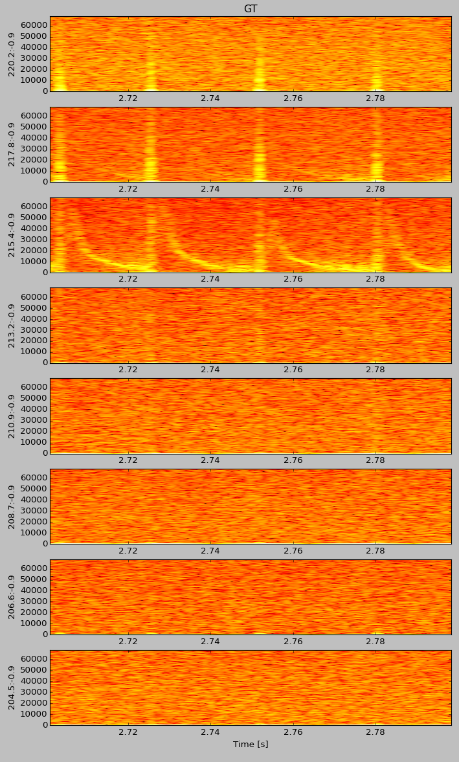
Check ECEI spectrum using check_ecei_data.py
Check the spectrum to determine the mode frequency
shot
name
time range
ELM

Slide 3
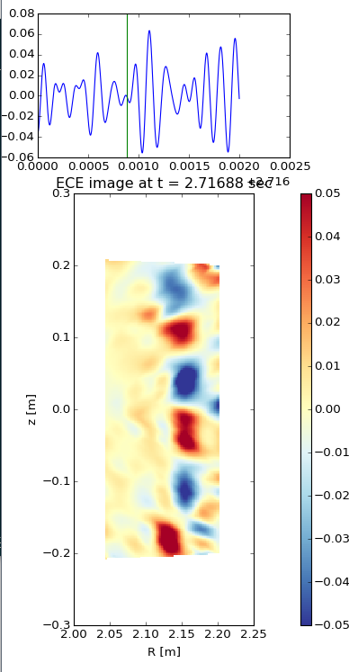


Check ECE images using check_ecei_image.py
I suggest to work on ipython
It is faster to plot the image
Command history is preserved
Import check_ecei_image
Play the image
You can choose ‘automatic’ or ‘manual’ mode by enterning 0 or 1
‘automatic’ mode : You can select time step [frame index unit]
‘manual’ mode : You can select the time point to plot the image in the top axes until you click the point beyond the available range
FIR band-pass range [kHz]
name
Color scale
time range

Slide 4
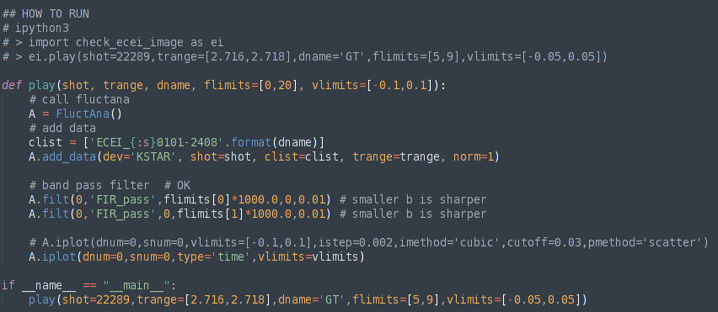
Note on check_ecei_image.py
You may use this code to check the MHD instability between shots during your KSTAR experiment. But, PLEASE DO NOT during the data archiving period (~ 3 minutes after the shot finish).
More options for a better image
You can also apply the svd filter after the FIR filter.
Please refer to ‘check_filter.py’ in ‘examples’
You can try to change interpolation methods or plot type
by changing ‘istep’, ‘imethod’ [‘linear’,’nearest’,’cubic’], ‘cutoff’, ‘pmethod’ [‘scatter’,’contourf’]

