Slide 1
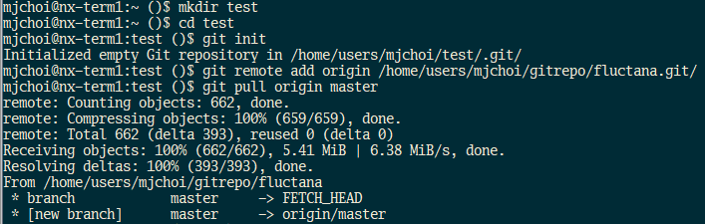
How to get fluctana Python codes on nKSTAR
Login nKSTAR server
Make a directory for fluctana
Git initialize
Add the nKSTAR ‘fluctana’ repo and pull the code
Use ‘python38’ instead of ‘python3’ on nKSTAR or alias python3=‘python38’ in .bash_profile

Slide 2
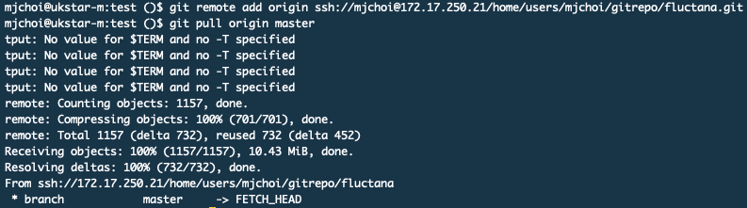
How to get fluctana Python codes on uKSTAR
Login uKSTAR server
Make a directory for fluctana
Git initialize
Add the iKSTAR ‘fluctana’ repo and pull the code
your iKSTAR id

Slide 3
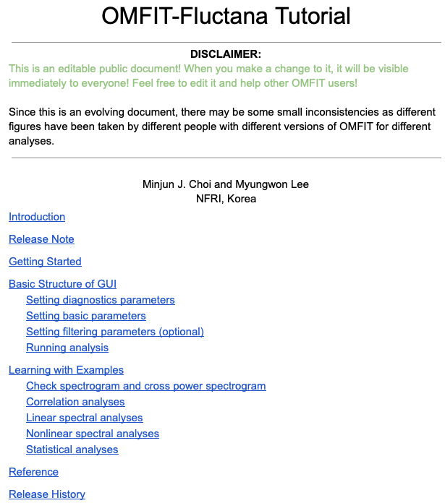
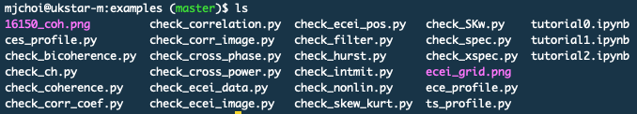
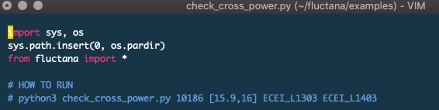
Example scripts
There are Python scripts in ‘examples’ folder of ‘fluctana’
Please refer to comments in the script and ‘OMFIT-Fluctana tutorial.pdf’ in ‘docs’ folder of ‘fluctana’

Slide 4
How to play with ‘fluctana’
Please make the folder named ‘analysis’ under ‘fluctana’
Any change in ‘analysis’ will be ignored from Git, and so you can make your own analysis scripts based on ‘examples’ scripts.

